Slide 1
IoT Greenhouse
Andreas B. Søndergård
Lasse Lundholm

Slide 2
Concept
Make drawing

Slide 3
Requirements
Supply voltage: 12V (pump), 5V (Particle Photon)
Make system battery ready – ie low power consumption
WiFi
Cloud data
Precision temperature +/- 1 deg
Precision humidity +/- 5 %
Precision waterlevel +/- 3 cm
Read temperature/humidity/waterlevel every 15 minute
Alarmmessage within 1 hour of ”alarm event”
Alarm from temperature and waterlevel low in rainwater reservoir

Slide 4
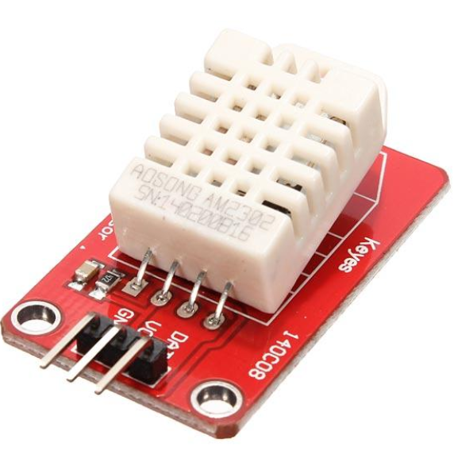
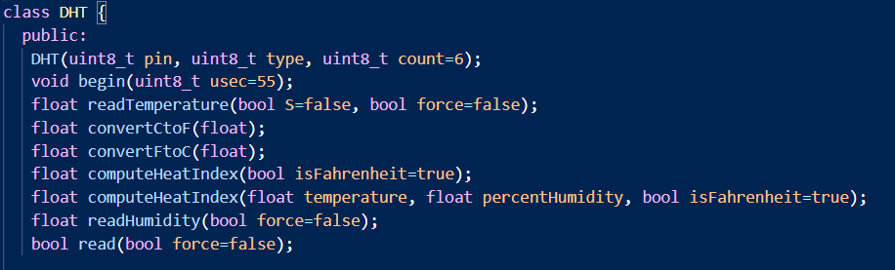
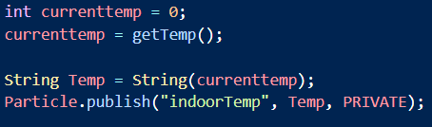
Sensor – DHT22
LM35 example

Slide 5
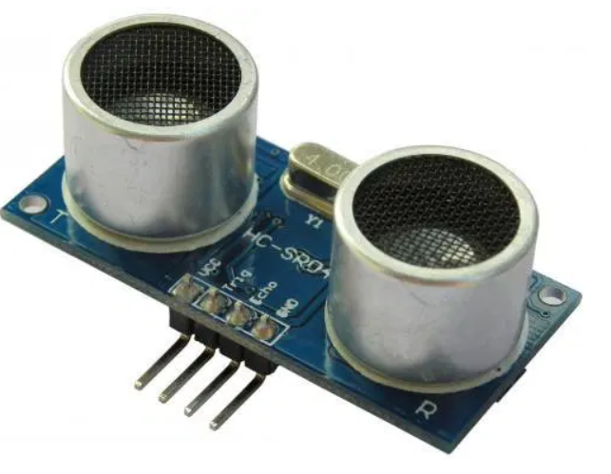
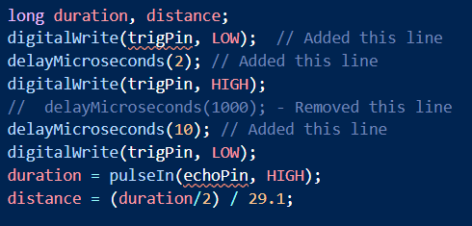
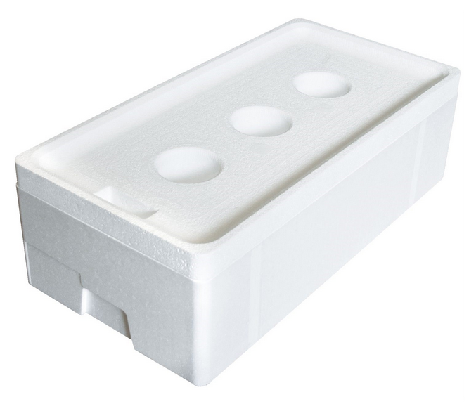
Sensors – HC-SR04
Depth

Slide 6
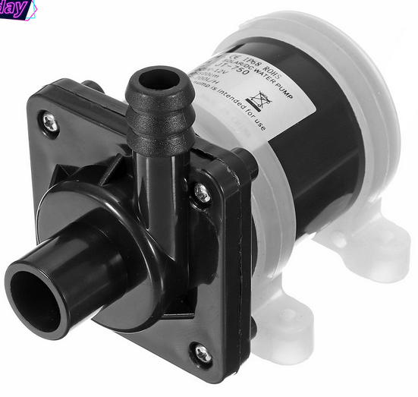
Actuator
700 L/hour
Max: 1.2 A; 6-12V
Could be powered by 3 Lithium batteries

Slide 7



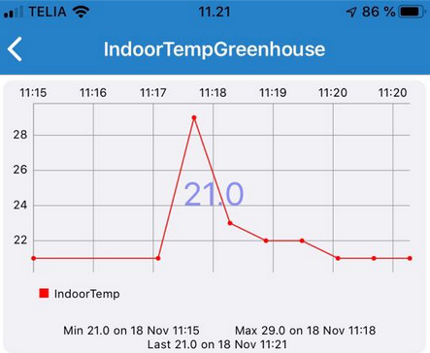
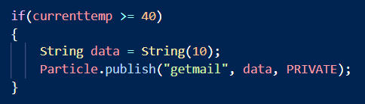
Webhooks

