Slide 1
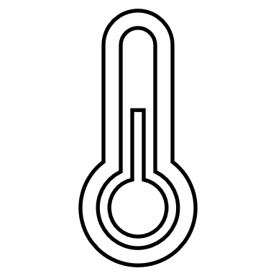
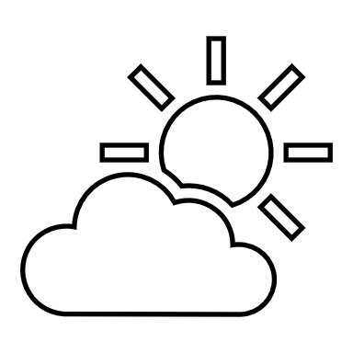
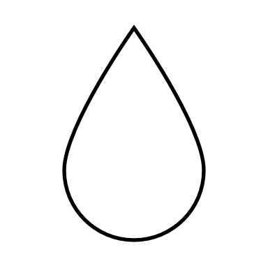
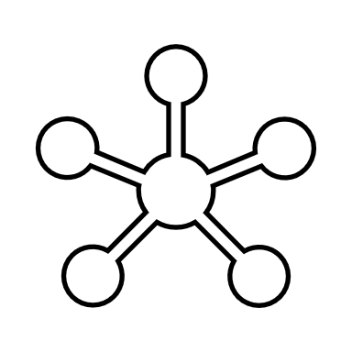
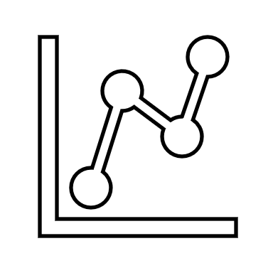




IoT Greenhouse
TEMPERATURE
WEATHER
HUMIDITY
PHOTON
STATS
WATER
MONITOR
WARNING
Andreas Beier Søndergaard – Lasse Lundholm

Slide 2
Disposition
Highlights

Slide 3
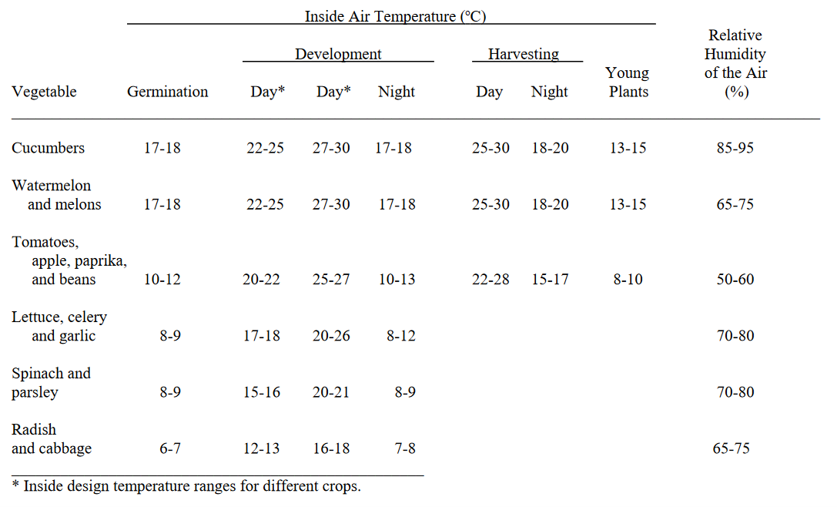
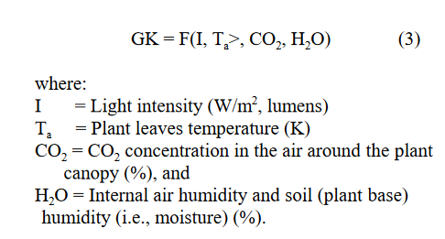
Optimal indoor conditions

Slide 4
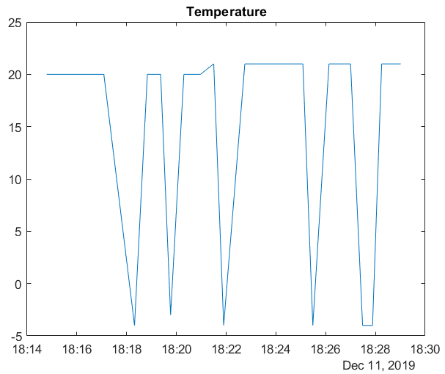
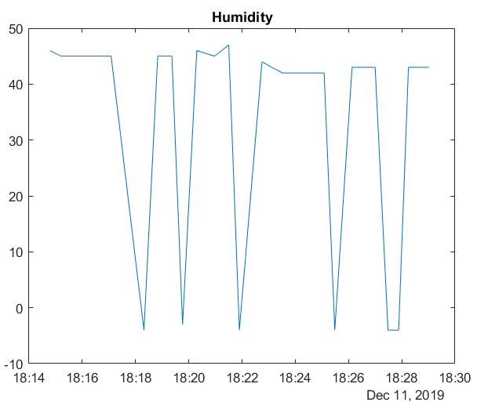
Measurements
ERROR checks
Before publishing
Thingspeak -> MATLAB code

Slide 5
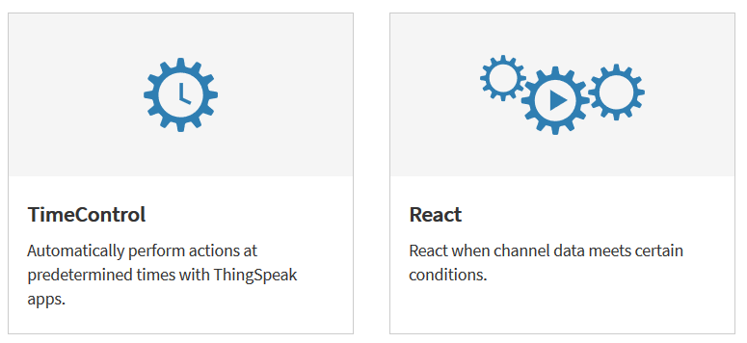
Future implementations
Make the system night/day or oven season dependend
This could be an alternative to the way the actuator is controlled now.

