Slide 1
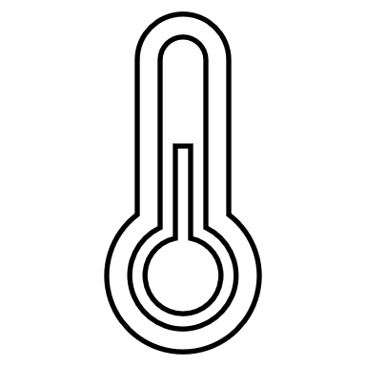
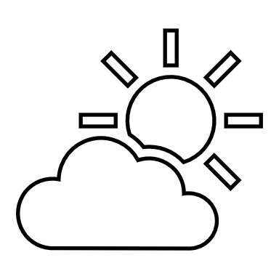
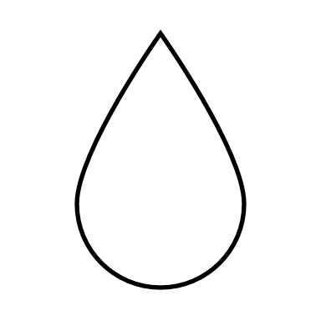
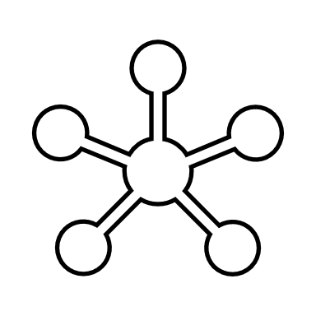
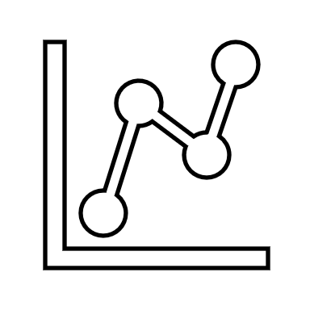
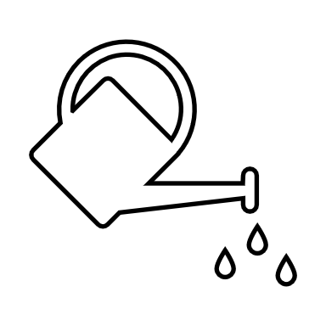



IoT Greenhouse
TEMPERATURE
WEATHER
HUMIDITY
PHOTON
STATS
WATER
MONITOR
WARNING
Andreas Beier Søndergaard – Lasse Lundholm

Slide 2
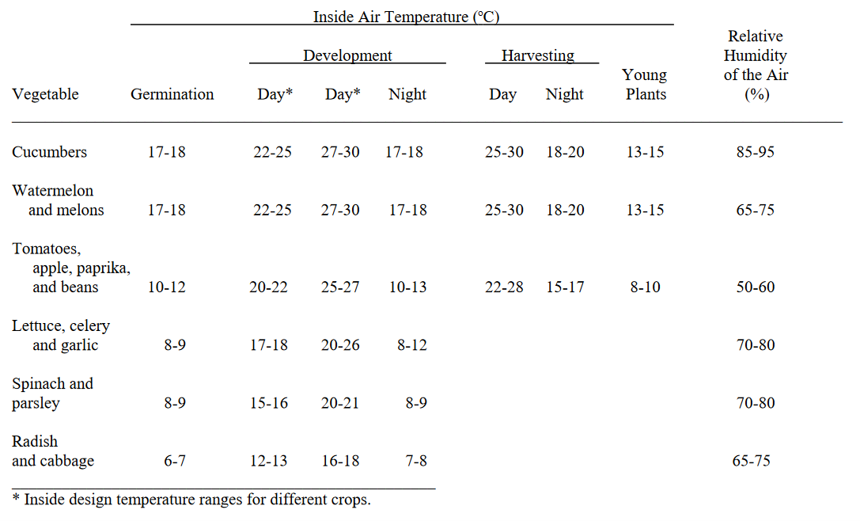
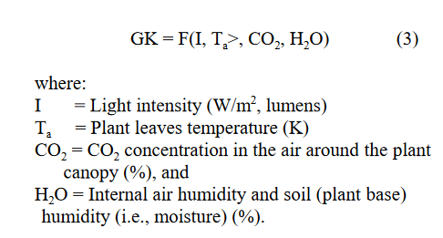
Optimal indoor conditions

Slide 3
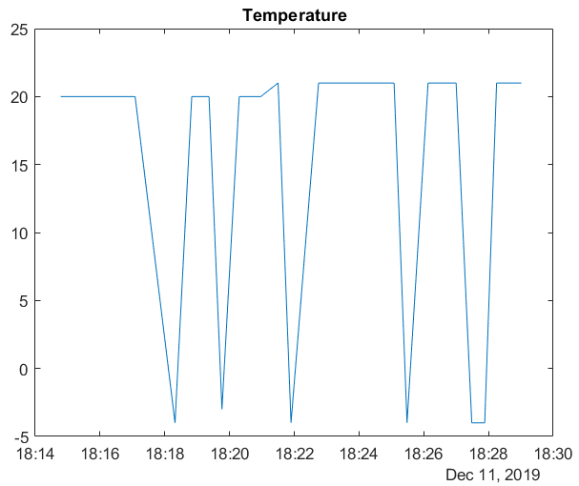
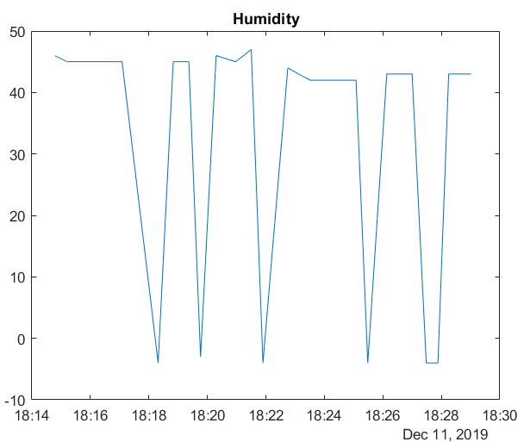
Measurements
ERROR checks
before publishing
ThingSpeak → MATLAB code

Slide 4
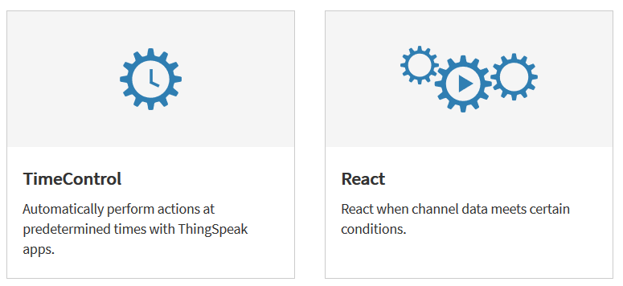
Future implementations
Make the system night/day or season dependend
This could be an alternative to the way the actuator is controlled now.

