Slide 1
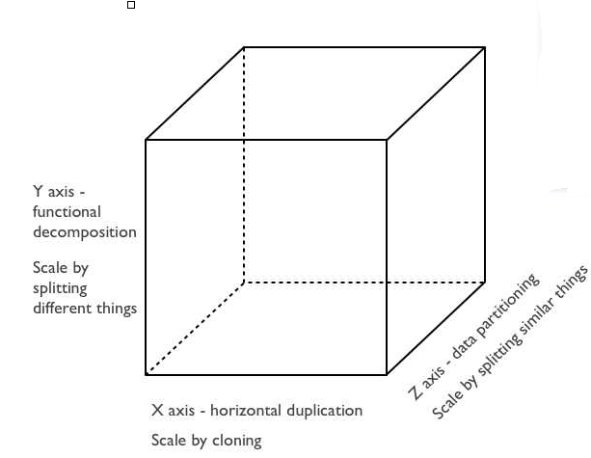

Slide 2
The biggest advantage of serverless architecture is - by definition - that you don’t need to deal with servers anymore.
This brings plenty of benefits.
No more idle, at least on your bills. It means that cost will grow only if your load grows too, more or less linearly.
No more machine maintenance (OS/containers), which means increased overall security. Plus, developers can focus on the main business logic AND operations become a smaller/simpler part of the process. As a direct consequence, developers and software engineers can finally achieve 100% ownership of their software workflow (design, implementation, deployment, monitoring, bug-fixing, etc.).
Higher level of abstraction and easy cross-language projects, which is granted by the very granular approach based on individual Functions (FaaS). Potentially, each function can be implemented in different programming languages. At the same time, the very same code can potentially be migrated to different FaaS providers that support a given language runtime (still, without dealing with the underlying problems).
I would also highlight that, as any other technology that enables microservices architectures, serverless will make your life will be simpler if you develop state-less services (i.e. session-less): I’d say that’s not a limitation of the architecture, but rather a common use case and a recommended best-practice.

Slide 3
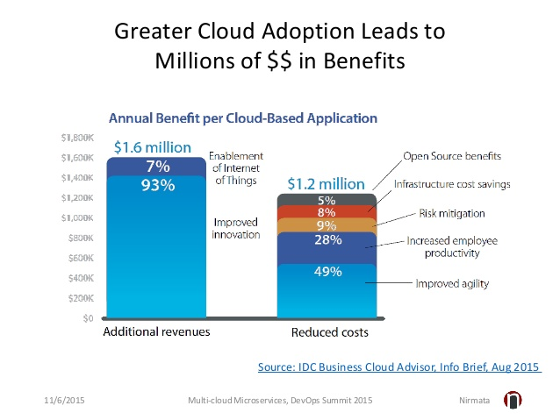
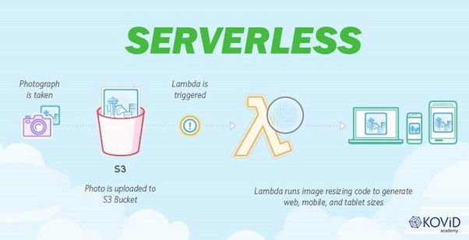

Slide 4
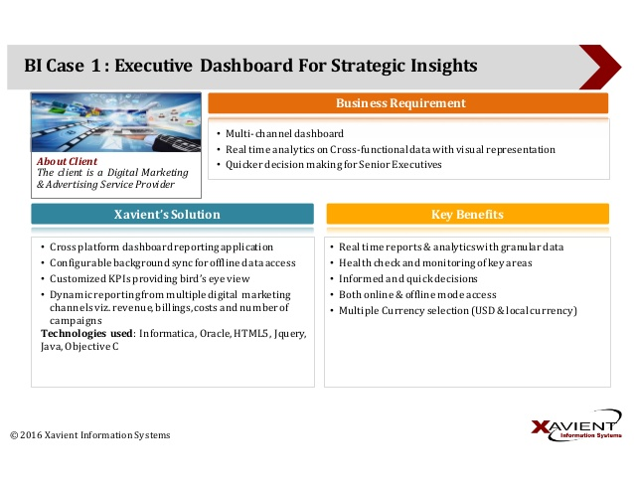

Slide 5
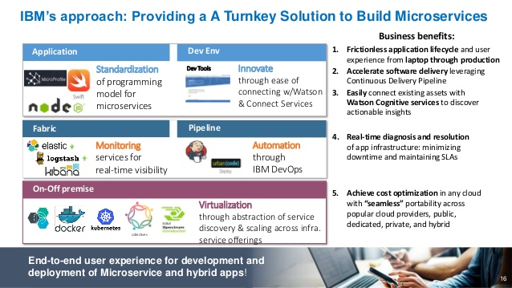

Slide 6
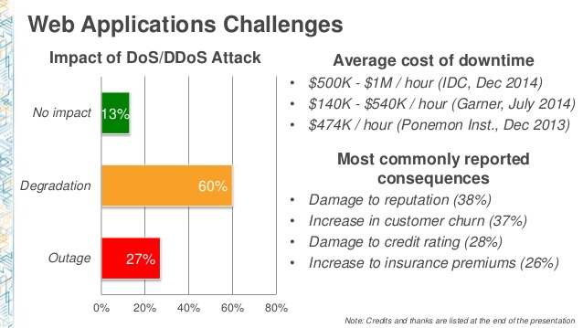

Slide 7
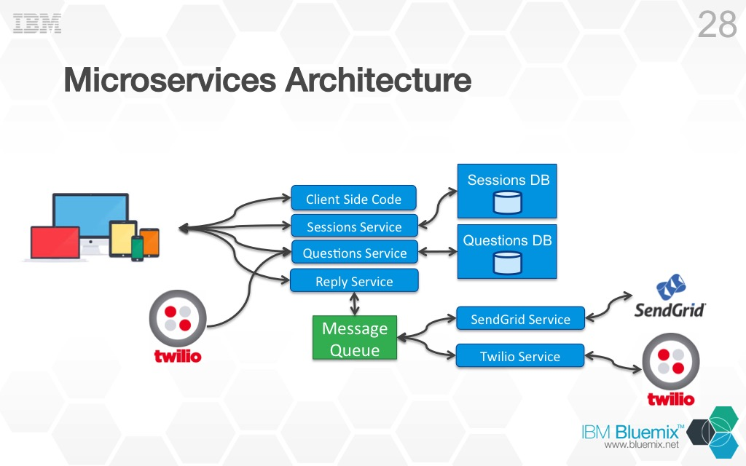

Slide 8
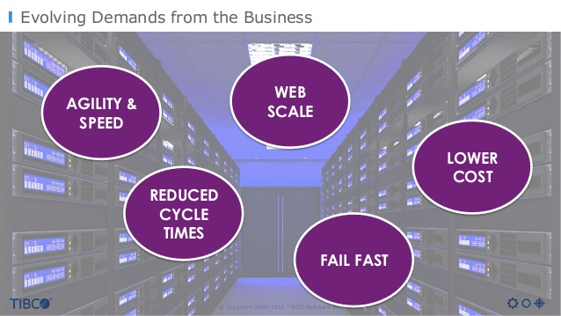

Slide 9
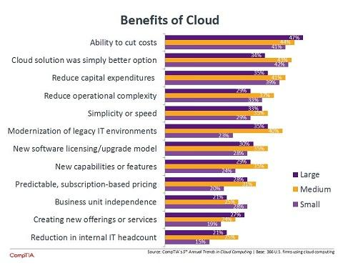

Slide 10
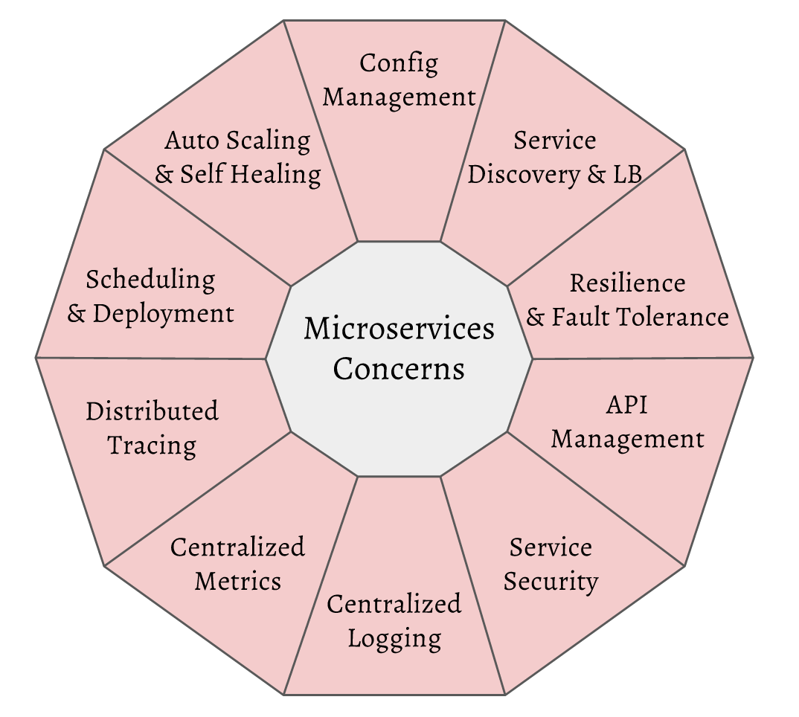

Slide 11
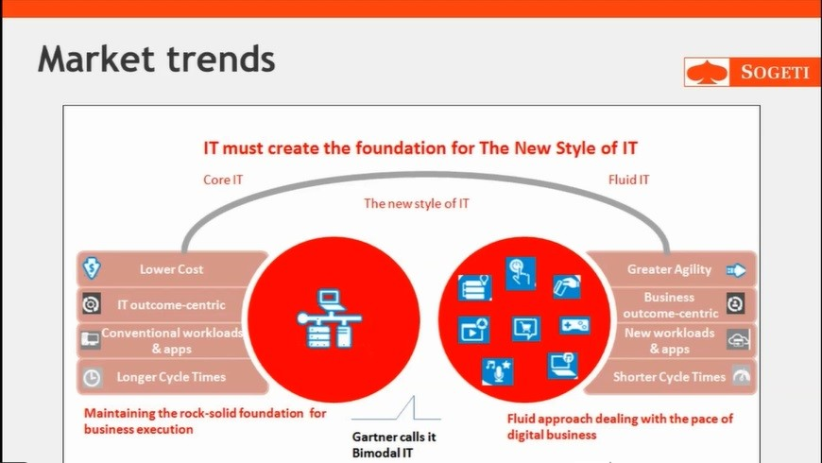

Slide 12
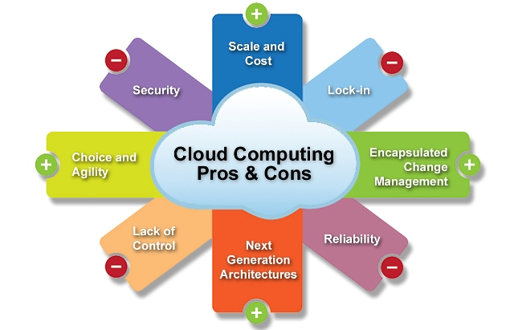

Slide 13
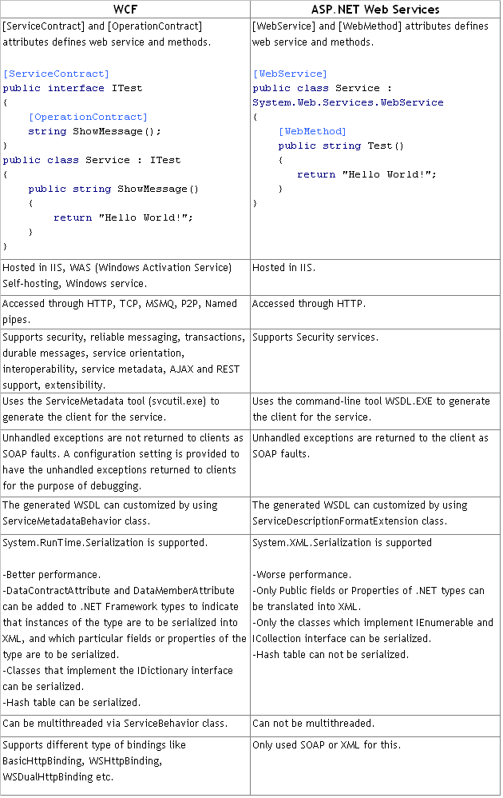

Slide 14
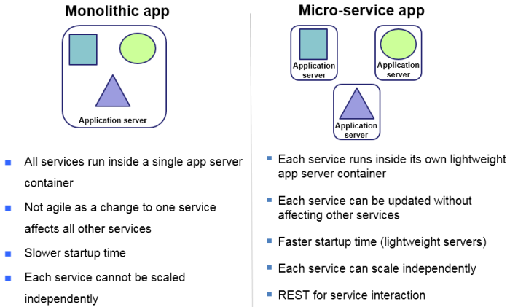

Slide 15
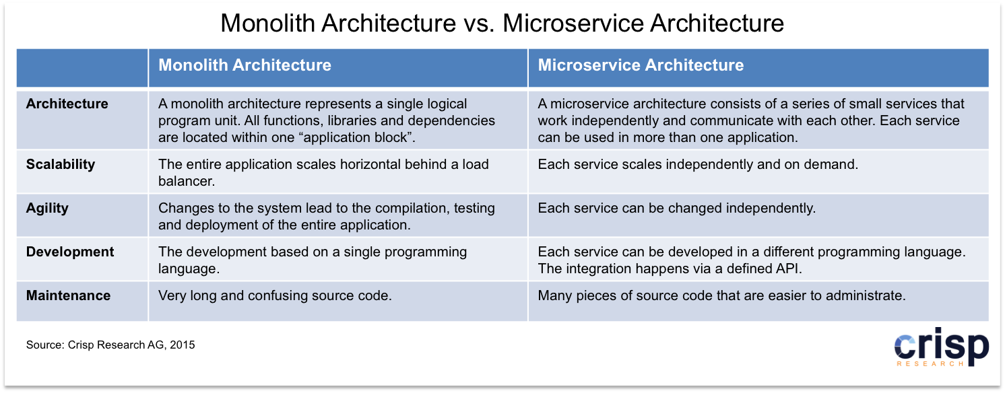

Slide 16
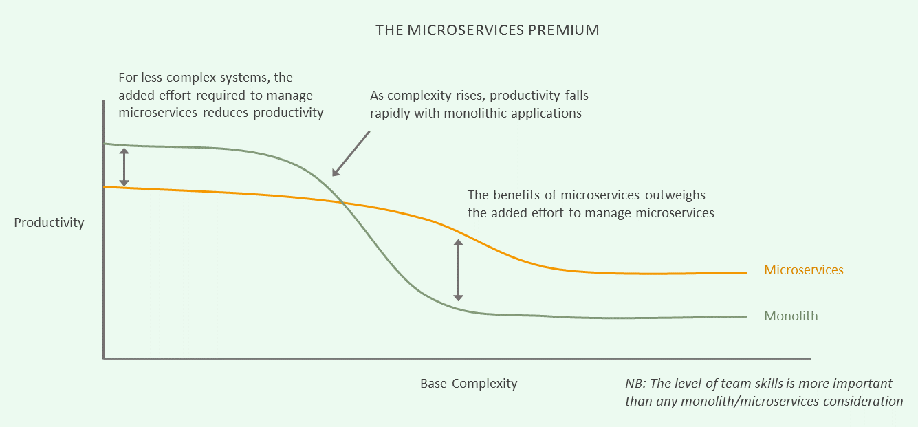

Slide 22
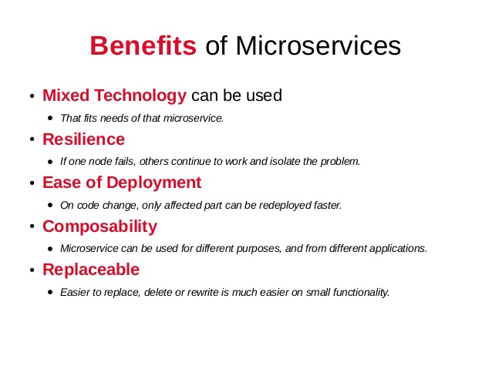

Slide 23
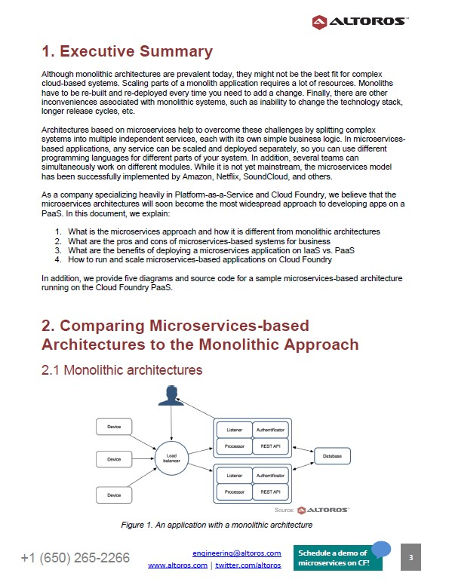

Slide 24
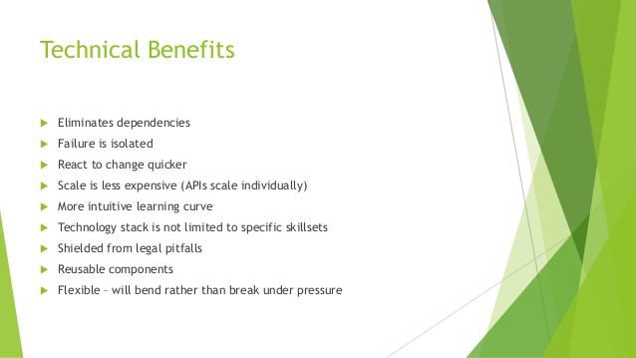

Slide 25

