Slide 1
<Project Sdk="Microsoft.NET.Sdk.Web">
<PropertyGroup>
<TargetFramework>netcoreapp1.1</TargetFramework>
<DockerComposeProjectPath>..\docker-compose.dcproj</DockerComposeProjectPath>
</PropertyGroup>
<ItemGroup>
<Folder Include="wwwroot\" />
</ItemGroup>
<ItemGroup>
<PackageReference Include="Microsoft.ApplicationInsights.AspNetCore" Version="2.0.0" />
<PackageReference Include="Microsoft.AspNetCore" Version="1.1.1" />
<PackageReference Include="Microsoft.AspNetCore.Mvc" Version="1.1.2" />
<PackageReference Include="Microsoft.Extensions.Logging.Debug" Version="1.1.1" />
</ItemGroup>
<ItemGroup>
<DotNetCliToolReference Include="Microsoft.VisualStudio.Web.CodeGeneration.Tools" Version="1.0.0" />
</ItemGroup>
</Project>
<?xml version="1.0" encoding="utf-8"?>
<Project ToolsVersion="12.0" DefaultTargets="Build" xmlns="http://schemas.microsoft.com/developer/msbuild/2003">
<Import Project="$(MSBuildExtensionsPath)\$(MSBuildToolsVersion)\Microsoft.Common.props" Condition="Exists('$(MSBuildExtensionsPath)\$(MSBuildToolsVersion)\Microsoft.Common.props')" />
<PropertyGroup>
<Configuration Condition=" '$(Configuration)' == '' ">Debug</Configuration>
<Platform Condition=" '$(Platform)' == '' ">AnyCPU</Platform>
<ProductVersion>
</ProductVersion>
<SchemaVersion>2.0</SchemaVersion>
<ProjectGuid>{8D0D1153-082A-4ED3-8C28-2799C1FE40FB}</ProjectGuid>
<ProjectTypeGuids>{349c5851-65df-11da-9384-00065b846f21};{fae04ec0-301f-11d3-bf4b-00c04f79efbc}</ProjectTypeGuids>
<OutputType>Library</OutputType>
<AppDesignerFolder>Properties</AppDesignerFolder>
<RootNamespace>WebApplication1</RootNamespace>
<AssemblyName>WebApplication1</AssemblyName>
<TargetFrameworkVersion>v4.5</TargetFrameworkVersion>
<MvcBuildViews>false</MvcBuildViews>
<UseIISExpress>true</UseIISExpress>
<IISExpressSSLPort />
<IISExpressAnonymousAuthentication />
<IISExpressWindowsAuthentication />
<IISExpressUseClassicPipelineMode />
</PropertyGroup>
<PropertyGroup Condition=" '$(Configuration)|$(Platform)' == 'Debug|AnyCPU' ">
<DebugSymbols>true</DebugSymbols>
<DebugType>full</DebugType>
<Optimize>false</Optimize>
<OutputPath>bin\</OutputPath>
<DefineConstants>DEBUG;TRACE</DefineConstants>
<ErrorReport>prompt</ErrorReport>
<WarningLevel>4</WarningLevel>
</PropertyGroup>
</Project>

Slide 2
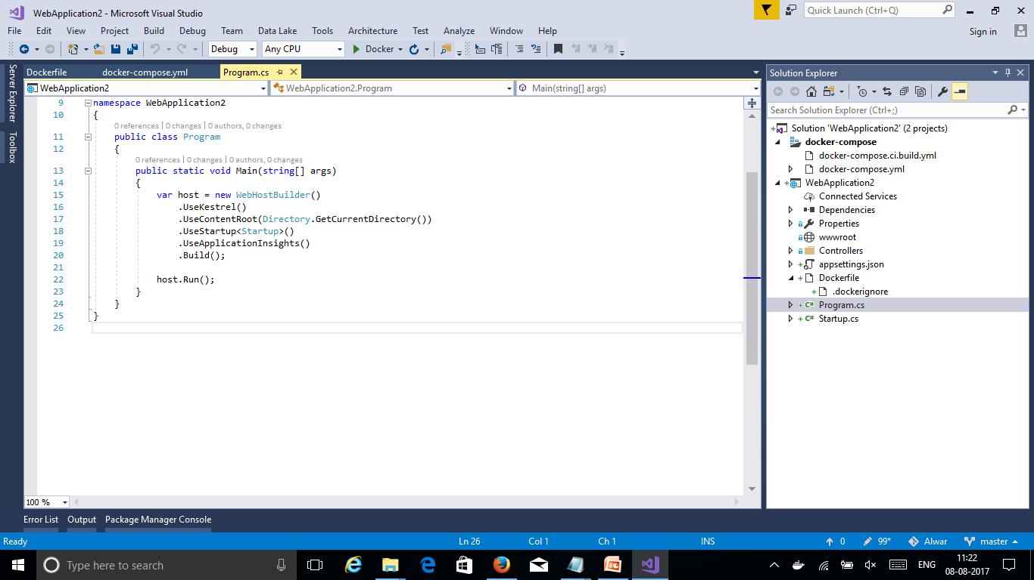

Slide 3
