Slide 1


Slide 2

NGINX
It is a web server
It is an open-source.
Used as a reverse proxy, load balancer and HTTP cache.
High performance, stability, simple configuration.
Improve user experience.
Handles a large number of clients at the same time.
Designing and Deploying
What is NGINX
To achieve faster time to market.
Moving away from heavy monolithic architectures to Microservices architectures.
Adopted
Netflix, Dropbox, Pinterest, Airbnb, WordPress.com, Box, Instagram
There are only two things a web server needs to be…..fast…..really fast…..and secure.

Slide 3
NGINX
Reverse Proxy
Reverse Proxy
Internet
Reverse Proxy
Reverse Proxy
From Monolithic | To Dynamic
3 Tier, J2EE style architecture | Microservices
Complex Protocols (HTML, SOAP) | Lightweight (REST, Messaging)
Persistent deployments | Containers, VMs
Fixed, Static Infrastructure | SDN, NFV, Cloud
Big-bang releases | Continuous delivery
Silo’ed teams | DevOps Culture

Slide 4
NGINX
tasklist /fi “imagename eq nginx.exe” – gives response as below
Image Name | PID | Session Name | Session# | Memory Usage
nginx.exe | 43404 | Console | 19 | 7,140 K
nginx.exe | 48244 | Console | 19 | 7,588 K
First is the master process and another is the worker process.
nginx -t
nginx: the configuration file C:\Users\nginx\nginx-1.13.2\nginx-1.13.2/conf/nginx.conf syntax is ok
nginx: configuration file C:\Users\nginx\Downloads\nginx-1.13.2\nginx-1.13.2/conf/nginx.conf test is successful
Reverse Proxy
Browser <----> Nginx <----> Kestrel
Enable HTTPS
Browser <---- HTTPS ---> Nginx
Brotli
Compression algorithm
compress files and save you around 10-20% bandwidth
Improved Streaming API

Slide 5
NGINX
REST API
Make a request
Client
Server
Send response and close response
Streaming API
Make a request
Client
Server
Send response and have new updates

Slide 6
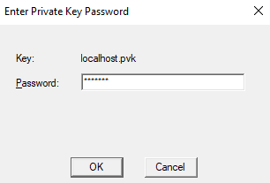
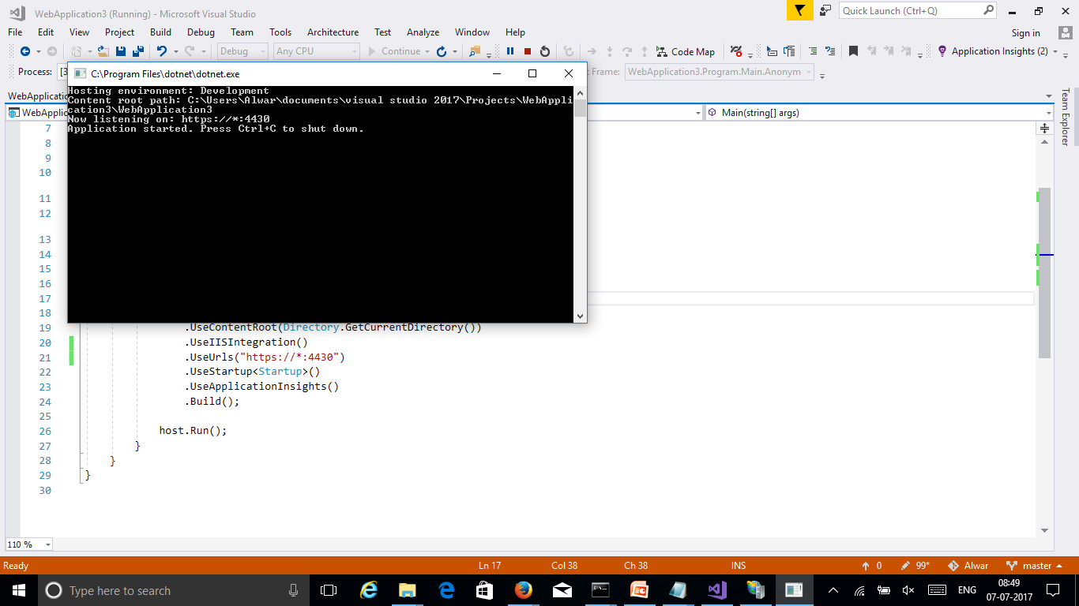
NGINX
C:\Program Files (x86)\Windows Kits\10\bin\x64>makecert -r -n "CN=localhost" -b 01/01/2000 -e 01/01/2099 -eku 1.3.6.1.5.5.7.3.3 -sv localhost.pvk localhost.cer
Succeeded
C:\Program Files (x86)\Windows Kits\10\bin\x64>cert2spc localhost.cer localhost.spc
Succeeded
C:\Program Files (x86)\Windows Kits\10\bin\x64>pvk2pfx -pvk localhost.pvk -spc localhost.spc -pfx localhost.pfx

Slide 7
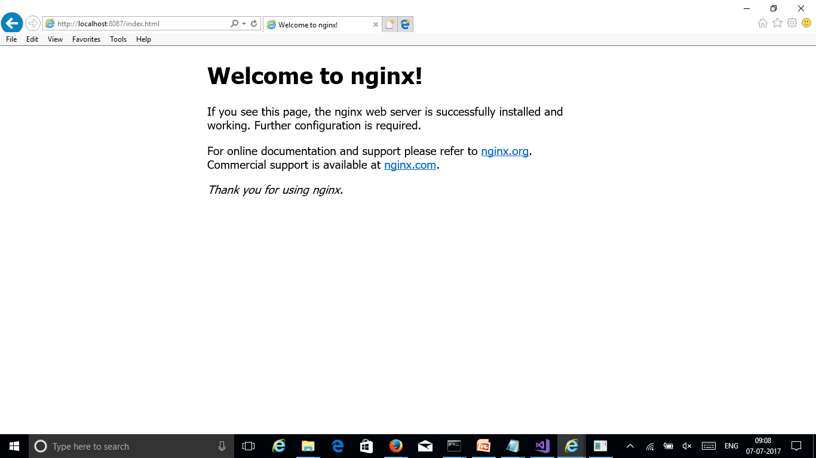
NGINX

Slide 8


