Slide 1
Clustering of Indian States for Providing Medical Supplies
A presentation by:
Abhiroop Bhattacharya

Slide 2
Introduction
The COVID-19 pandemic has been wreaking havoc globally for the larger part of 2020. My home country of India is one of the most severely affected countries in the world and, while many countermeasures are currently underway, the virus still seems to be on the winning side.
One problematic issue that India faces is the enormous percentage of rural population that, most often, do not have access to proper medical facilities. This creates significant problems for anyone attempting to reach out to the rural population and these sections of the country almost always require special planning in terms of distribution due to the lack of passable roadways. I believe that it would be immensely helpful for anyone planning a rollout of supplies and eventually, a vaccine, to be able to understand not only the break-up of urban/rural population across states but also the number of hospitals in each state. I believe that this information can be an immensely beneficial input to any strategic rollout of any resources/medication/vaccines.

Slide 3
Data
State (str): The name of the state/Union Territory
Population (num): The population of the state as per the 2011 Census
Capital (str): The capital city of the state/Union Territory in question
U to R (num): The ratio of Urban to Rural population in the state
Latitude (num): The latitude value of the state capital (captured using geolocator)
Longitude (num): The latitude value of the state capital (captured using geolocator)
Area (num): The area of the state in square kilometers.
Active Cases (num): The number of currently active COVID cases in each state.
The geographical coordinates will be used to discover hospitals within a given radius of the capital city of each state. All of these locations will be represented on a map of India.
The final outcome of this project will be a map containing all of the states (using the capital city as reference). Each capital will be color-coded based on the cluster of which it is a part.

Slide 4
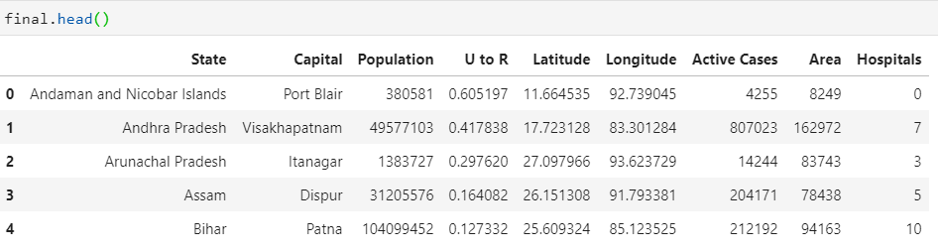
Methodology
We will make use of the K-means clustering algorithm in the scikit-learn package
The final dataset to be used is shown on the right

Slide 5
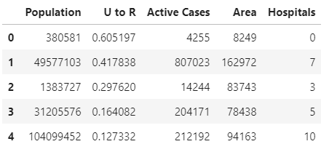
Methodology
The majority of the data is continuous and, therefore, we remove the State and Capital columns so that we can go ahead with our clustering.

Slide 6
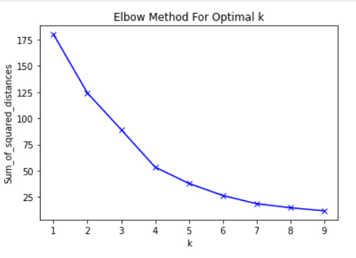
Methodology: Optimal Clusters
We determine the optimal number of clusters using the elbow method which requires us to plot the WSS values against the number of clusters
The optimal number of clusters is 4, based on the position of the elbow on the graph

Slide 7
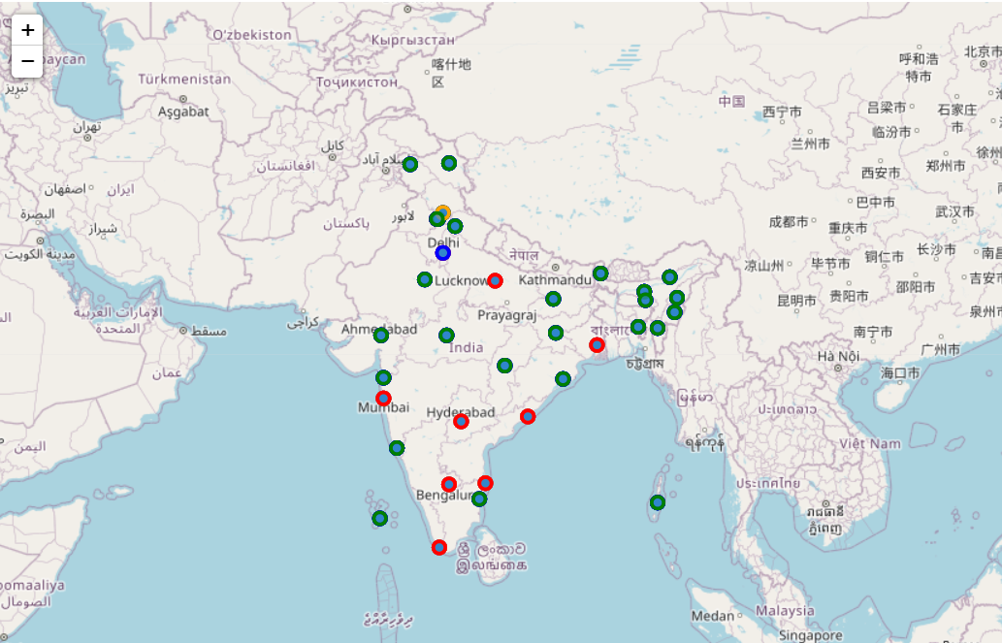
Mapping Clusters

Slide 8
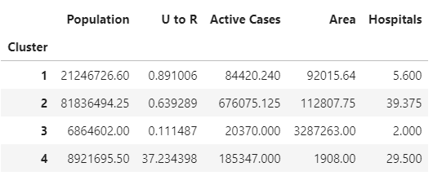
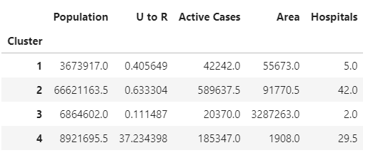
Results: Clusters
Mean Values Median Values

Slide 9
Results: Cluster Names and Attributes
Cluster 1:
Name: Mildly affected tier-2 states.
Color: Green
Attributes:
Second highest population.
Almost equal urban and rural population.
Relatively low case count.
Smallest area on average.
Low hospital count.

Slide 10
Results: Cluster Names and Attributes
Cluster 2:
Name: Severely affected developed states
Color: Red
Attributes:
Highest population.
Low urban population.
Very high case count.
Fairly large in area.
Highest hospital count.

Slide 11
Results: Cluster Names and Attributes
Cluster 3:
Name: Relatively unaffected tier-3 states.
Color: Orange
Attributes:
Lowest population.
Extremely low urban population.
Lowest case count.
Largest area on average.
Extremely low hospital count.

Slide 12
Results: Cluster Names and Attributes
Cluster 4:
Name: Small urban states.
Color: Blue
Attributes:
Relatively low population.
Overwhelmingly urban population.
Second highest case count.
Smallest area on average.
High hospital count.

Slide 13
Discussion
In terms of drawing up a distribution plan for any medical supplies or, eventually, a vaccine, it is imperative that the highest priority be given to clusters 1 and 2. These are the mildly affected tier-2 states and the severely affected developed states for the following reasons:
The developed states are hubs of population and commerce. It is imperative to get these states up and running as soon as possible so as to minimize the economic impact of the pandemic on India.
The Tier-2 states appear to have a very low level of medical infrastructure development and will require the most effort not only in terms of providing the required healthcare but also in reaching them as they are underdeveloped and are difficult to reach via established supply lines.
Delhi can be used as a hub to reach out to many of the states mentioned above and, since it is the smallest cluster, using it in this fashion would allow for a very swift response to a confirmed vaccine.

Slide 14
Conclusion
Establishing supply lines in India is incredibly difficult given the variance in infrastructure and levels of urbanization.
However, if prioritized correctly by looking at each state individually, these challenges can be overcome to a large extent.

Slide 15
Thank You!

