Slide 1


AN EXPERIENTIAL LEARNING ON
“RECOGNITION OF VEHICLE NUMBER PLATE”
Under the Guidance of
Dr.(Prof.) Priyadarshi Kanungo
&
Prof. Tapaswani Pattanaik
Presented by:-
Abhishek Kumar-20010679
Arpit Kumar - 20010676
Saumyakant Baral -20010677
Abhishek Pattanaik-20010678
GROUP-A(4)
DEPARTMENT OF ELECTRONICS AND COMMUNICATION ENGINEERING

Slide 2
CONTENTS
Introduction
Motivation
Problem Statement
Methodology
Simulation and Result
References
WorkFlow Process
Literature Review
Conclusion and Future Scope

Slide 3
INTRODUCTION
The ANPR (Automatic Number plate Recognition) system is based on image processing technology.
In today’s world with the increasing number of vehicle day by day it’s not possible to manually keep a record of the entire vehicle.
The system first would capture the vehicles image as soon as the vehicle reaches the security checking area.
The captured images are then extracted by using the segmentation process.
The obtained data is then compared with the data stored in their database.

Slide 4
MOTIVATION
The main objective here is to design an efficient automatic vehicle identification system by using vehicle number plate.
These have been designed for numerous detection tasks, but the task of detecting illegally parked vehicles has been left largely to the human operators of surveillance system.
This work proposes a method for the detection and identification of vehicle number plate that will help in the detection of number plates of authorized and unauthorized vehicles.
This type of system is widely used in Traffic control areas, tolling, parking area.etc.

Slide 5
PROBLEM STATEMENT
EXTRACTION OF VEHICLE NUMBER PLATE LOCATION USING MATLAB
1. Broken number plate.
2. Blurry images.
3. Number plate not within the legal specification.
4. Low resolution of the characters.
5. Poor maintenance of the vehicle plate. Like similarity b/w certain characters.
(Ex: O & D)

Slide 6
Literature Review
Sl No | Paper Title | Author | Publication Year | Methodologies | Advantages | Disadvantages
1 | Recognition Of Vehicle Number Plate Using Matlab | Gotham Vardhan | 2022 | Region-based technique | money-saving and eco-friendly if applied effectively. | Not working properply on Blurry images.
2 | Detection and recognition of license plate characters with different appearances | Shen-Zheng Wang | 2003 | Optical character recognition | recognize the rotation-free characters in the license plates | Low resolution of the characters.
3 | Vehicle number plate detection and recognition using bounding box method | K Babu | 2016 | Bounding box method | segmentation of each character using boundingbox | Difficult to detect similarity b/w certain characters. (Ex: O & D)
4 | An Efficient Method for Indian Vehicle License Plate Extraction and Character Segmentation | Kumar Parasuraman | 2010 | Morphological algorithms and connected components analysis. | Efficiency is 98% | influence the efficiency of the extraction, such as, dirty plate, shadows or reflection.

Slide 7
BLOCK DIAGRAM
Vehicle captured from camera
Pre-processing
Localization
Recognition
Segmentation
Fig 1: System Block Diagram

Slide 8
METHODOLOGY
Input Captured Image
Pre Processing
Plate Region Extraction
Segmentation of character
Character Recognition
Fig.2: Flow Diagram of ANPR

Slide 9
WORKFLOW PROCESS
Capture of Image: The first step is that the capture of image. The image is captured by device. Photographic camera or digital camera. The image captured is keep in JPEG format.
Pre-processing: The next step once capturing the image is the pre-processing of the image. Once the image is captured there's a heap of disturbances and noises stay within the image that the image can’t be used properly.
Gray Processing: This step involves the conversion of the image into gray levels. Color pictures are regenerated into the grey image. As per the R, G, B worth within the image, it calculates the worth of gray value and obtains the grey image at a similar time.
Median Filtering: Media filtering is that the step to get rid of the noises from the image. The gray level cannot take away the noises. Thus to create an image free from noise media filtering is employed.

Slide 10
CONTD…
Plate region extraction: The most important stage is the extraction of number plate from eroded image significantly. The extraction can be done by using image segmentation method. In most of the methods image binarization is used.
Character segmentation: In this step get the o/p of extracted number plate,then separate each character and split the each and every character in the number plate image by using boundingbox technique and then find the correlation and database if both the value is same means it will generate the value 0-9 and A - Z, and finally convert the value to string and display it in edit box, and also store the character in some text file in this code.

Slide 11
APPLICATIONS
Parking: Allow to enter prepaid members.
Tolling: Calculate travel fee in toll road and used to double check ticket.
Border Security: Monitors inter as well as intra crossing of vehicles.
Traffic Control: Directed to different lanes acc. to their entry permits.
Airport Parking: Reduce ticket frauds and captures image of car and number plate.

Slide 12
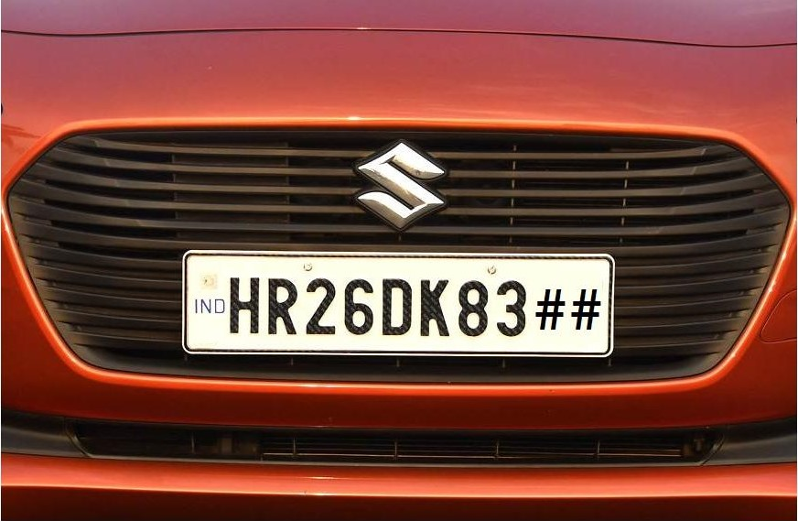
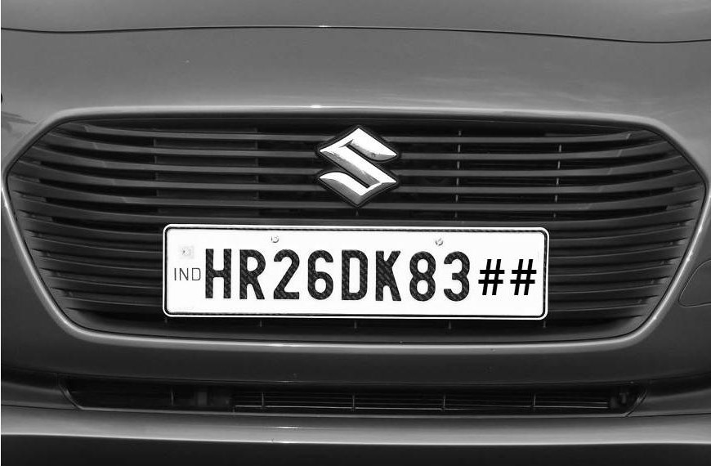
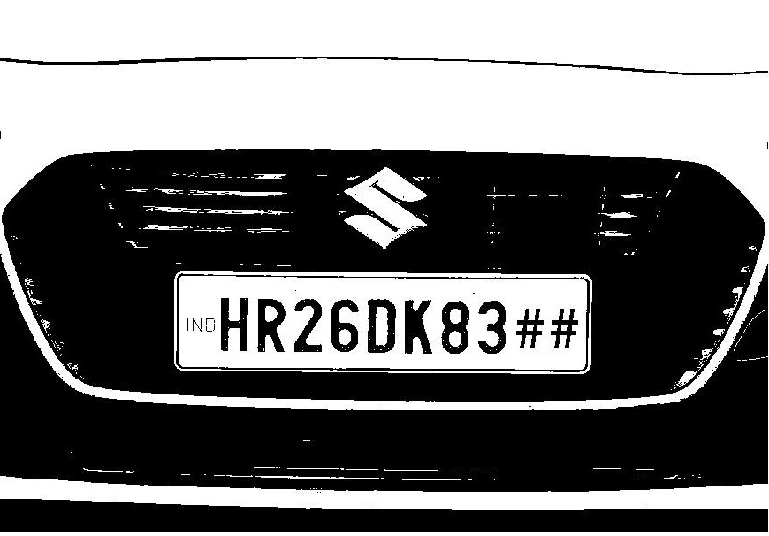
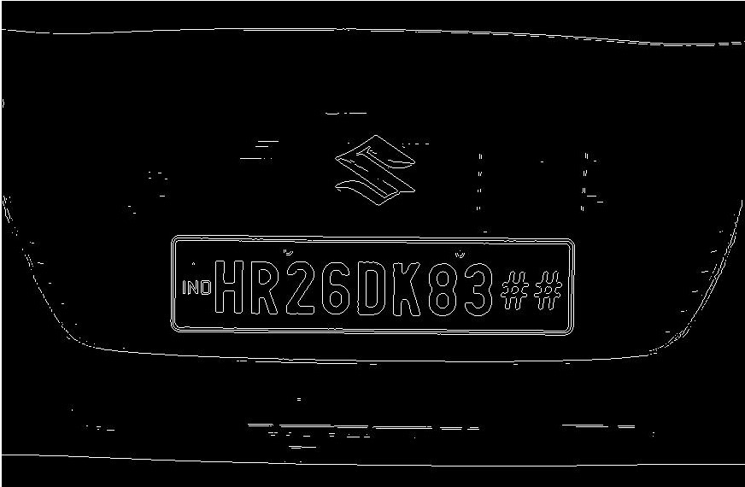
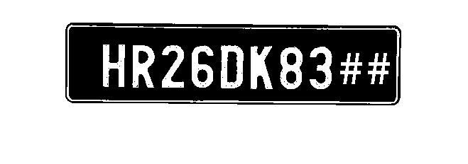
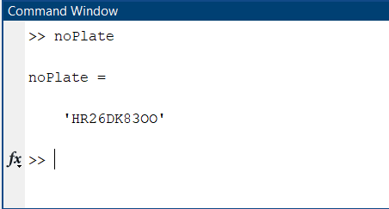
RESULT
1. Original Image
2. Gray Image
3. Binarized Image
4. Edge Detection
5.Output
6. As Text

Slide 13
CONCLUSION
In the proposed system, we have designed for the detection of licensed number plate vehicles. First we select the image, remove noise and find the interested area of image, then the license plate location is extracted using edge detection then segmentation of each characters individually. At-last the template matching method is used with the use of correlation for recognition of each characters in the number plate.
FUTURE SCOPE
Detection threats to defense conjointly it will improve the protection associated with the women’s as they'll simply notice the quantity plate before victimization cab or alternative services.
The system strength may be increase if a bright and sharp camera is employed.
The government ought to take some interest in developing this technique as this technique is money-saving and eco-friendly if applied effectively.

Slide 14
REFERENCES
[1] Vardhan, G.R. et al. (2022) “Recognition of vehicle number plate using MATLAB,” International Journal of Computer Science and Mobile Computing, 11(1), pp. 108–115. Available at: https://doi.org/10.47760/ijcsmc.2022.v11i01.013.
[2] Shen Zheng Wang & His-Jian Lee “Detection and Recognition of License Plate Characters with Different Appearances”,IEEE Intelligent Transportation Systems, Proceedings 2003 , vol.2 , Page(s): 979 – 984.
[3] Humayun Karim Sulehria, Ye Zhang, Danish Irfan, Atif Karim Sulehria, “ Vehicle Number Plate Recognition Using Mathematical Morphology and Neural Networks”, WSEAS TRANSACTIONS on COMPUTERS, Volume 7,ISSN: 1109-2750, Issue 6, June 2008.
[4] Dr. P.K.Suri, Dr. Ekta Walia, Er. Amit Verma,” Vehicle Number Plate Detection using Sobel Edge Detection Technique”, International Journal of Computer Science and Technology, ISSN : 2229 – 4333, IJCST Vol. 1, Issue 2, December 2010.
[5] Kumar Parasuraman and P.Vasantha Kumar, “ An Efficient Method for Indian Vehicle License Plate Extraction and Character Segmentation”, IEEE International Conference on Computational Intelligence and Computing Research,2010.

Slide 15
THANK YOU

