Slide 1

Data Wrangling on Ride Rental Datasets
This presentation outlines in preparing clean and reliable datasets for further analysis. The primary objective is to identify ambiguities within raw ride rental data and apply robust data wrangling techniques to ensure data quality and consistency. This foundational work is crucial for enabling accurate insights and subsequent advanced analytics.
Notes:
1

Slide 2
Datasets and Key Attributes
Datasets Utilized
Key Attributes Explained
Dataset_1: Contains historical ride rental information.
date, season, holiday, working day: Temporal and contextual features.
Dataset_2: Provides additional environmental and usage metrics.
weather: Categorical encoding for atmospheric conditions (1: Clear, 2: Mist, 3: Light Snow/Rain, 4: Heavy Rain/Snow/Fog).
Dataset_3: Introduced later for comprehensive analysis, requiring integration.
temp, humidity, windspeed: Continuous numerical environmental factors in °C.
casual, registered, count: Rental metrics, with 'count' being the total of casual and registered rentals.
Notes:
2

Slide 3
Data Acquisition and Initial Setup
Data Acquisition Process
Essential Libraries Employed
Initial Data Checks
The initial datasets were efficiently downloaded directly from Google Sheets, ensuring access to the most recent data versions. Following acquisition, these datasets were uploaded into our analytical environment, typically a Jupyter Notebook, preparing them for immediate processing and exploration.
Upon loading, immediate checks were performed to understand the fundamental structure of the datasets. This included verifying dataset dimensions (rows and columns) to confirm completeness, and inspecting data types to ensure they aligned with expected formats, preempting potential compatibility issues during analysis.
For robust data manipulation and numerical operations, we leveraged key Python libraries. Pandas was indispensable for its powerful data structures and analysis tools, enabling efficient handling of tabular data. NumPy provided essential capabilities for high-performance numerical computations, crucial for array-based operations.
Notes:
3

Slide 4






Core Data Wrangling Techniques
Merge Datasets
Combined Dataset_1 and Dataset_2 based on common keys like 'date' to create a unified view of ride rental information. This step is critical for integrating diverse data sources into a single analytical framework.
Identify Unique Values
Performed checks for unique values within categorical columns (e.g., 'weather', 'season') to identify inconsistencies or unexpected entries, ensuring data consistency and readiness for encoding.
Drop Unnecessary Columns
Removed columns that were deemed irrelevant for the analysis (e.g., redundant identifiers or features with no analytical value) to streamline the dataset and improve processing efficiency.
Check Dimensions and Data Types
Re-validated the dataset's dimensions and data types after each major wrangling step to ensure the structural integrity and correct format of the transformed data.
Treat Missing Values
Addressed null values using appropriate imputation strategies, such as mean or median, depending on the data distribution and impact on subsequent analysis. This ensures data completeness for modeling.
Validate Correctness
Conducted spot-checks on the data integrity post-transformation to confirm that wrangling operations were applied accurately and did not introduce new errors or corrupt existing data.
Notes:
4

Slide 5



Central Tendency and Initial Data Analysis
Mean
Calculated the average for continuous variables like 'temp', 'humidity', 'windspeed', and 'count' to understand the typical value and overall central point of the data distribution.
Median
Determined the middle value for ordered datasets, particularly useful for skewed distributions to provide a more robust measure of central tendency less affected by outliers.
Mode
Identified the most frequently occurring value in both numerical and categorical attributes to highlight common occurrences or patterns within the data.
Applying measures of central tendency serves a dual purpose: it helps in understanding the typical values and overall distribution of key metrics such as temperature, humidity, windspeed, and rental counts. Furthermore, by observing deviations from these central points, we can effectively identify potential anomalies or outliers that may warrant further investigation, ensuring a more accurate representation of the underlying data trends.
Notes:
5

Slide 6
Handling Missing Values and Outliers
Dataset_3 Integration
Outlier Detection
The previously cleaned and merged data was concatenated with Dataset_3. This step ensures all relevant data is unified before proceeding with advanced cleaning, providing a comprehensive dataset for analysis.
Outliers were identified through visual inspection using boxplots for numerical distributions and statistical methods like the Interquartile Range (IQR). This helps in flagging extreme values that could skew analytical results.
1
2
3
4
Missing Values Imputation
Outlier Mitigation
Missing values were addressed using strategic imputation. For numerical features, the mean or median was applied based on the distribution, while the mode was used for categorical data, ensuring data completeness without distorting patterns.
Mitigation strategies included either the removal of severe outliers or capping them to a reasonable threshold. This process preserves the integrity of the dataset for more accurate statistical analysis and model training.
Notes:
6

Slide 7
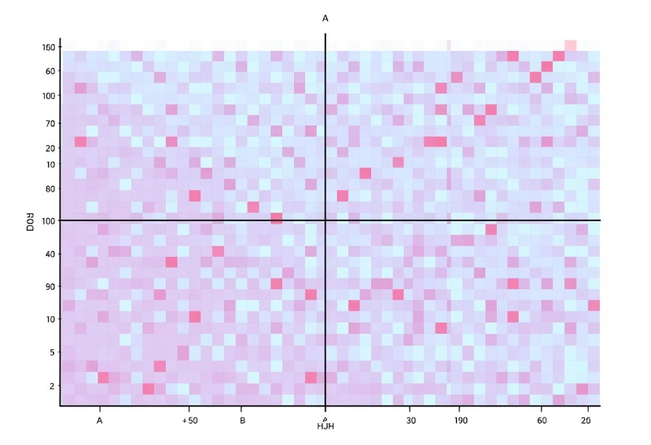
Skewness and Correlation Analysis
Skewness Measurement
Skewness was measured for each numerical feature to assess the symmetry of its distribution. A positive skew indicates a longer tail to the right, while a negative skew indicates a longer tail to the left. Understanding skewness is crucial for selecting appropriate statistical models and transformations.
A correlation matrix was generated for all numerical variables, visually highlighting the strength and direction of relationships between them. This revealed strong relationships, such as the positive correlation between 'temp' and 'count' (ride rentals), indicating that warmer weather tends to increase rental activity. Identifying these correlations helps in feature selection and understanding underlying drivers in the dataset.
Notes:
7

Slide 8
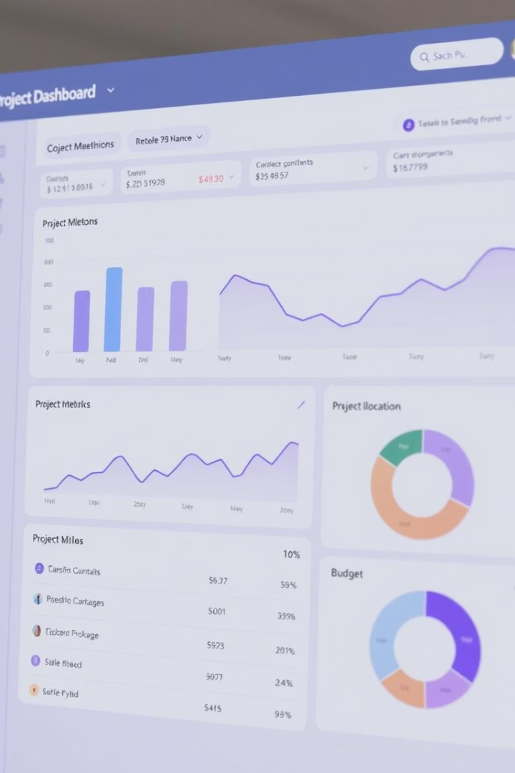



Learning Outcomes and Deliverables
Enhanced Technical Skills
Key Project Deliverables
The primary output includes a meticulously cleaned and merged dataset, ready for advanced analytics. Additionally, a complete Jupyter Notebook documenting all steps and a GitHub repository for version control ensure reproducibility and transparency.
This project significantly strengthened my proficiency in data acquisition, comprehensive data wrangling techniques, and initial exploratory data analysis. These skills are foundational for any data science endeavor.
Future Direction
The next logical step involves transitioning this clean dataset into advanced analytics or predictive modeling. This could include forecasting ride rental demand or developing machine learning models to identify key influential factors.
Notes:
8

Slide 9

Thank You
I appreciate your attention to this detailed overview of the data wrangling process. The robust techniques applied ensure the dataset's reliability, paving the way for insightful analysis and informed decision-making. I'm eager to apply these cleaned datasets to advanced analytical models to uncover deeper patterns and predictive capabilities.
Notes:
9

