Slide 1
Assessing diagnostic accuracy using ROC Curves
Aidan Bindoff (biostatistician)
Wicking Dementia Research and Education Centre
25th August 2022

Slide 2
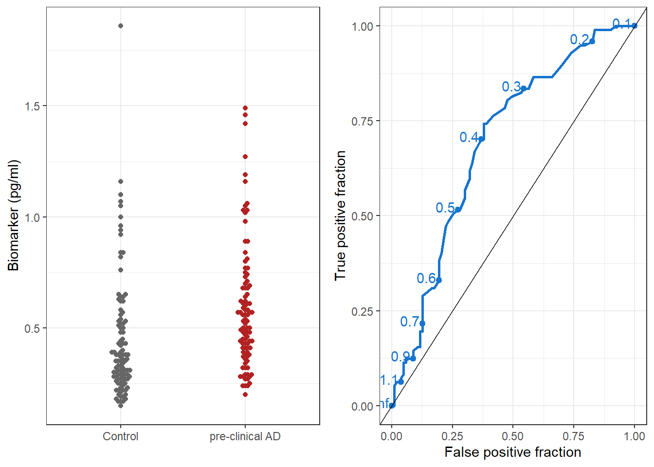
What is a ROC curve used for?

Slide 3
?
The labelled points on the curve (in blue) are the thresholds. What is the “true positive fraction” and the “false positive fraction” for threshold = 0.5? Find 0.5 on the y-axis of the beeswarm plot, do these fractions look right to you?

Slide 4
?
Imagine we have a promising treatment that slows the progression of AD if given early enough. Unfortunately, it also carries the risk of serious side effects. You wish to test the treatment on participants with pre-clinical AD, so you screen participants using biomarker m1. Which part of the curve would you choose your threshold from?

Slide 5
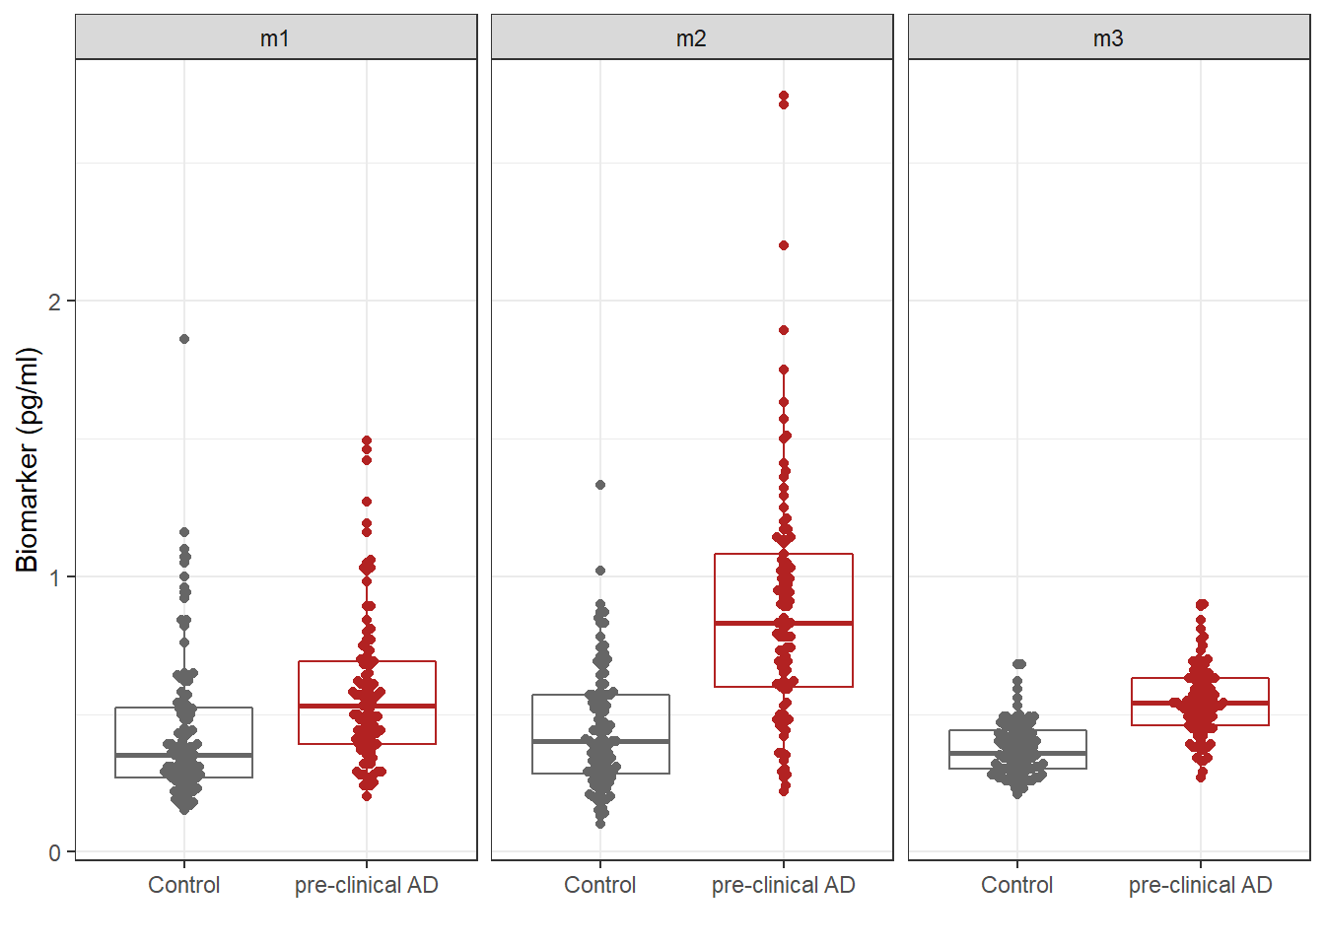
Comparing diagnostic tests

Slide 6
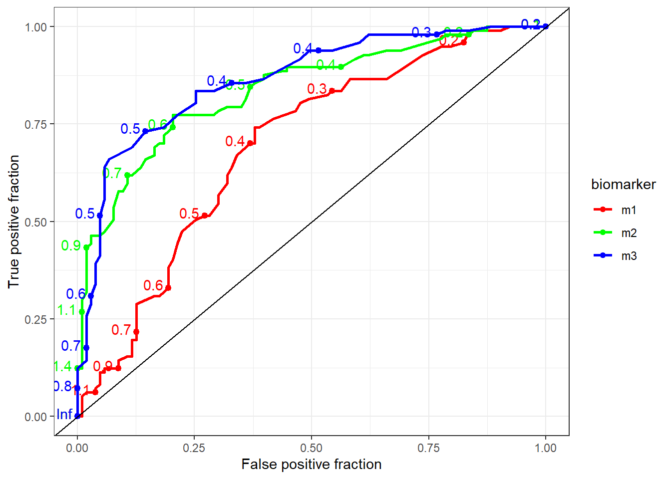
Comparing diagnostic tests

Slide 7

?
Assuming we can obtain any of the three biomarkers for the same cost and inconvenience to the patient, are there any biomarkers you would not bother to obtain? Are there any that stand out as having the best diagnostic accuracy?

Slide 8
A detailed set of lecture notes and some bonus questions can be found at https://github.com/ABindoff/Intro_to_ROC_curves
Additional Questions?
Acknowledgment: Thanks to Xinyi Wang for reviewing the questions

