Slide 1
Statistical Inference - Understanding p-values
Bindoff, A.

Slide 2
What is inference?
descriptive statistics describes the sample (mean, standard deviation)
inferential statistics infers properties of population
dependent on data
valid inference dependent on how the data were collected and analysed

Slide 3
Why do we need p-values?
Consider the data from a single experiment on extra-sensory perception (Bem, 2011). Participants are shown a pair of curtains on a monitor and asked to guess which curtain the image is hidden behind. After the participant has made their selection, the computer decides at random whether there was an image behind the chosen curtain. Erotic images or non-erotic images were displayed.
Participants were able to guess which curtain would conceal an erotic image 53.1% of the time.
What proportion of times would we expect participants to correctly guess which curtain concealed the erotic image?

Slide 4
Why do we need p-values?
p-values tell us how surprising the data would be if there was no underlying effect
e.g imagine experiment where both groups receive the same placebo
$$t(99)=2.51,p=.01,d=0.25$$

Slide 5
Why do we need p-values?
If participants did not have ESP, what would the distribution of correct responses look like?
First, let’s simulate data for 100 participants who do not have ESP. There were 36 trials per participant in the Bem experiment. We’ll ignore whether images were erotic or not (for now).
# 36 trials with p = 0.5 chance of guessing correctly, n= 100 participants bem <- function(n = 100, trials = 36){ y <- replicate(n, rbinom(trials, 1, prob = 0.5)) colMeans(y) } y <- bem(n = 100)

Slide 6
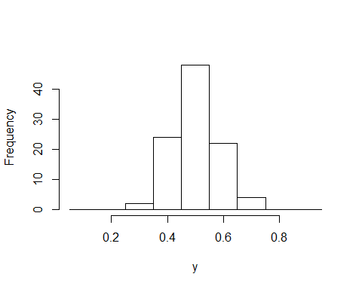
Proportion of correct responses per participant

Slide 7
Mean correct responses per Bem replication
Replicate Bem 1000 times (ignoring image attributes), plot distribution of results

Slide 8
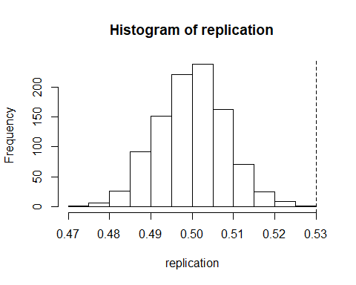

Slide 9
Mean correct responses per Bem replication
Bem reported results for erotic images and non-erotic images separately, claiming that the signficant result for erotic images and the non-significant result for non-erotic images had been hypothesised a-priori. Bem argued that the results were confirmatory of the hypothesis supporting precognition for erotic images.
There were 40 trials that included 12 erotic images and 60 trials that included 18 erotic images. We will simulate results for 1000 experiments with 40 + 60 participants each.

Slide 10


Slide 11
## ## 12 out of 1000 replications with mean correct responses > .53

Slide 12
Do p-values completely solve the problem?
What is the distribution of p-values from our 1000 Bem replications?

Slide 13
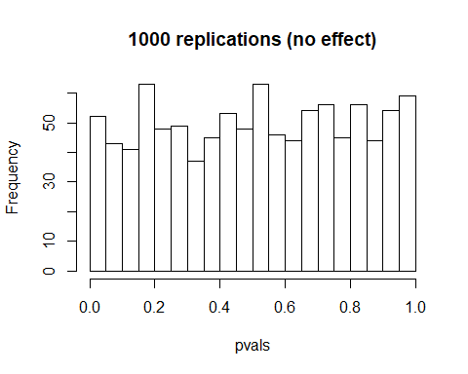

Slide 14
Type 1 error rate
We use $α=.05$ by convention (or is it by convenience?)
“It is convenient to take this point as a limit in judging whether a deviation is to be considered significant or not. Deviations exceeding twice the standard deviation are thus formally regarded as significant” (Fisher, 1925)
Compare with the histogram on the previous slide, is this what you would expect?
(Hold this thought, we will look at the distribution of p-values when there is an effect later)

Slide 15
Linear models
Let’s build a data generation model!
$$y=β_{0}+β_{1}x_{1}+ε \\ ε∼N(0,σ^{2})$$

Slide 16
Linear models
set.seed(10) B0 <- 3 B1 <- 1.5 epsilon <- function(){rnorm(12, mean = 0, sd = 1)} x1 <- c(rep(0, 6), rep(1, 6)) y <- function(){B0 + B1*x1 + epsilon()}

Slide 17
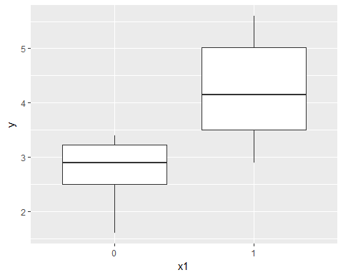
Linear models

Slide 18
Linear models
## y x1 ## 1 3.0 0 ## 2 2.8 0 ## 3 1.6 0 ## 4 2.4 0 ## 5 3.3 0 ## 6 3.4 0 ## 7 3.3 1 ## 8 4.1 1 ## 9 2.9 1 ## 10 4.2 1 ## 11 5.6 1 ## 12 5.3 1

Slide 19
Linear models
## ## Welch Two Sample t-test ## ## data: y by x1 ## t = -2.8891, df = 8.4102, p-value = 0.0192 ## alternative hypothesis: true difference in means is not equal to 0 ## 95 percent confidence interval: ## -2.6573292 -0.3093374 ## sample estimates: ## mean in group 0 mean in group 1 ## 2.750000 4.233333
## ## ## Difference in group means = 1.483333

Slide 20
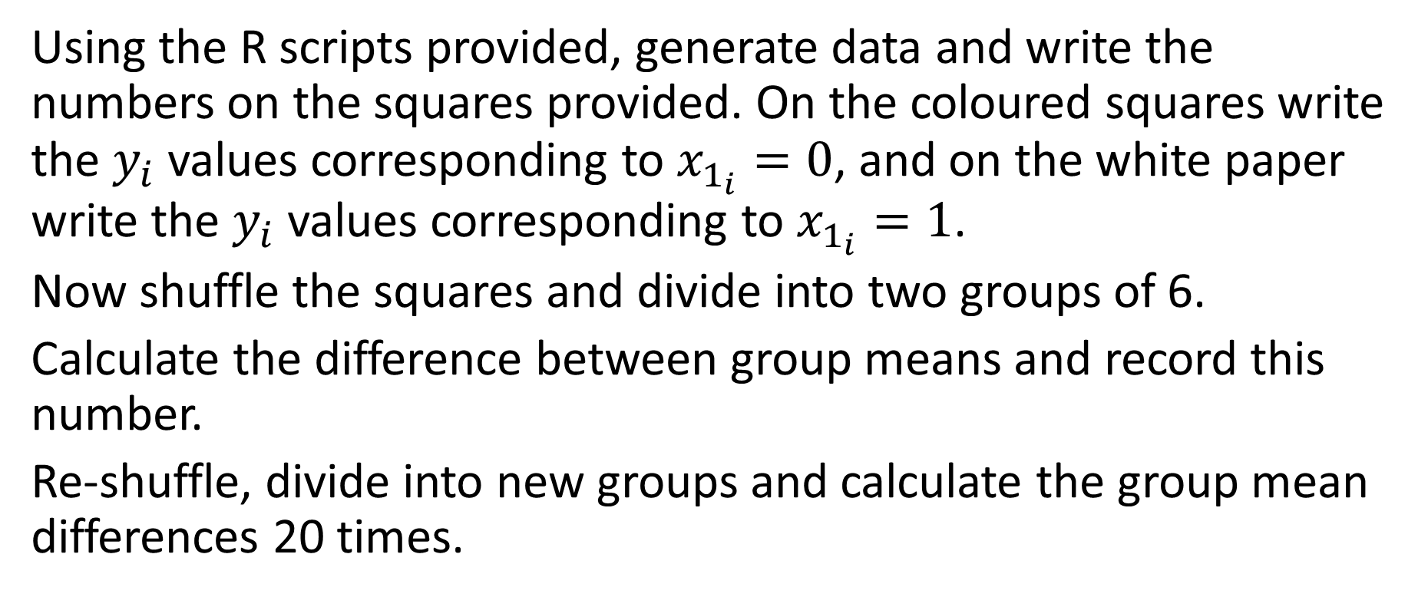
Practical example - permutation test
Using the R scripts provided, generate data and write the numbers on the squares provided. On the coloured squares write the $y_{i}$ values corresponding to $x_{1_{i}}=0$, and on the white paper write the $y_{i}$ values corresponding to $x_{1_{i}}=1$.
Now shuffle the squares and divide into two groups of 6.
Calculate the difference between group means and record this number.
Re-shuffle, divide into new groups and calculate the group mean differences 20 times.

Slide 21
Practical example - permutation test
Out of 100 permutations, how many resulted in a difference at least as large as observed in our experiment?

Slide 22
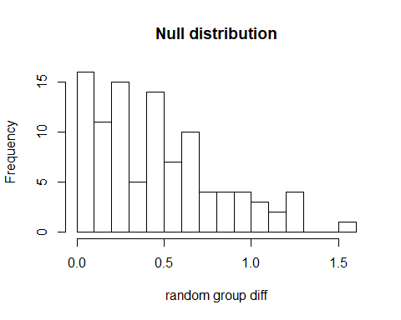

Slide 23
Distribution of p-values (large effect)
p.val.perm <- function(){ k <- y() # run experiment again (random draws from generating model) obs.diff <- abs(mean(k[7:12]-k[1:6])) # calculate observed difference of means perm <- replicate(100, shuffle(k)) # permute ("shuffle") 100 times and calculate observed differences mean(perm >= obs.diff) # what proportion of permutations >= observed difference from experiment } p.perm <- replicate(500, p.val.perm()) # repeat experiment 500 times, storing p-value each time mean(p.perm < .05) # true positive rate by permutation test
## [1] 0.622

Slide 24
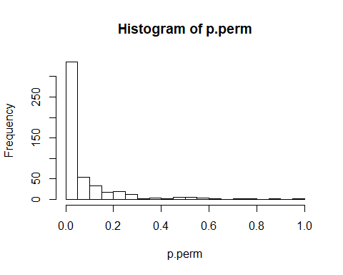
Distribution of p-values (large effect)

Slide 25
What have we learned?
$α$ (typically $α=.05$) is the proportion of times we’re prepared to reject the null when it is true, the so-called Type 1 error rate
if there is no difference between groups p-values are uniformly distributed over many experiments (p = .001 is no more unusual than p = .321)
if there is a difference between groups, p-values will not be uniformly distributed over many experiments (this is why p-values are useful under the “frequentist” assumptions)

Slide 26
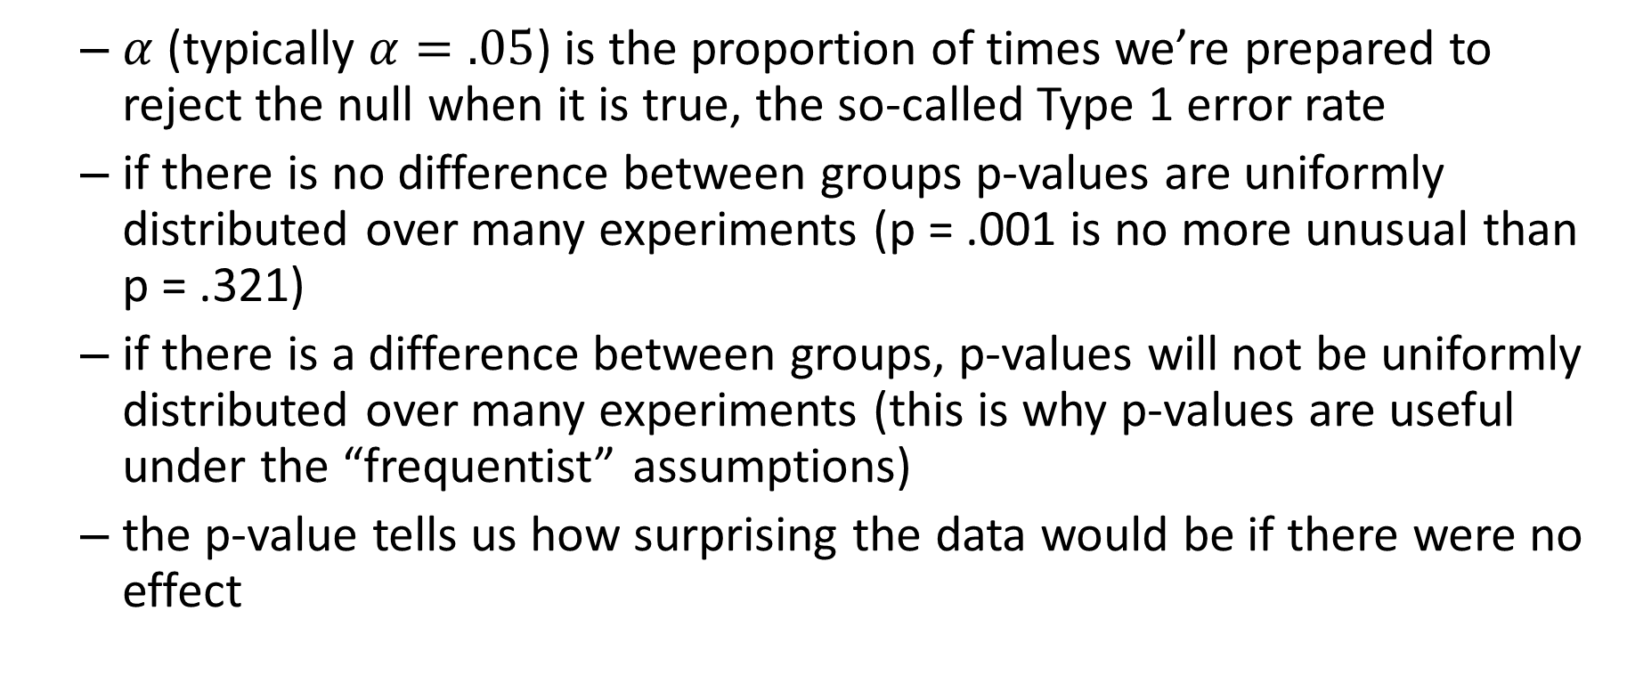
What have we learned?
$α$ (typically $α=.05$) is the proportion of times we’re prepared to reject the null when it is true, the so-called Type 1 error rate
if there is no difference between groups p-values are uniformly distributed over many experiments (p = .001 is no more unusual than p = .321)
if there is a difference between groups, p-values will not be uniformly distributed over many experiments (this is why p-values are useful under the “frequentist” assumptions)
the p-value tells us how surprising the data would be if there were no effect

Slide 27
What have we learned?
the p-value can’t tell us if there is no effect (it can tell us if the data would not be surprising under the null)
$p(y|H_{0})≠p(H_{0}|y)$ “fallacy of the transposed conditional”

Slide 28
What have we learned?
the p-value can’t tell us if there is no effect (it can tell us if the data would not be surprising under the null)
$p(y|H_{0})≠p(H_{0}|y)$ “fallacy of the transposed conditional”
the p-value is heavily dependent on test assumptions - you must check that these assumptions are satisfied

Slide 29
What have we learned?
the p-value can’t tell us if there is no effect (it can tell us if the data would not be surprising under the null)
$p(y|H_{0})≠p(H_{0}|y)$ “fallacy of the transposed conditional”
the p-value is heavily dependent on test assumptions - you must check that these assumptions are satisfied
Google
consult a friendly statistician

Slide 30
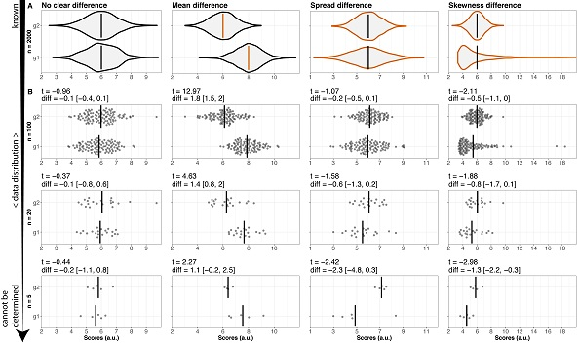
What have we learned?

Slide 31
Fig courtesy of Rousselet, G. A., Pernet, C. R., Wilcox, R. R. (2017) “Beyond differences in means: robust graphical methods to compare two groups in neuroscience”

Slide 32
References
Bem, D. J. (2011). Feeling the future: experimental evidence for anomalous retroactive influences on cognition and affect. Journal of personality and social psychology, 100(3), 407.
https://slate.com/health-and-science/2017/06/daryl-bem-proved-esp-is-real-showed-science-is-broken.html
https://rationalwiki.org/wiki/Confusion_of_the_inverse (“fallacy of the transposed conditional”)
Rousselet, G. A., Pernet, C. R., & Wilcox, R. R. (2017). Beyond differences in means: robust graphical methods to compare two groups in neuroscience. European Journal of Neuroscience, 46(2), 1738-1748.

