Slide 1
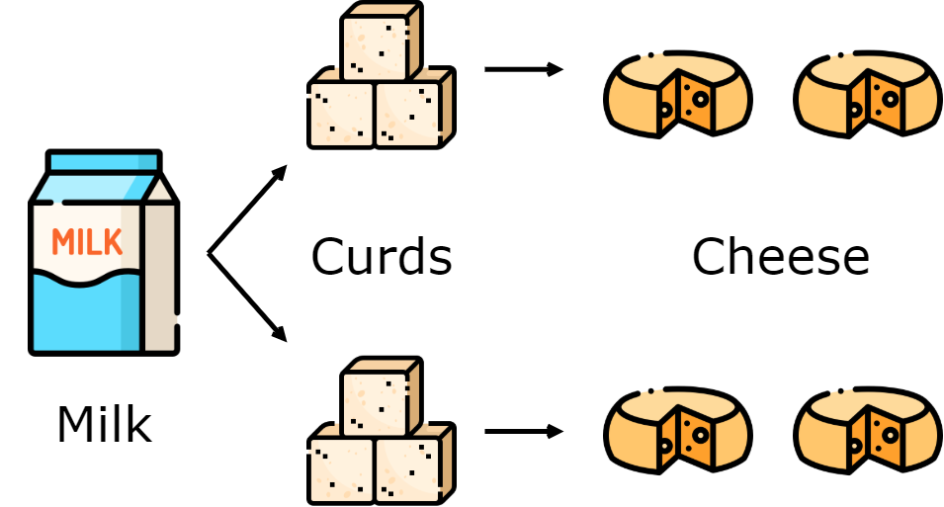

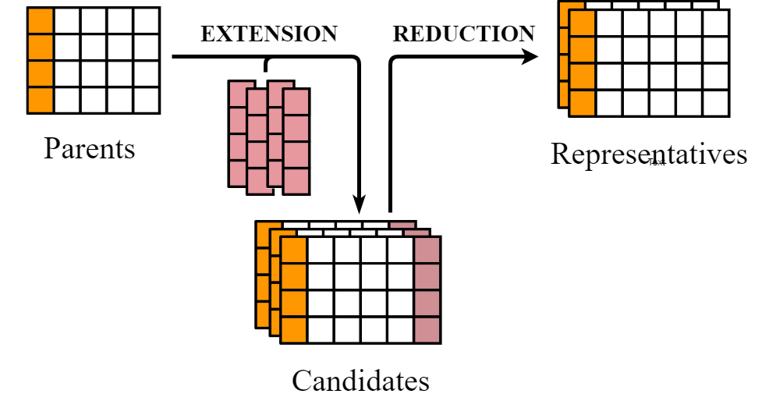
Screening experiment
128 runs
1 four-level factor
9 two-level factors
NO CATALOG AVAILABLE
Enumeration procedure
SOLUTION
Catalog of designs with 4-level and 2-level factors
up to 256 runs
1, 2 or 3 four-level factors
up to 20 two-level factors
Enumeration of large four-and-two-level designs
Alexandre Bohyn

