Slide 1
Outline
getInlineOptions
findSymmetryOperators
Input_m
readInput
loadInSpaceGroup
formatInput
identifySpaceGroup
cellReduction
symmetrizeStructure
findRotationalSymmetry
writeOutput
identifyCrystal
restricAtomicCoordinates

Slide 2
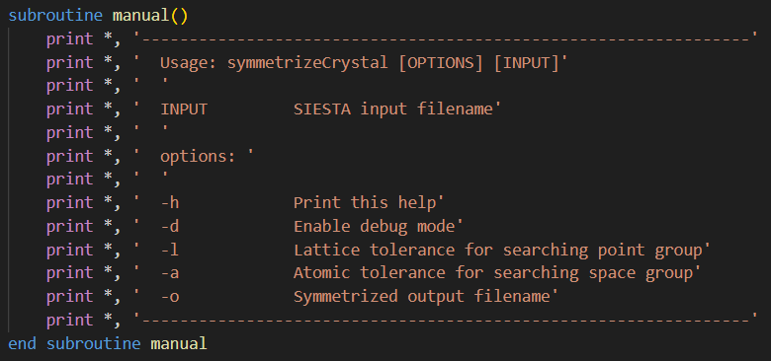
getInlineOptions
Take in variables from inline command.
Default values are
Lattice tolerance = 0.01 Bohr, Atomic tolerance = 0.005 Bohr,
output filename = ‘symmetrizedStructure.out’, debug = .false.
ex)
symmetrizeCrystal –d –l 0.001 –a 0.0001 –o symm.out input.fdf
Sets lattice tolerance to 0.001 (unitless), atomic tolerance to 0.0001 Bohr, output filename as ‘symm.out’ and input filename as ‘input.fdf’

Slide 3
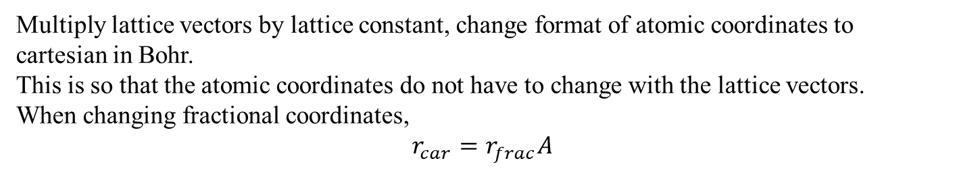
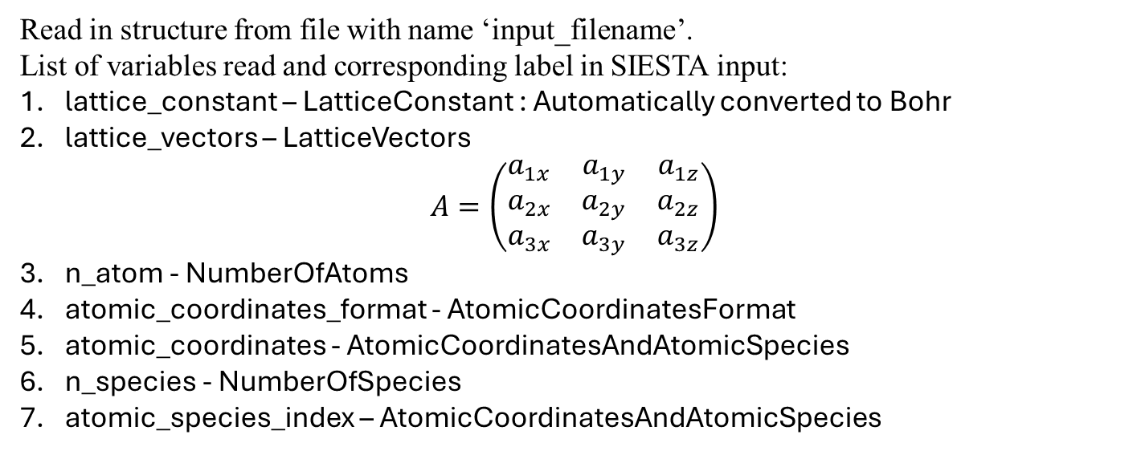
Input_m
readInput
Read in structure from file with name ‘input_filename’.
List of variables read and corresponding label in SIESTA input:
lattice_constant – LatticeConstant : Automatically converted to Bohr
lattice_vectors – LatticeVectors
$$A=\left(\begin{matrix}a_{1x} & a_{1y} & a_{1z} \\ a_{2x} & a_{2y} & a_{2z} \\ a_{3x} & a_{3y} & a_{3z}\end{matrix}\right)$$
n_atom - NumberOfAtoms
atomic_coordinates_format - AtomicCoordinatesFormat
atomic_coordinates - AtomicCoordinatesAndAtomicSpecies
n_species - NumberOfSpecies
atomic_species_index – AtomicCoordinatesAndAtomicSpecies
formatInput
Multiply lattice vectors by lattice constant, change format of atomic coordinates to cartesian in Bohr.
This is so that the atomic coordinates do not have to change with the lattice vectors.
When changing fractional coordinates,
$$r_{car}=r_{frac}A$$

Slide 4
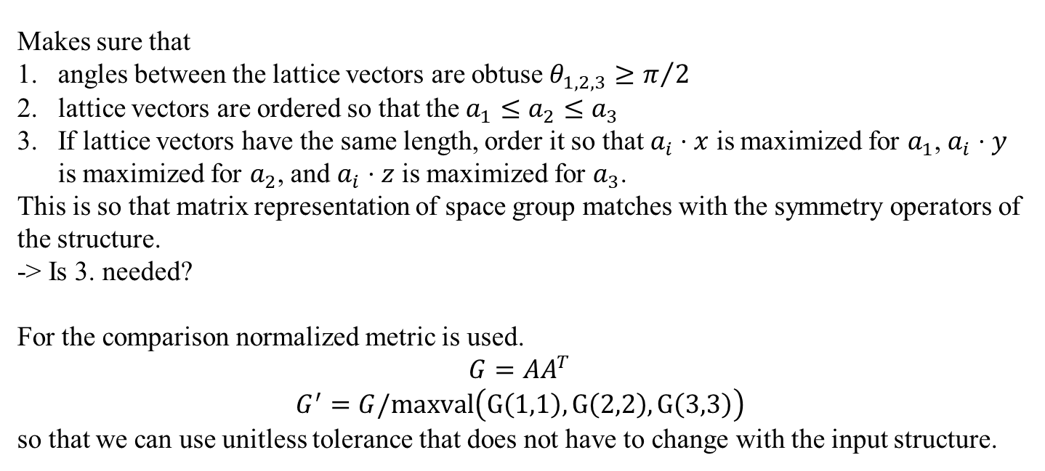
cellReduction
Makes sure that
angles between the lattice vectors are obtuse $θ_{1,2,3}≥π/2$
lattice vectors are ordered so that the $a_{1}≤a_{2}≤a_{3}$
If lattice vectors have the same length, order it so that $a_{i}⋅x$ is maximized for $a_{1}$, $a_{i}⋅y$ is maximized for $a_{2}$, and $a_{i}⋅z$ is maximized for $a_{3}$.
This is so that matrix representation of space group matches with the symmetry operators of the structure.
-> Is 3. needed?
For the comparison normalized metric is used.
$$G=AA^{T}$$
$$G^{′}=G/maxval\left(G\left(1,1\right),G\left(2,2\right),G\left(3,3\right)\right)$$
so that we can use unitless tolerance that does not have to change with the input structure.

Slide 5
findRotationalSymmetry
Make all matrices with elements {-1, 0, 1} that have determinant 1 or -1.

