Slide 1







KIRA
DESIGN LTD
WEBSITE REVAMP · 2026
紅牆 The Red Wall
A homepage built the way KIRA builds a room — from its own materials, its own light, and its own red wall.
Prepared for Kim Wong, Design Director
Notes:
Open here. Don't explain the concept yet — let the red and the oak do the work for a beat. Then: 'This palette isn't something I invented. It's your reception.'

Slide 2
01 — WHERE WE ARE
The work is better than the website.
Awards sit on top of the photography
Four badges cover the rooms you were awarded for. They shrink the work they're meant to prove.
IN YOUR OWN WORDS
“Minimal, but it does not bring out the Interior Design advantage.”
Projects are thumbnails, not evidence
No developer, area, scope or year. A buyer can't assess capability from a caption in brackets.
Your best clients are a footnote
Henderson, Chinachem, Wheelock, Grand Ming, Poly, K&K — the strongest credential you own, set in small grey text.
That is the whole brief. Restraint only reads as confidence when something is being withheld.
The categories don't match the grid
Commercial / Residential / Art Collection read as columns, but the projects beneath them ignore it.
Notes:
Lead with the compliment — the work is genuinely award-winning. The problem is presentation, not practice. The red card is Kim's own sentence; let him read it.

Slide 3
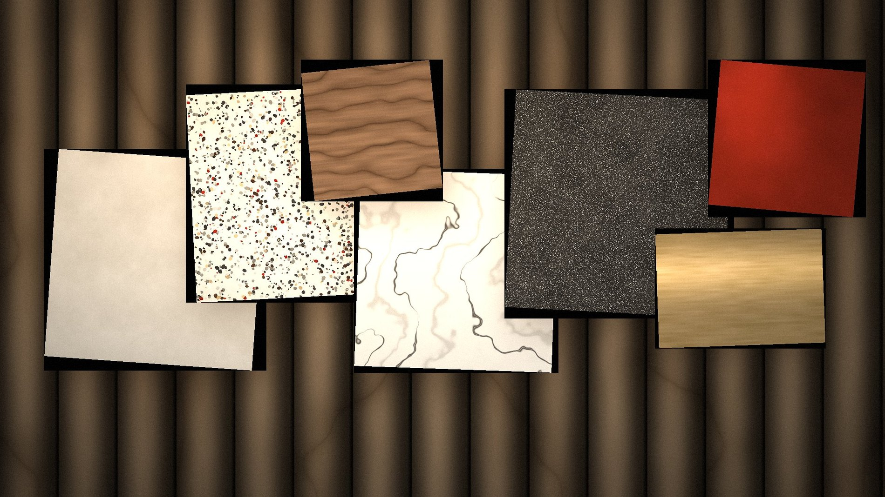
02 — THE IDEA
Your palette was already in your reception.
A lacquer-red wall. Black lettering. Pale oak battens. An orange bench — the same orange as the I in your wordmark. Nothing needed inventing; it needed noticing.
Lacquer
Oak
Walnut
Limestone
Champagne
Granite
#A02C1C
#C9A984
#4A3324
#E4DED2
#C6A87C
#3A3733
Almost nobody in Hong Kong luxury interiors uses red. It is auspicious, and it is unmistakably yours.
Notes:
This is the emotional centre of the pitch. The point to land: the identity was already in the building — I only read it back. Pause on the swatch row.

Slide 4
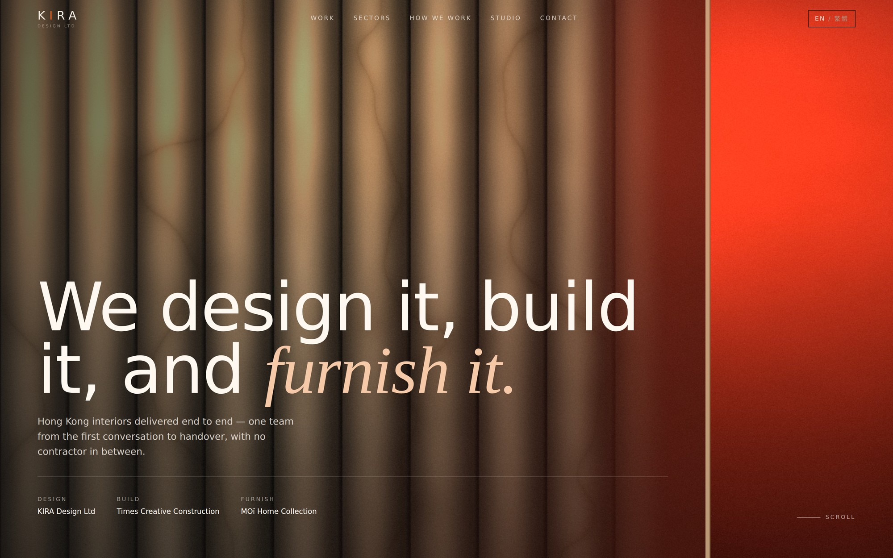
03 — THE NEW HOMEPAGE
Built, not sketched.
WHAT CHANGES
Awards move off the photography
Into a typographic honours rail. The rooms are finally uncovered.
Projects become plates
Developer, area, scope, year and award on every one.
Your clients lead
Six major Hong Kong developers, given their own section.
Four clear routes
Residential · Commercial · Hospitality · Art Collection.
The form routes itself
A developer brief and a private home reach different people.
Live, responsive, bilingual EN / 繁體中文 — not a mockup.
Notes:
Open the real site here if the room has a screen — the language toggle and the sector filter both land better live than on a slide.

Slide 5

04 — TO GO LIVE
Three things, and it ships.
01
02
03
Your photography
The hotel projects
The logo as SVG
Whatever exists, at whatever quality. Every image slot is already sized and labelled for what it needs.
Names, locations, years and scope. Hospitality becomes a real fourth route the moment they arrive.
The wordmark is staying. Real letterforms will tune the spacing of the whole type system.
Once those land: project pages, the three sector routes, and the Chinese copy read by someone in your office. Two weeks to a site you can send a developer.
KIRA
admin@kiradesign.com.hk · +852 2981 2838
DESIGN LTD
Notes:
Close on the ask, not on the design. Three concrete deliverables and a two-week horizon. Get agreement on who is sending the photography before leaving the room.

