Slide 1


Slide 2
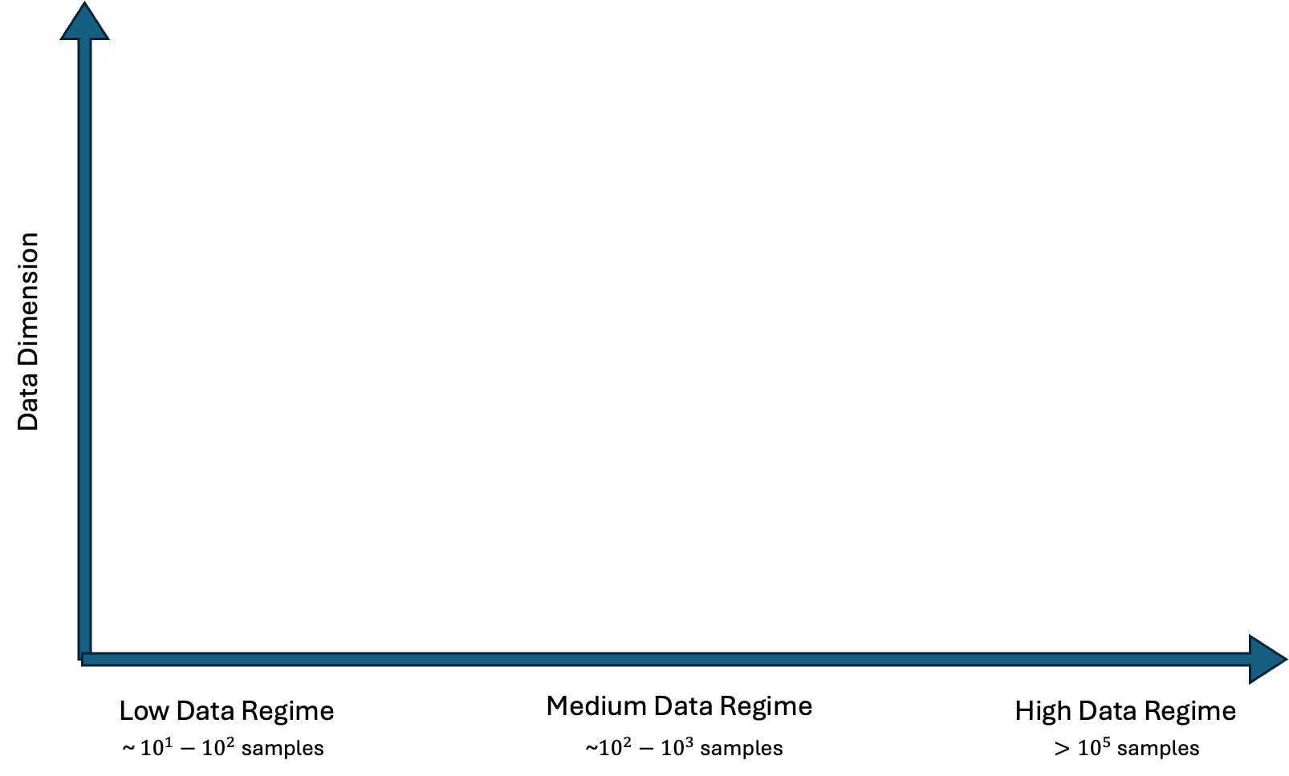
Bayesian Optimization in different data regimes
Neural network ensemble;
Bayesian Neural Network;
Latent space representation
Dimension Reduction; Feature Selection;
Ex : Random Forest
Active learning with Gaussian Process

Slide 3
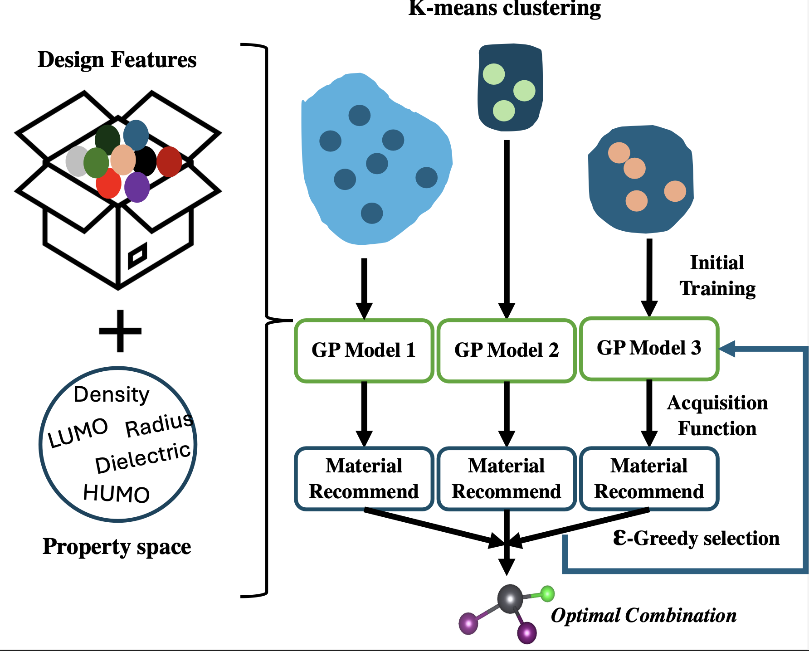
Our Approach
K means clustering is used to initially partition the data.
A percent of the data from each of the sampled clusters goes to train each of the local GP models.
Based on the material recommended we use an epsilon-greedy algorithm to choose which GP model to continue training.

Slide 4
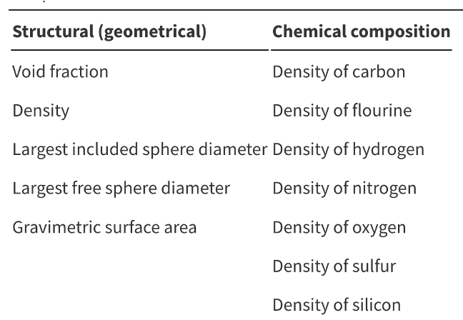
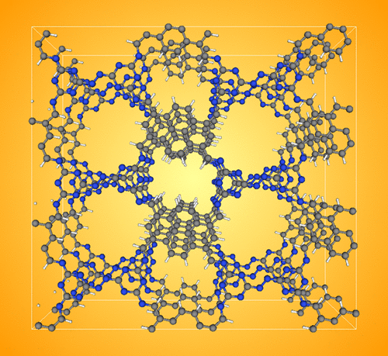
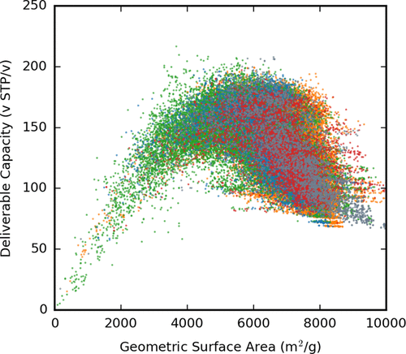
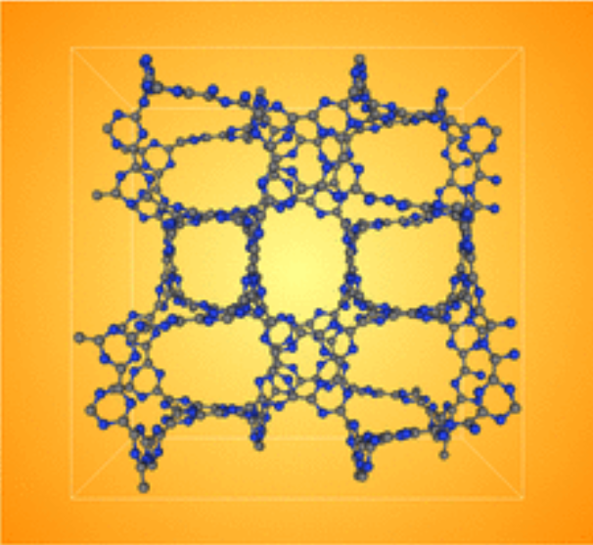
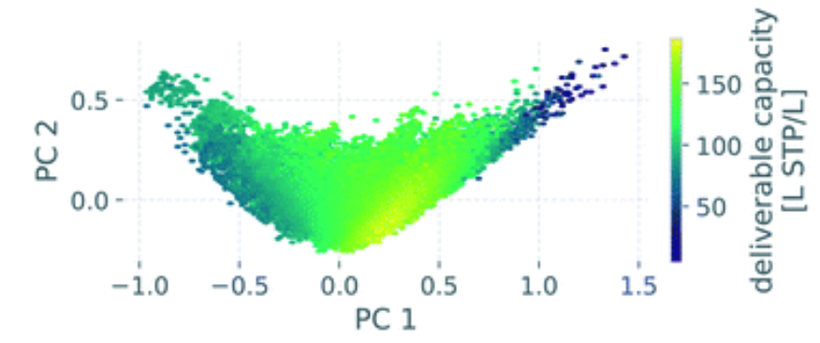
The COFs dataset
69,840 2D/3D covalent organic frameworks (COFs) assembled in silico from 666 distinct organic linkers and four established synthetic routes.
Objective: maximax methane storage performance (deliverable capacity)
linker108_CH_linker91_N_bex (2D COF)
Features representation of a COF
Deliverable capacity v.s geometric surface area of all structures
linker91_C_linker91_C_lcs_f (3D COF)
Heatmap over reduce 2D feature space
Chem. Mater. 2018, 30, 15, 5069–5086
Mol. Syst. Des. Eng., 2021,6, 1066-1086

Slide 5
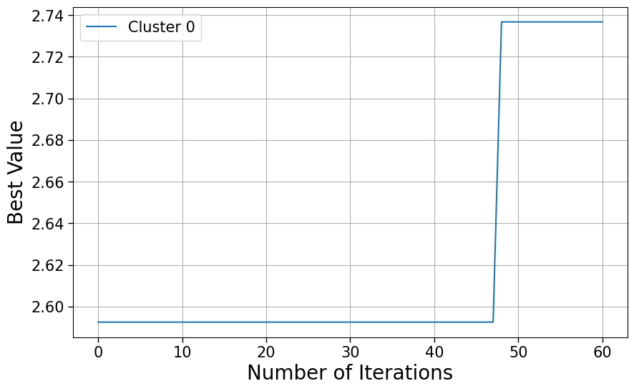
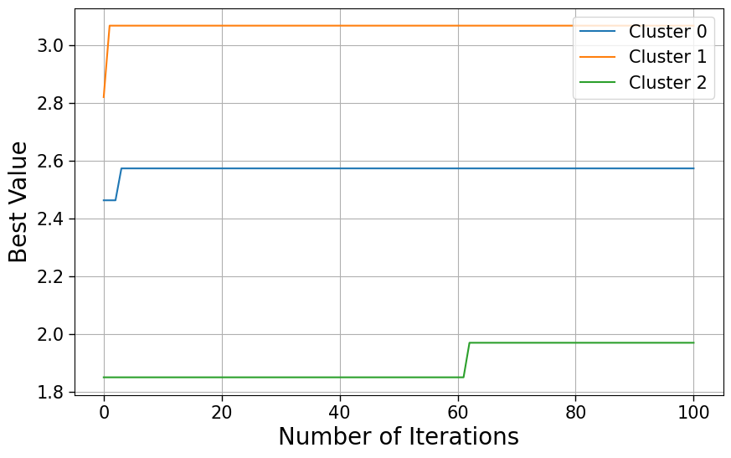
Results of Single GPs vs 3 Local GPs
In both cases the GP model was retrained after 20 iterations
5% of the data was used to initially train the surrogate models.

Slide 6
