Slide 1
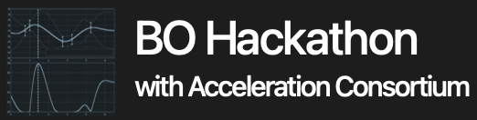
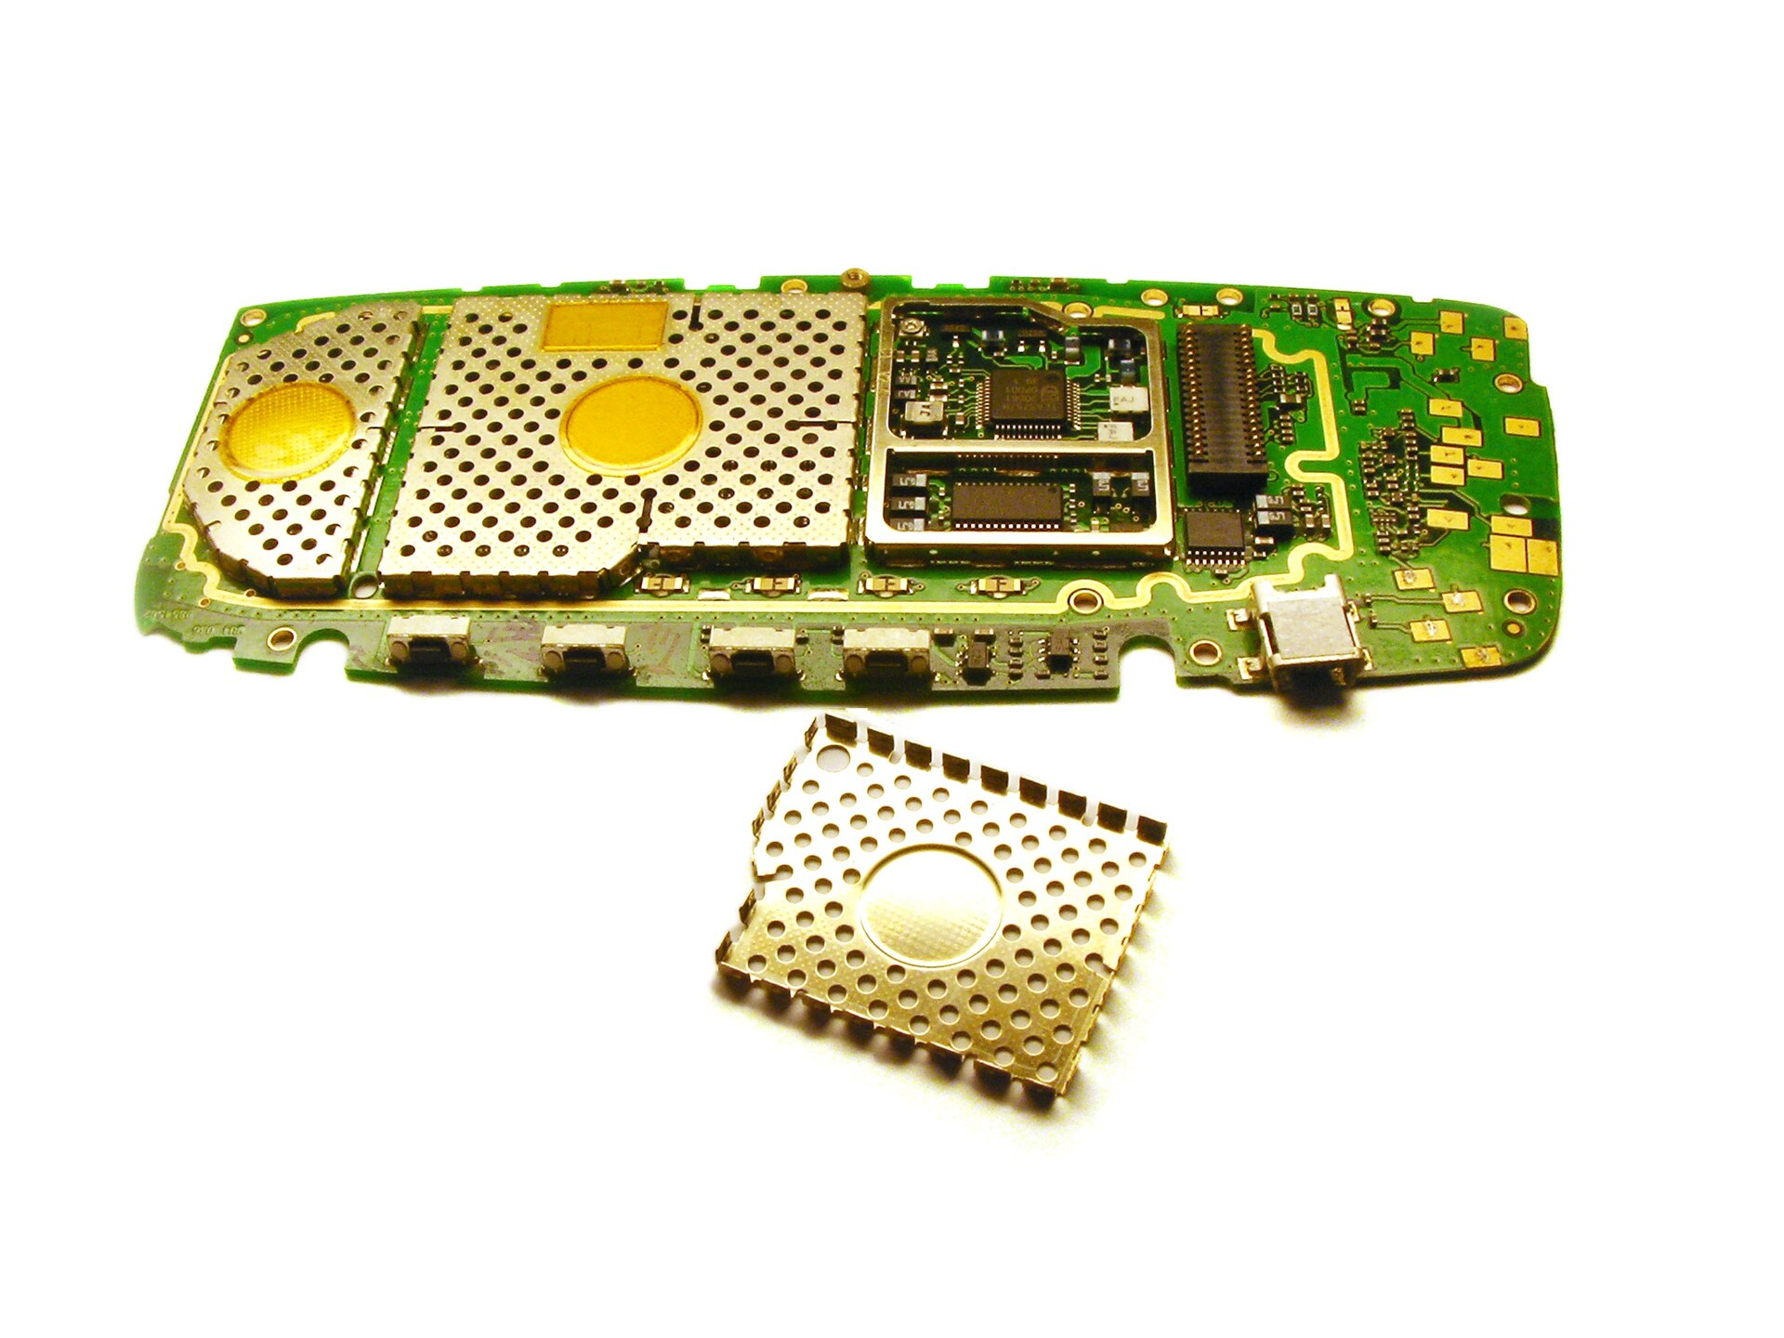
PROJECT 6: Multi-Objective Bayesian Optimization
for Transparent Electromagnetic Interference Shielding
with Thin-Film Structures
Jungtaek Kim (Team Leader), Mingxuan Li,
Oliver Hinder, and Paul W. Leu
Electromagnetic Interference Shielding
Search Space
Protect a device from radio-frequency interference.
Transparency is required for specific applications such as spacecraft windows.
Material choices
Ag, Al, Al₂O₃, Cr, Ni, Pd, Si₃N₄, SiO₂, Ti, TiN, TiO₂, W
Thickness range
[5, 20] nm
Problem Formulation
Two-layer system
Four-layer system
Simple thin-film structures are used for electromagnetic interference shielding.
Transmittance and shielding effectiveness are considered as objectives being optimized.
Material and thickness for each layer is selected by Bayesian optimization.
Bayesian Optimization
Gaussian processes with the Matérn 5/2 kernel
Expected improvement
Multi-Objective Bayesian Optimization
Six-layer system
Eight-layer system
Since two objectives are black-box, multi-objective Bayesian optimization is employed.
Random scalarization for both acquisition functions are used for multi-objective Bayesian optimization.

