Slide 1
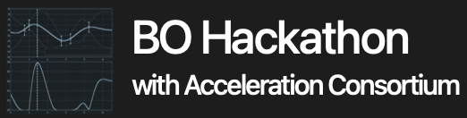
PROJECT 6: Multi-Objective Bayesian Optimization for Transparent Electromagnetic Interference Shielding with Thin-Film Structures
Jungtaek Kim (Team Leader),
Mingxuan Li, Oliver Hinder, and Paul W. Leu
Notes:
Hello, everyone.
Today we are talking about our hackathon project, multi-objective Bayesian optimization for transparent electromagnetic interference shielding with thin-film structures.

Slide 2
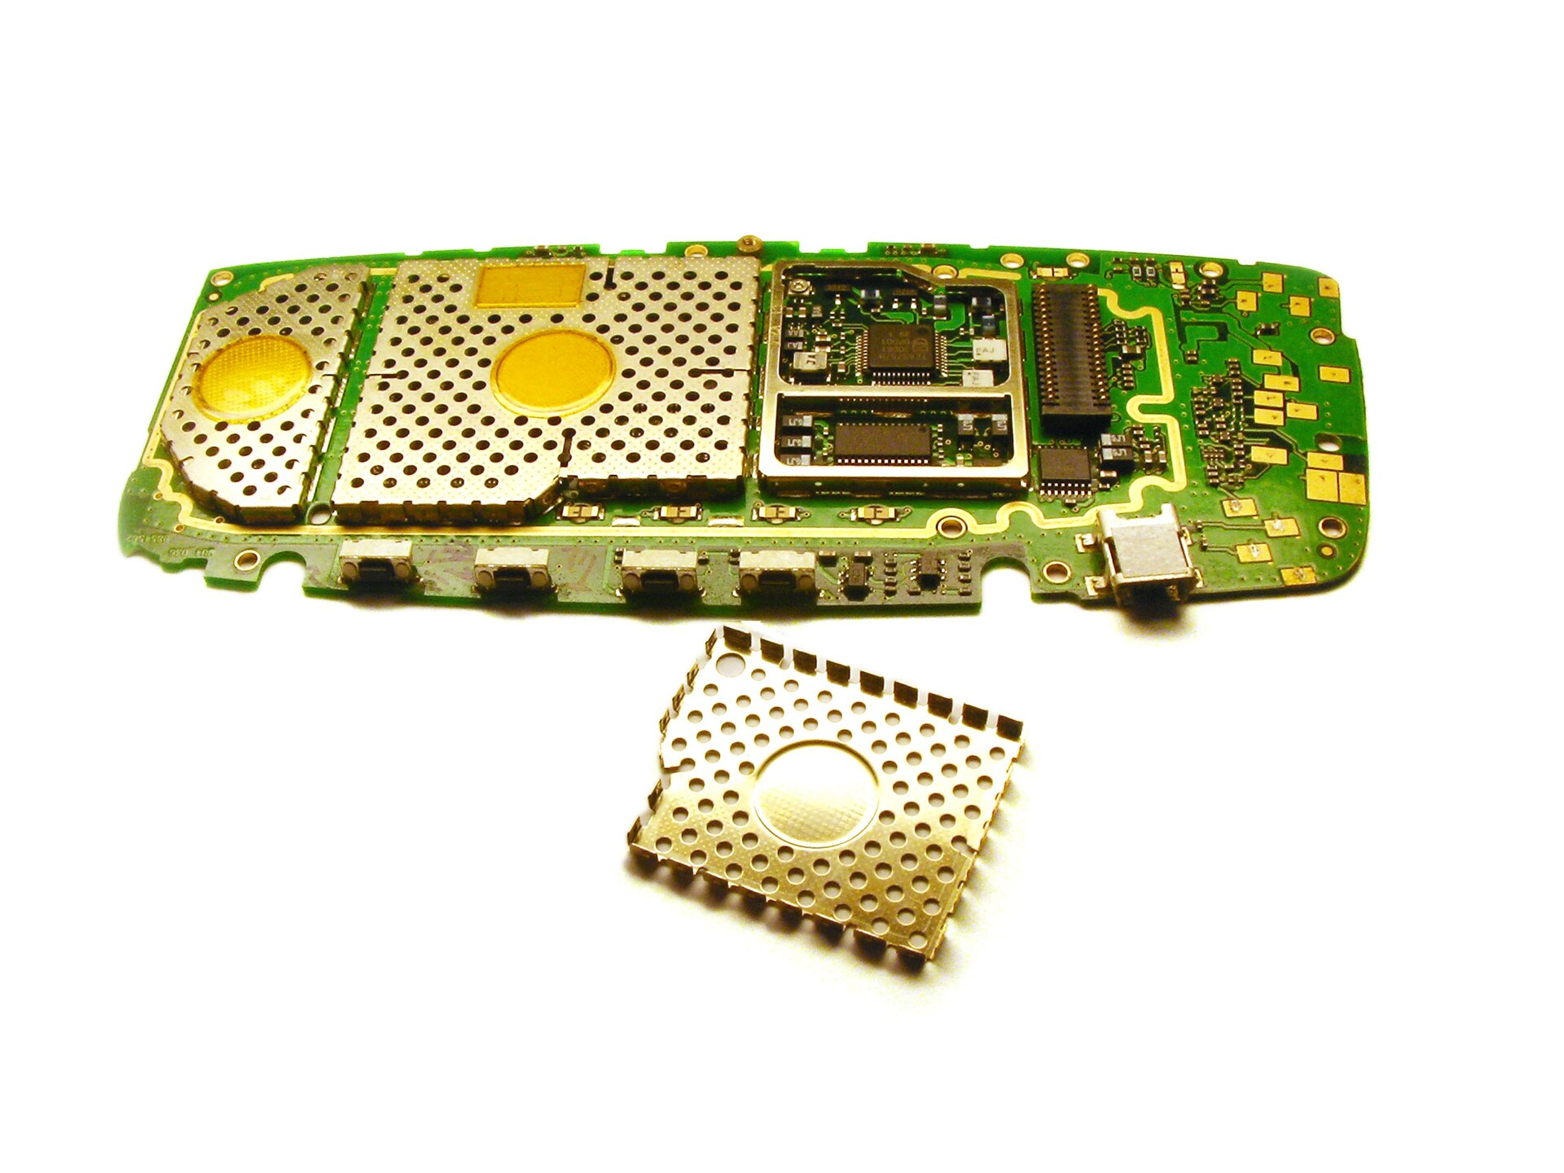
Electromagnetic Interference Shielding
Protect a device from radio-frequency interference.
Transparency is required for specific applications such as spacecraft windows.
Notes:
Electromagnetic interference shielding is to protect a device from radio-frequency interference.
In addition, transparency is required for specific applications such as spacecraft windows.

Slide 3
Problem Formulation
Simple thin-film structures are used for electromagnetic interference shielding.
Transmittance and shielding effectiveness are considered as objectives being optimized.
Material and thickness for each layer is selected by Bayesian optimization.
Notes:
In this project, we are interested in simple thin-film structures for electromagnetic interference shielding.
For objectives, transmittance and shielding effectiveness are used.
Our goal is to maximize both objectives by selecting material and thickness for each layer.

Slide 4
Multi-Objective Bayesian Optimization
Since two objectives are black-box, multi-objective Bayesian optimization is employed.
Random scalarization for both acquisition functions are used for multi-objective Bayesian optimization.
Notes:
We maximize two objectives regarding transmittance and shielding effectiveness using multi-objective Bayesian optimization.
To implement the multi-objective Bayesian optimization, we use random scalarization for both acquisition function.

Slide 5
Search Space
Material choices
Ag, Al, Al2O3, Cr, Ni, Pd, Si3N4, SiO2, Ti, TiN, TiO2, W
Thickness range
[5, 20] nm
Notes:
Our search space contains twelve material choices and a thickness range from 5 to 20 nanometers.

Slide 6
Bayesian Optimization Setting
Gaussian processes with the Matérn 5/2 kernel
Expected improvement
Notes:
For the Bayesian optimization, Gaussian process regression and expected improvement are used.

Slide 7
Experimental Results
Two-layer system
Four-layer system
Six-layer system
Eight-layer system
Notes:
We present experimental results in this page.
Multi-objective Bayesian optimization is quite effective for finding the Pareto frontier of two objectives as shown in figures.

Slide 8
Thank you!
Notes:
Thank you.

