Slide 1
Computationally Efficient “Stator-winding” Temperature Predictions for Electric Motors
Problem:
Stator winding temperature sensors increase the permanent magnet synchronous motor’s price and size. This makes the motor less efficient and more costly to produce. Stator winding insulation degrades more rapidly due to overheating causing motor failure.
Bantebya, Beck, Crespo, Kickhoefer

Slide 2
Bottom Line Up Front (BLUF)
Agenda
Stator Winding Prediction
Data Overview
Raw data Exploratory Visualizations (descriptive)
Data Pre-processing (Steps)
K-means Clustering
PCA
Regression
*NEMA Insulation class B failure prediction: Logistics regression Classification Model
Objective: Build a more computationally efficient model for predicting stator winding temperatures than previous attempts with Deep Neural networks (R2 = 0.9439 RMSE 0.2368, Guo, Ding, Song, Tang, Wang, and Zhao) and PCA+ELM [extreme learning machine} (R2 = 0.9955 and RMSE = 0.0622, Dilmi, Kebaili, Ladjal) to support more cost-efficient electric motor construction for manufacturers . Additionally, Classify overheating in a National Electric Motor Associations (NEMA) Class B stator winding insulation.

Slide 3
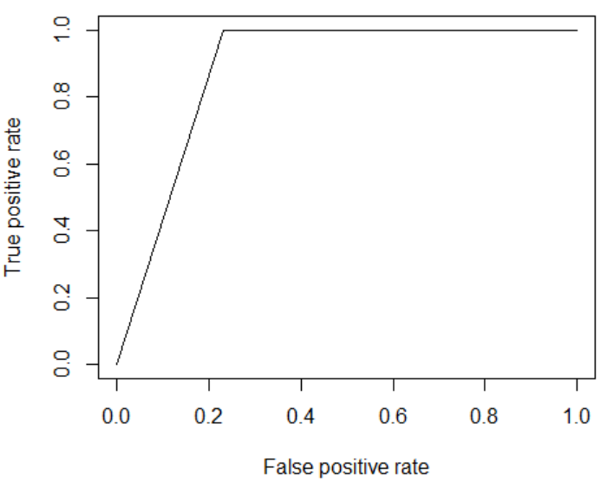
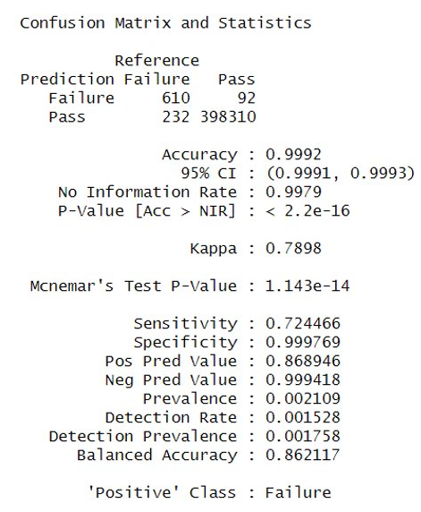
Bottom Line up Front (BLUF)
Stator Winding: Temp Prediction and Insulation Classification (CV 10-Fold)
REQUIREMENTS
Source - Kaggle and Paderborn University
High Level summary Raw predictors and response
Preprocessing applied
A high-level summary of the final cleaned-up data set
Models tried and Results
Roadblocks encountered - Response variable initial change from permanent magnet to stator winding (due to Domain research). Brute force feature selection yielded poor results, so we tried recursive feature selection using a linear model.
Roadblocks encountered for Insulation Classification-
Type of insulation used in the data not provided by Paderborn University. We had to make an assumption regarding insulation type in our data.
Initial Classification Logistics regression yielded poor results using all 12 quantitative predictors. Had to use original 5 predictors.
Results/Insights
Customer- Electric Car Manufacturers
Response- Stator Winding Temp, and Insulation Result Boolean column
Predictors- Stator tooth, stator Yoke, Coolant, pm, ambient
What is the best Motor Prediction model-
Elastic net – R2 .999 RMSE .859 Degree Celsius Lambda 0.4987 alpha 0.5
Methodologies- 50% sample, 70/30 train/test stratified, center & scale, Recursive Feature Selection using lm (to find 5 best vars), tried all Linear Models, PCA, and K-means, Logistic Regression, Neural Network, and Entire Data train validation

Slide 4
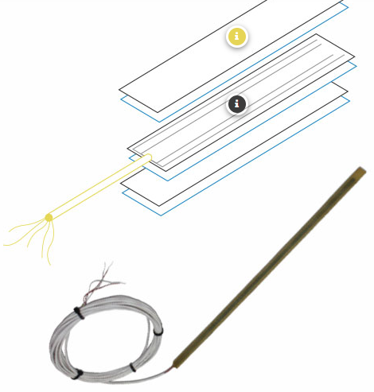
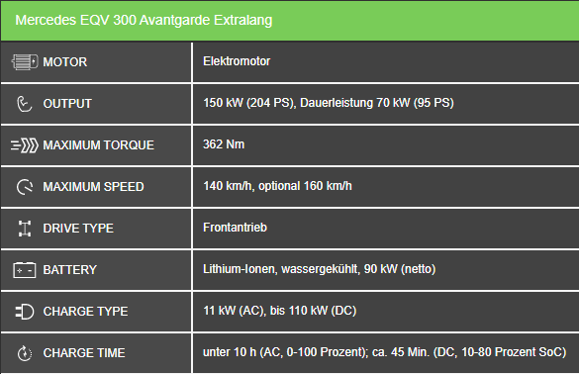
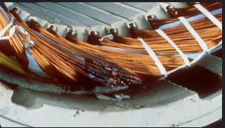
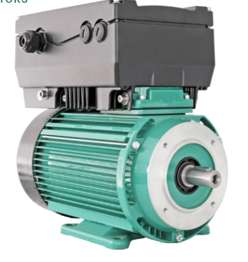

Domain Knowlege
Overheated stator windings
Our Dataset Stator Winding Temp Range
Stator winding Censor
Note: stator temperature is strongly correlated with the exponentially weighted moving average of the PMSM motor coolant temperature, and removing this variable from the feature vector results in a significant decrease in the effectiveness of the prediction algorithm. [1]
NEMA specifies letter designations for motor insulation temperature ratings. These insulation temperature ratings are denoted as Class: A = 105°C, B = 130°C, F = 155°C, and H = 180°C [2]

Slide 5
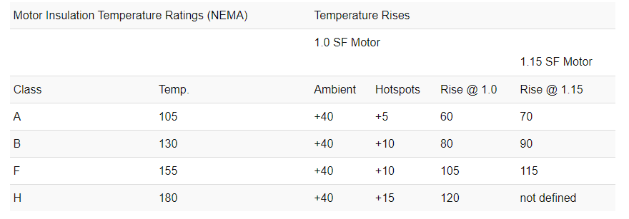
Stator Winding insulation Allowable Temperature Ratings
Meaning RMSE less than 10 degrees Celsius is required
http://www.drivesandautomation.co.uk/useful-information/nema-insulation-classes/

Slide 6
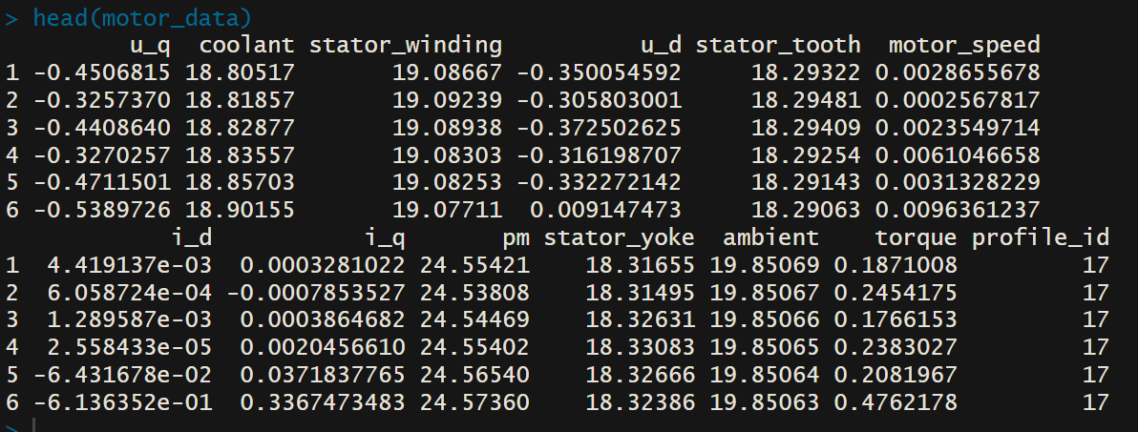
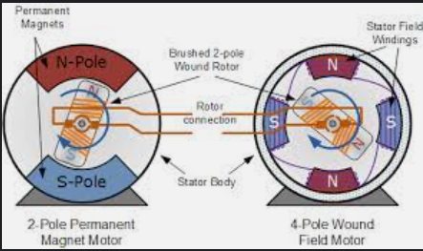
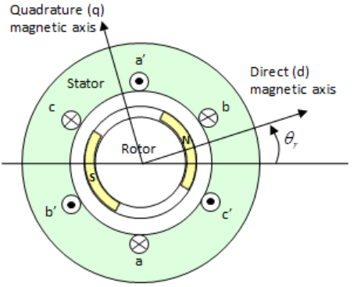
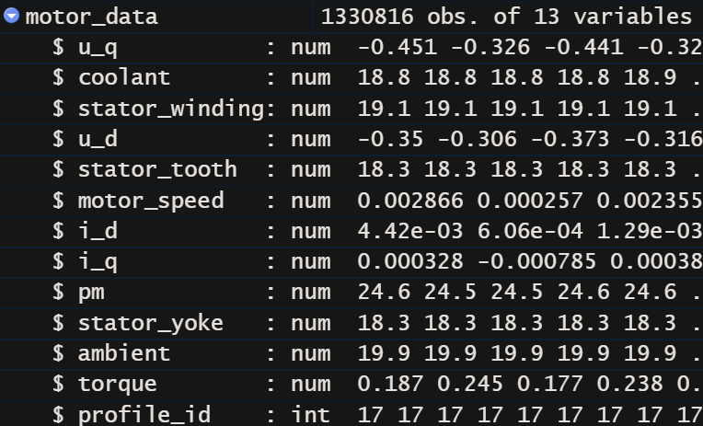
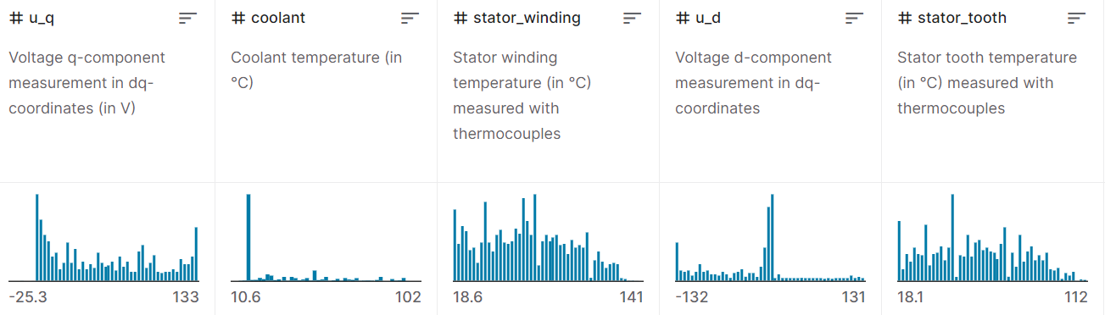
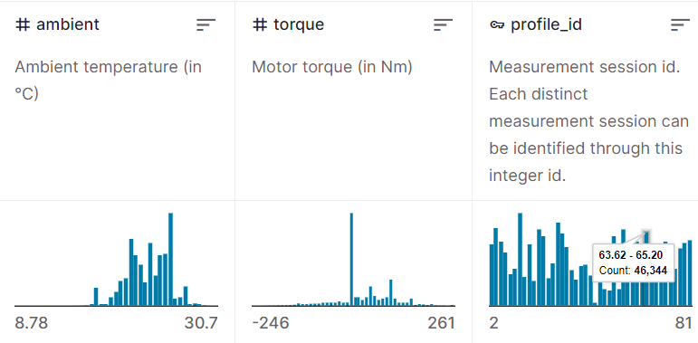
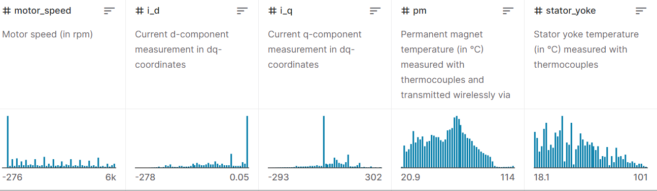
Electric Motor Dataset
(13 Columns, 1330816 Rows)
Response: Stator Winding
Possible Predictors: Stator Tooth, Stator Yoke, ambient, pm, coolant
Measurement of Quality: 10-fold cross validation
Link

Slide 7
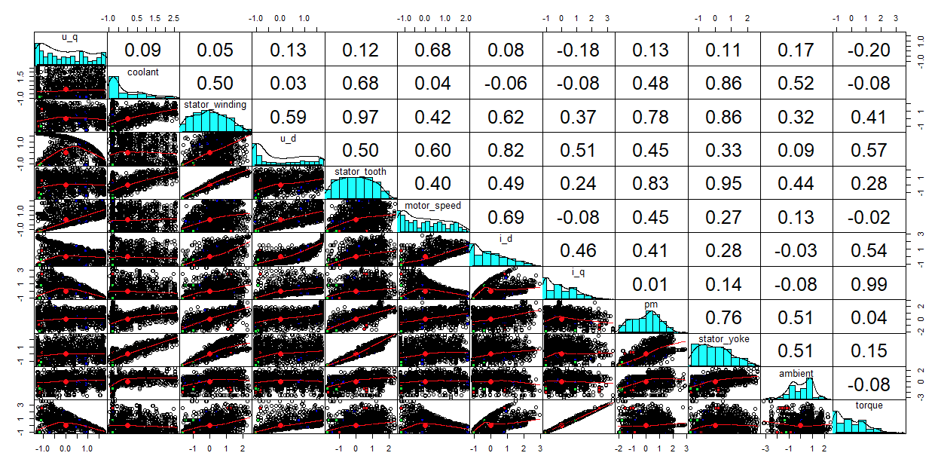
Pairs Panels (Distributions & Correlations)

Slide 8
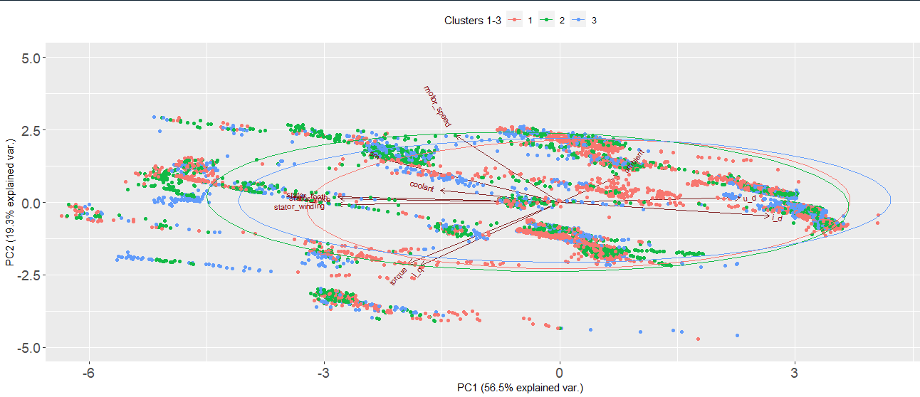
PCA Biplot (3 clusters
On Stator winding/Motor speed, 66544 /5%)

Slide 9
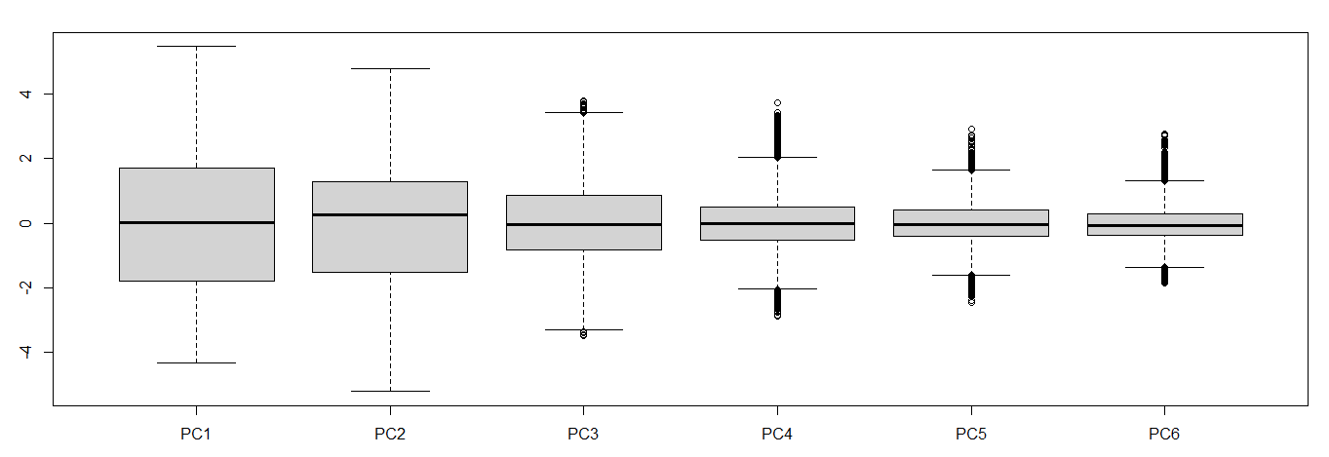

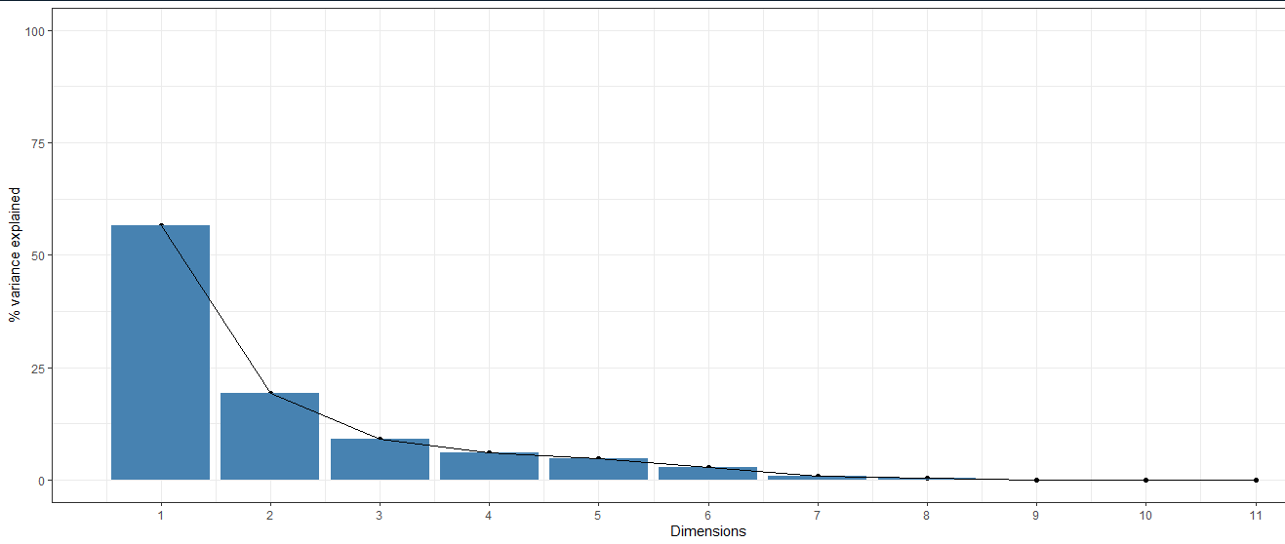
PCA (66544 /5% rows)
Colinear
1
K=3 For Clusters
2
3

Slide 10
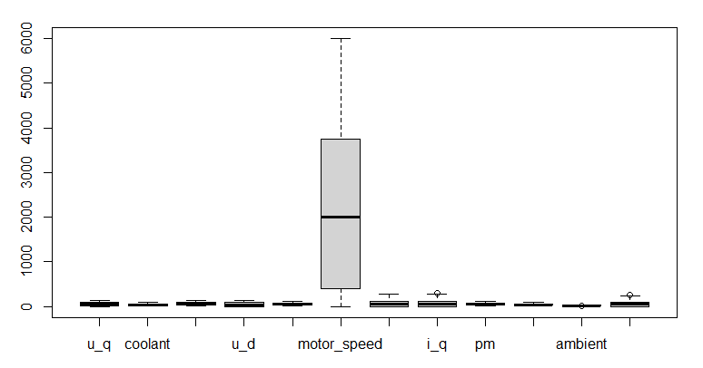
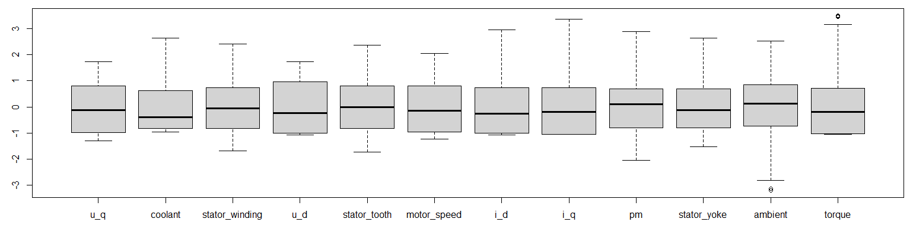
Data Pre-processing (Motor Data)
Subset data
Slice sample- 50% rows 13 columns
Stratified 70/30 split train/test
Change profile ID to a factor
Checks
Number zeros- 0
Number of negatives- 4625 (Take abs and center scale)
Number Na’s- 0
Skew Values -
u_q coolant stator_winding u_d stator_tooth motor_speed 0.30844033 1.08527156 0.16361632 0.44673790 0.15327748 0.35733883 i_d i_q pm stator_yoke ambient torque 0.72652757 0.79527274 0.08007482 0.49989342 -0.33462876 0.78030613
Preprocessing Applied
Center and Scale
After
Before

Slide 11
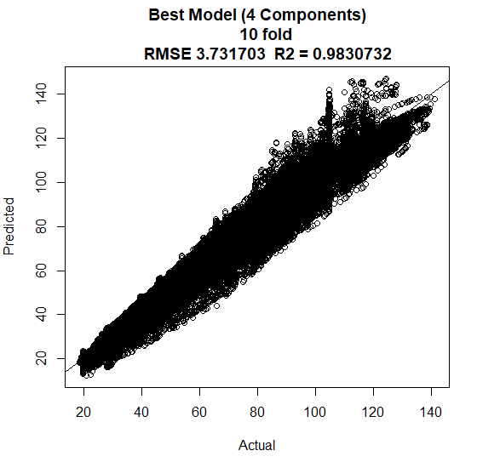

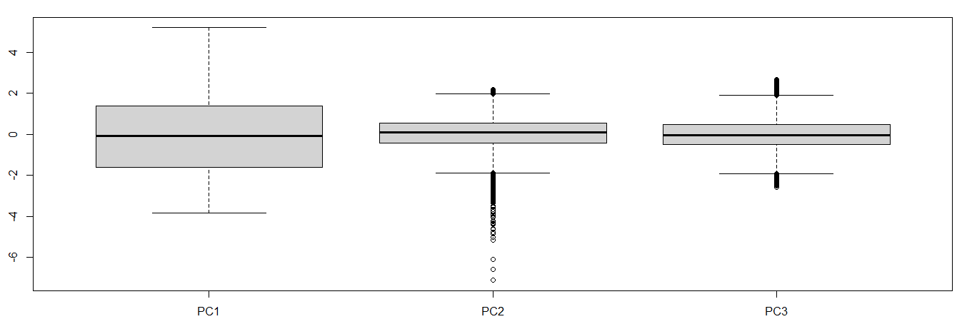
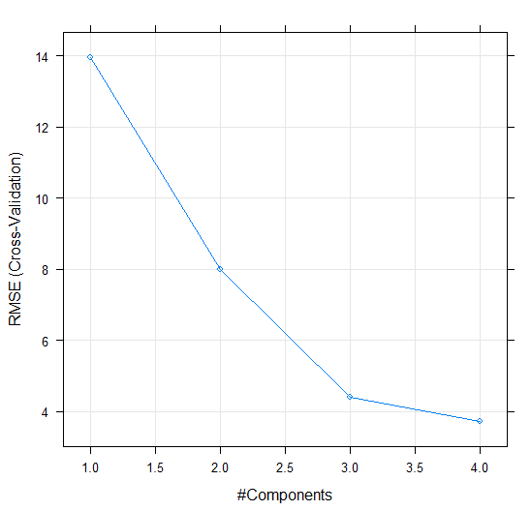
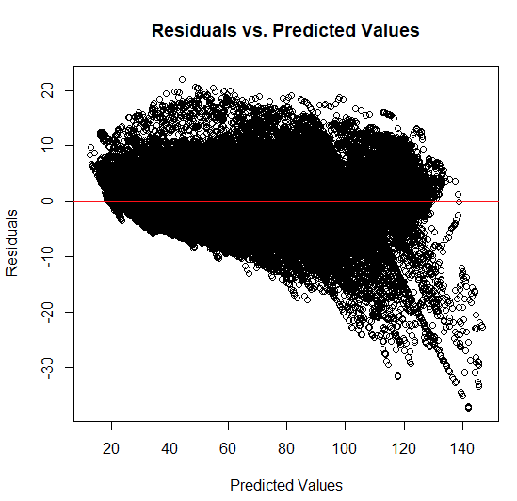
Partial Least Squares (Winding Temp)
Stratified 70/30 train/test on 50% of raw data
Recursive Feature Selection using lm choose 5
Predictors
Components of 5 Variables
PCA selects 3 components from 5 variables
PLS Selects 4 Components
Stator Winding Temp(Response)
Predictors: PC2, PC2, PC3, PC4

Slide 12
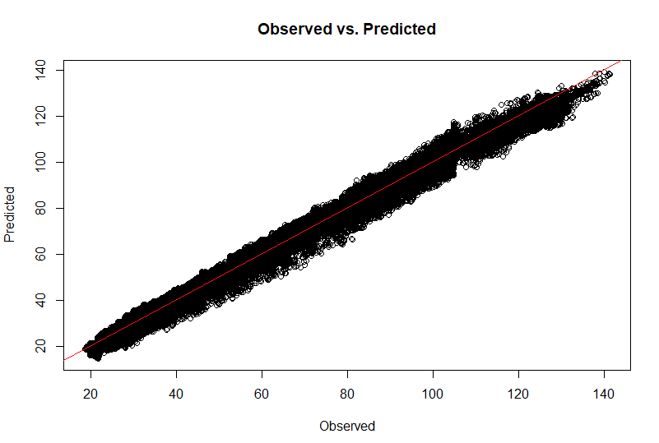
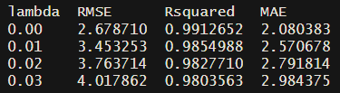

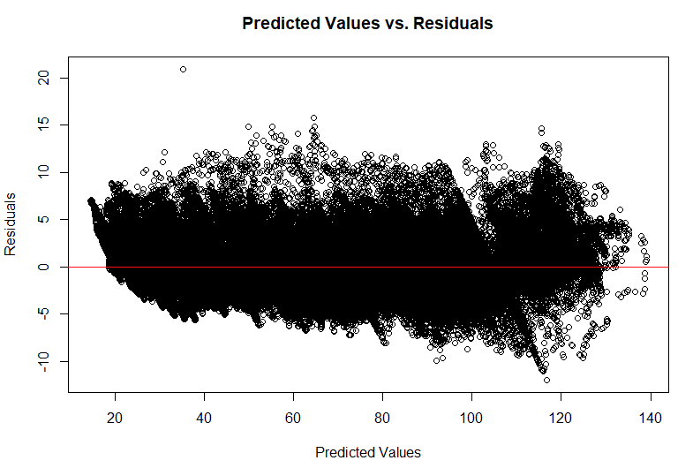
Ridge Regression (Winding Temp)
Stratified 70/30 train/test on 50% of raw data
Recursive Feature Selection using lm choose 5 variables ( Ridge selects lambda 0 or lm as best beta)
Trained on entire dataset (still less than 10 deg RMSE)
Predictors: Stator tooth, stator yoke, coolant, pm, ambient
Stator Winding Temp(Response)

Slide 13
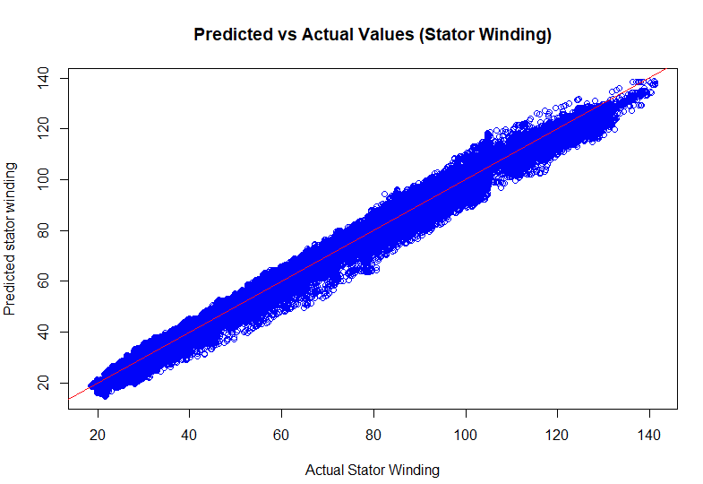


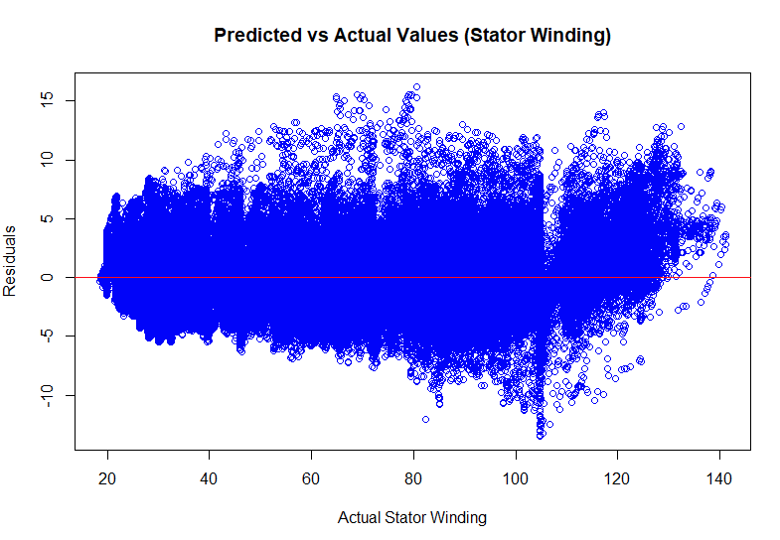
Lasso (Winding Temp)
Stratified 70/30 train/test on 50% of raw data
Recursive Feature Selection using lm choose 5 variables (lasso alpha = 0.6452 as the best)
After raw data training
Pretty stable
Predictors: Stator tooth, stator yoke, coolant, pm, ambient
Stator Winding Temp(Response)

Slide 14
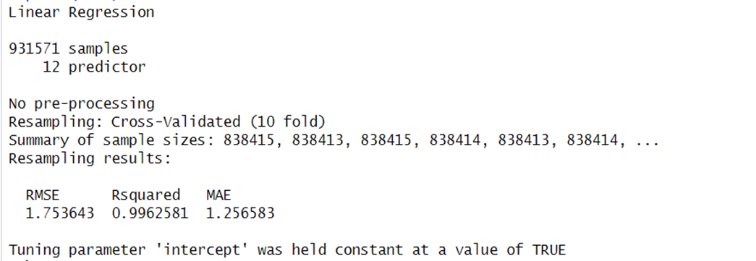
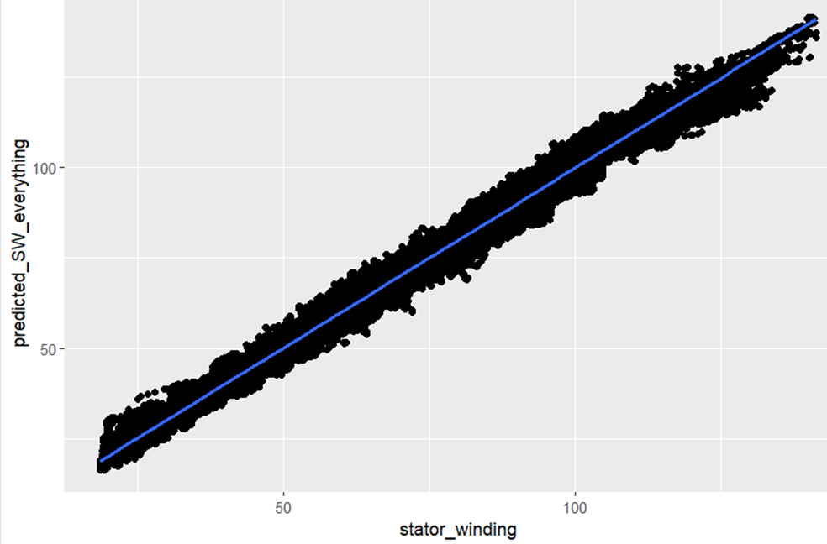
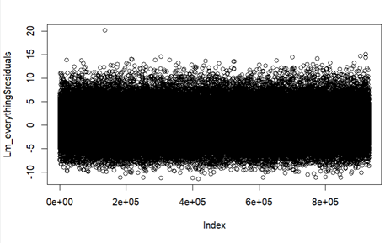
Ordinary Linear Regression
RSME on test data: 1.753
R-Squared: .996
Predictors: Stator tooth, stator yoke, coolant, pm, ambient
Stator Winding Temp(Response)

Slide 15
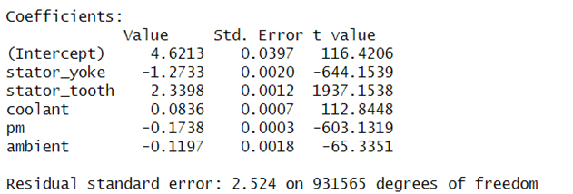
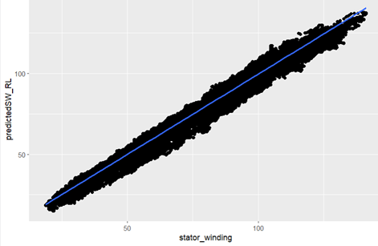
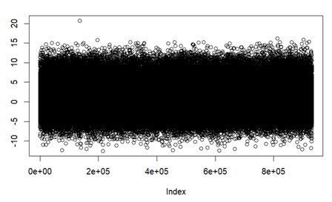
Robust Linear Regression
Robust Linear Regression with 10 Cross fold validation
RSME on test data: 2.69
R-Squared: .991
Predictors: Stator tooth, stator yoke, coolant, pm, ambient
Stator Winding Temp(Response)

Slide 16
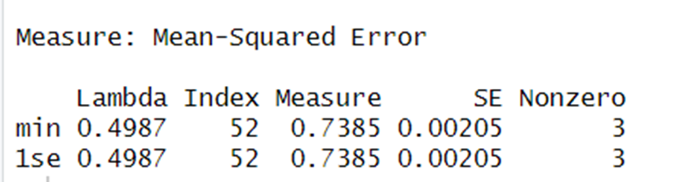
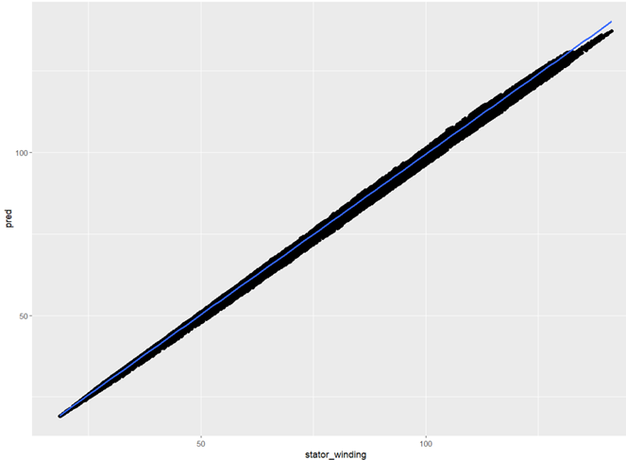
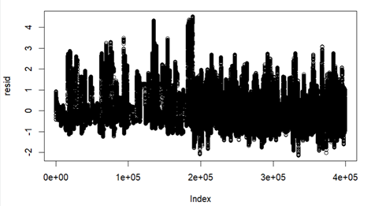
Elastic net
RSME on test data: .859
R-Squared: .999
Predictors: Stator tooth, stator yoke, coolant, pm, ambient
Stator Winding Temp(Response)

Slide 17
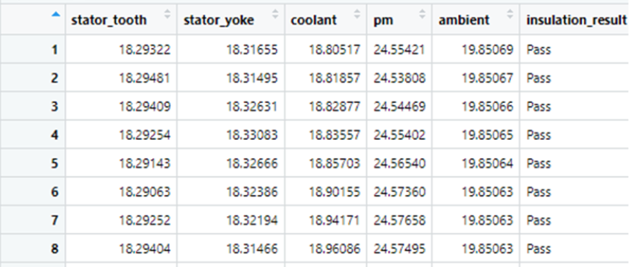
Logistics Regression (Class B Insulation)
Predictors: Stator tooth, stator yoke, ambient, coolant, pm
Response: "Insulation Result" Class B insulation (Pass or Fail, meaning it overheats or doesn't) we are interested in predicting the failures.

Slide 18
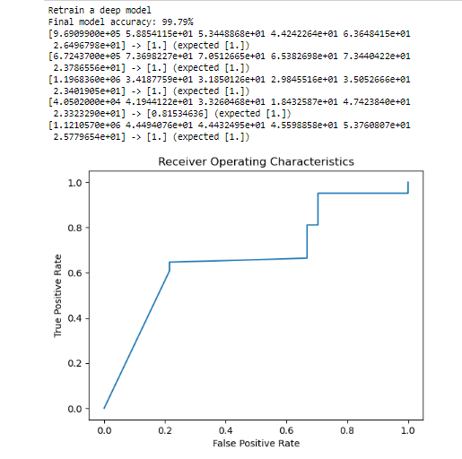
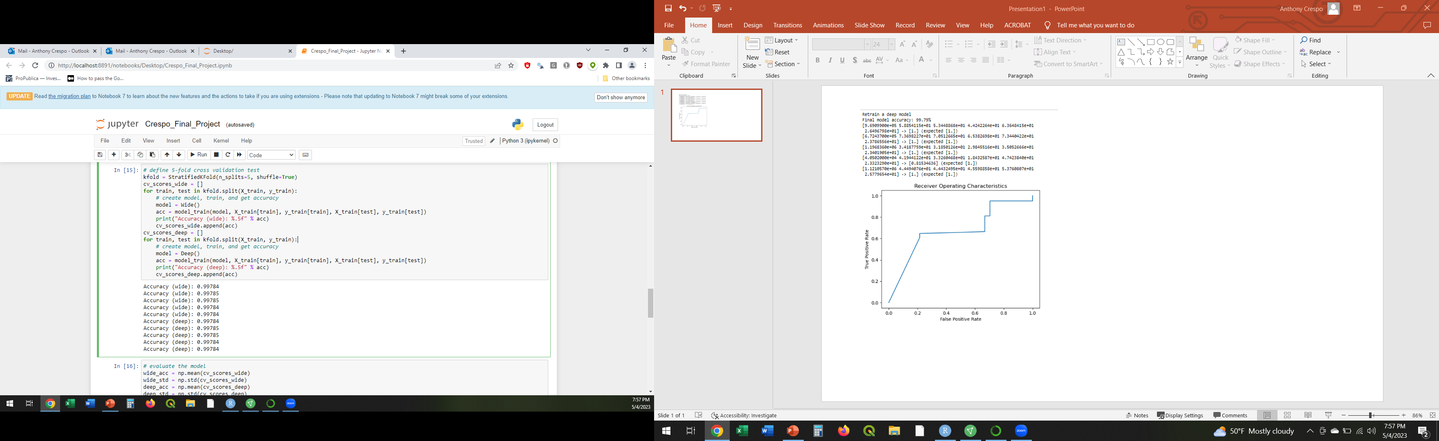
Neural Network (Class B Insulation)

Slide 19
Sources
Images
https://one.ai/
https://ev-database.org/car/1240/Mercedes-EQV-300-Long
https://www.tesla.com/roadster
https://ev-database.org/car/1191/SEAT-Mii-Electric
https://electrek.co/2021/12/16/lightyear-announces-34000-solar-electric-car/
https://www.seat.com/mobility/electric-vehicle-range.html
https://www.ultimatespecs.com/car-specs/Mercedes-Benz/120227/Mercedes-Benz-EQV-300-Long.html#:~:text=The%20Mercedes%20Benz%20EQV%20300,Permanent%20magnet%20AC%20synchronous%20motor.
https://emgr.de/en/products/permanentmagnet-excited-synchronous-motors/ (EQV 300 motor Manufacturer)
Dataset sources
EV dataset- https://www.kaggle.com/datasets/geoffnel/evs-one-electric-vehicle-dataset
OR https://ev-database.org/
Motor Temp Dataset - https://www.kaggle.com/datasets/wkirgsn/electric-motor-temperature
Variance Inflation Factor: (Feature selection)
https://www.statisticshowto.com/variance-inflation-factor/
https://en.wikipedia.org/wiki/Variance_inflation_factor
https://www.rdocumentation.org/packages/car/versions/3.0-12/topics/vif
https://cran.r-project.org/web/packages/car/car.pdf

Slide 20
Sources Continued
Recursive Feature Selection: (Caret Package)
https://topepo.github.io/caret/recursive-feature-elimination.html
Other Prediction attempts for stator winding (EML Neural Network and Deep learning)
https://ieeexplore.ieee.org/document/9955806 (PCA + ELM)
https://www.mdpi.com/1996-1073/13/18/4782 (deep neural network)
Domain Knowledge:
https://www.mdpi.com/1424-8220/21/14/4655 [1] (Machine Learning for Sensor less Temperature Estimation)
https://www.toshiba.com/tic/datafiles/app_notes/Temperature_Rise_1605749858.pdf [2] (NEMA TEMP RATINGS)
https://insideevs.com/reviews/445486/mercedes-benz-eqv-first-drive/ (EQV 300 long review and motor manufacturer)
https://www.diva-portal.org/smash/get/diva2:14278/FULLTEXT01.pdf (Thorough overview of Electric motor types)

Slide 21
QUESTIONS

