Slide 1
Mini Project-I
Automatic Vehicle Entry System
By:
Akshat Srivastava
Sachin Tandon

Slide 2
Introduction
Our project is based on computer vision using python.
We have tried to make an application to track the movement of vehicles around the campus.
We have used QR code for this purpose.

Slide 3
Computer Vision
It gives sense of vision to computer.
It enables a computer to acquire information from the digital images.
Computer can process the data from the image and simultaneously respond to it.
Notes:
It all began from summer 1966 at mit as a summer project

Slide 4
4 Re’s of Computer Vision
Recognition
Reconstruction
Registration
Reorganization
Notes:
Recognition-of objects barcode Qr code
Reconstruction-3d mapping of data in depth sensing
Registration-tracking of car
Reorganisation-self learning unsupervised data organise it to make sense

Slide 5
openCV
It stands for open source computer vision library.
Developed by intel.
Real life application QR code scanner, barcode scanner, image processing.
Its various field of application involves human-machine interaction ,object identification etc.

Slide 6
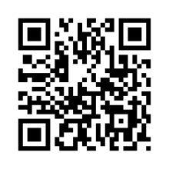
QR CODE
It stands for Quick Responsive Code.
It is a machine-readable optical label that contains information about the item to which it is attached.

Slide 7
Functioning of QR code
QR code consists of black squares arranged in a square grid on a white background.
Which can be read by an imaging device such as a camera, and processed .
The required data is then extracted from patterns that are present in both horizontal and vertical components of the image.

Slide 8
Project Diagrams

Slide 9
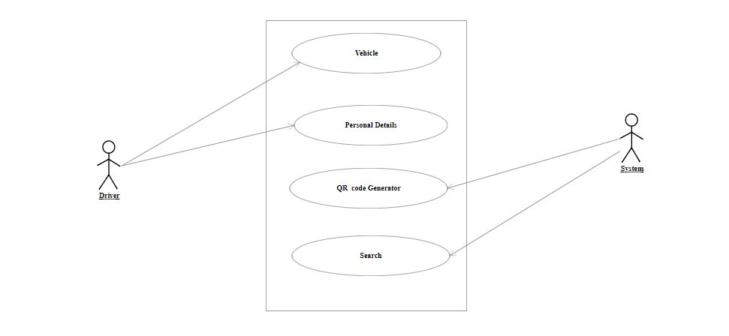
Class Diagram

Slide 10
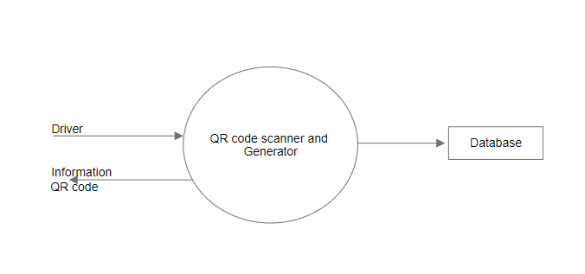
Data Flow Diagram
Level-0:

Slide 11
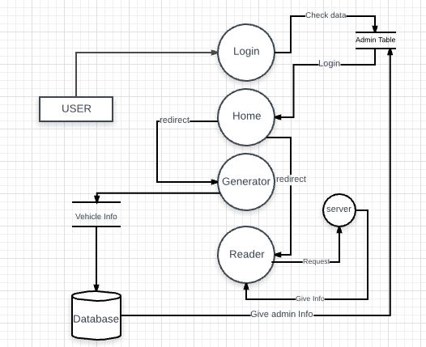
DFD-Level 1

Slide 12
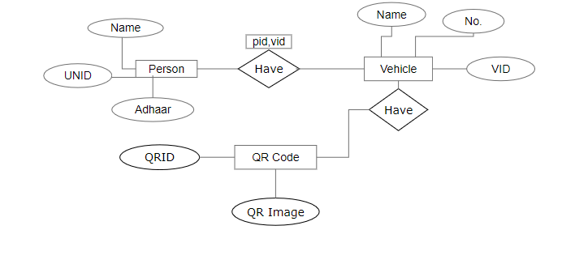
ER Diagram

Slide 13
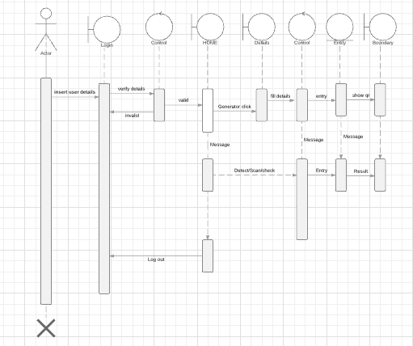
Sequence Diagram

Slide 14
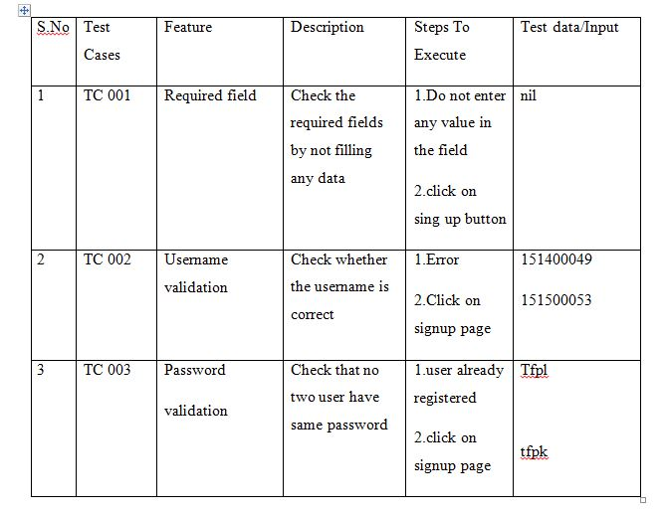
Test Cases

Slide 15
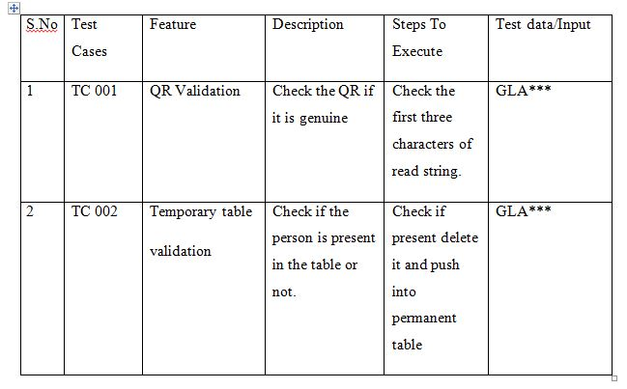

Slide 16
Thank You!!

