Slide 1
Beta hedging for random selected portfolio
Haosu
3/7

Slide 2
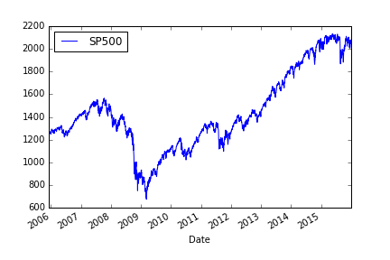
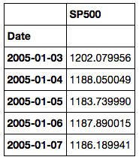
Portfolio construction
Market: get market data from Quandl by calling ^GSPC (S&P 500 index).

Slide 3
Portfolio construction
Portfolio: First read in data from stock list universe csv file; Sample from the stock universe with criteria: 1. From NYSE and NASDAQ 2. n=14 3. Market cap larger than 2000 million 4. Randomly selected 5. Date range must start from early 2006

Slide 4
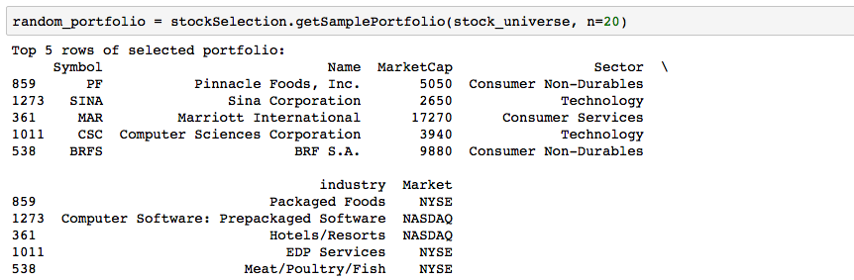
Portfolio construction

Slide 5
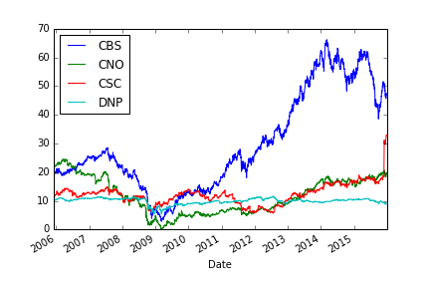
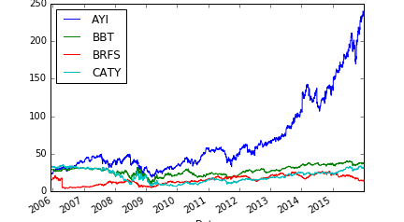
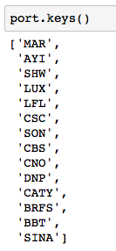
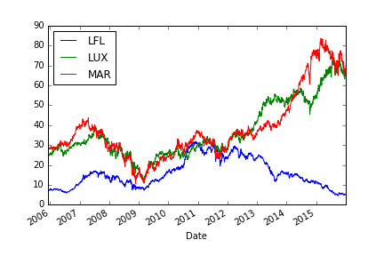
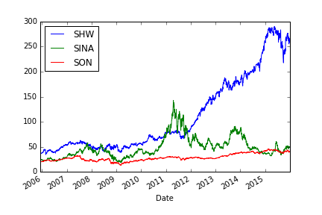
Portfolio construction

Slide 6
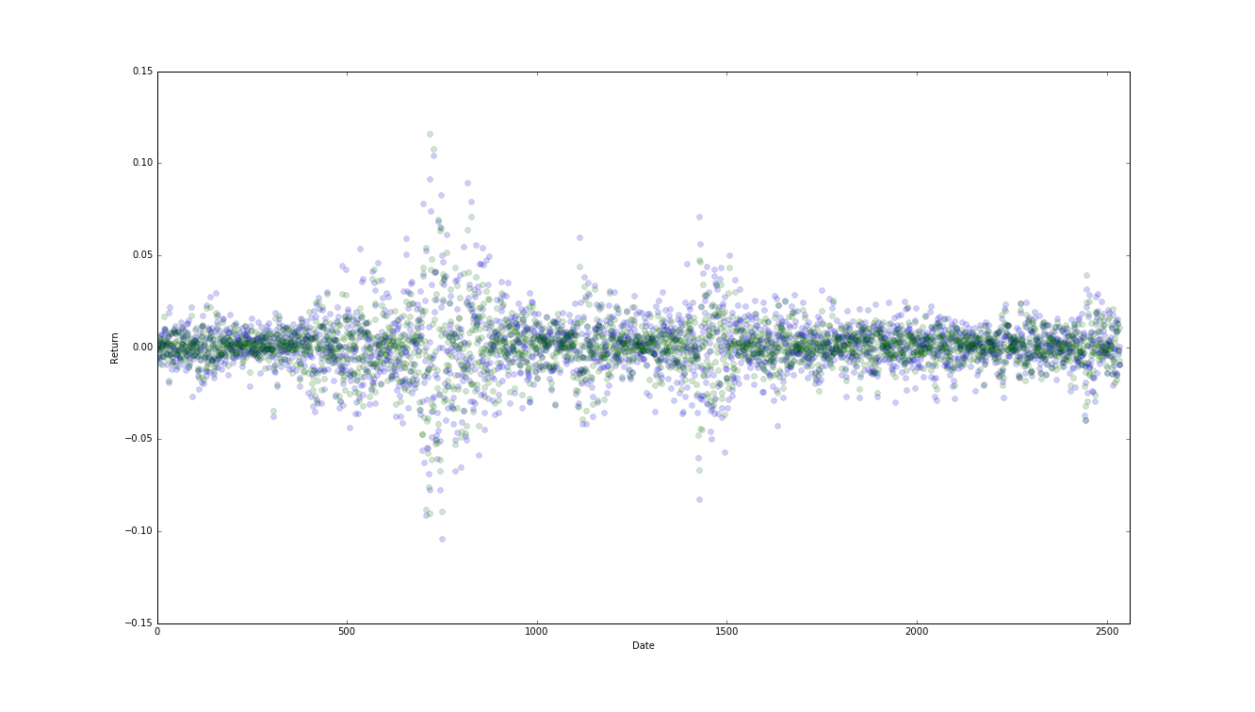
Portfolio returns
Concatenate all stock historical price data and market, and inner merge by date. The return profile (Portfolio in Blue and Market in Green):

Slide 7
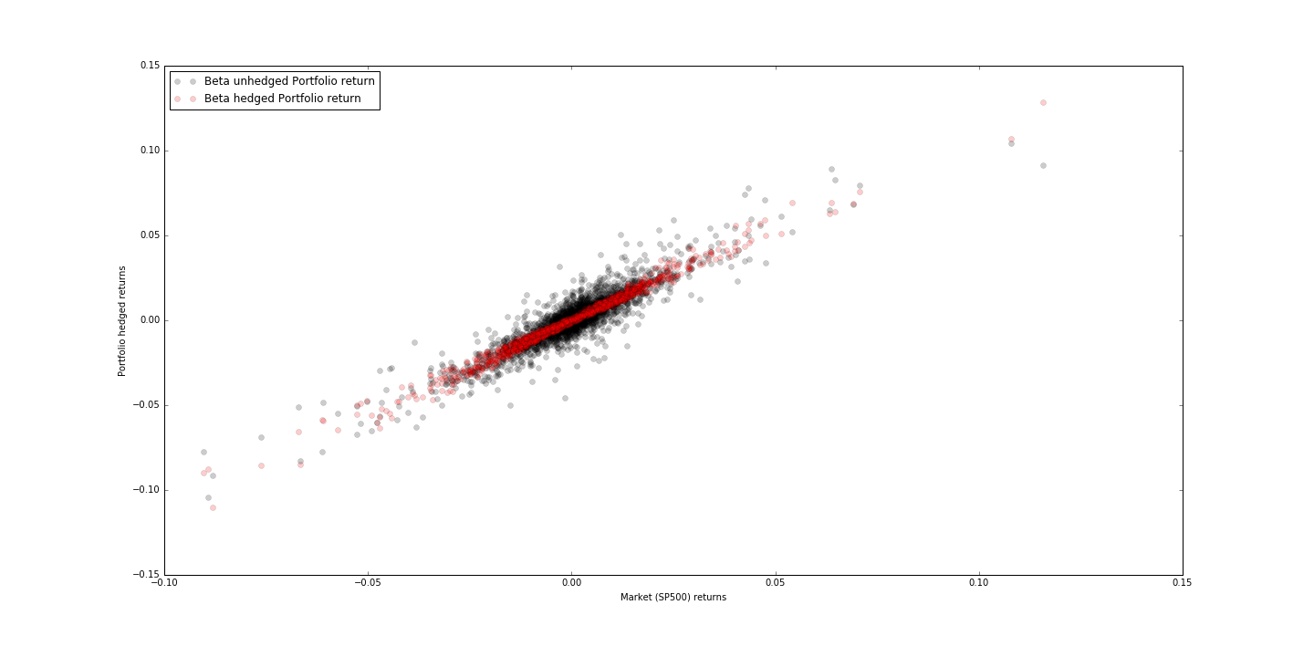
Beta hedging
Using past 60 days’ return data and linear model to calculate the alpha and beta of portfolio returns:
Portfolio
Return
Market Return

Slide 8
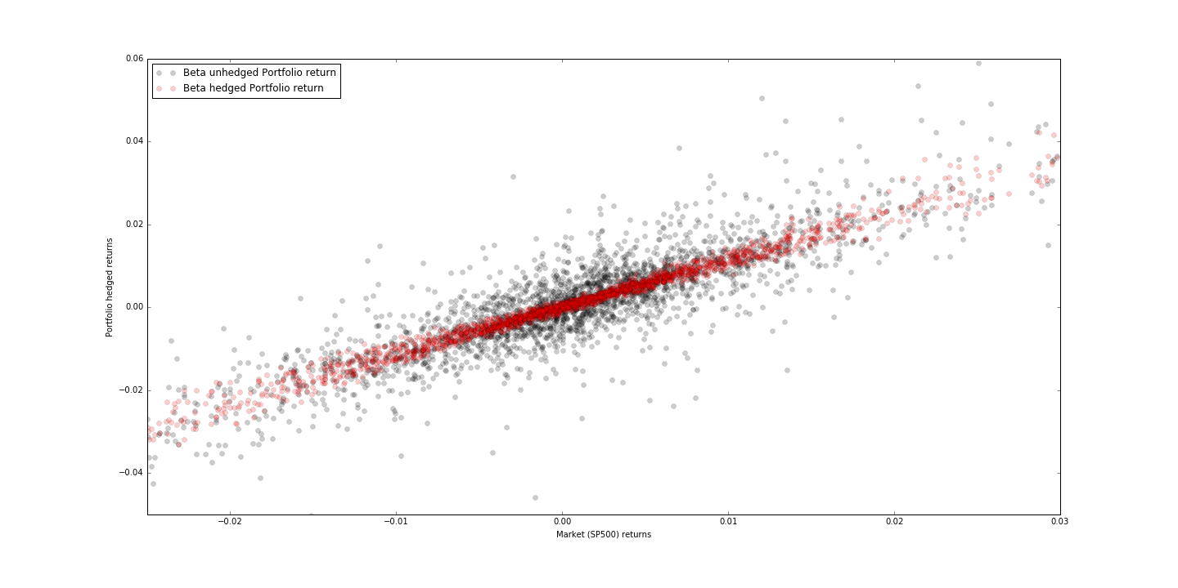
Beta hedging
A zoom-in of the center data:
Portfolio
Return
Market Return

Slide 9
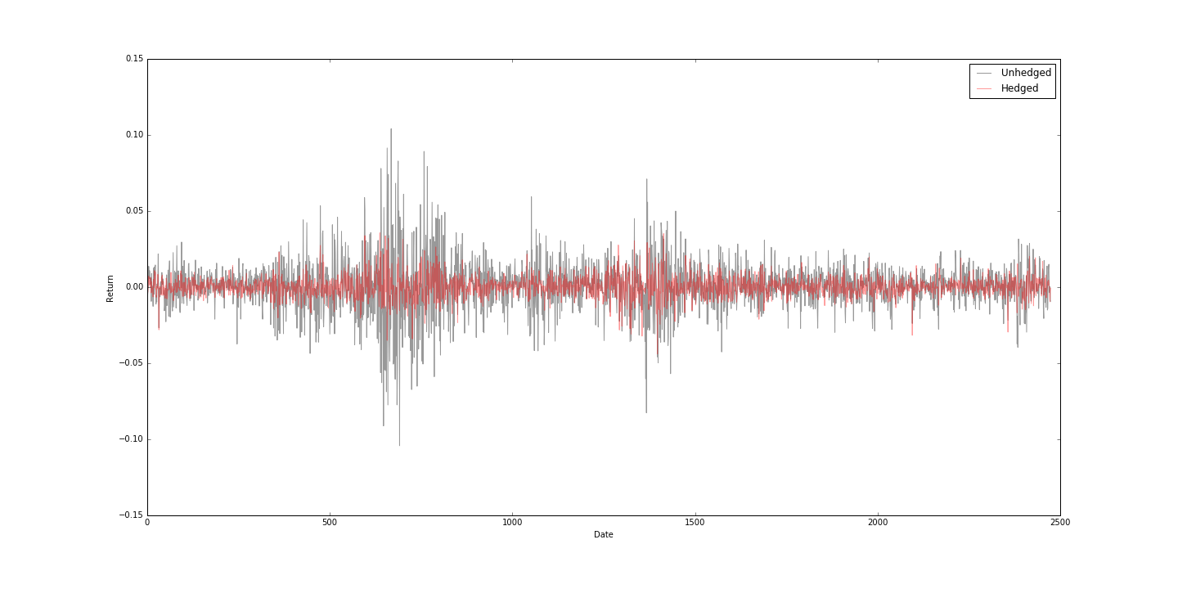
Beta hedged returns
Calculate the beta hedged portfolio returns:
Return
Date

Slide 10
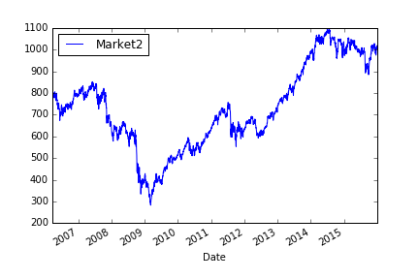
Random Market

Slide 11
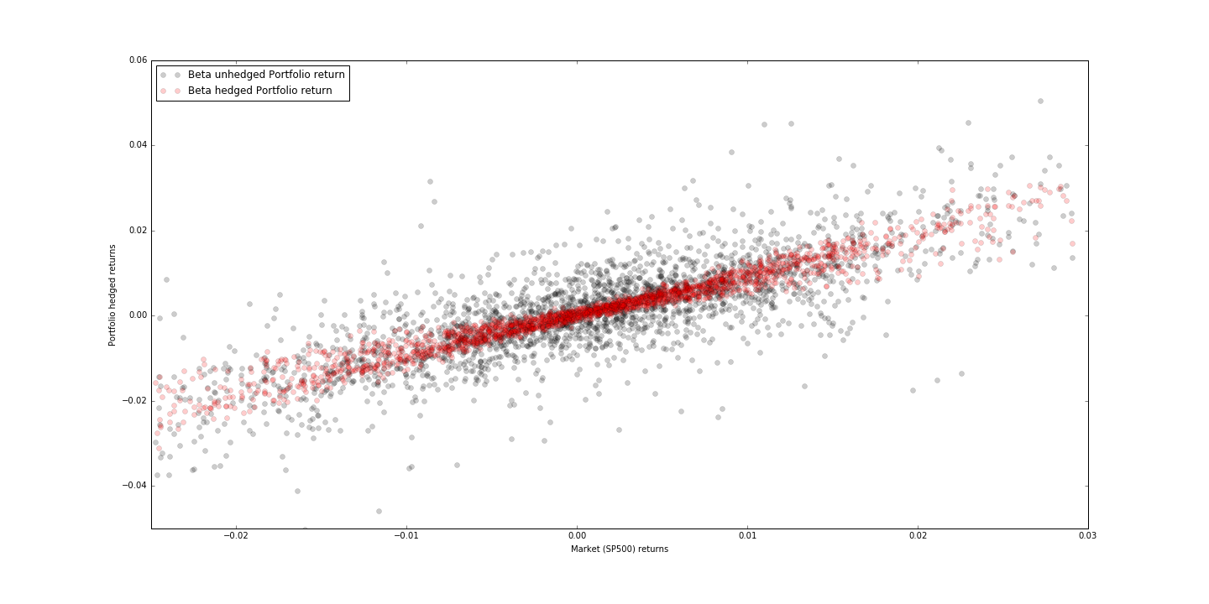
Random Market
Portfolio
Return
Market Return

Slide 12
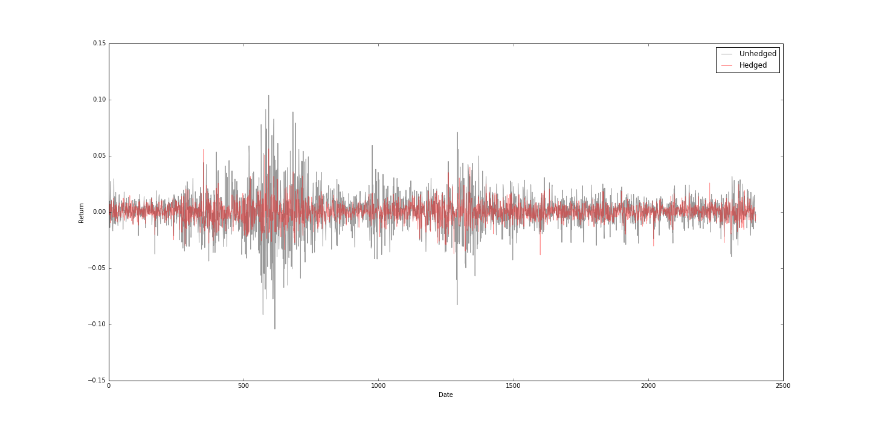
Random Market
Return
Date

Slide 13
Mean, SD
Unhedged return: Mean: 0.00059 Absolute mean: 0.0112 SD: 0.0164
Hedged return: Mean: 0.00032 Absolute mean: 0.00575 SD: 0.0080

