Slide 1

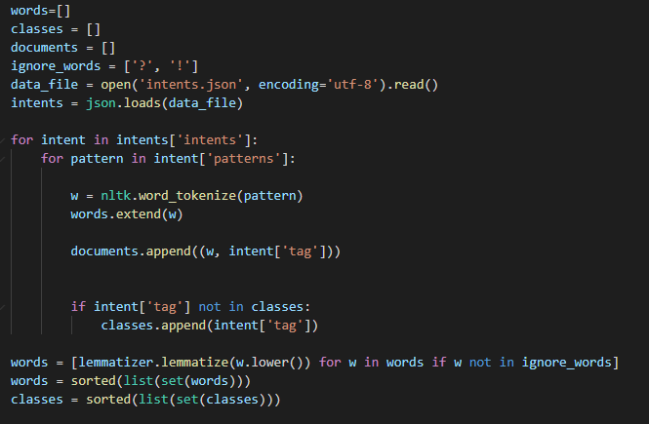
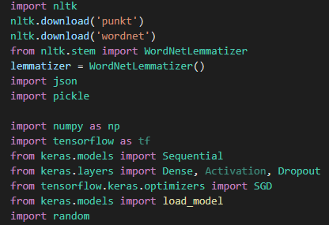
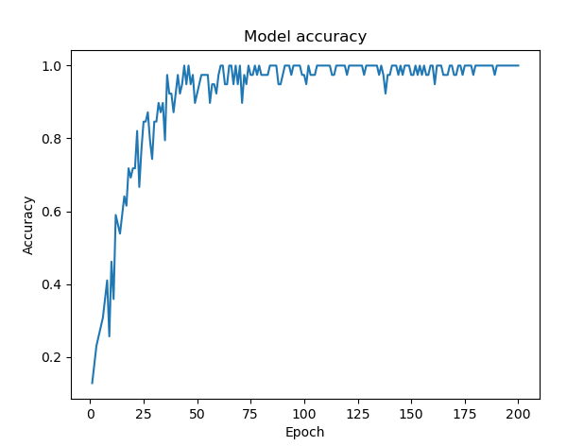
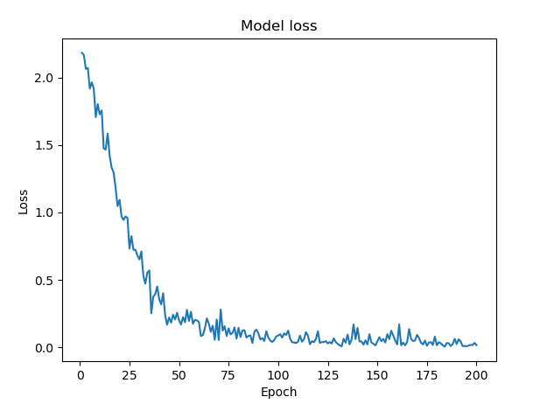
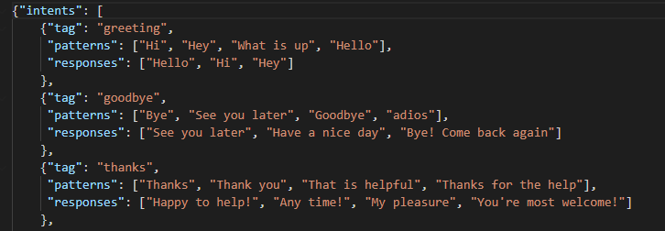
Domain Specific Chatbot
Vighnesh K. Ramesh - 2018A7PS0074U
BITS Pilani, Dubai Campus
Abstract
The objective of this project is to create a chatbot that can respond to queries related to a certain domain. The purpose of the domain specific chatbot is to help in gathering information about a given subject by asking questions to the bot and receiving information in response. This can be implemented using python along with certain deep learning and natural language processing libraries such as Tensorflow, Keras and NLTK (Natural Language Toolkit).
Natural Language Processing
Tokenization: Tokenization is a step where we take sentences and split the words in them as smaller units known as tokens. Stemming: Stemming is the step that is performed after tokenization. Breaking down individual tokens to their simplest form is known as stemming.
Bag of Words: The bag of words is the step where the stemmed words are converted into a machine-readable form. Each word is converted to a unique combination of 0 and 1.
Libraries
Tensorflow and Keras – These libraries are used for implementing neural networks and executing deep learning models.
NLTK – Natural Language Toolkit also known as NLTK is a library that is used to perform operations on words and alphabetic data. Tokenizing and Stemming are some of the useful operations that we perform on the data and for this we use the NLTK library.
JSON – We use this library to import the intents file into the program which is of type JSON.
Numpy & Pandas – These are libraries that are almost always used in any projects that involve data. They are used to reorder, reshape, and rearrange data and perform other modifications to the dataset.
Training
Model: To train the model we need to import the Tensorflow and Keras libraries. We use a function known as dense to declare a layer of neurons. I have declared two hidden layers with 50 neurons each that perform the computations and a final layer with one neuron that gives the output.
Activation Function: The activation function is a parameter that is initialized while declaring the dense function. Each layer has an activation function. The activation function decides the types of predictions the model makes, and it is the most important parameter while declaring the model.
Compiling and Fitting: The next step is to compile and fit the model to the processed dataset. While compiling the model, we need to declare a function called compile and set the optimizer, loss function and metrics.
Intents
This is a JSON file that consists of classes, patterns and responses.
JSON: JSON stands for Java Script Object Notation. JSON files are used to store and transmit human-readable text data.
classes: classes are used to categorize the queries and responses in the chatbot. They act as subtopics inside the chatbot. For example, user inputs such as “Hello”, “Hi”, “Good Morning”, etc. will belong to the greeting class.
Patterns: Patterns are the types of queries that the chatbot can expect from the users. Certain keywords and terms will generally be a be part of queries related to a certain topic. The patterns section will help the bot pick up these terms and generate an appropriate response based on its response section for the same class.
Responses: Responses are the replies that the chatbot will give depending on the questions from the user. There can be one or more similar responses for the same query as there are multiple responses under each class.
Result
After training the model, we declare functions to tokenize, stem and create a bag of words model for the user text input (like how we processed the initial document). The user input, after being processed is then classified under a class and based on that a response is given. The bot is then hosted on a webpage using flask python library and html code.

