Slide 1

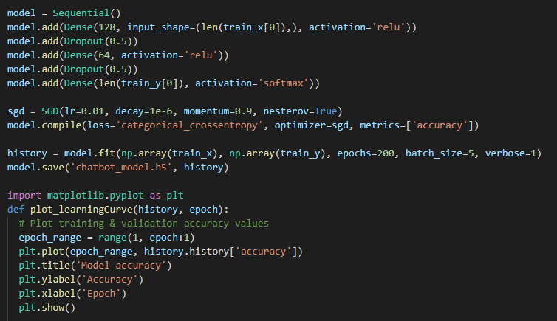
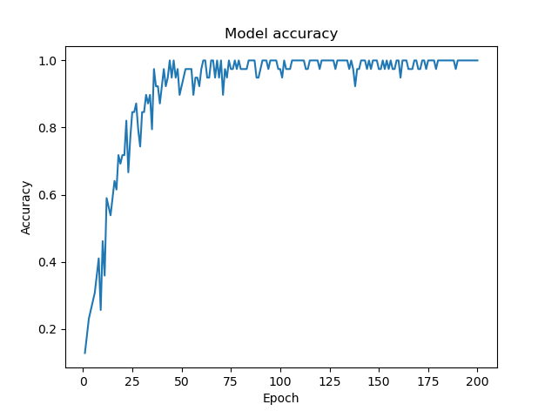
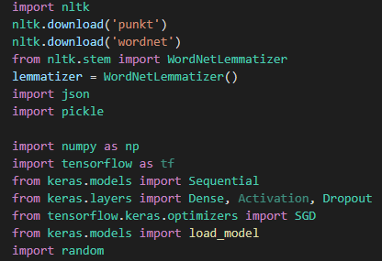
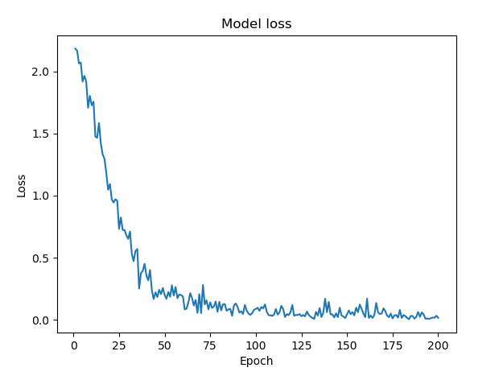
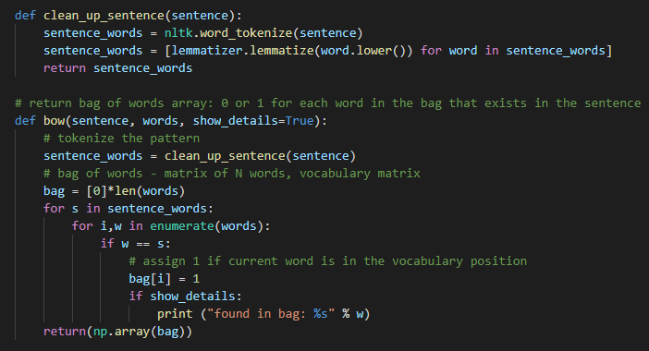
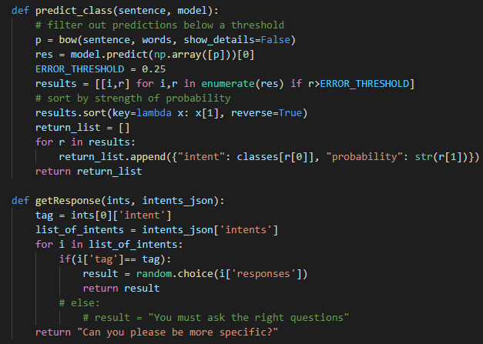
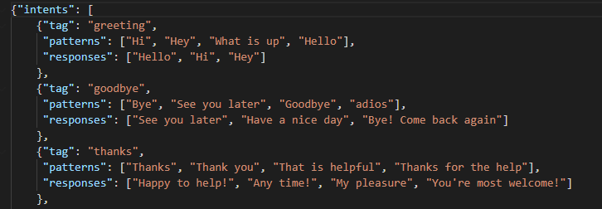
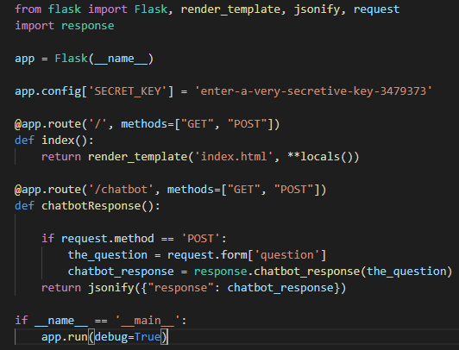
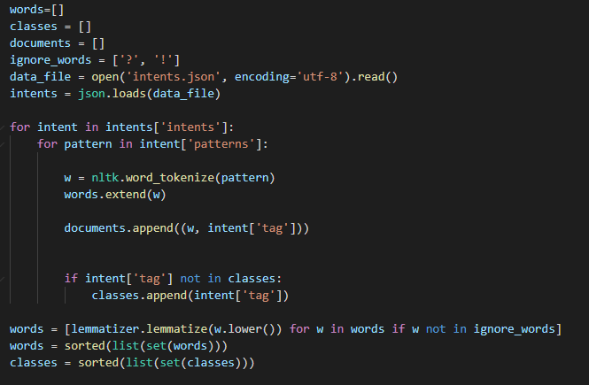
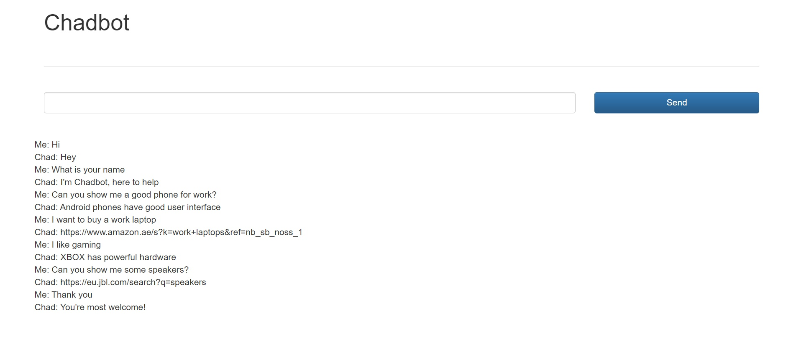
Domain Specific Chatbot
Vighnesh K. Ramesh - 2018A7PS0074U
BITS Pilani, Dubai Campus
Abstract
The objective of this project is to create a chatbot that can respond to queries related to a certain domain. The purpose of this chatbot is to provide information related to electronic gadgets. This can be implemented using python along with certain deep learning and natural language processing libraries such as Tensorflow, Keras and NLTK (Natural Language Toolkit).
Training
Model: Three layers are created using the Dense function (input layer, hidden layer and output layer).
Activation Function: The activation function is declared while initializing the layer. It decides how the inputs are trained. The input layer and hidden layer use ‘relu’ (rectified linear unit) and the output layer uses ‘sigmoid’
Compiling: The compilation decides the evaluation criteria for the model. Loss function, optimizer and metrics are chosen.
Fitting: The deep learning model is fitted to the training data with parameters such as epochs and batch size.
Libraries
Tenorflow & Keras: For training the model
Numpy: To reshape and rearrange the data
Matplotlib: To visualize the training results graphically
Nltk: To perform operations on words and alphabetic data before training
JSON: To import JSON files
Pickle: To save and load the training model and data
Random: For shuffling the data prior to training
Processing the user input
Intents
This is a JSON file that consists of classes, patterns and responses.
Classes: Classes are used to categorize the queries and responses in the chatbot. For example, user inputs such as “Hello”, “Hi”, “Good Morning”, etc. will belong to the greeting class.
Patterns: Patterns contain keywords and terms that will generally be a be part of queries related to a certain topic. The patterns section will help the bot pick up these terms.
Responses: Responses are the replies that the chatbot will give depending on the questions from the user.
After training the model, we create functions to tokenize, stem and make a bag of words model for the user’s input (similar to the initial document). After processing the user input, a function is created to predict the class from which a response will be selected for the user’s query. To get the response after predicting the class another function is created.
Web Deployment
Natural Language Processing
Once the chatbot is fully functional, it can be hosted to a webpage using Flask (python library for web deployment) and a html script for the webpage design.
Tokenization: Splitting sentences into a set of tokens.
Documentation: Creating groups of patterns and tags under a single list.
Stemming: Converting each token into its simplest form.
Bag of Words: A model in which each word is converted into a unique combination of 0s and 1.

