Slide 1

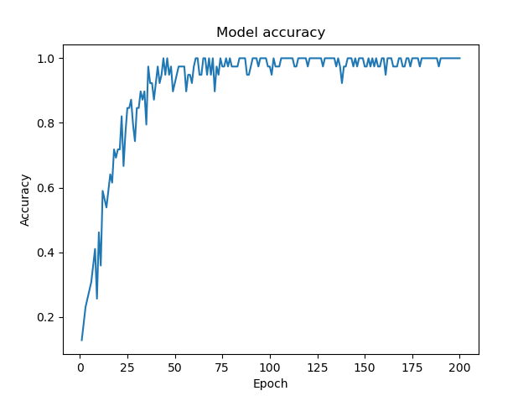
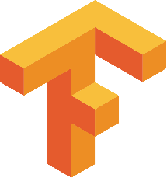
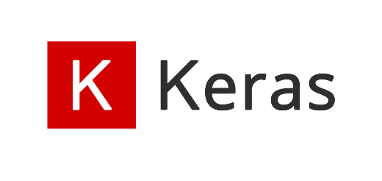
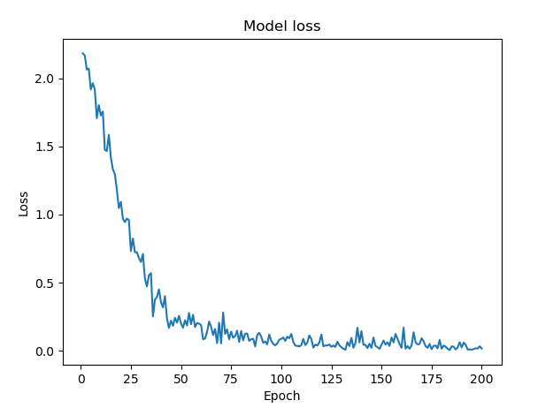
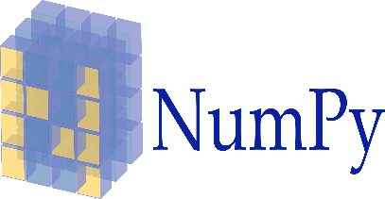
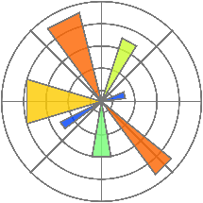
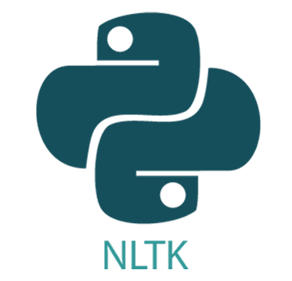

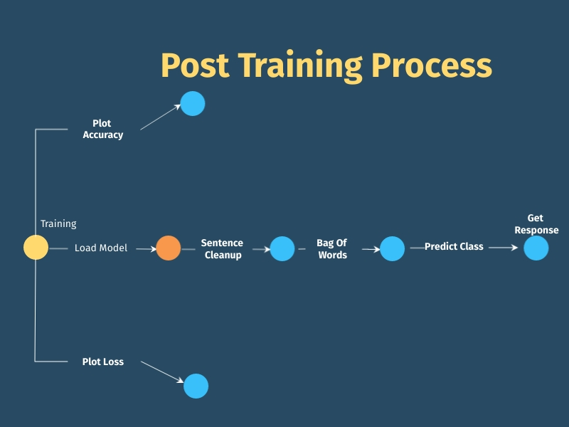
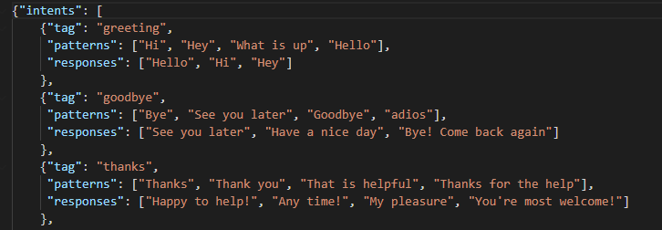
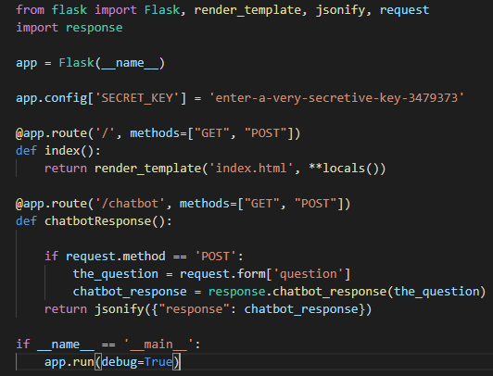
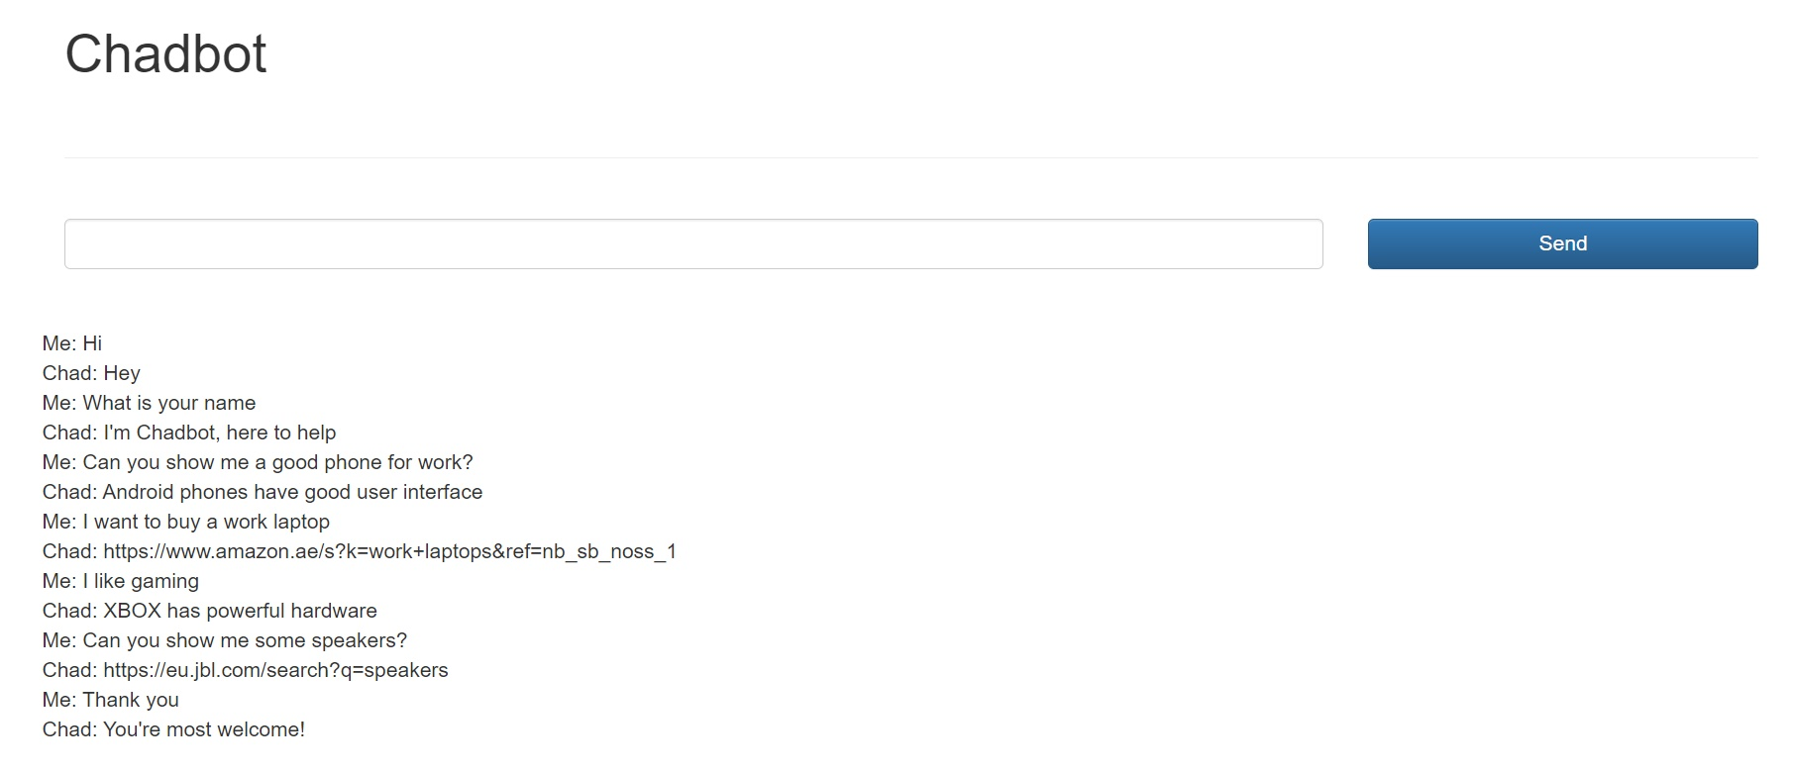
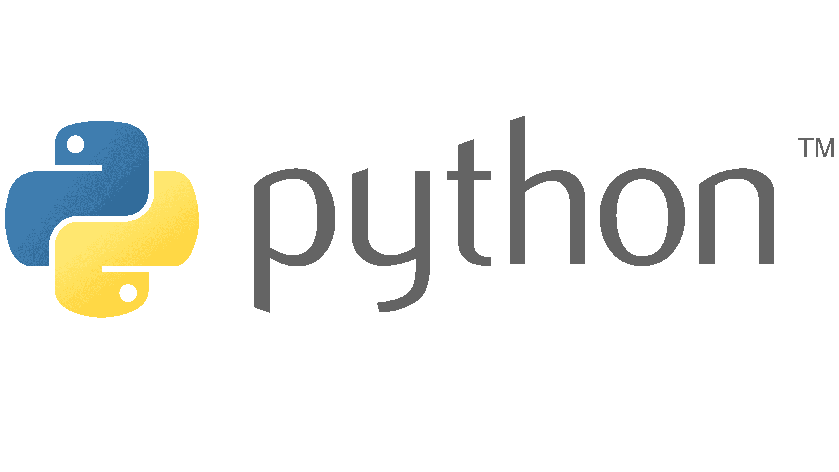
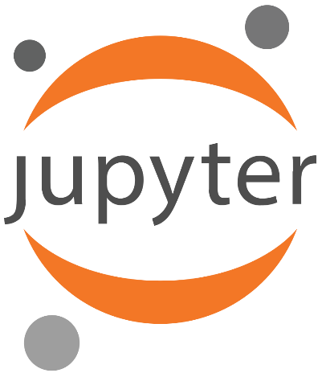


Domain Specific Chatbot
Vighnesh K. Ramesh - 2018A7PS0074U
BITS Pilani, Dubai Campus
Abstract
The objective of this project is to create a chatbot that can respond to queries related to a certain domain. The purpose of this chatbot is to provide information related to electronic gadgets. This can be implemented using python along with certain deep learning and natural language processing libraries such as Tensorflow, Keras and NLTK (Natural Language Toolkit).
Training
Model: Three layers are created using the Dense function (input layer, hidden layer and output layer).
Activation Function: The activation function is declared while initializing the layer which decides how the inputs are trained.
Compiling: The compilation decides the evaluation criteria for the model.
Fitting: The deep learning model is fitted to the training data with parameters such as epochs and batch size.
Tools
Tenorflow & Keras: For training the model.
Numpy: To reshape and rearrange the data.
Matplotlib: To visualize the training results graphically
Nltk: To perform operations on words and alphabetic data before training.
JSON: To import JSON files
Pickle: To save and load the training model and data.
Random: For shuffling the data prior to training.
Processing the user input
After training the model, we create functions to tokenize, stem and make a bag of words model for the user’s input (similar to the initial document). After processing the user input, a function is created to predict the class from which a response will be selected for the user’s query. To get the response after predicting the class another function is created.
Intents
This is a JSON file that consists of classes, patterns and responses.
Classes: Classes are used to categorize the queries and responses for the chatbot.
Patterns: Patterns contain keywords and terms that will generally be a be part of queries related to a certain topic. The patterns section will help the bot pick up these terms.
Responses: Responses are the replies that the chatbot will give depending on the questions from the user.
Web Deployment
Once the chatbot is fully functional, it can be hosted to a webpage using Flask (python library for web deployment) and a html script for the webpage design.
Natural Language Processing
Tokenization: Splitting sentences into a set of tokens.
Documentation: Creating groups of patterns and tags under a single list.
Stemming: Converting each token into its simplest form.
Bag of Words: A model in which each word is converted into a unique combination of 0s and 1.
References
https://www.nltk.org/
https://keras.io/api/models/sequential/
https://flask.palletsprojects.com/en/2.0.x/
https://docs.python.org/3.8/

