Slide 1
Joining and pivoting tables
Raphael Eisenhofer
2022_06_02

Slide 2
Outline for today:
1. Introduction to tidy data
2. How to pivot tables longer or wider
3. Joining tables

Slide 3
1. Introduction to tidy data

Slide 4

Tidy data
Hadley Wickham: see original paper here: https://vita.had.co.nz/papers/tidy-data.pdf
Tidy data is a consistent way of representing data
Benefits include:
Easier to interpret
Easier to learn tools that manipulate it (e.g. dplyr)
Faster (takes advantage of R’s vectorized nature)
The three rules of tidy data:
1: Each variable forms a column
2: Each observation forms a row
3: Each value must have its own cell

Slide 5
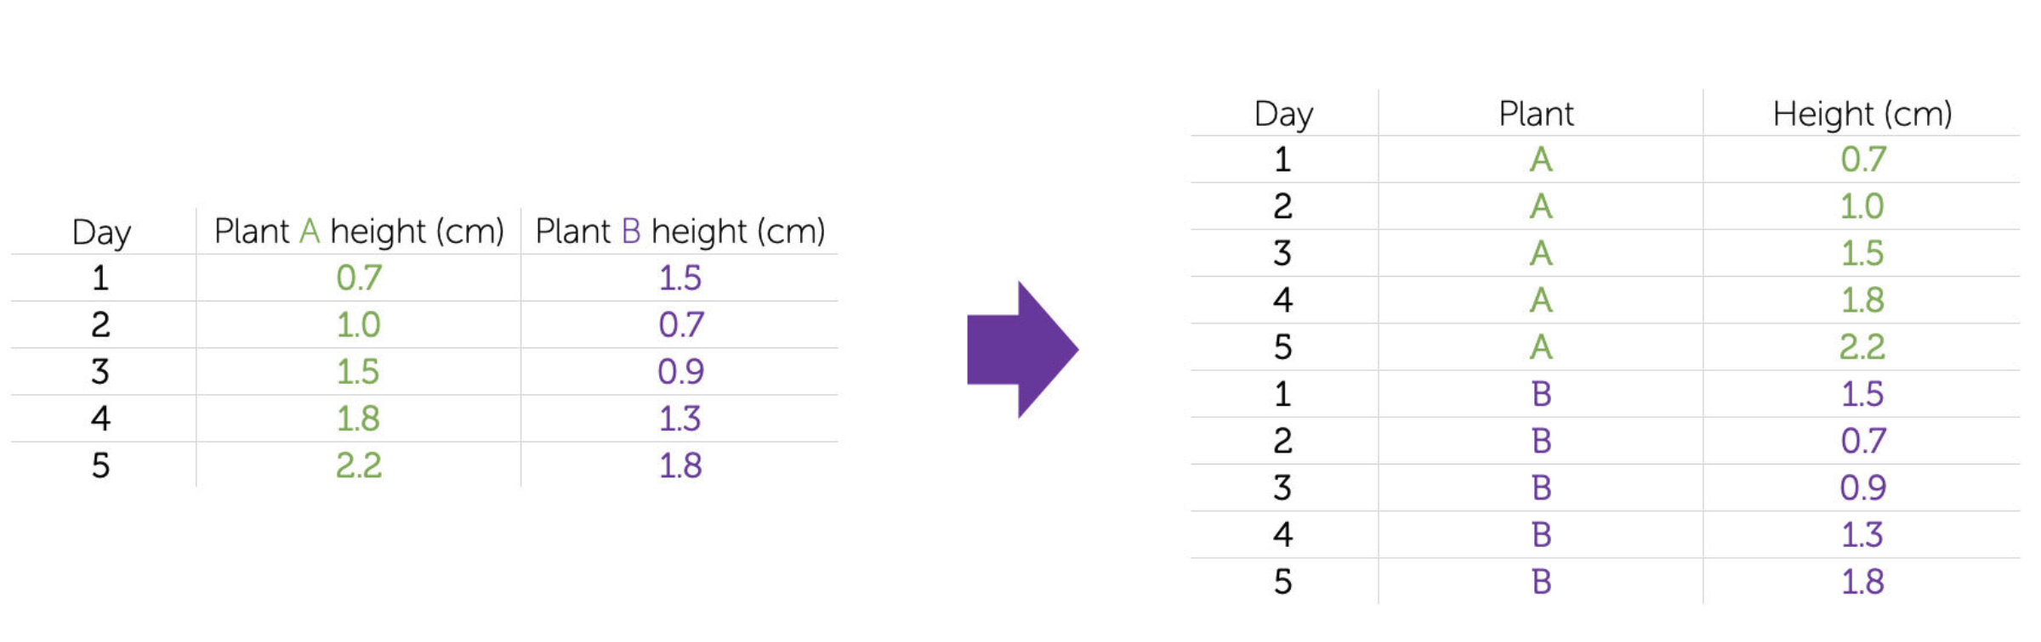
Tidy data example:
https://about.dataclassroom.com/blog/keep-your-data-tidy
Tidy
Not tidy!

Slide 6
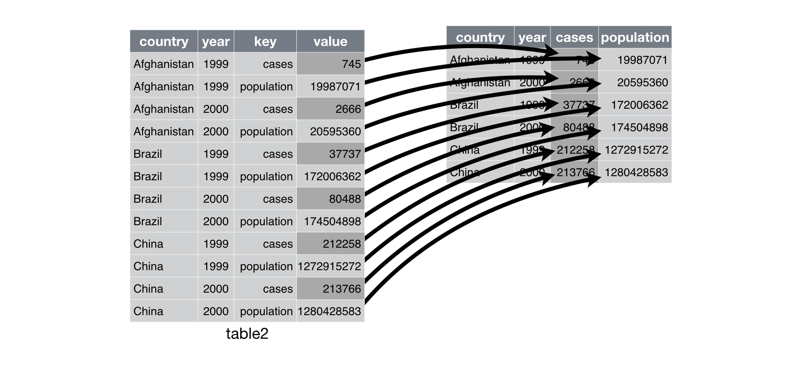
Tidy data example:
https://r4ds.had.co.nz/tidy-data.html
Tidy

Slide 7
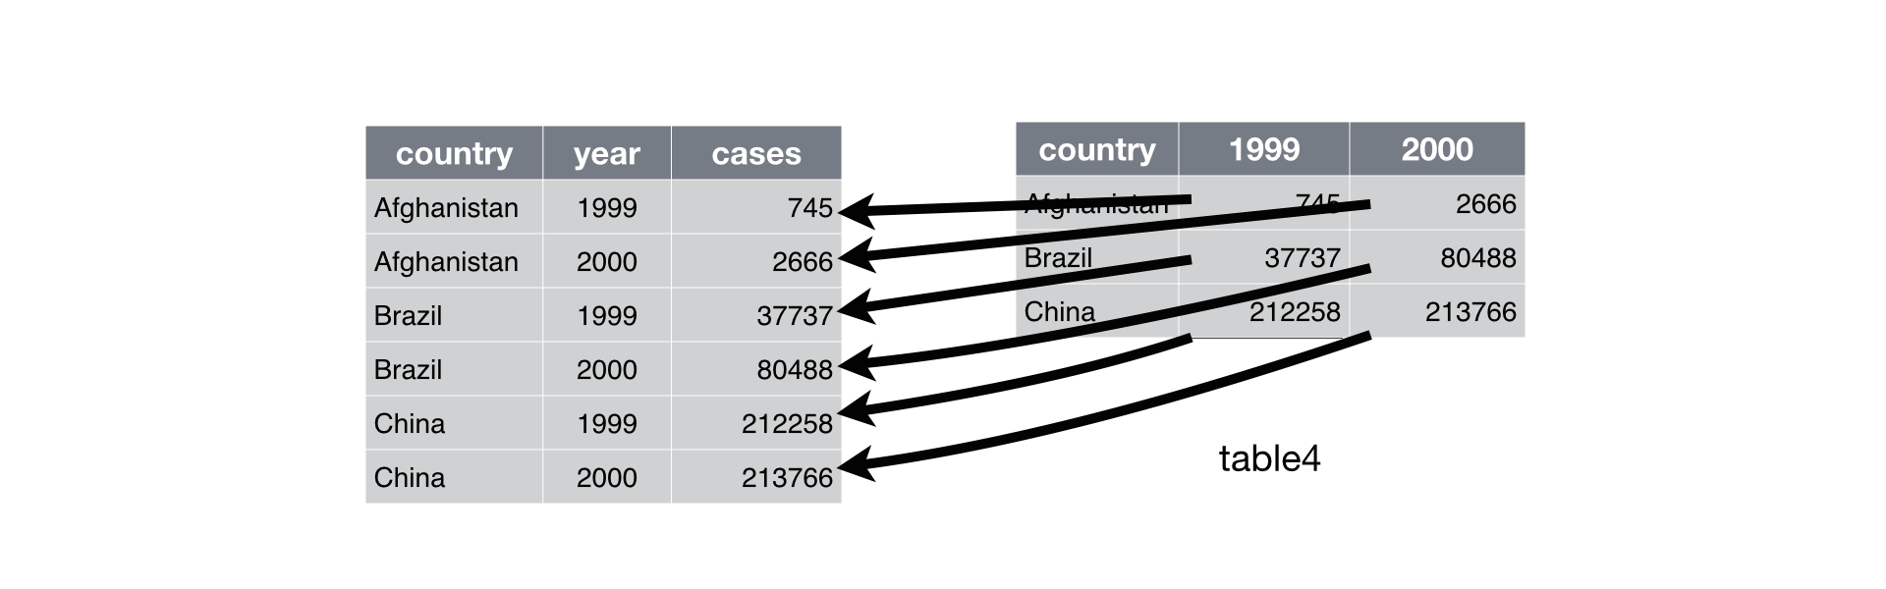
Tidy data example:
https://r4ds.had.co.nz/tidy-data.html
Tidy

Slide 8
2. How to get tidy

Slide 9


Pivoting longer or wider
pivot_longer()
pivot_wider()

Slide 10
pivot_longer()
Syntax:
x = dataframe
cols = columns to make longer [e.g. c(1999, 2000) ]
can also use ! (for not), e.g. cols = !country
names_to = name of new column, e.g. “year”
Can choose multiple, but need to provide names_sep or names_pattern
values_to = name of new column to store values, e.g. “cases”
Optional:
values_drop_na = TRUE
Will remove redundant rows ☺
names_pattern = “pattern”
Determines how name will be broken, can use regular expressions e.g. (.*)_suffix

Slide 11
pivot_wider()
Syntax:
x = dataframe
names_from = name of column to widen, e.g. “key”
Can choose multiple, but need to provide names_sep or names_pattern
values_from = name of column that has values e.g. “value”
Optional:
values_fill = value for missing values e.g. 0

Slide 12
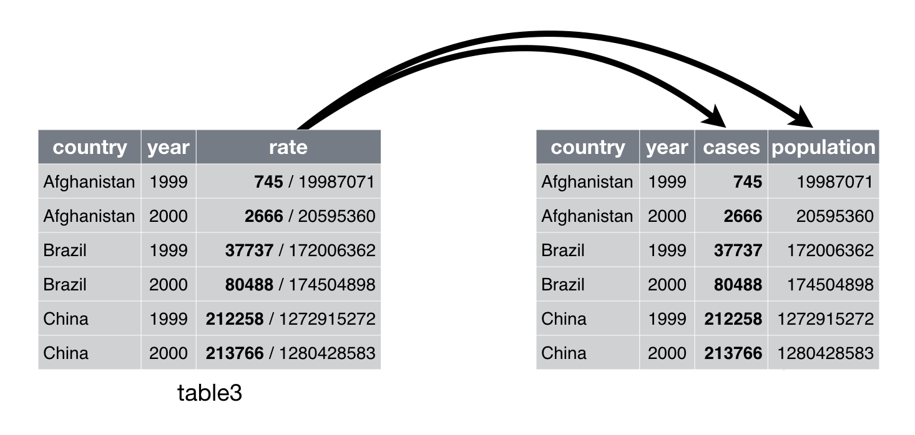
separate()
Syntax:
col = name of the column (e.g. rate)
into = name of new columns -- e.g. c(“cases”, “population”)
sep = separator character (e.g. “/”) – by default it will guess non-alphanumeric chars
convert = TRUE or FALSE (default behaviour is to leave column types as is – ‘chr’, so by using TRUE it will guess and change to an integer for us!

Slide 13
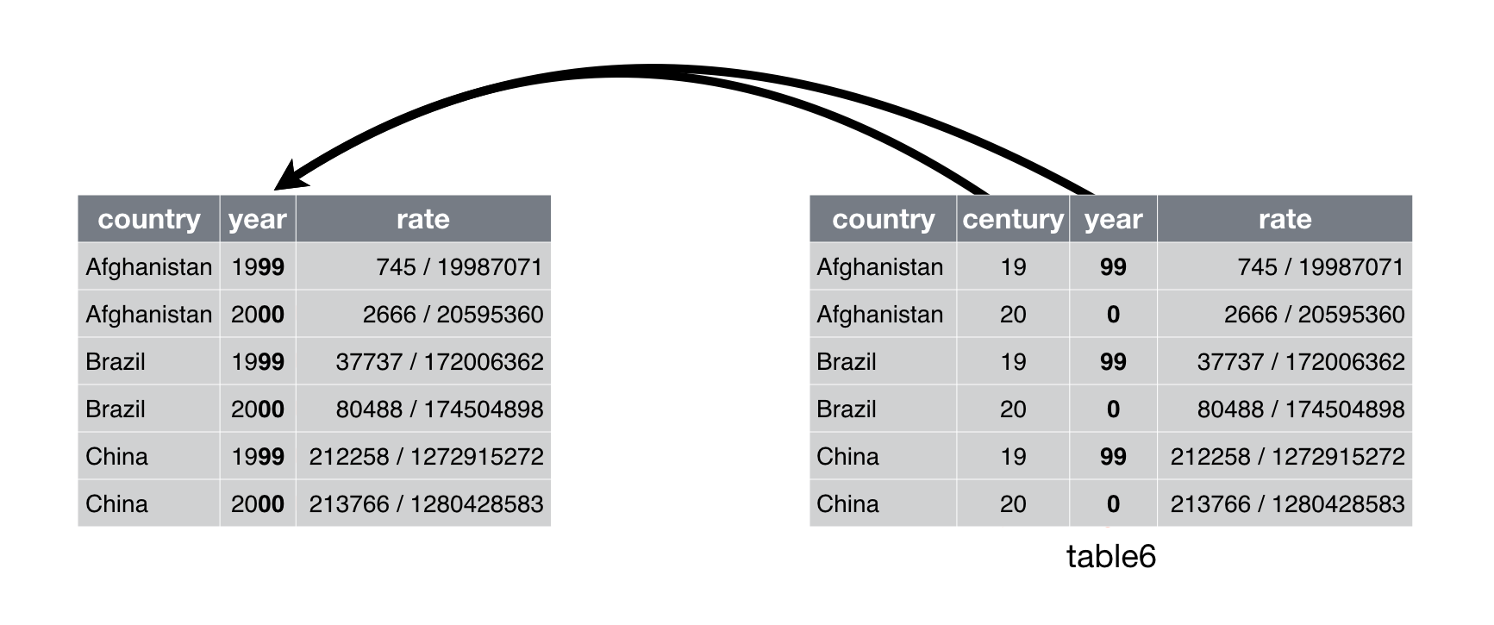
unite()
Syntax:
col = name of new column e.g. year
... = columns you want to join e.g. century, year
sep = delimiter to put between columns (use “” for no separator)

Slide 14
3. Joining tables

Slide 15
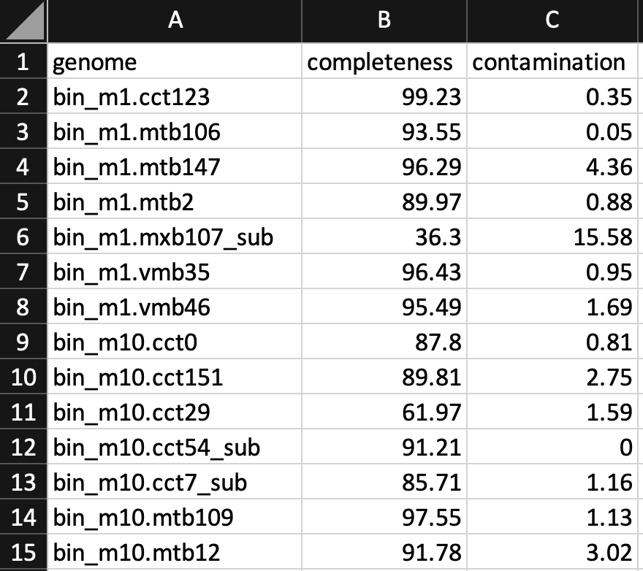
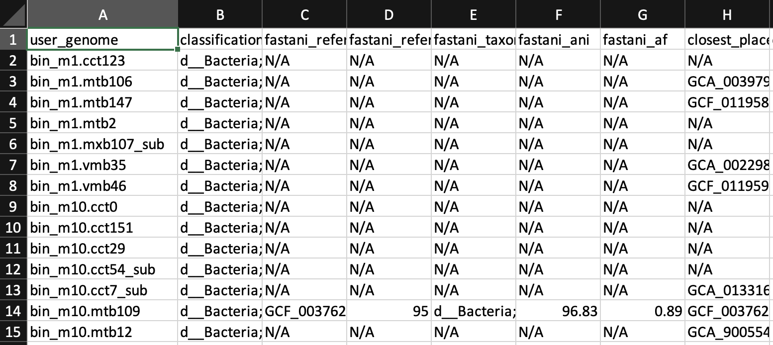
The problem
+
What if they are not ordered in the same way?
What if tables do not have the same number of rows?

Slide 16
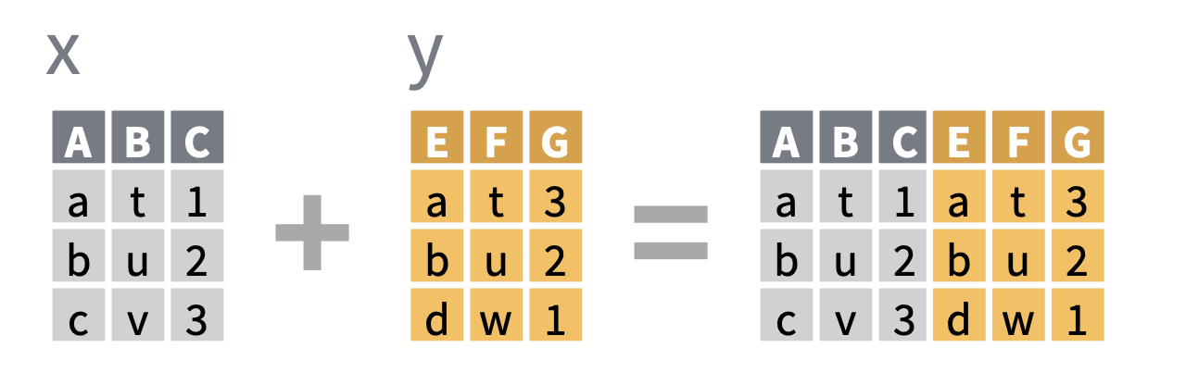
The simplest, but non-ideal way
Simplest way: bind_cols()
N.B. does not match tables by ID, so you have to ensure that both tables are sorted correctly!

Slide 17
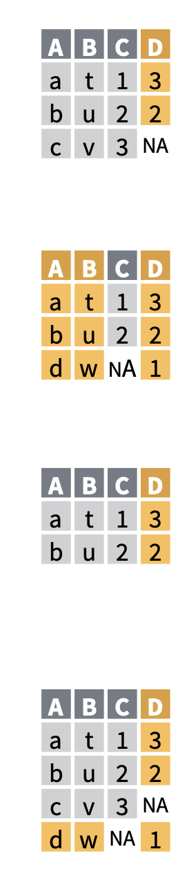
Relational joining of tables
We can do this a bit smarter by matching values in the rows between two tables (relational)
E.g. say that both tables have the same grouping variable:
sample_id
genome_name
etc.
left_join()
right_join()
inner_join()
full_join()

Slide 18
Relational joining of tables
Example: left_join(x = dataframe1,
y = dataframe2,
by = ”col name” OR c(“col name1”, “colname2”),
)
If both tables have the same column name for grouping, by = “column name”
If both tables have different names (e.g. x = grouping_var_x & y = grouping_var_y), then use a vector: by = c(“grouping_var_x”, “grouping_var_y”)
If you have multiple tables, you can pipe %>% multiple *_join() together!

Slide 19
Exercise time!
See the exercises in “Exercises.R”

Slide 20
Summary
Tidy data is consistent, easier to learn to manipulate, and faster
Dplyr has some really nice tools for manipulating tables to get tidy
pivot_longer() and pivot_wider()
spread() and gather()
Joining tables in a relational fashion saves time, and is less prone to error!

