Slide 1
Lists
Raphael Eisenhofer
2022_10_20

Slide 2
Outline for today:
1)Recap of lists
2)How to assess and access lists
3)Doing things with lists

Slide 3
1. Recap of lists

Slide 4
R lists
Are a bit of a mess…
Can contain:
different types of data (character, integers, etc.)
different lengths of data
other lists…

Slide 5
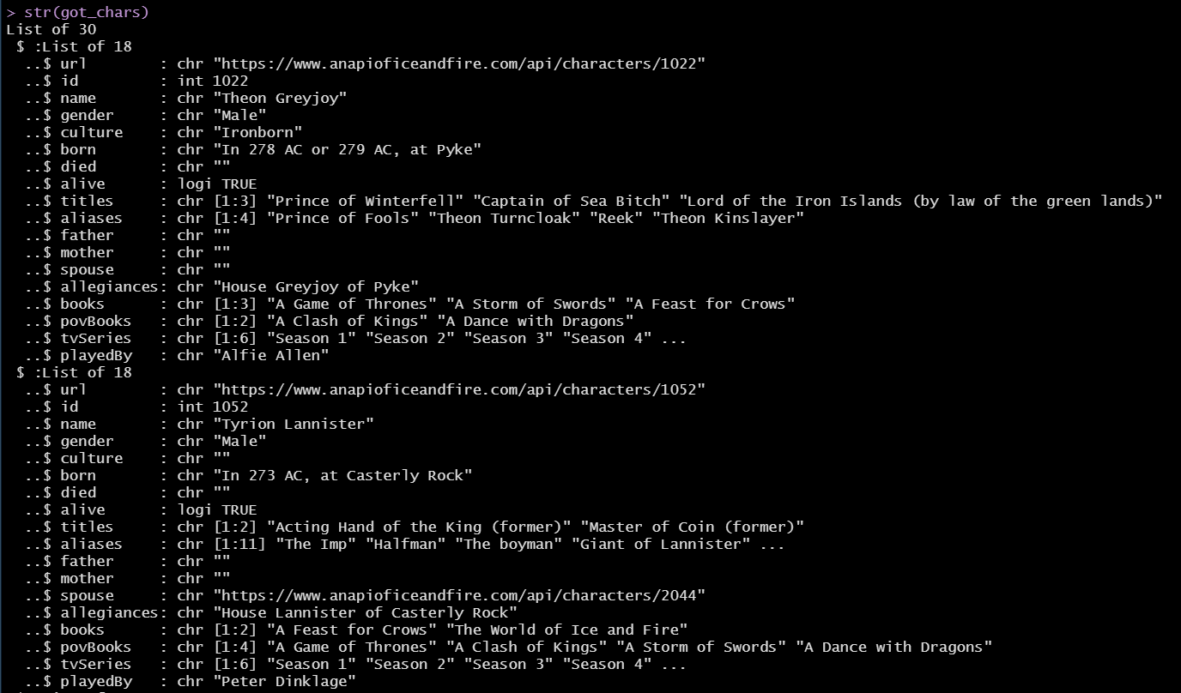

Slide 6
2. How to assess and access

Slide 7

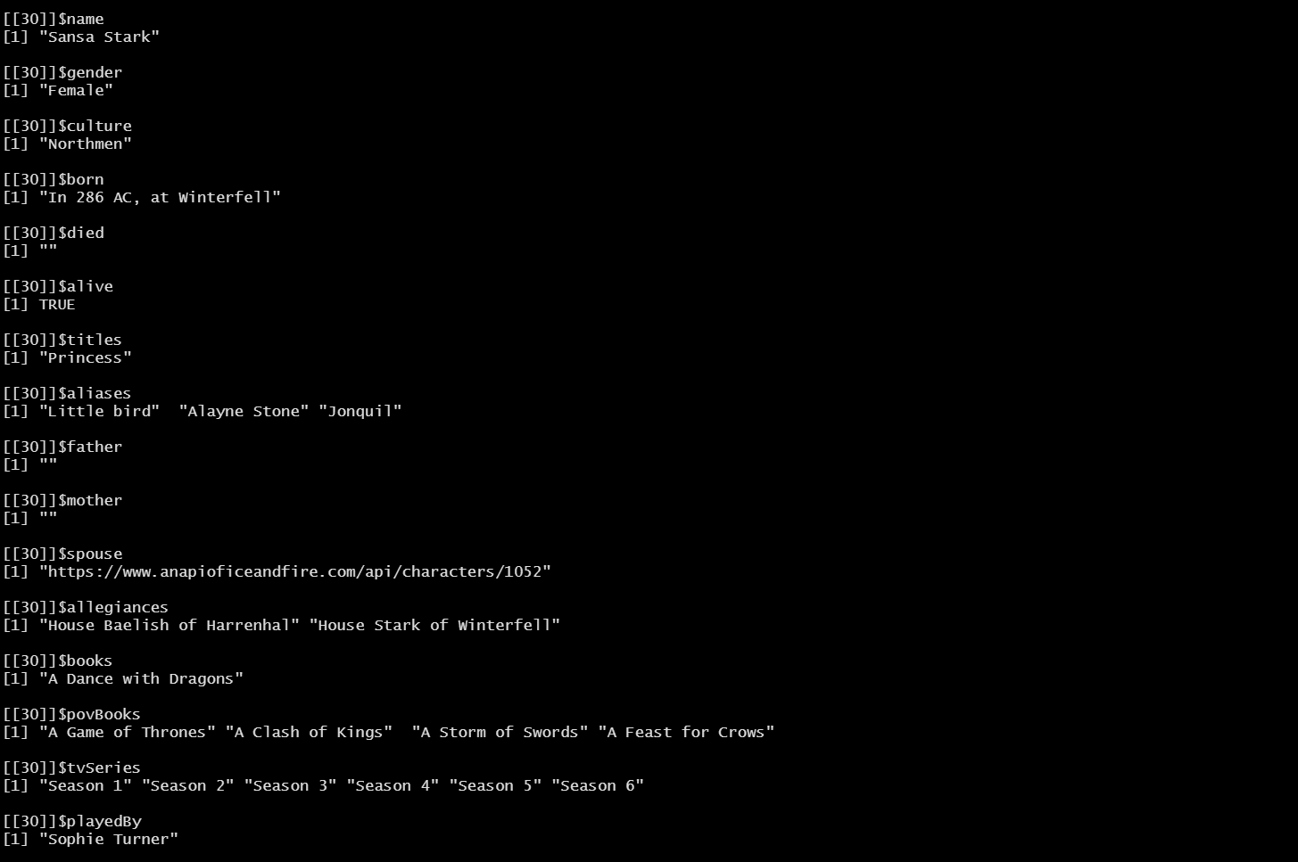
Assessing lists
https://purrr.tidyverse.org/
https://github.com/jennybc/repurrrsive
Just calling the list does not usually give you a usable output…

Slide 8
str() is your friend for basic list assessment
str(list, list.len = n)

Slide 10
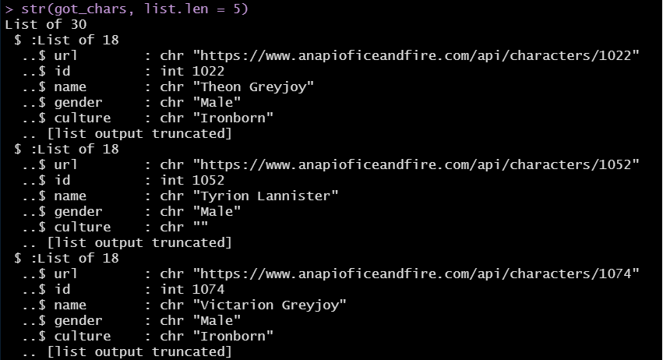

Slide 11
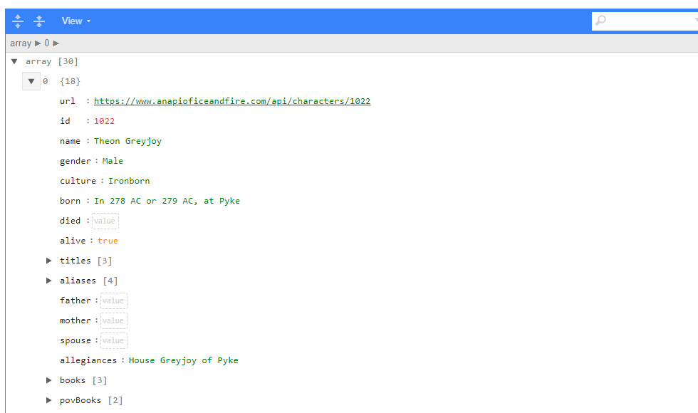
Listviewer
https://github.com/timelyportfolio/listviewer
A package that let’s you interact with lists
listviewer::jsonedit(got_chars, mode = "view")

Slide 12
map() – a versatile tool
You can do a lot with map() and it’s brethren – it can replace for loops and is a super powerful and concise means of functional programming!
See here for more on this awesome tool: https://r4ds.had.co.nz/iteration.html#the-map-functions
map(
.x = list or vector of things you want to iterate, (e.g. your list)
.f = function or formula (or with lists, a component within – e.g. “name” or 3)
… = other options passed to your function
)

Slide 13
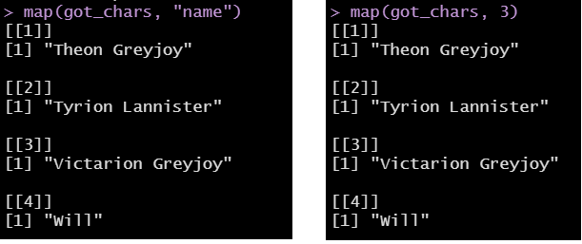

Slide 14
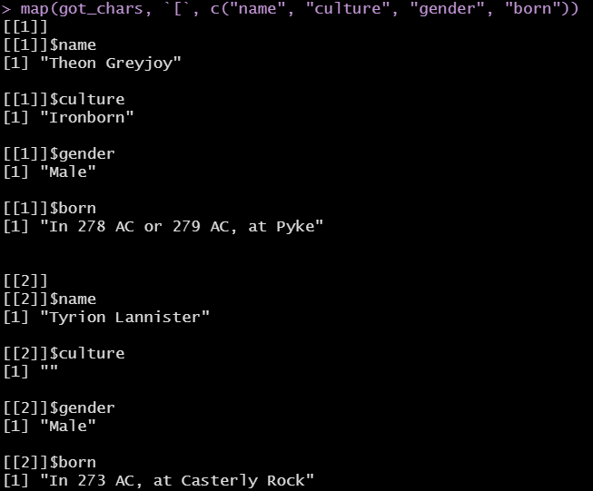
What about multiple elements of a list?
We can use map() to do this too:
Note that .f = `[` here, which is used to index
alternatively, you can use magrittr::extract in place of `[`
We can use the … to specify the vector of elements we want

Slide 15
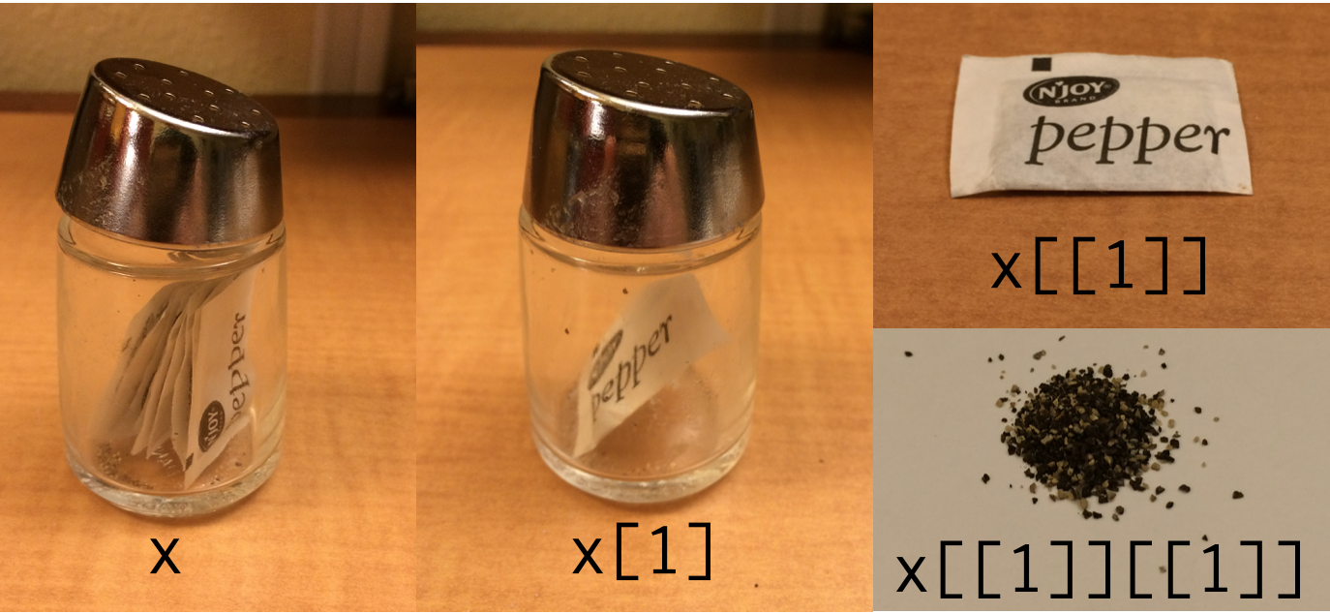
Accessing lists using base R
https://twitter.com/hadleywickham/status/643381054758363136/photo/1

Slide 16
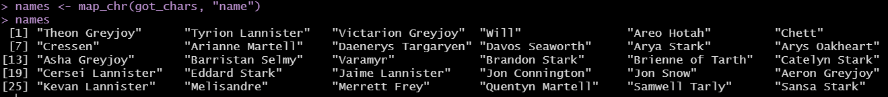
Accessing lists using purr’s map()
map() always returns a list as output
There are different flavours of map() that give different outputs though
map_chr() = character vector
map_dbl() or map_int() = numbers
map_lgl() = logical vector
map_dfr() = outputs a dataframe! (more on this later)

Slide 17
3. Getting to dataframe heaven

Slide 18
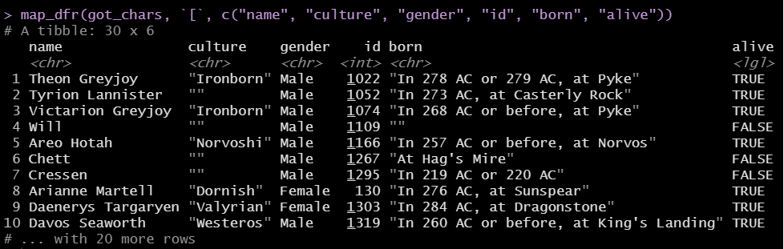
map_dfr(), our saviour

Slide 19
Exercise time!
See the exercises in “Exercises.R”

Slide 20
Summary
Lists can be pretty scary
purrr has some great tools for dealing with lists

