Slide 1
Ggplot2 continued…
Code Club - 19th May 2022
Olivia Johnson

Slide 2
Outline for today
Quick recap of last week
A new dataset
Plotting times series data
Practise plotting!

Slide 3

Quick recap
ggplot basic structure
ggplot(data = <DATA>, mapping = aes(<MAPPINGS>)) + <GEOM_FUNCTION>()
Mappings
x, y, col etc
Geom_functions
geom_point, geom_violin, geom_boxplot, geom_smooth
Facets
Using facet_wrap and facet_grid

Slide 4
Quick recap
Tidying plot
labs() – to change axis labels
theme(legend.position=“none”) – to remove legend key
Saving plots
ggsave("plot.jpg", plot = plot, width = 5, height = 5)

Slide 5
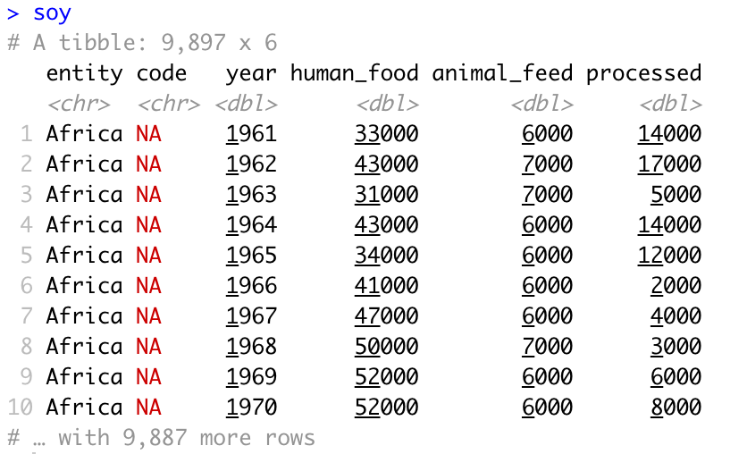
Today’s dataset
Soybean production and use by year and country, from tidytuesdays https://github.com/rfordatascience/tidytuesday/tree/master/data/2021/2021-04-06

Slide 6
What can we plot

Slide 7
Time series data
Today’s data can be plotted over time!
Most obvious option is a line graph.
Use geom_line() function

Slide 8
Time series data
Today’s data can be plotted over time!
Most obvious option is a line graph.
Use geom_line() function.
ggplot(soy, aes(x=year, y=processed))+
geom_line()

Slide 9
Time series data
Today’s data can be plotted over time!
Most obvious option is a line graph.
Use geom_line() function.
ggplot(soy, aes(x=year, y=processed))+
geom_line()
If multiple variables need to use colour or
group to separate them

Slide 10
ggplot(soy, aes(x= year, y=processed, group= entity))+
geom_line()

Slide 11
ggplot(soy, aes(x= year, y=processed, colour= entity))+
geom_line()
** too many colour variable, need to remove legend

Slide 12
ggplot(soy, aes(x= year, y=processed, colour= entity))+
geom_line()+
theme(legend.position=“none”)

Slide 13
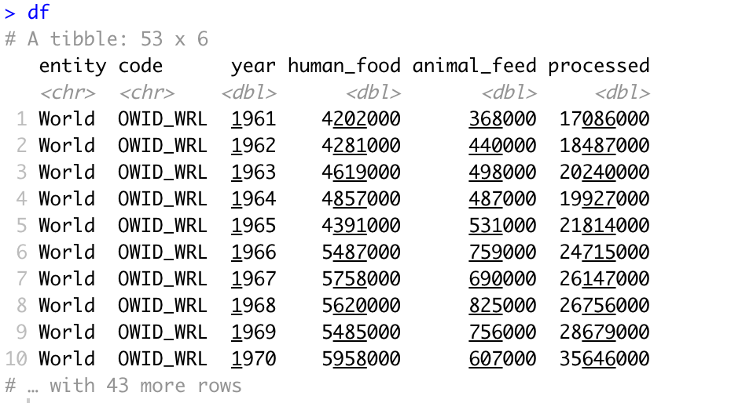
Adding more variables
Want to add animal and human food amounts
Plot will be too busy with all the lines
Subset to a portion of the data, in this case the total amounts for the world
df <- soy %>% filter(entity==“World”)
Leaves us with a much more manageable dataset

Slide 14
To add additional variables, add more geom layers
ggplot(soy, aes(x= year))+
geom_line(aes(y= processed))+
geom_line(aes(y= human_food))

Slide 15
To add additional variables, add more geom layers
ggplot(soy, aes(x= year))+
geom_line(aes(y= processed))+
geom_line(aes(y= human_food))+
geom_line(aes(y= animal_feed))

Slide 16
To add additional variables, add more geom layers
ggplot(soy, aes(x= year))+
geom_line(aes(y= processed))+
geom_line(aes(y= human_food))+
geom_line(aes(y= animal_feed))
This is difficult to differentiate between the values. However, we can add colour and labels to improve this.

Slide 17
Colour and label lines
To colour, outside of aes in geom_function add in colour.
geom_line(aes(y= animal_feed), col = “orange”)
To add label, use geom_text().
geom_text(aes(2005, 1000, label = "Animal Feed"), col="orange", size=5)

Slide 18
ggplot(df, aes(x=year))+
geom_line(aes(y=human_food), col = "deeppink")+
geom_line(aes(y=animal_feed), col="orange")+
geom_line(aes(y=processed), col="blue")+
geom_text(aes(2005, 1000, label = "Animal Feed"), col="orange", size=5)+
geom_text(aes(2005, 25000000, label = "Human Food"), col="deeppink", size=5)+
geom_text(aes(2005, 130000000, label = "Processed"), col="blue", size=5)

Slide 19
Area plots
Can use geom_area instead to show filled region.
ggplot(df, aes(x=year))+
geom_area(aes(y=processed), fill = "blue", alpha = 0.5)

Slide 20
Area plots
Can use geom_area instead to show filled region.
ggplot(df, aes(x=year))+
geom_area(aes(y=processed), fill = "blue", alpha = 0.2)+
geom_area(aes(y=human_food), fill = "deeppink", alpha = 0.5)+
geom_area(aes(y=animal_feed), fill = "orange", alpha = 0.6)+
geom_text(aes(1970,170000000,label = "Animal Feed"),col="orange",size=5)+
geom_text(aes(1970,185000000,label = "Human Food"),col="deeppink",size=5)+
geom_text(aes(1970,200000000,label = "Processed"),col="blue",size=5)

Slide 21
Tidy axes
x-axis increments are a bit sparse can use scale_x_continuous() to fix this
Can also use this to change axis labels, add limits to axis
Can also use scale_x_* fuction to transform axis. For example log10 make logarithmic scale, reverse, or replace x with y and change y axis.
scale_x_continuous(breaks = c(1960, 1970, 1980, 1990, 2000, 2010))
Use theme_bw()to make white background of plot
Change scale of y axis, do this in aes() but could also mutate dataset

Slide 22
Final plot
ggplot(df, aes(x=year))+
geom_area(aes(y=processed/1e6), fill = "blue", alpha = 0.2)+
geom_area(aes(y=human_food/1e6), fill = "deeppink", alpha = 0.5)+
geom_area(aes(y=animal_feed/1e6), fill = "orange", alpha = 0.6)+
scale_x_continuous(breaks = c(1960, 1970, 1980, 1990, 2000, 2010))+
geom_text(aes(1970,170,label = "Animal Feed"),col="orange",size=5)+
geom_text(aes(1970,185,label = "Human Food"),col="deeppink",size=5)+
geom_text(aes(1970,200,label = "Processed"),col="blue",size=5)+
labs(x= "Year", y="Quantity (Million Tonnes)")+
theme_bw()

Slide 23
Summary
Used geom_line and geom_area to show time series data
Filtered new dataset
Utilised colour and alpha options
Add annotation to plot using geom_text
Edited axis using scale_x_*

Slide 24
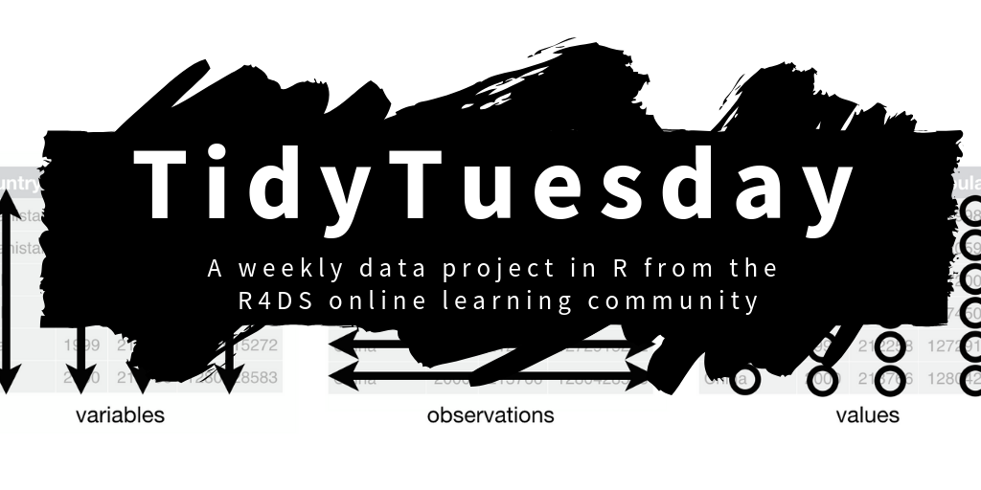
Tidytuesday
Datasets and the plots people have made from them
https://shiny.rstudio.com/gallery/tidy-tuesday.html
https://github.com/rfordatascience/tidytuesday

Slide 25
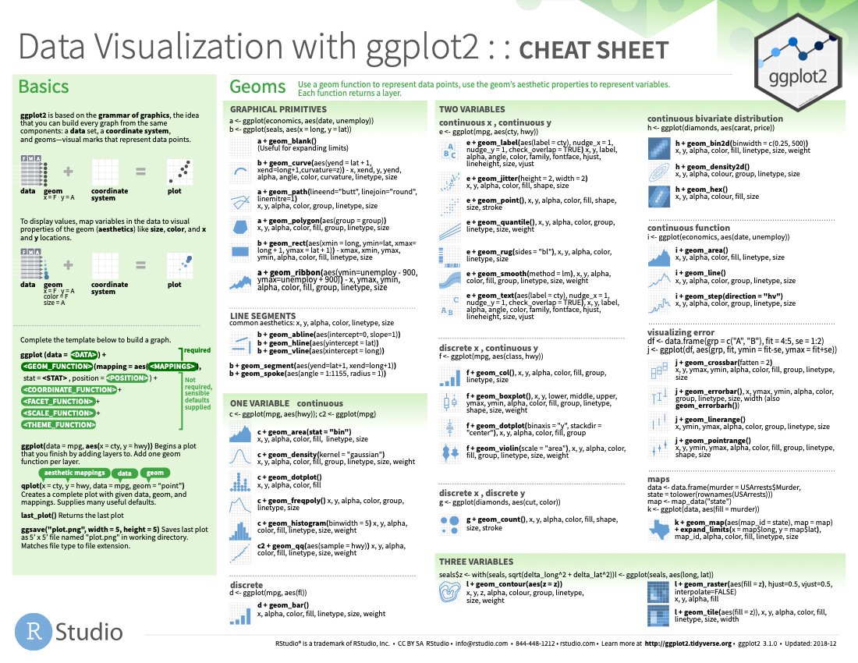
Cheat sheets available online
https://www.rstudio.com/resources/cheatsheets/

