Slide 1
Introduction to RStudio
Adelaide Code Club
24/03/2022

Slide 2
Outline for Today
What is R and RStudio?
Basics of R
Operators
Variables
Vectors
Functions
Practise using R

Slide 3
What is R and RStudio
R is a programming language for statistical computing.
R is powerful, and fast.
If you open R, just get a console.
RStudio provides
a text editor
history of commands
an “environment” where you can see the objects and elements you have created
help functions
a panel to view plots.
Notes:
Run through Rstudio window here

Slide 4
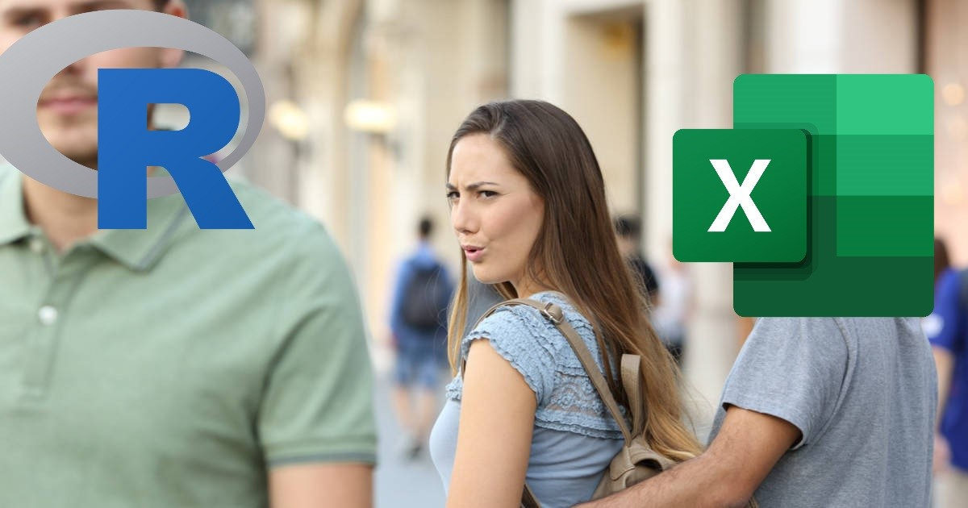
R Basics
Operators
Variables
Vectors
Other data formats
Functions

Slide 5
Operators
Arithmetic operators – return a number
Regular operators (+ - * / ^)
x % % y – modulus (x mod y)
x % / % y – integer division

Slide 6
Operators
Arithmetic operators – return a number
Regular operators (+ - * / ^)
x % % y – modulus (x mod y)
x % / % y – integer division
Regular logical operators – return a logical (True/False)
Regular (<, <=, >, >=, ==, !=)
!x – not x
x|y – x OR y
x & y – x AND y

Slide 7
Operators
Arithmetic operators – return a number
Regular operators (+ - * / ^)
x % % y – modulus (x mod y)
x % / % y – integer division
Regular logical operators – return a logical (True/False)
Regular (<, <=, >, >=, ==, !=)
!x – not x
x|y – x OR y
x & y – x AND y
Test it out!

Slide 8
Variables
A variable is a value that you assign a name to.
The names can be whatever you want, they cant have spaces but can include _ or ‘ . ’. ( x , sample.one , s_1)

Slide 9
Variables
A variable is a value that you assign a name to.
The names can be whatever you want, they cant have spaces but can include _ or ‘ . ’. ( x , sample.one , s_1)
Assign values using ‘<-’ or ‘=‘
var <- 40

Slide 10
Variables
A variable is a value that you assign a name to.
The names can be whatever you want, they cant have spaces but can include _ or ‘ . ’. ( x , sample.one , s_1)
Assign values using ‘<-’ or ‘=‘
var <- 40
You can return the value of the variable to typing its name

Slide 11
Variables
A variable is a value that you assign a name to.
The names can be whatever you want, they cant have spaces but can include _ or ‘ . ’. ( x , sample.one , s_1)
Assign values using ‘<-’ or ‘=‘
var <- 40
You can return the value of the variable to typing its name
Can use this variable as you would that value
## make percentage: (# character allows you to add comments to code)
var / 100

Slide 12
Variables continued…
Can also use variables to create other variables
var.2 <- var /100

Slide 13
Variables continued…
Can also use variables to create other variables
var.2 <- var /100
If you change the value of variable, it won’t automatically change values of variables that’s used it.
If var = 80, var.2 wont be 0.8 unless reassign value.

Slide 14
Vectors
A vector is a collection of numbers. Each individual number is referred to as an element. (A single value is technically a vector of length 1.)

Slide 15
Vectors
A vector is a collection of numbers. Each individual number is referred to as an element. (A single value is technically a vector of length 1.)
To create a vector need to use c() which means to combine.
vec <- c(1, 2, 3, 4, 5)
This can also be done with vec = c(1:5)

Slide 16
Vectors
A vector is a collection of numbers. Each individual number is referred to as an element. (A single value is technically a vector of length 1.)
To create a vector need to use c() which means to combine.
vec <- c(1, 2, 3, 4, 5)
This can also be done with vec = c(1:5)
You can often use vectors as you would a single number
vec * 10

Slide 17
Vectors
A vector is a collection of numbers. Each individual number is referred to as an element. (A single value is technically a vector of length 1.)
To create a vector need to use c() which means to combine.
vec <- c(1, 2, 3, 4, 5)
This can also be done with vec = c(1:5)
You can often use vectors as you would a single number
vec * 10
You can also have vectors of character strings
char_vec<- c(“one”, “two”, “three”, ”four”)

Slide 18
Indexing vectors
Indexing allows you to extract certain values from a vector. Index using [ ]

Slide 19
Indexing vectors
Indexing allows you to extract certain values from a vector. Index using [ ]
** R is a 1-based system, meaning the first value is value 1. Other languages can be 0-based meaning the first value is value 0 and value 1 is actually the second value.

Slide 20
Indexing vectors
Indexing allows you to extract certain values from a vector. Index using [ ]
** R is a 1-based system, meaning the first value is value 1. Other languages can be 0-based meaning the first value is value 0 and value 1 is actually the second value.
Extract a value → vec[1]

Slide 21
Indexing vectors
Indexing allows you to extract certain values from a vector. Index using [ ]
** R is a 1-based system, meaning the first value is value 1. Other languages can be 0-based meaning the first value is value 0 and value 1 is actually the second value.
Extract a value → vec[1]
Reassign a value → vec[2] <- 20

Slide 22
Indexing vectors
Indexing allows you to extract certain values from a vector. Index using [ ]
** R is a 1-based system, meaning the first value is value 1. Other languages can be 0-based meaning the first value is value 0 and value 1 is actually the second value.
Extract a value → vec[1]
Reassign a value → vec[2] <- 20
Extract a slice of a vector → vec_s[2:4]

Slide 23
Other Data Formats
lists
matrix
data.frames

Slide 24
Functions
Functions enable you to perform a specific task without you having to code it yourself.
You are also able to create your own functions

Slide 25
Functions
Functions enable you to perform a specific task without you having to code it yourself.
You are also able to create your own functions
typeof() – determines the type of any object

Slide 26
Functions
Functions enable you to perform a specific task without you having to code it yourself.
You are also able to create your own functions
typeof() – determines the type of any object
str() – describes the structure of an object

Slide 27
Functions
Functions enable you to perform a specific task without you having to code it yourself.
You are also able to create your own functions
typeof() – determines the type of any object
str() – describes the structure of an object
length() - will return the number of elements

Slide 28
Functions
Functions enable you to perform a specific task without you having to code it yourself.
You are also able to create your own functions
typeof() – determines the type of any object
str() – describes the structure of an object
length() - will return the number of elements
max()

Slide 29
Functions
Functions enable you to perform a specific task without you having to code it yourself.
You are also able to create your own functions
typeof() – determines the type of any object
str() – describes the structure of an object
length() - will return the number of elements
max()
min()

Slide 30
Functions
Functions enable you to perform a specific task without you having to code it yourself.
You are also able to create your own functions
typeof() – determines the type of any object
str() – describes the structure of an object
length() - will return the number of elements
max()
min()
mean()

Slide 31
Functions
Functions enable you to perform a specific task without you having to code it yourself.
You are also able to create your own functions
typeof() – determines the type of any object
str() – describes the structure of an object
length() - will return the number of elements
max()
min()
mean()
sum()

Slide 32
Functions
Functions enable you to perform a specific task without you having to code it yourself.
You are also able to create your own functions
typeof() – determines the type of any object
str() – describes the structure of an object
length() - will return the number of elements
max()
min()
mean()
sum()
If you don’t know have to use a function type ?function_name in the console

Slide 33
Exercise
Download R script from Adelaide Code Club git repository.
To do this, go to the terminal and move into the directory using cd
On my machine this is cd ~/2022_Adelaide_Code_Club
Once in the directory use ‘git pull’ to download a copy of the files added to the repository.
We will be using the file intro_to_r.R

Slide 34
R scripts
To execute a line of code in an R script use:
Cmd + enter for macs
Ctrl + enter for windows
This runs the line the cursor is in and then moves the cursor to the next line
To execute the file:
Use the run button at the top of the script window
cmd + shift + enter (mac)
ctrl + shift + enter (windows)

Slide 35
Summary
R and Rstudio
Create variables and vectors
Index vectors
Utilise basic functions : typeof(), str(), length(), max(), min(), and mean()

