Slide 1
Data.table
Olivia Johnson
Adelaide Code Club
11 August 2022

Slide 2
Outline for today
Recap of last week
Why use data.table
Reading in data
Syntax
Applying functions
Exercise!

Slide 3
Recap
For loops and nested for loops
for (i in sequence){ statement }
for (x in x_vals){
for (y in y_vals){
print(paste(“x =“, x, “, y =”, y)) }
}

Slide 4
Recap
If else statements
if (condition){
statement
} else {
statement
}

Slide 5
Recap
apply functions
apply(x, MARGIN (1 for rows, 2 for columns), function)
For data frame or matrix
lapply(x, function)
Output is a list
sapply(x, function)
Simplified, output is a vector.

Slide 6
Why Data.table
Considered the fasted R package for data manipulation
R generally thought not suitable for big data (>10 GB)
Not memory efficient.
Benchmarked against dplyr and pandas (python), data.table was best.

Slide 7
Reading in data
fread(path)
Will read data or webpage in as data.table
Can also convert pre-existing R objects
setDT(data frames and lists)
as.data.table(for other structures)
Or create using data.table(values)

Slide 8
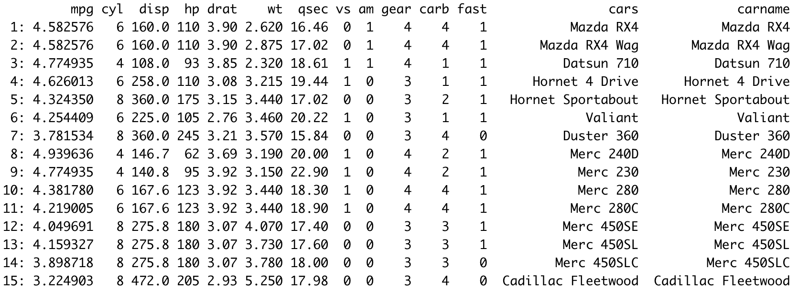
Structure of a data.table

Slide 9
Basic syntax
DT[i, j, by]
Use square brackets
i subsets rows
j subsets columns
Group by by

Slide 10
Subsetting
To subset rows
DT[2:3]
DT[column==x]
To subset columns
DT[, col_name] (will return as vector)
DT[,.(col1, col2)] (will return as data.table)

Slide 11
Grouping by
DT[i, j, by=col_name]
Apply j to groups of values of col_name
Can use multiple columns names, just have to be in a vector.
i.e. c(“cyl”, ”fast”)

Slide 12
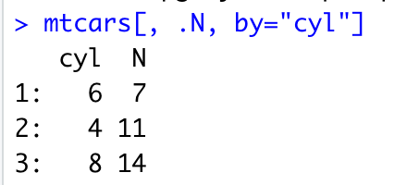
Using functions
.N - returns the number of rows, goes in j
DT[, .N, by=“cyl”)

Slide 13
Using functions
Can also use regular functions
DT[, sum(column)]
DT[, mean(col2),by=“col1”]
This will not change the table, just output the result

Slide 14
Exercise time!

