Slide 1
Introduction to ggplot2
Code Club - 5th May 2022
Olivia Johnson

Slide 2
Outline for today
Quick recap of last week
Basic structure of ggplot
Scatter plot
Distribution plots
Practise plotting!

Slide 3

Quick recap
Summary statistics calculated across groupings
df %>% group_by(species) %>% summarise(mean=mean())
Create new columns and overwrite existing ones
df %>% mutate(new_column = what_you_want)
Replace character strings (equivalent of find and replace)
str_replace_all(string, pattern, replacement)
Apply a function across specific columns (only in dplyr functions)
across(.cols=X, .fns = ~function)

Slide 4
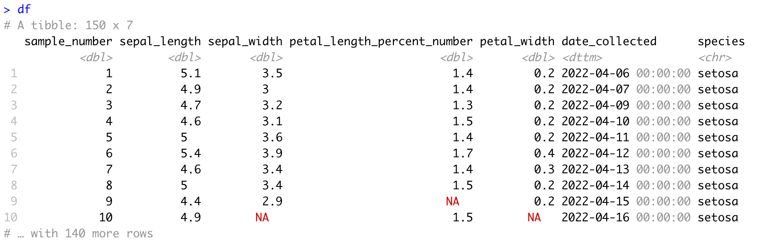
Our dataset
We have a nice clean dataset, now we want to visualise it!

Slide 5

Basic structure
ggplot(data = <DATA>, mapping = aes(<MAPPINGS>)) + <GEOM_FUNCTION>()
Mappings – x, y, col, size etc
GEOM_FUNCTION – specify what type of plot

Slide 6
What do we want to plot

Slide 7
What do we want to plot

Slide 8
What do we want to plot

Slide 9
Scatter plot
Start by looking at sepal length x sepal width
ggplot(data = df, aes(x=sepal_length, y=sepal_width)) +
geom_point()

Slide 10
Scatter plot
Start by looking at sepal length x sepal width
ggplot(data = df, aes(x=sepal_length, y=sepal_width)) +
geom_point()
No clear trend, but we could see how species affects the data

Slide 11
Scatter plot
Start by looking at sepal length x sepal width
ggplot(data = df, aes(x=sepal_length, y=sepal_width, col = species)) +
geom_point()

Slide 12
Scatter plot
Start by looking at sepal length x sepal width
ggplot(data = df, aes(x=sepal_length, y=sepal_width, col = species)) +
geom_point()
Looks like increase in sepal length with sepal width, when look on species level.

Slide 13
Facets
Can use facets to separate out data by a variable.
Can use facet_wrap or facet grid
plot = ggplot(data = df, aes(x=sepal_length, y=sepal_width, col = species)) +
geom_point() +
facet_grid(“species”)

Slide 14
Facets
plot +
facet_grid(“species”)

Slide 15
Trend line
plot +
geom_smooth()+
facet_grid(“species”)
Not a straight line, but can specify in the geom function.

Slide 16
Trend line
plot = plot +
geom_smooth(method=“lm”)+
facet_grid(“species”)
Not a straight line, but can specify in the geom function.

Slide 17
Tidy Plot
Relabel axes
Remove redundant species label

Slide 18
Tidy Plot
Relabel axes
Remove redundant species label

Slide 19
Relabel axes
Can use labs(x=“label”, y=“label”)
plot +
labs(x=“Sepal Length (cm)”, y=“Sepal Width (cm)”)

Slide 20
Remove redundant labels
Don’t need key on left edge
plot +
labs(x=“Sepal Length (cm)”, y=“Sepal Width (cm)”)+
theme(legend.position=“none”)

Slide 21
distributions
Good to look at distribution of a specific variable
ggplot(df)+
geom_boxplot(aes(x=species, y=petal_width))

Slide 22
distributions
Good to look at distribution of a specific variable
ggplot(df)+
geom_boxplot(aes(x=species, y=petal_width))
ggplot(df)+
geom_violin(aes(x=species, y=petal_width))

Slide 23
Saving plots
ggsave("plot.jpg", plot = plot, width = 5, height = 5)

Slide 24
Summary
Create scatter plots
Plot distributions
Facet data
Tidy plots

Slide 25
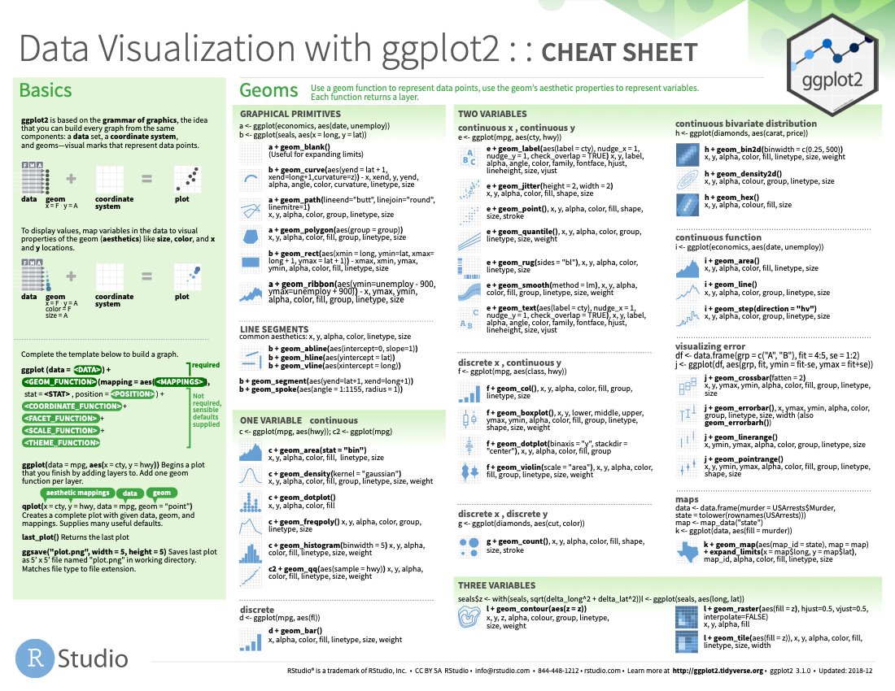
Cheat sheets available online
https://www.rstudio.com/resources/cheatsheets/

