Slide 1

Introduction to python
Olivia Johnson
Adelaide Code Club
2 February 2023

Slide 2
What is python?
General-purpose programming language
Designed to:
be more readable (than java, C++ etc),
use fewer lines of code.

Slide 3
Using python
Python doesn’t have specific interface.
Can be written in a text file and run in command line.
A number of editors available:
Visual studio code
Spyder
Pycharm
Atom etc.

Slide 4
Key differences from R
0-based language
Uses indentation rather than brackets
Built more for programming than statistical analysis
For our purposes, base functions not as helpful*

Slide 5
Operators
The standard (+, -, *, /, ==, != , < , <= , > , >=)
% - modulus
** - exponential
// - floor division

Slide 6
Operators
The standard (+, -, *, /, ==, != , < , <= , > , >=)
% - modulus
** - exponential
// - floor division
And, or, not, is , is not, in, not in (written)
&, |, only used to compare binary numbers

Slide 7
Variables
Can only use ‘=‘ to assign

Slide 8
Assignment operators
Assignment operators
x n= 3 → x = x n 3
Where n can be any operator
x*=3 → x = x * 3

Slide 9
Variables
Can only use ‘=‘ to assign
Can be text, number, or logical
Cant assign variable to any of python’s keywords (if using editor will become coloured)

Slide 10
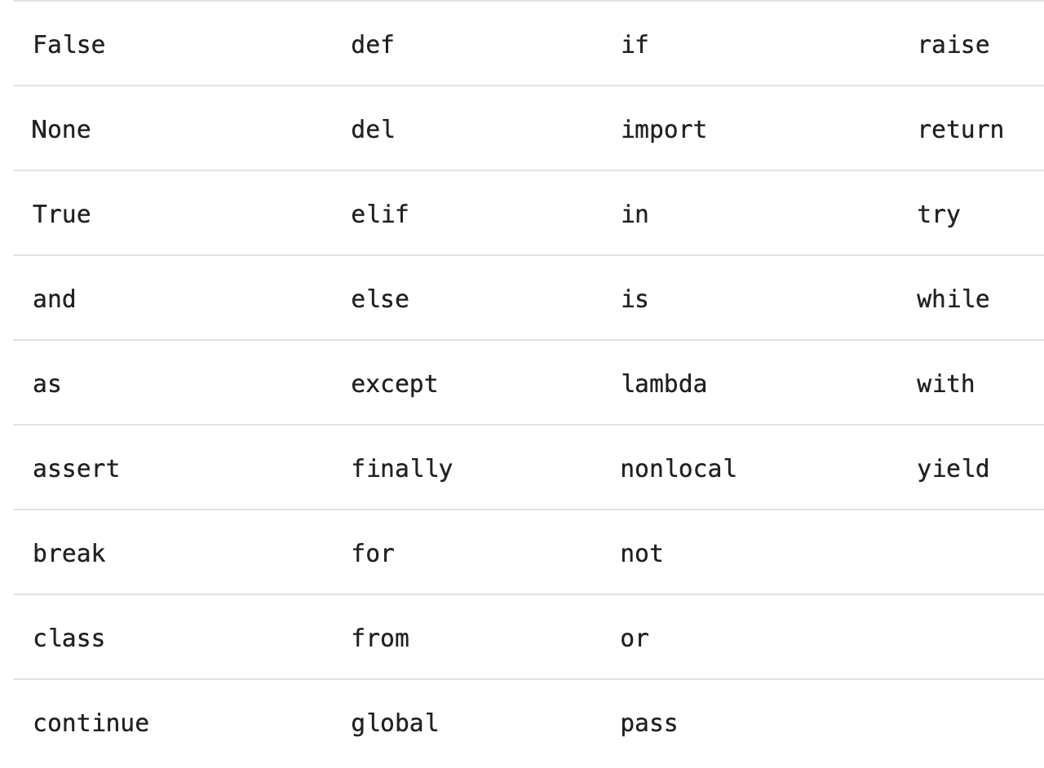

Slide 11
Lists
Python lists much simpler than R
Also act as vectors, in python called a single dimension array
Use squares when assigning name
list1 = [1, 2, 3]

Slide 12
Indexing
Index of first value is 0
If multidimensional [x, y, …]
To splice use colons [start:stop:step]
list1[2:] → [3]
list1[::2] → [1,3]
list1[-1] → [3]
list1[::-1] → [3,2,1]

Slide 13
Loops
Loops use colons and indentations rather than brackets
In r,
for (i in sequence) {statement}
In python,
for i in sequence:
statement

Slide 14
Loops
Loops use colons and indentations rather than brackets
In r,
for (i in sequence) {statement}
In python,
for i in sequence:
tab statement
Will not work if even a space in in the wrong place.
Indents must align throughout whole script

Slide 15
Indentation
Many features have this syntax
while
if, else
with
def – to create a function
Block 1
Block 2
Block 3
Block 2 continued
Block 1 continued

Slide 16
Packages
Load packages using ‘import’
Need to download first
Can give packages shortened names
i.e. import numpy as np
Numpy used for fast operations on arrays

Slide 17
Functions
Called from package
np.array(list1)
As a function of an object
list1.append()
Base functions can be stand alone
len(), print(), str(), int(), min(), max(), range(), round()

Slide 18
Time to Practise!
jupyter.org/try-jupyter
Intro_to_python.ipynb

