Slide 1
Iterative Functions
Olivia Johnson
Adelaide Code Club
28 July 2022

Slide 2
Outline for today
Recap of iterative functions
For loops
If statments
Apply functions

Slide 3

Quick Recap
glue(“text and {values to iterates over}”)
year <- 1998:2022
year_searches <- glue(“wombats AND {year}[PDAT]”)

Slide 4

Quick Recap
glue(“text and {values to iterates over}”)
year <- 1998:2022
year_searches <- glue(“wombats AND {year}[PDAT]”)
map_dbl(.x = things to iterate over, .f=function or formula (need ~ before function))
map_dbl(.x=year_searches, .f=~entrez_search(db=“pubmed”, term= .x))

Slide 5
For loops
Most basic iterative function
Can be slow
for (i in sequence){ statement }

Slide 6
For loop examples
for (i in 1:10){
print(i) }

Slide 7
For loop examples
for (i in 1:10){
print(i) }
groups <- c(1:25)
all_groups=NULL for (g in groups){
parameters <- fread(file=paste0("~/data/parameters_”, g, “.txt"))
all_groups = cbind(all_groups, parameters)
}

Slide 8
Nested loops
for (x in x_vals){
for (y in y_vals){
print(paste(“x =“, x, “, y =”, y))
}
}

Slide 9
If else statements
If statements have the same syntax
Can leave out else if just want to use the if statement
if (condition){
statement
} else {
statement
}

Slide 10
Apply functions
Base iterative functions
Often used as faster than a for loop
apply(x, MARGIN (1 for rows, 2 for columns), function)
For dataframe or matrix

Slide 11
Apply functions
Base iterative functions
Often used as faster than a for loop
apply(x, MARGIN (1 for rows, 2 for columns), function)
For dataframe or matrix
lapply(x, function)
Output is a list

Slide 12
Apply functions
Base iterative functions
Often used as faster than a for loop
apply(x, MARGIN (1 for rows, 2 for columns), function)
For dataframe or matrix
lapply(x, function)
Output is a list
sapply(x, function)
Simplified, output is a vector.

Slide 13
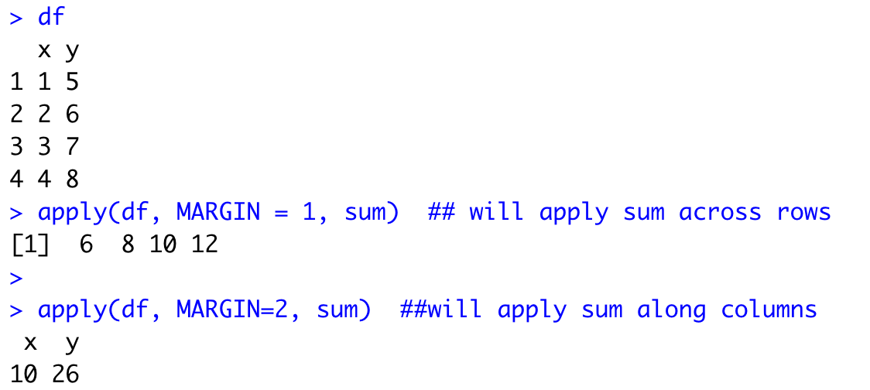
Example - apply

Slide 14
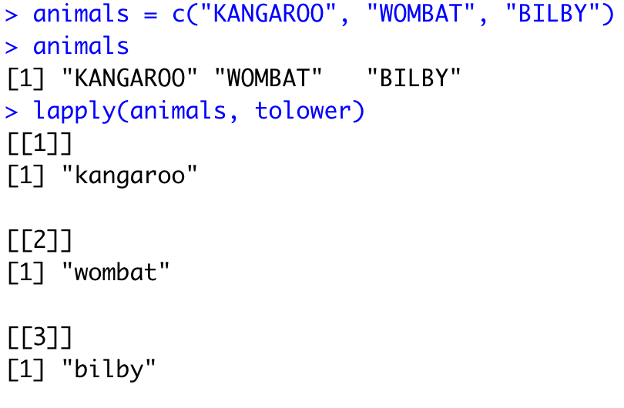
Example - lapply

Slide 15
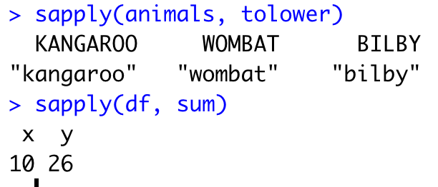
Example - sapply

Slide 16
Exercise time!

Slide 17
Summary
For loops – the most basic iterative function
for ( x in sequence ) { statement }
If else statements can be useful in iterative functions
if ( condition ) { statement } else { statement }
Apply functions – often faster than for loops
apply(), lapply(), sapply()

