Slide 1
Cleaning table data 2
Raphael Eisenhofer
2022_04_21

Slide 2
Outline for today:
1. Quick recap of last lesson
2. Identifying problems in our table data
3. Fixing problems in our table data

Slide 3
1. Quick recap

Slide 4


A quick recap
Tidyverse
Wickham et al., (2019). Welcome to the Tidyverse. Journal of Open Source Software, 4(43), 1686, https://doi.org/10.21105/joss.01686

Slide 5
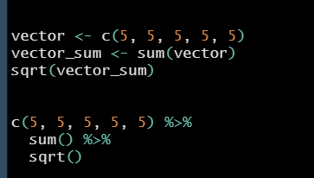
A quick recap
Tidyverse
Pipes %>%
Wickham et al., (2019). Welcome to the Tidyverse. Journal of Open Source Software, 4(43), 1686, https://doi.org/10.21105/joss.01686

Slide 6
A quick recap
Tidyverse
Pipes %>%
Importing tables
read_xlsx() and read_delim()
Wickham et al., (2019). Welcome to the Tidyverse. Journal of Open Source Software, 4(43), 1686, https://doi.org/10.21105/joss.01686

Slide 7
A quick recap
Tidyverse
Pipes %>%
Importing tables
read_xlsx() and read_delim()
Initial cleaning with janitor
Wickham et al., (2019). Welcome to the Tidyverse. Journal of Open Source Software, 4(43), 1686, https://doi.org/10.21105/joss.01686

Slide 8
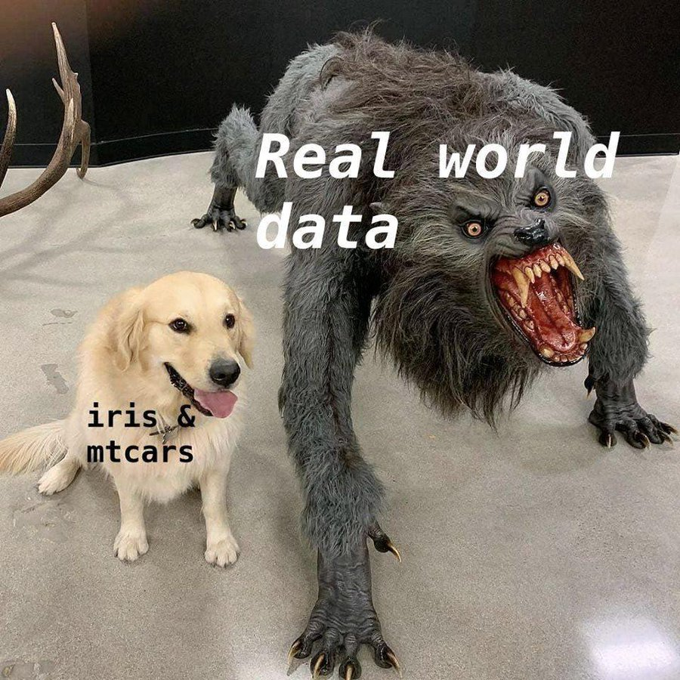

Slide 9
2. Identifying problems in table data

Slide 10
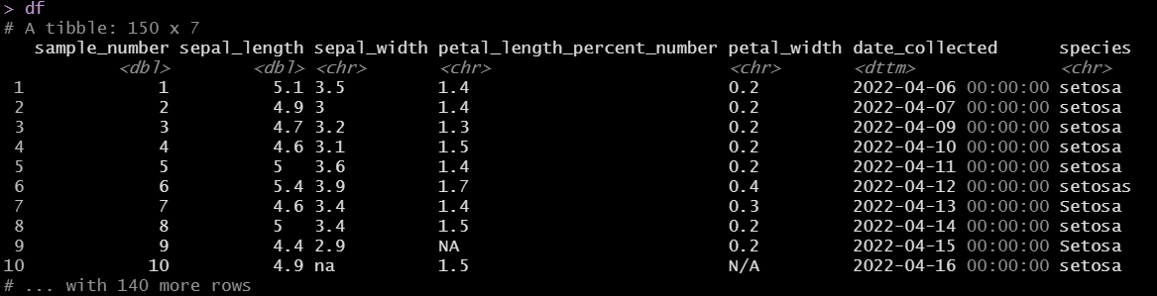
Finding issues with our table

Slide 11
Finding issues with our table
Inconsistent NA, na, N/A values
What R wants!

Slide 12
Finding issues with our table
Inconsistent NA, na, N/A values

Slide 13
Finding issues with our table
Inconsistent naming of variables (setosa, Setosa, setosas)

Slide 14
Finding issues with our table
Incorrect data types

Slide 15
How to identify in a large table
If you have a very large table (>100 rows), I would recommend not just eye-balling it
You could miss errors!

Slide 16
How to identify in a large table
If you have a very large table (>100 rows), I would recommend not just eye-balling
You could miss errors!
Base R way:
df$species %>% unique()
$ = print the column as a vector
%>% = pipe this vector into another function (so not strictly base R :P )
unique() = return a vector with duplicate elements removed

Slide 17
How to identify in a large table
If you have a very large table (>100 rows), I would recommend not just eye-balling
You could miss errors!
Base R way:
df$species %>% unique()
$ = print the column as a vector
%>% = pipe this vector into another function (so not strictly base R :P )
unique() = return a vector with duplicate elements removed

Slide 18

How to identify in a large table
If you have a very large table (>100 rows), I would recommend not just eye-balling
You could miss errors!
dplyr way:
df %>% group_by(species) %>% summarise(n = n())
group_by() creates a grouped copy of a table by columns

Slide 19
How to identify in a large table
If you have a very large table (>100 rows), I would recommend not just eye-balling
You could miss errors!
dplyr way:
df %>% group_by(species) %>% summarise(n = n())
group_by() creates a grouped copy of a table by columns
summarise() applies summary functions to columns
n() = number of values/rows
mean() = calculate mean
median() = calculate median
sd() = calculate standard deviation

Slide 20
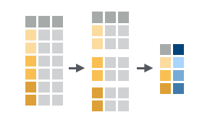
How to identify in a large table
If you have a very large table (>100 rows), I would recommend not just eye-balling
You could miss errors!
dplyr way:
df %>% group_by(species) %>% summarise(n = n())

Slide 21
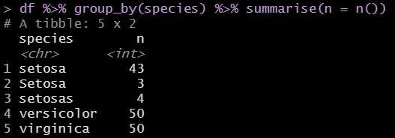
How to identify in a large table
If you have a very large table (>100 rows), I would recommend not just eye-balling
You could miss errors!
dplyr way:
df %>% group_by(species) %>% summarise(n = n())

Slide 22
A quick aside
These two functions are a great way of exploring your dataset too!
Finding out samples sizes between groups n()
Finding means/SDs of variables between groups

Slide 23
3. Fixing problems in table data

Slide 24
The mutate() function
We need a way of making changes to large table data without manually doing it in excel

Slide 25

The mutate() function
We need a way of making changes to large table data without manually doing it in excel
In comes the mutate() function!
Adds new variables (columns) while keeping existing ones
Can also overwrite columns with the new variable too
mutate is a ‘vectorized function’
Fancy way of saying “takes vectors as input, outputs vector of same length”

Slide 26
The mutate() function
We need a way of making changes to large table data without manually doing it in excel
In comes the mutate() function!
Syntax:
dataframe %>% mutate(new_column = what_you_want)
Note: if you’re not piping you will have to specify the data you want to use!
E.g. mutate(dataframe, new_column = what_you_want)

Slide 27

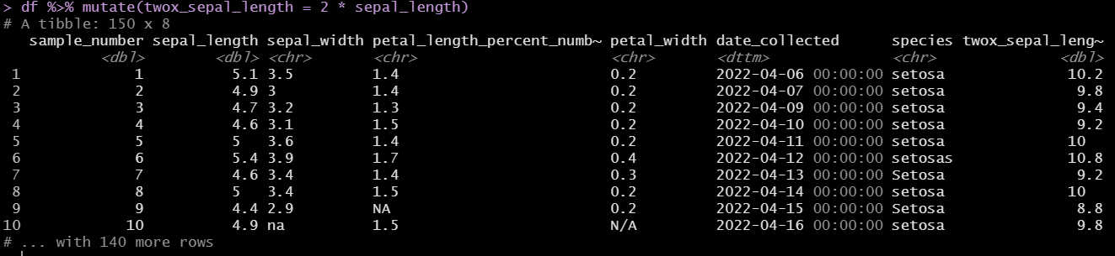
The mutate() function
We need a way of making changes to large table data without manually doing it in excel
In comes the mutate() function!
Example: df %>% mutate(twox_sepal_length = 2 * sepal_length)

Slide 28

The mutate() function
We need a way of making changes to large table data without manually doing it in excel
In comes the mutate() function!
Example: df %>% mutate(twox_sepal_width = 2 * sepal_width)

Slide 29
The mutate() function
We need a way of making changes to large table data without manually doing it in excel
In comes the mutate() function!
Example: df %>% mutate(twox_sepal_width = 2 * sepal_width)

Slide 30

Correcting variables with stringr
We have a way of overwriting variables in a column -- mutate()
The str_replace_all function lets us change strings:

Slide 31
Correcting variables with stringr
We have a way of overwriting variables in a column -- mutate()
The str_replace_all function lets us change strings:
str_replace_all(string, pattern, replacement)
string = input vector (vectorized – like mutate)
pattern = the pattern to look for – e.g. cat
replacement = the replacement character vector – e.g. dog

Slide 32
Correcting variables with stringr
We have a way of overwriting variables in a column -- mutate()
The str_replace_all function lets us change strings:
str_replace_all(string, pattern, replacement)
string = input vector (vectorized – like mutate)
pattern = the pattern to look for – e.g. cat
replacement = the replacement character vector – e.g. dog
pets <- c(“cat”, “cat”, “dog”) #Create a character vector called pets
str_replace_all(pets, “cat”, “dog”) #Replace all appearances of “cat” with “dog
output = “dog” “dog” “dog”
Note that we need to use “”, as these are character values!

Slide 33
Correcting variables with stringr
We have a way of overwriting variables in a column -- mutate()
The str_replace_all function lets us change strings:
str_replace_all(string, pattern, replacement)
string = input vector (vectorized – like mutate)
pattern = the pattern to look for – e.g. cat
replacement = the replacement character vector – e.g. dog
pattern can itself be a vector if we have multiple patterns to match! E.g. “dog”, “cat”
In this case, our character vector needs to have “|” separating each value (“|” = OR)
patterns <- c(“cat|dog")
str_replace_all(pets, patterns, “possum”)
output = “possum” “possum” “possum”

Slide 34
Applying a function across all columns
We now need a way of applying this function across all columns to clean up the Nas
Because str_replace_all works on a vector (remember tibbles can be considered a list of vectors!)

Slide 35
Applying a function across all columns
We now need a way of applying this function across all columns to clean up the Nas
Because str_replace_all works on a vector (remember tibbles can be considered a list of vectors!)
Meet the across() function
across(.cols = X, .fns = X)
.cols = the columns that you want to apply a function
.fns = the function that you want to apply to the chosen columns
‘~’ is needed sometimes in front of .fns (short for function() in Tidyverse)

Slide 36
Applying a function across all columns
We now need a way of applying this function across all columns to clean up the Nas
Because str_replace_all works on a vector (remember tibbles can be considered a list of vectors!)
Meet the across() function
across(.cols = X, .fns = X)
.cols = the columns that you want to apply a function
.fns = the function that you want to apply to the chosen columns
‘~’ is needed sometimes in front of .fns (short for function() in Tidyverse)
.cols examples:
c(sepal.length, sepal.width)
starts_with(“sepal”) #see also ends_with() and contains()
everything()

Slide 37
Applying a function across all columns
We now need a way of applying this function across all columns to clean up the Nas
Because str_replace_all works on a vector (remember tibbles can be considered a list of vectors!)
Meet the across() function
across(.cols = X, .fns = X)
.cols = the columns that you want to apply a function
.fns = the function that you want to apply to the chosen columns
‘~’ is needed sometimes in front of .fns (short for function() in Tidyverse)
.cols examples:
c(sepal.length, sepal.width)
starts_with(“sepal”) #see also ends_with() and contains()
everything()
Note: across() is only used within dpylr functions

Slide 38
Combining these functions
Let’s now combine these functions we learned to fix our NA problem!
See the Fixing_NAs.R file

Slide 39
Exercise time!
See the exercises in “Exercises.R”

Slide 40
Summary
Learned to group and summarise our table data with
group_by() and summarise()
Create new columns and overwrite existing
mutate()
Replace character strings (equiv. to find/replace)
str_replace()
Perform a dpylr function to multiple or all columns in a table
across()

