Slide 1
Manipulating Data.tables
Olivia Johnson
Adelaide Code Club
25 August 2022

Slide 2
Outline for today
Recap of last week
Adding columns
Converting columns
Extracting summaries
Time to practise!

Slide 3
Recap
data.table considered the fasted R package for data manipulation
Create/read in data
fread(path to data or webpage)
setDT(data frames and lists)
as.data.table(for other structures)
data.table(values)

Slide 4
recap
Basic syntax
DT[i, j, by]
Use square brackets
i subsets rows
j subsets columns
Group by by

Slide 5
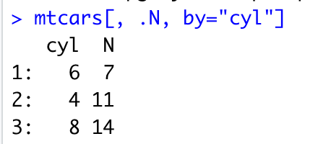
recap
Can apply functions to the data
DT[, sum(column)]
DT[, mean(col2),by=“col1”]
.N - returns the number of rows, goes in j

Slide 6
Adding columns ( := )
Data.table allows you to compute values and add them to the table in a new column
Can use other columns to compute values
DT[, col_name:=function or equation]
ie. iris[, sepal_ratio := Sepal.Width/Sepal.Length]
iris[, species_ratio := Sepal.Width/Sepal.Length, by=“species”]
this will assign the same value to all observations in each grouping

Slide 7
Adding multiple columns
Can compute multiple columns at once
DT[, ‘:=‘ (col_1=value, col_2=value)]
ie. iris[, ‘:=‘ (Sepal_ratio=Sepal.Width/Sepal.Length, Petal_ratio=Petal.Width/Petal.Length)]

Slide 8
Converting columns
Can also use := to covert the data type of column values
DT[, b := as.integer(b)]
And delete columns
DT[, b := NULL ]

Slide 9
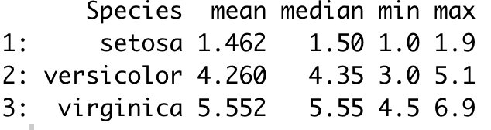
Extracting summaries
You can also calculate values from a data.table and output them in another data.table
dt[, .(mean=mean(Petal.Length), median=median(Petal.Length), min=min(Petal.Length), max=max(Petal.Length)), by=‘Species’]

Slide 10
Exercise time!

