Slide 1
Manipulating tables
Adelaide Code Club
16/06/2022

Slide 2
Outline for today
Recap of last week
A few more join functions
Comparing similar datasets
Extracting values

Slide 3

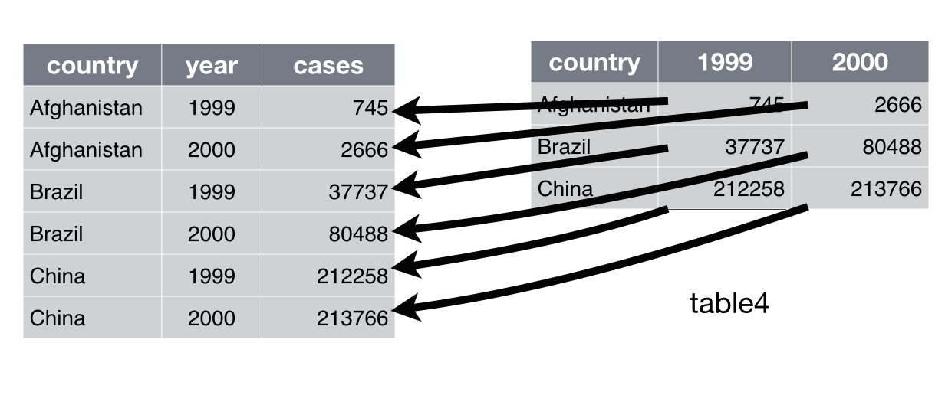
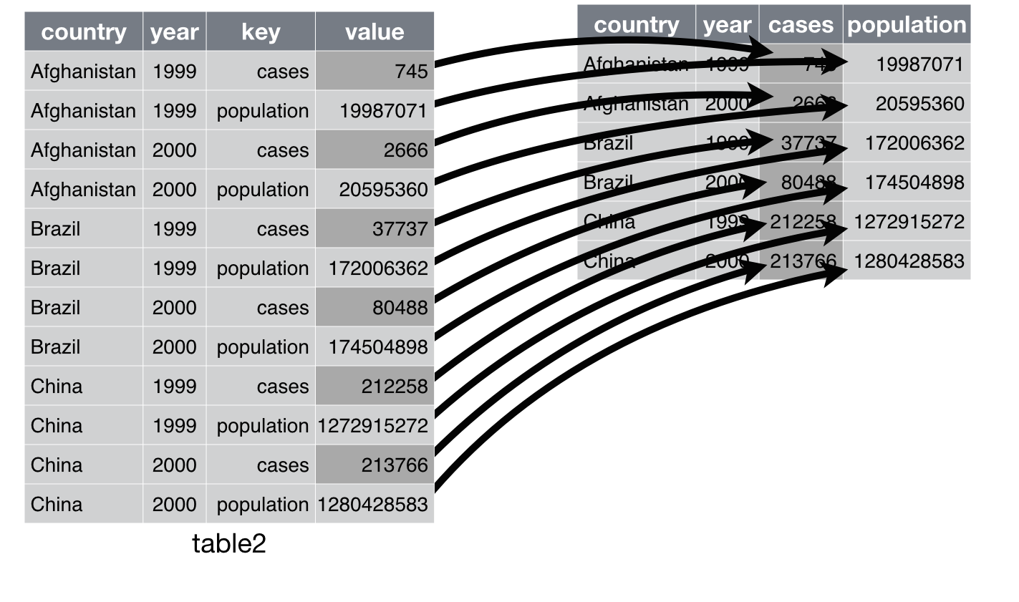
recap
pivot_longer( x = data frame, cols= columns to make longer, names_to=new column name, values_to = name of new column for values)
pivot_wider( x= data frame, names_from= name of column to widen, values_from= name of column with values)

Slide 4
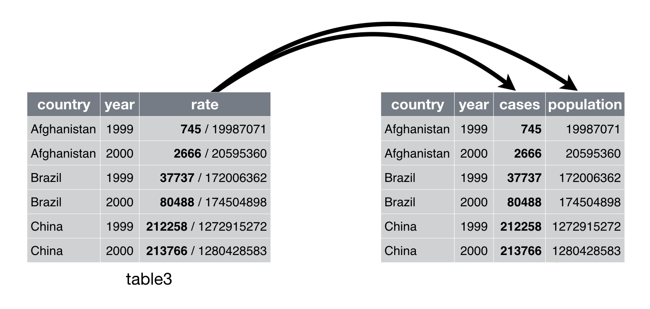
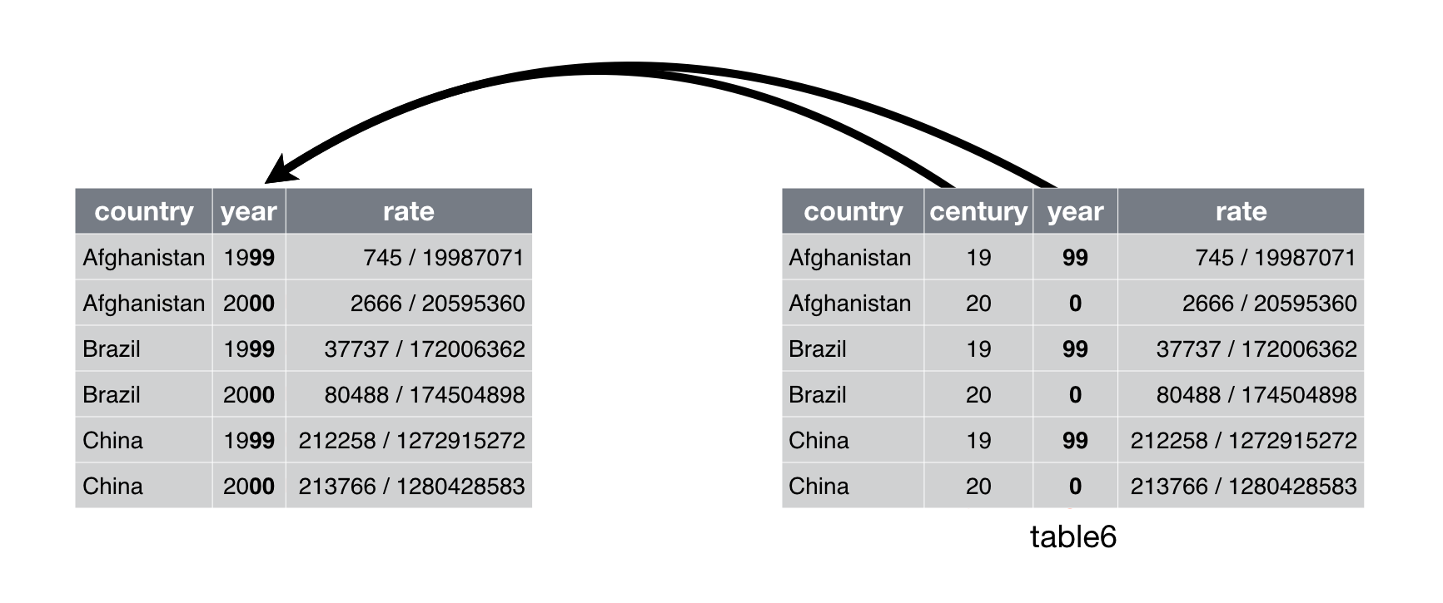
recap
separate( col= name of column, into= name of new columns, sep= separator character, convert= TRUE/FALSE as to whether to leave as character or change to integer )
unite( col= name of new column, …= name of columns to join, sep= delimiter to put between columns)

Slide 5
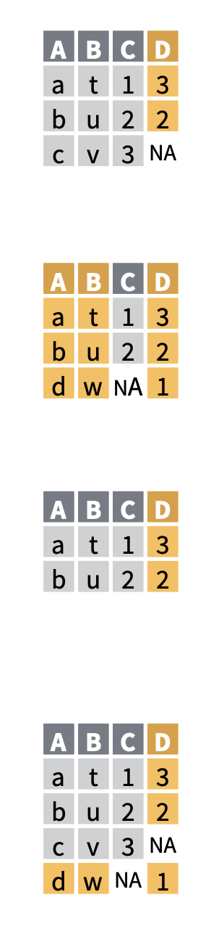
recap
*_join( x= df_1, y= df_2. by=col_name or c(col_1, col_2) or by=(x = grouping_var_x & y = grouping_var_y) if x and y cols have different names )
left_join()
right_join()
inner_join()
full_join()

Slide 6
Manipulating datasets
You may have two of the same dataset from different sources
These might have small differences that need to be reconciled to assimilate into one data frame

Slide 7
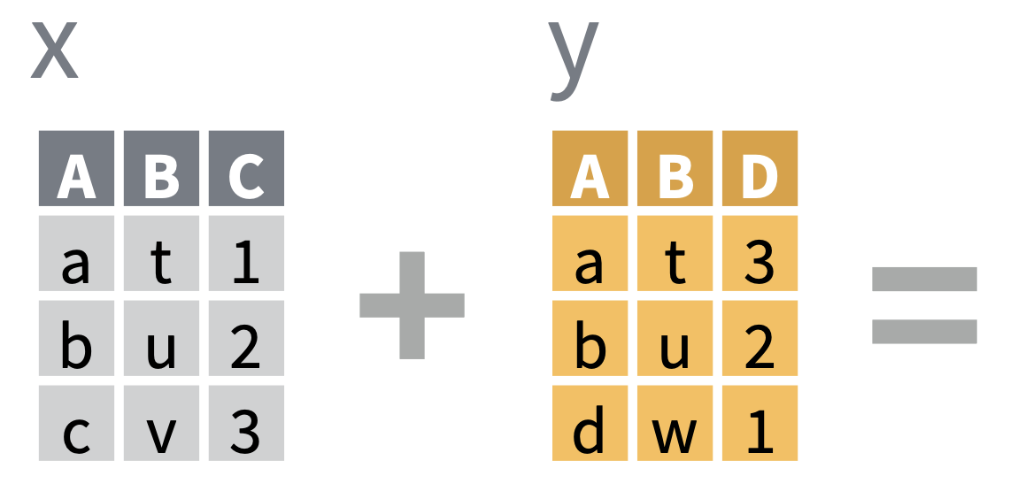
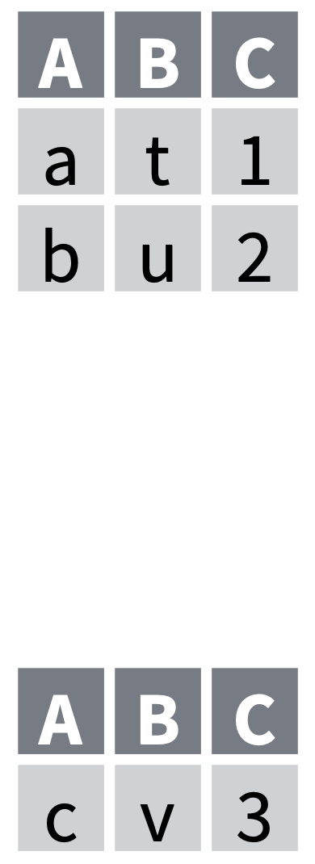
A few more join functions
There are 2 more join functions that can be useful
to check a join is going to go how you want.
Syntax is the same
semi_join (x, y, by=) – rows of x that match in y (if you perform a left join will show what will be kept)
anti_join (x, y, by=) – shows what in x is not in y (and will be excluded from join)

Slide 8
A few more join functions
There are 2 more join functions that can be useful
to check a join is going to go how you want.
Syntax is the same
semi_join (x, y, by=) – rows of x that match in y (if you perform a left join will show what will be kept)
anti_join (x, y, by=) – shows what in x is not in y (and will be excluded from join)

Slide 9
A few more join functions
There are 2 more join functions that can be useful
to check a join is going to go how you want.
Syntax is the same
semi_join (x, y, by=) – rows of x that match in y (if you perform a left join will show what will be kept)
anti_join (x, y, by=) – shows what in x is not in y (and will be excluded from join)

Slide 10
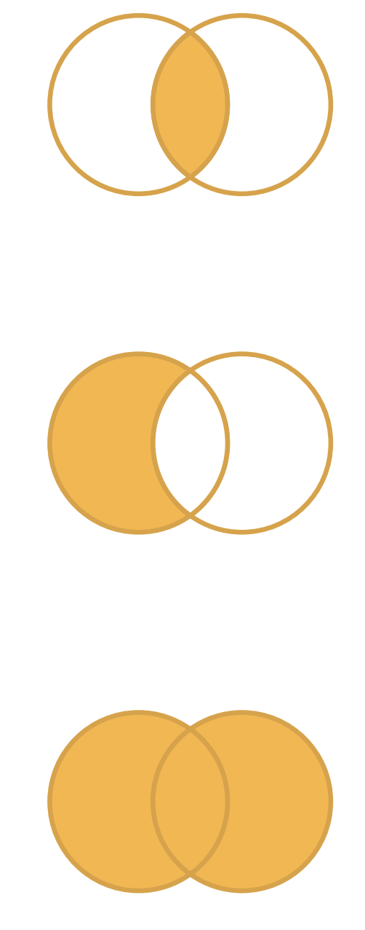
Comparing similar datasets
intersect(x, y)– rows that are in both x and y
setdiff(x, y)– rows that are in x but not y
union(x, y)– rows that’s are in x or y but without duplicates.
setequal(x, y)– to test if two data set have the same rows in any order.

Slide 11
Comparing similar datasets
intersect(x, y)– rows that are in both x and y
setdiff(x, y)– rows that are in x but not y
union(x, y)– rows that’s are in x or y but without duplicates.
setequal(x, y)– to test if two data set have the same rows in any order.

Slide 12
Comparing similar datasets
intersect(x, y)– rows that are in both x and y
setdiff(x, y)– rows that are in x but not y
union(x, y)– rows that’s are in x or y but without duplicates.
setequal(x, y)– to test if two data set have the same rows in any order.

Slide 13
Comparing similar datasets
intersect(x, y)– rows that are in both x and y
setdiff(x, y)– rows that are in x but not y
union(x, y)– rows that’s are in x or y but without duplicates.
setequal(x, y)– to test if two data set have the same rows in any order.

Slide 14
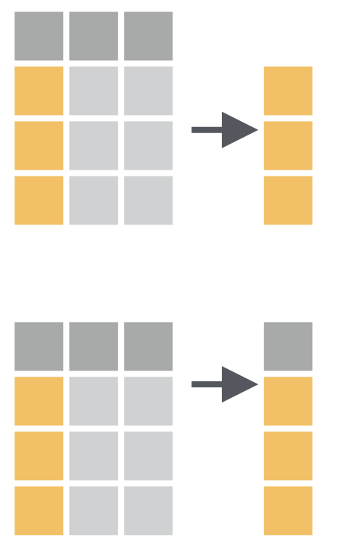
Extracting values
pull(data, var=col names or position)– extracts the values of a column into a vector
select(data, var=col names or position)– extracts the column into a table

Slide 15
Extracting values
pull(data, var=col names or position)– extracts the values of a column into a vector
select(data, var=col names or position)– extracts the column into a table

Slide 16
Exercise time!

Slide 17
Summary
How to check joins with semi_join and anti_join
How to compare similar datasets with intersect, setdiff and union.
How to extract values using pull or select.

