Slide 1
Restart Remapping for Atmosphere Restarts

Slide 2
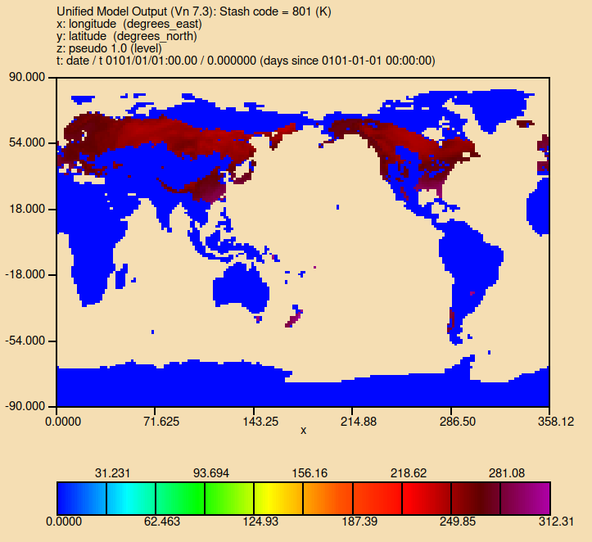
The Problem
Land variables in the atmosphere model have non-sensical values on non-active tiles. Creates problems when changing land cover map.
Soil temperature for evergreen needleleaf tiles

Slide 3
The Solution
Use nearby data to fill tiles that become active. However, can’t use single process for all variables. There are two “classes” of variables:
Tile agnostic variables, which aren’t strongly tied to the classification of the tile e.g. soil moisture and temperature.
Tile specific variables, which are strongly tied to the classification of the tile e.g. nutrient pools, LAI.
In short, tile agnostic variables can source data from any tile classification, tile specific variables can only source data from specific tiles.

Slide 4
Tile Agnostic Variables
Assuming land mask has not changed, filling tile agnostic variables is easy. Take area-weighted average of values from the other tiles on the grid cell.
Example: Added C4 grass to a grid cell that was previously 75% evergreen broadleaf and 25% C3 grass, with top layer soil temperature at 300.0K and 302.0K respectively. C4 grass tile will get a soil temperature of 300.5K.

Slide 5
Tile Specific Variables
Tile specific variables is trickier- new tiles won’t necessarily have valid source data on the same grid cell. A staged search process is used:
1. Search for valid source tiles on the same grid cell. If N valid source tiles are not found, move to next stage.
2. Search for valid source tiles in a distance around the grid cell. If N valid source tiles are not found, move to next stage.
3. Search for valid source tiles in a latitude band around the grid cell. If N valid source tiles are not found, move to next stage.
4. Search globally for valid source tiles. If N valid source tiles are not found, set value to 0.0.
By default, only equivalent tiles with same classification are valid sources. Can provide arbitrary mappings for each classification e.g. specify C3 grass, C4 grass and C3 crop are valid sources for new C3 crop tiles.

Slide 6
Tile Specific Variables
Tile specific variables is trickier- new tiles won’t necessarily have valid source data on the same grid cell. A staged search process is used:
1. Search for valid source tiles on the same grid cell. If N valid source tiles are not found, move to next stage.
2. Search for valid source tiles in a distance around the grid cell. If N valid source tiles are not found, move to next stage.
3. Search for valid source tiles in a latitude band around the grid cell. If N valid source tiles are not found, move to next stage.
4. Search globally for valid source tiles. If N valid source tiles are not found, set value to 0.0.
By default, only equivalent tiles with same classification are valid sources. Can provide arbitrary mappings for each classification e.g. specify C3 grass, C4 grass and C3 crop are valid sources for new C3 crop tiles.

Slide 7
The Tool
We built a tool to do this: adjust_restart_for_new_land_cover, which will reside at https://github.com/ACCESS-NRI/esm1.6-scripts. Has been tested with ESM1.6 and AM3. Configuration requires:
List of variables to treat as tile agnostic and tile specific.
Size of search region for nearby and latitude band search stages.
Minimum number of tiles found for search to be successful.

