Slide 1

Climate sensitivity in CMIP6 – presenting challenges for producing projections Michael Grose, Ian Macadam, Steve Sherwood

Slide 2
Climate sensitivity – key number/s
Notes:
(1) Understanding and (2) reducing uncertainties in the CC projections. ROB COLMAN
Introduction
Climate sensitivity = the degree warming per unit of forcing (i.e. doubling CO2) for each model.
(this excludes the CC-feedback which sits on top of that).
Requires two-pronged attck: (1) understanding the model ensemble and (2) understanding the process in our model
Sensitivity has come down only marginally, much larger than inter-model variability.
Mainly due to feedback, mainly clouds(+/-), water vapour(++), surface albedo(+) and laps rate(-).
If we had an analogue for this in the current climate, that would be very useful.

Slide 3
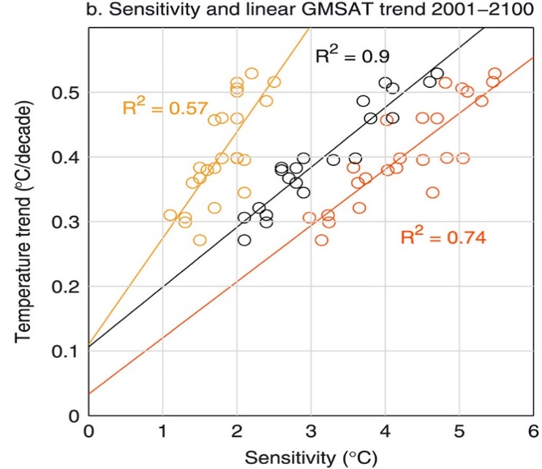

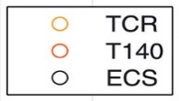
Why Equilibrium Climate Sensitivity (ECS)?
→ ECS is the best predictor of climate change trends over the coming century (better than say Transient Climate Response)
Surprising!
Grose et al., 2018
Very recent paper expanding this to CMIP6:
Huusko et al. In Press, ERL
Notes:
(1) Understanding and (2) reducing uncertainties in the CC projections. ROB COLMAN
Introduction
Climate sensitivity = the degree warming per unit of forcing (i.e. doubling CO2) for each model.
(this excludes the CC-feedback which sits on top of that).
Requires two-pronged attck: (1) understanding the model ensemble and (2) understanding the process in our model
Sensitivity has come down only marginally, much larger than inter-model variability.
Mainly due to feedback, mainly clouds(+/-), water vapour(++), surface albedo(+) and laps rate(-).
If we had an analogue for this in the current climate, that would be very useful.

Slide 4
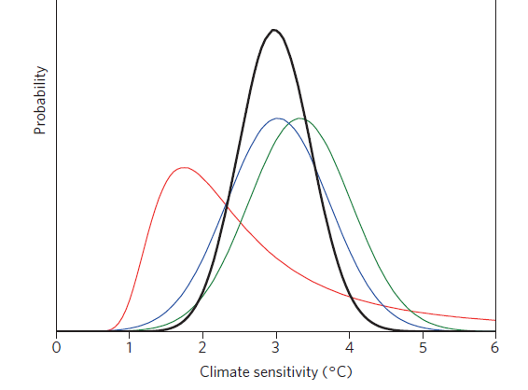
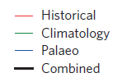
Estimates of climate sensitivity – lines of evidence
Models can be benchmarked against these other lines of evidence
Knutti et al. (2017)
Notes:
(1) Understanding and (2) reducing uncertainties in the CC projections. ROB COLMAN
Introduction
Climate sensitivity = the degree warming per unit of forcing (i.e. doubling CO2) for each model.
(this excludes the CC-feedback which sits on top of that).
Requires two-pronged attck: (1) understanding the model ensemble and (2) understanding the process in our model
Sensitivity has come down only marginally, much larger than inter-model variability.
Mainly due to feedback, mainly clouds(+/-), water vapour(++), surface albedo(+) and laps rate(-).
If we had an analogue for this in the current climate, that would be very useful.

Slide 5
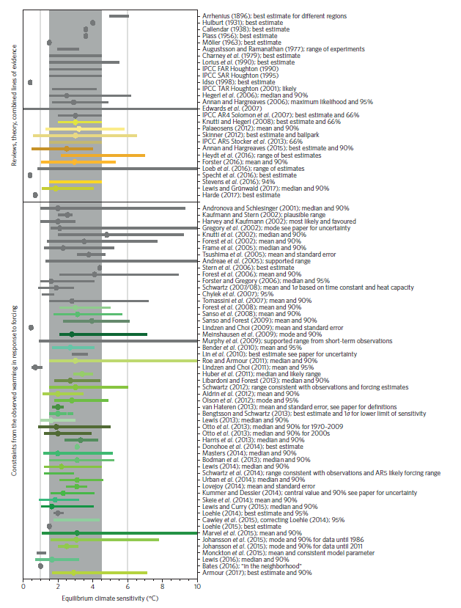
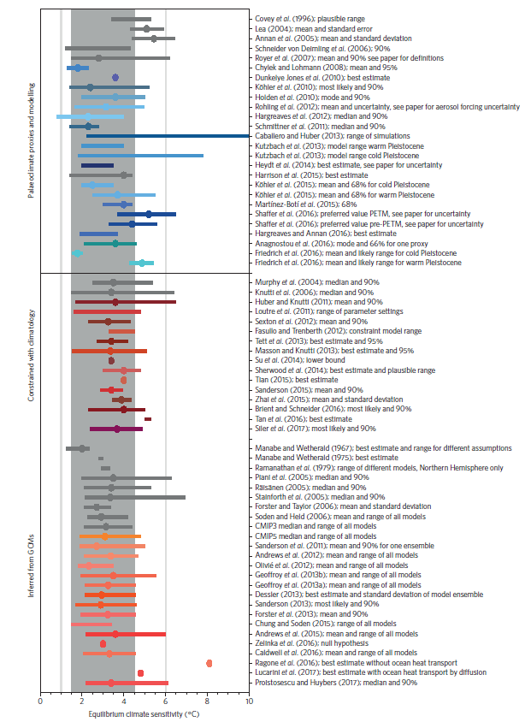
Knutti et al. (2017)
Notes:
(1) Understanding and (2) reducing uncertainties in the CC projections. ROB COLMAN
Introduction
Climate sensitivity = the degree warming per unit of forcing (i.e. doubling CO2) for each model.
(this excludes the CC-feedback which sits on top of that).
Requires two-pronged attck: (1) understanding the model ensemble and (2) understanding the process in our model
Sensitivity has come down only marginally, much larger than inter-model variability.
Mainly due to feedback, mainly clouds(+/-), water vapour(++), surface albedo(+) and laps rate(-).
If we had an analogue for this in the current climate, that would be very useful.

Slide 6
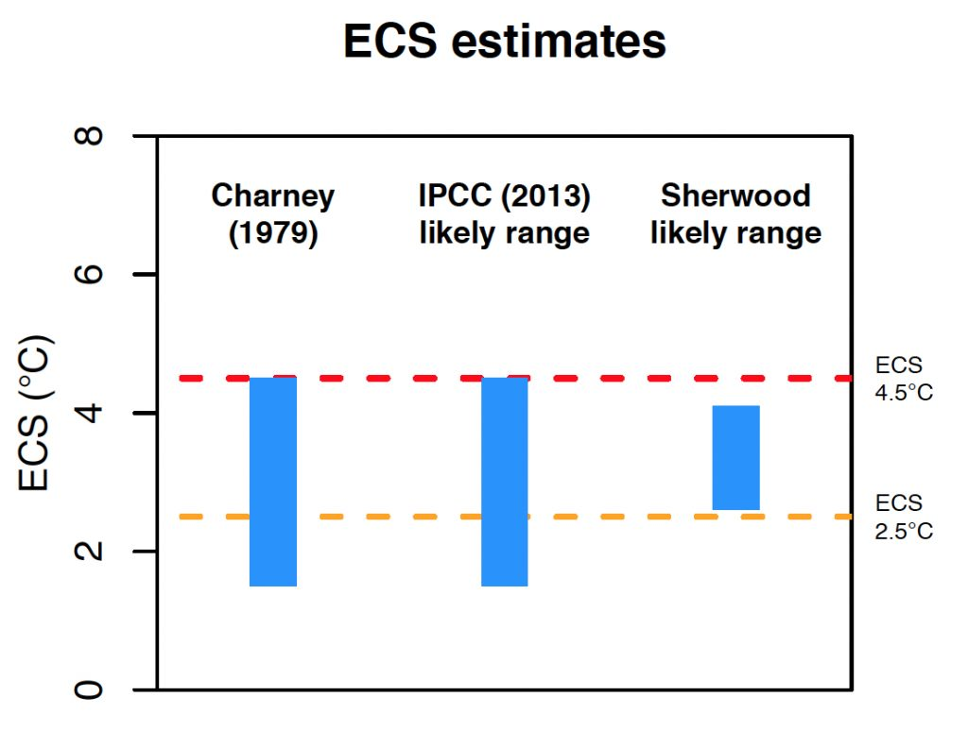
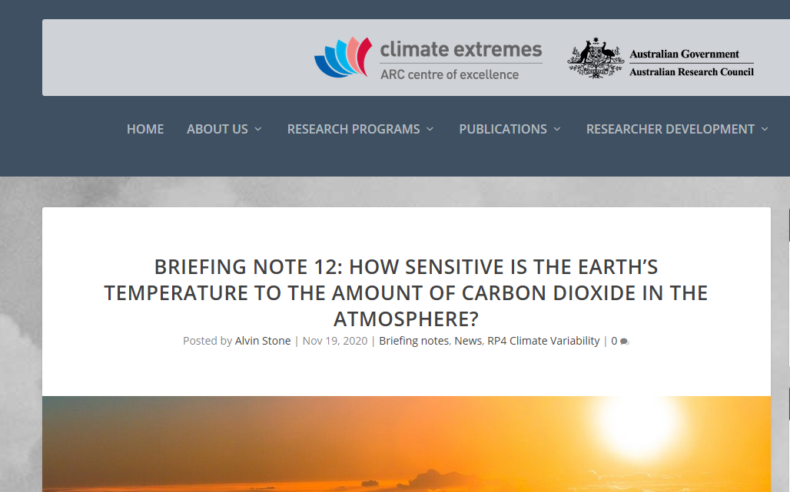
State of the art – Sherwood et al. 2020
Thorough, expansive review
Bayesian approaches
Years of work
Notes:
(1) Understanding and (2) reducing uncertainties in the CC projections. ROB COLMAN
Introduction
Climate sensitivity = the degree warming per unit of forcing (i.e. doubling CO2) for each model.
(this excludes the CC-feedback which sits on top of that).
Requires two-pronged attck: (1) understanding the model ensemble and (2) understanding the process in our model
Sensitivity has come down only marginally, much larger than inter-model variability.
Mainly due to feedback, mainly clouds(+/-), water vapour(++), surface albedo(+) and laps rate(-).
If we had an analogue for this in the current climate, that would be very useful.

Slide 7
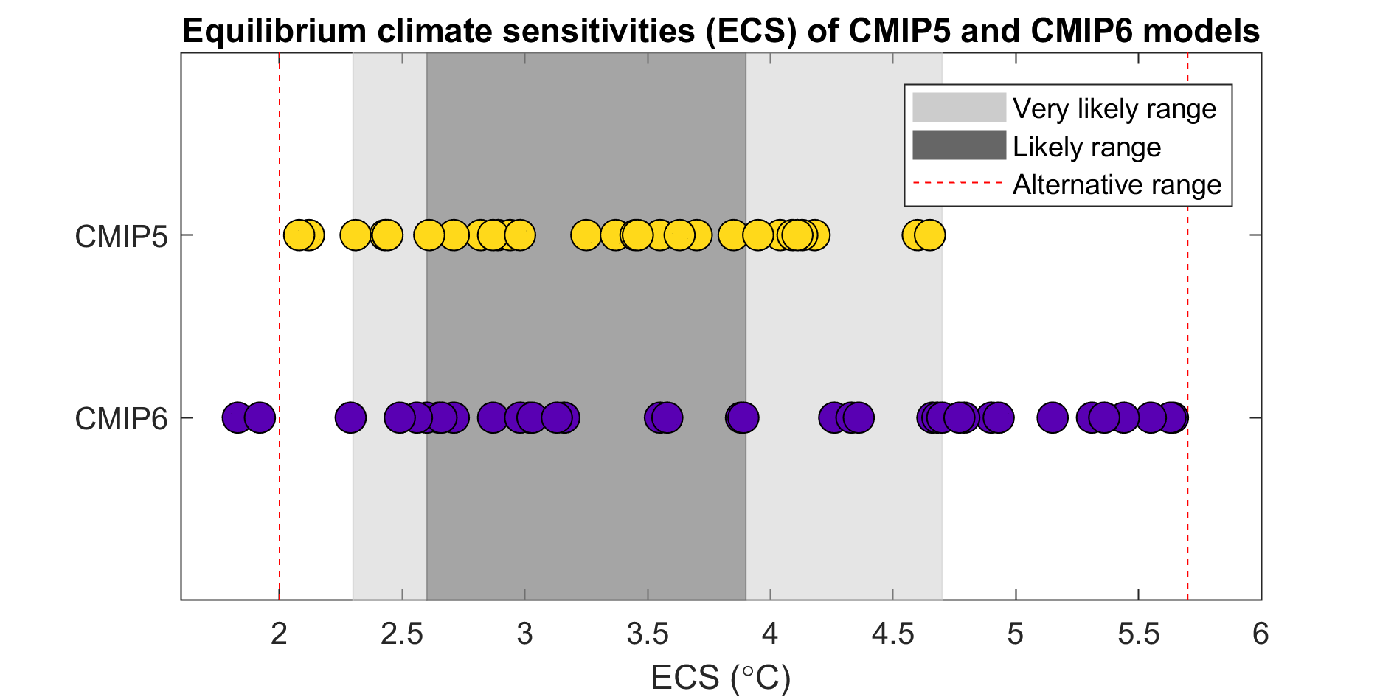
CMIP5 and CMIP6?
Notes:
(1) Understanding and (2) reducing uncertainties in the CC projections. ROB COLMAN
Introduction
Climate sensitivity = the degree warming per unit of forcing (i.e. doubling CO2) for each model.
(this excludes the CC-feedback which sits on top of that).
Requires two-pronged attck: (1) understanding the model ensemble and (2) understanding the process in our model
Sensitivity has come down only marginally, much larger than inter-model variability.
Mainly due to feedback, mainly clouds(+/-), water vapour(++), surface albedo(+) and laps rate(-).
If we had an analogue for this in the current climate, that would be very useful.

Slide 8
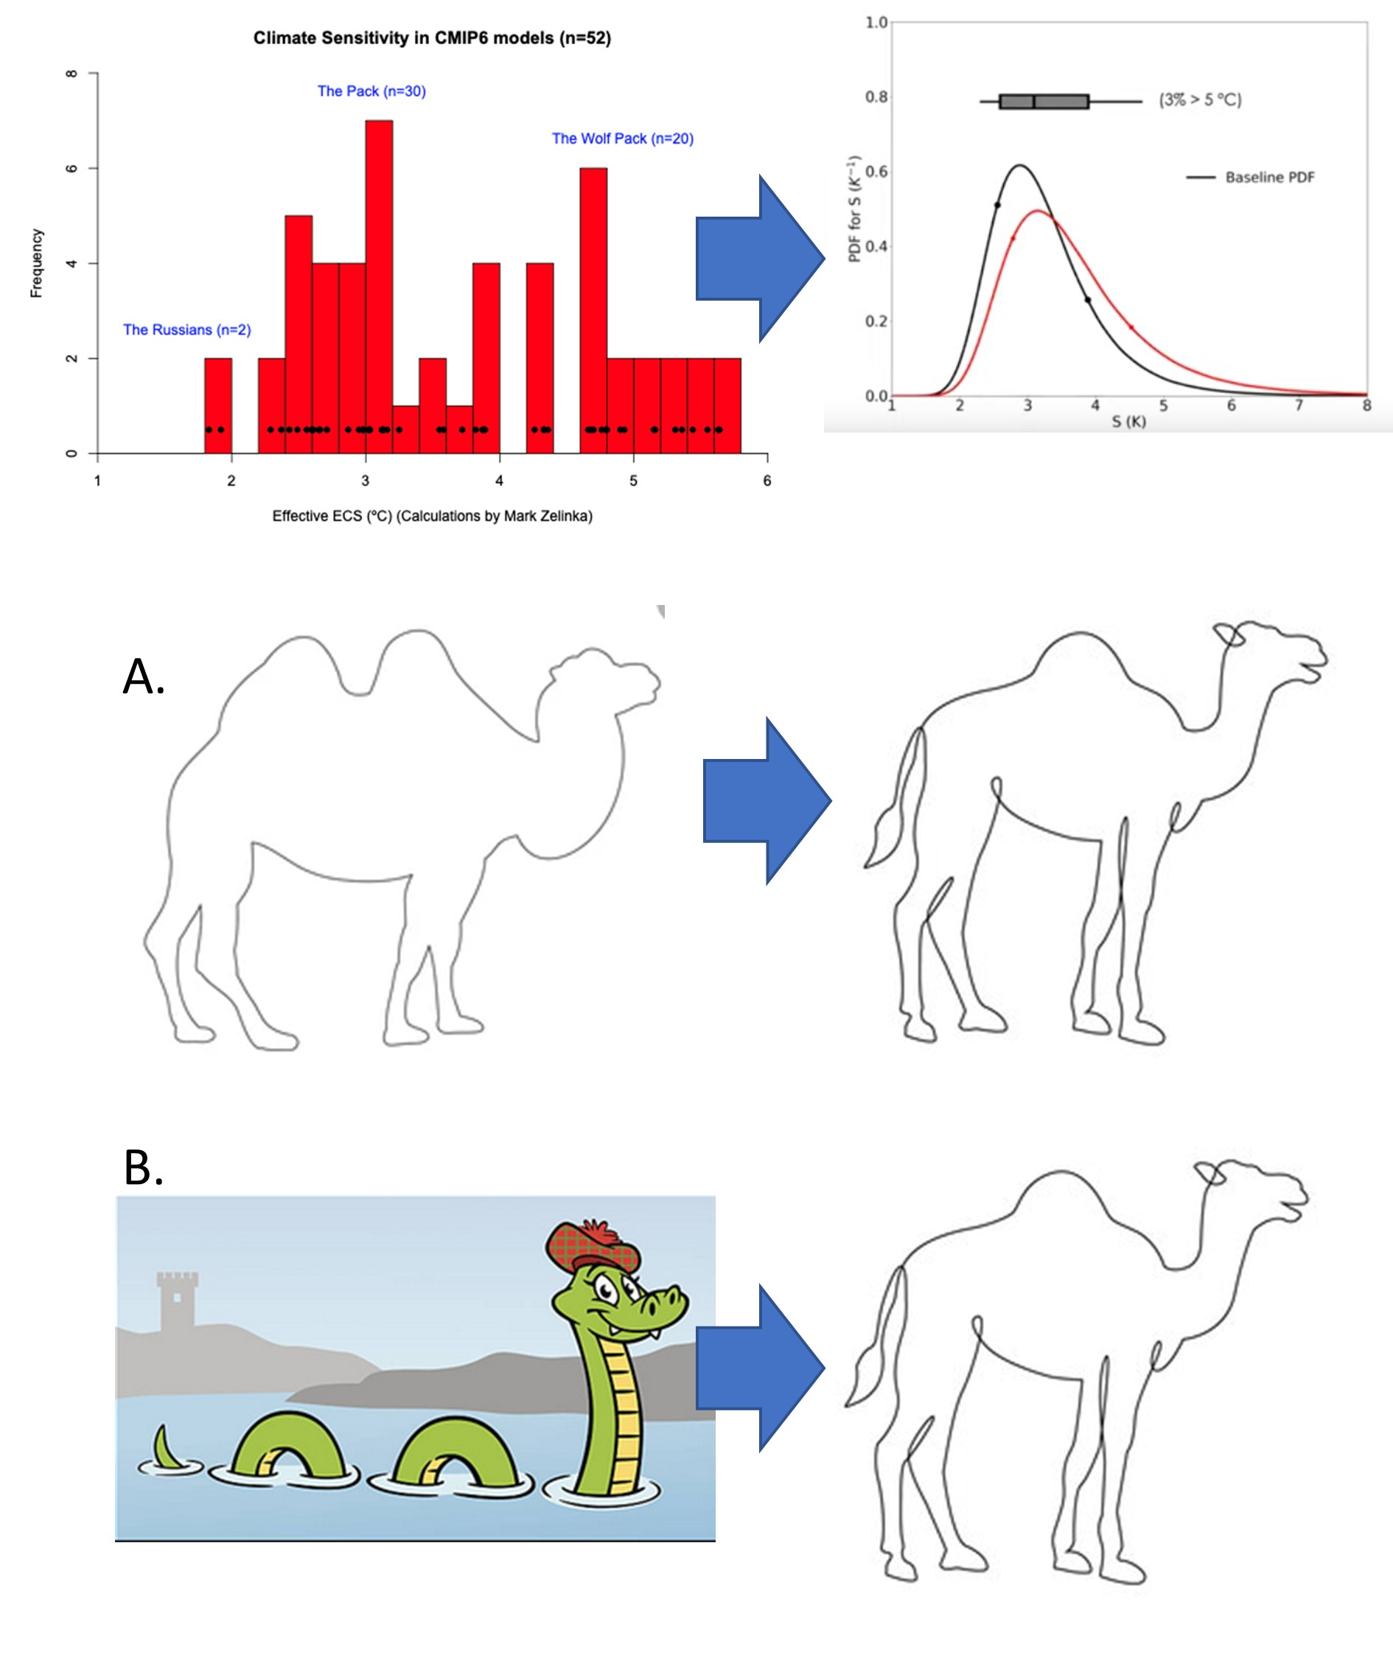
Comparing models to the assessment
Notes:
(1) Understanding and (2) reducing uncertainties in the CC projections. ROB COLMAN
Introduction
Climate sensitivity = the degree warming per unit of forcing (i.e. doubling CO2) for each model.
(this excludes the CC-feedback which sits on top of that).
Requires two-pronged attck: (1) understanding the model ensemble and (2) understanding the process in our model
Sensitivity has come down only marginally, much larger than inter-model variability.
Mainly due to feedback, mainly clouds(+/-), water vapour(++), surface albedo(+) and laps rate(-).
If we had an analogue for this in the current climate, that would be very useful.

Slide 9
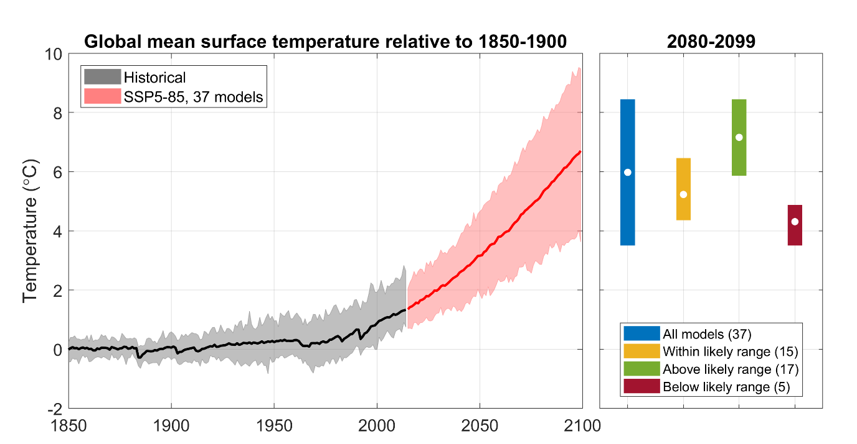
“One model, one vote” now not supportable?
Over-emphasised?
Dragged up?
Misleading?
Too low?
Notes:
(1) Understanding and (2) reducing uncertainties in the CC projections. ROB COLMAN
Introduction
Climate sensitivity = the degree warming per unit of forcing (i.e. doubling CO2) for each model.
(this excludes the CC-feedback which sits on top of that).
Requires two-pronged attck: (1) understanding the model ensemble and (2) understanding the process in our model
Sensitivity has come down only marginally, much larger than inter-model variability.
Mainly due to feedback, mainly clouds(+/-), water vapour(++), surface albedo(+) and laps rate(-).
If we had an analogue for this in the current climate, that would be very useful.

Slide 10
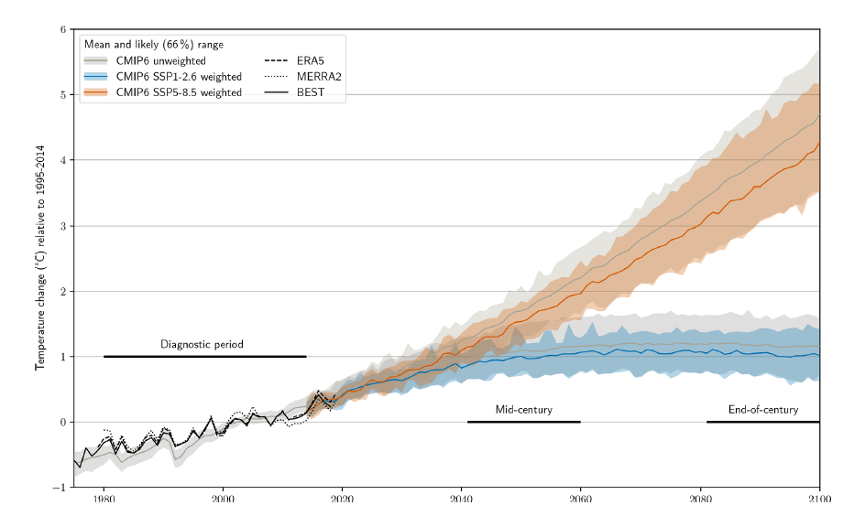
What to do about it?
Reject, weight models?
Already studies suggesting down-weighting outliers based on performance and independence, e.g. Brunner et al. 2020:
Notes:
(1) Understanding and (2) reducing uncertainties in the CC projections. ROB COLMAN
Introduction
Climate sensitivity = the degree warming per unit of forcing (i.e. doubling CO2) for each model.
(this excludes the CC-feedback which sits on top of that).
Requires two-pronged attck: (1) understanding the model ensemble and (2) understanding the process in our model
Sensitivity has come down only marginally, much larger than inter-model variability.
Mainly due to feedback, mainly clouds(+/-), water vapour(++), surface albedo(+) and laps rate(-).
If we had an analogue for this in the current climate, that would be very useful.

Slide 11
What to do about it?
Analyse groups of models separately?
For example,
Range from models within the likely range of ECS
Models above likely range – ‘low likelihood, high impact’ outcome
Below likely range – ‘low likelihood, low impact’
Notes:
(1) Understanding and (2) reducing uncertainties in the CC projections. ROB COLMAN
Introduction
Climate sensitivity = the degree warming per unit of forcing (i.e. doubling CO2) for each model.
(this excludes the CC-feedback which sits on top of that).
Requires two-pronged attck: (1) understanding the model ensemble and (2) understanding the process in our model
Sensitivity has come down only marginally, much larger than inter-model variability.
Mainly due to feedback, mainly clouds(+/-), water vapour(++), surface albedo(+) and laps rate(-).
If we had an analogue for this in the current climate, that would be very useful.

Slide 12
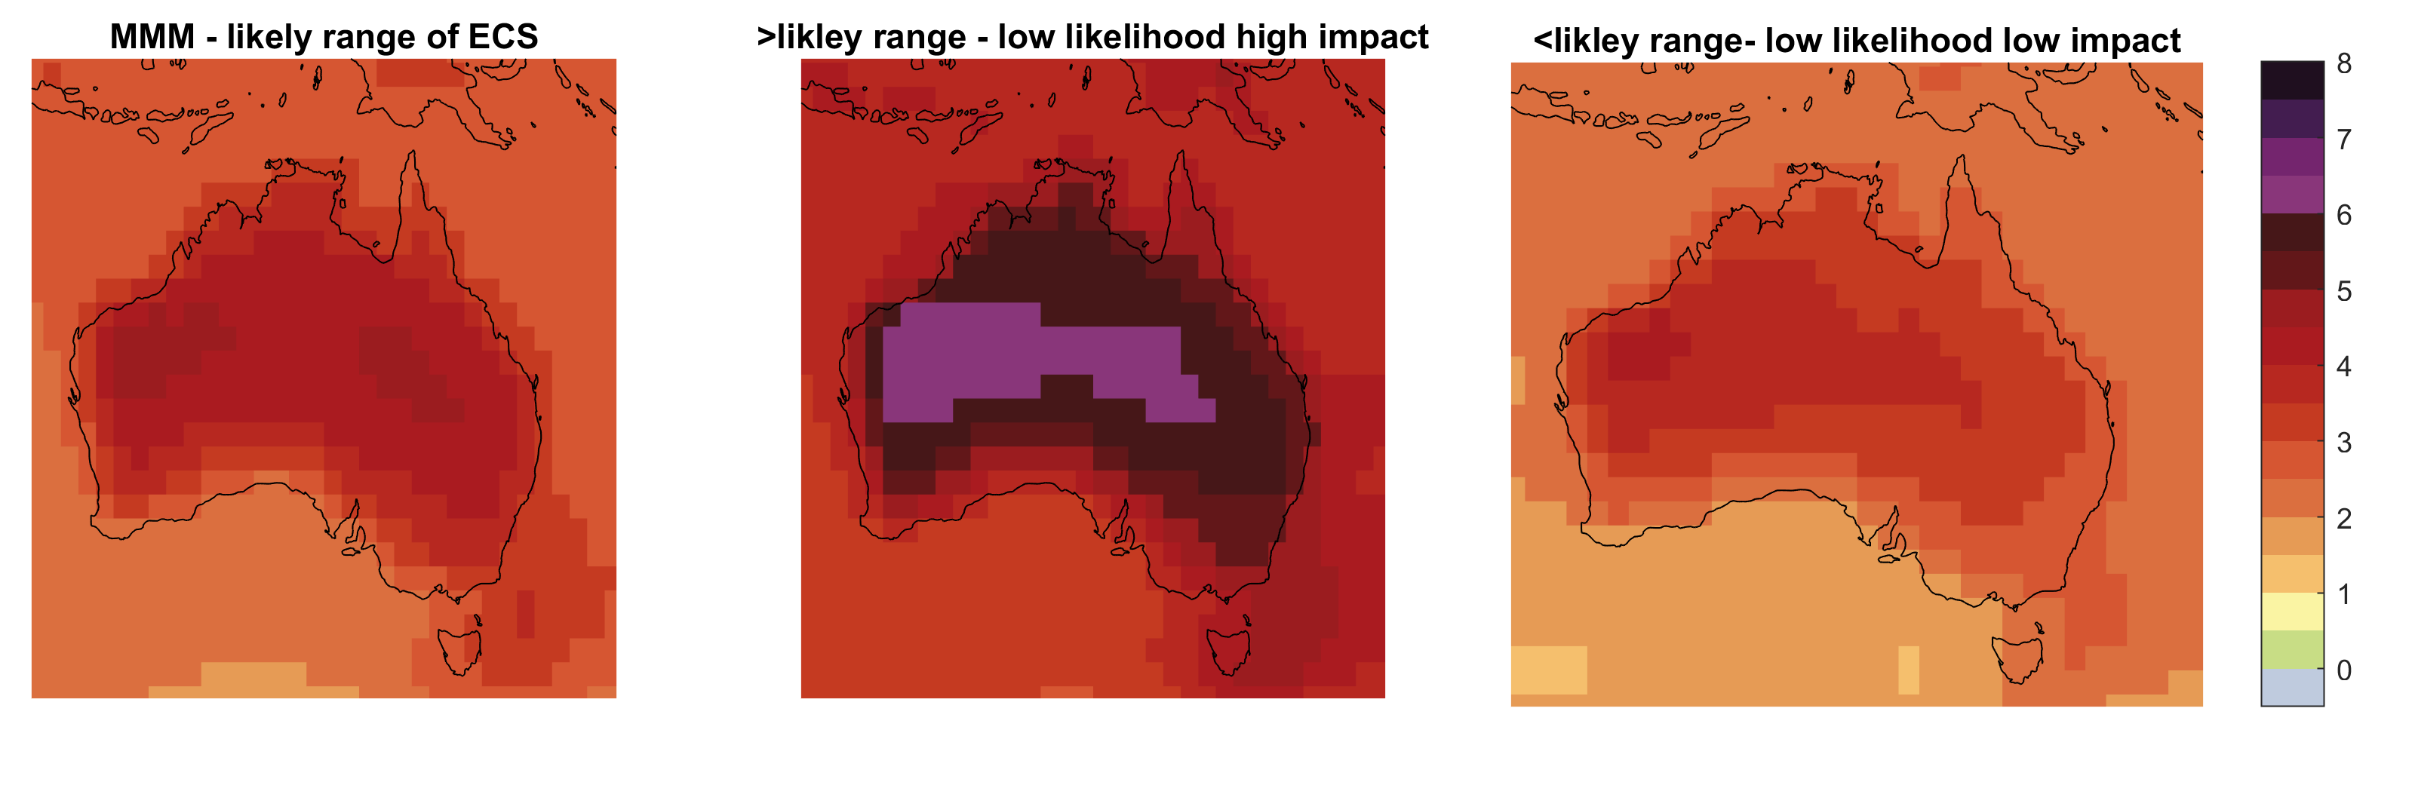
What to do about it?
Analyse groups of models separately?
Notes:
(1) Understanding and (2) reducing uncertainties in the CC projections. ROB COLMAN
Introduction
Climate sensitivity = the degree warming per unit of forcing (i.e. doubling CO2) for each model.
(this excludes the CC-feedback which sits on top of that).
Requires two-pronged attck: (1) understanding the model ensemble and (2) understanding the process in our model
Sensitivity has come down only marginally, much larger than inter-model variability.
Mainly due to feedback, mainly clouds(+/-), water vapour(++), surface albedo(+) and laps rate(-).
If we had an analogue for this in the current climate, that would be very useful.

Slide 13

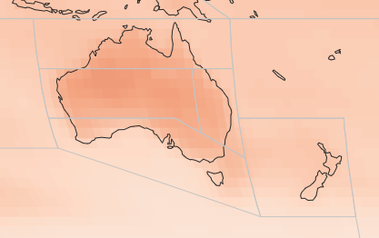
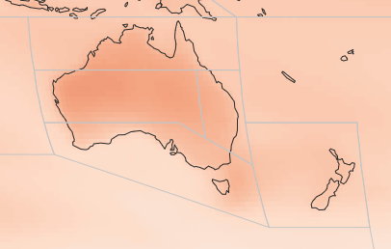
What to do about it?
Examine projections mainly by Global Warming Levels (+1.5, 2, 3 and 4 °C)?
Standardises for climate sensitivity, and how fast you get to each warming level
Bring in timing of reaching each GWL from independent assessment?
+2 °C GWL – CMIP5
+2 °C GWL – CMIP6
Notes:
(1) Understanding and (2) reducing uncertainties in the CC projections. ROB COLMAN
Introduction
Climate sensitivity = the degree warming per unit of forcing (i.e. doubling CO2) for each model.
(this excludes the CC-feedback which sits on top of that).
Requires two-pronged attck: (1) understanding the model ensemble and (2) understanding the process in our model
Sensitivity has come down only marginally, much larger than inter-model variability.
Mainly due to feedback, mainly clouds(+/-), water vapour(++), surface albedo(+) and laps rate(-).
If we had an analogue for this in the current climate, that would be very useful.

Slide 14

See our new NESP-CLEX Technical Note
Notes:
(1) Understanding and (2) reducing uncertainties in the CC projections. ROB COLMAN
Introduction
Climate sensitivity = the degree warming per unit of forcing (i.e. doubling CO2) for each model.
(this excludes the CC-feedback which sits on top of that).
Requires two-pronged attck: (1) understanding the model ensemble and (2) understanding the process in our model
Sensitivity has come down only marginally, much larger than inter-model variability.
Mainly due to feedback, mainly clouds(+/-), water vapour(++), surface albedo(+) and laps rate(-).
If we had an analogue for this in the current climate, that would be very useful.

