Slide 1

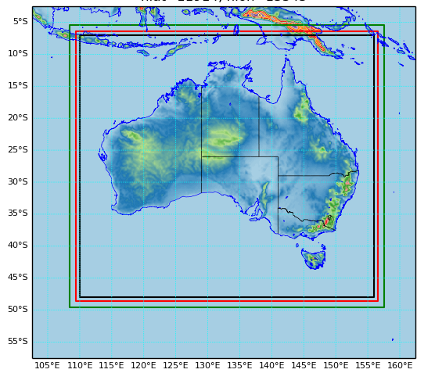
National Analysis System
Monika Krysta, Peter Steinle, Susan Rennie, Jin Lee, Tan Le, Wenming Lu, Imtiaz Dharssi, Ilia Bermous, Andy Smith, Shaun Cooper, Chris Tingwell, John Le Marshall, Charmaine Franklin
Research and Research to Operations Programs,
Science and Innovation Group,
Bureau of Meteorology, Melbourne

Slide 2
Background
Motivation
response to internal customers’ requirements
discrepancy between analysis and observations as perceived by forecasters
discrepancy between broadcast weather forecast and current meteorological situation as observed by general public
Purpose
improve situational awareness to support forecasters
supply current meteorological information to Forecast Systems
provide data for verification, case studies, scientific research
replace MSAS with a 3D representation of the atmosphere

Slide 3
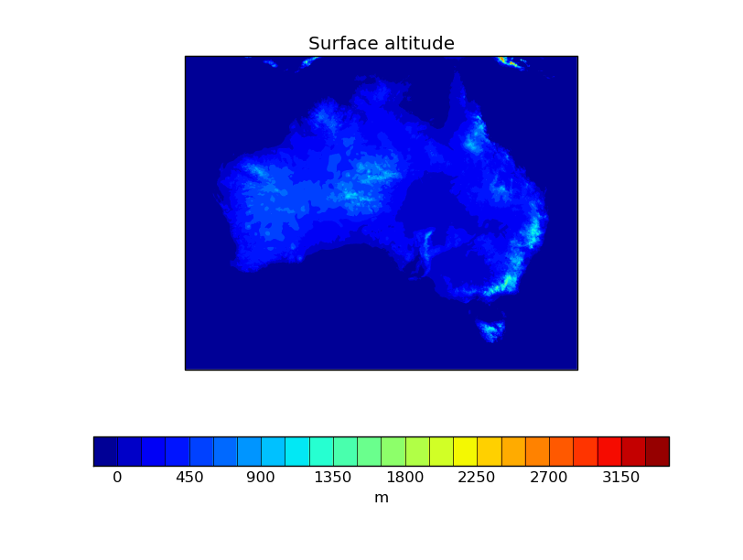
Solution
Concept
Use variational analysis to provide the current state of the atmosphere
Implementation
Domain covering entire Australia
2.2 km of horizontal grid spacing (2400x1920)
80 vertical levels (38.5 km)
High-resolution limited area hourly cycling suite
based on existing implementations of an hourly cycling 4D-Var suite for limited area applications (C3)
supplementary 3D-Var analyses performed using low-latency observations

Slide 4
How do these analyses work?
4DVar
Best analysis technique
Appropriate for cycling
Provides initial condition for a short forecast
Expensive
Cannot handle low latency
3DVar
Reasonable analysis technique
Not optimal for cycling due to an early cut-off
In two steps
Standard step adjusts large scale analyses
Additional step ensures a closer fit to observations – main product
Cheap
Appropriate for low latency
4DVar (t)
Forecast (t→t+n)
3DVar (t+1)
3DVar (overfit)
4DVar (t+1)
Forecast (t+1→t+n+1)
3DVar (t+2)
3DVar (overfit)
Slide modified from Pete Steinle, with permission

Slide 5
Assimilated Observations
Early cut-off 15 min after every hour for 3D-Var
Conventional observations including surface, aircraft, sonde
Atmospheric motion vectors
ASCAT winds
Late cut-off 55 min after every hour for 4D-Var
Conventional observations including surface, aircraft, sonde
Atmospheric motion vectors
ASCAT winds
Satellite radiances (with bias correction)
AIRS, ATMS, ATOVS,CRIS IASI
Ground GPS
Doppler radial winds

Slide 6
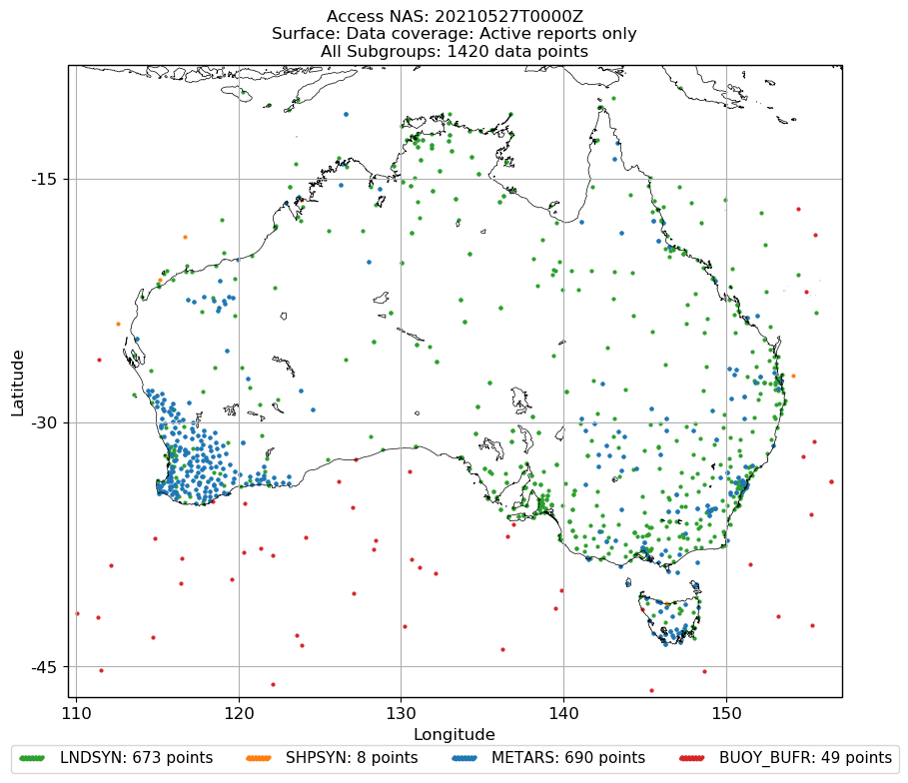
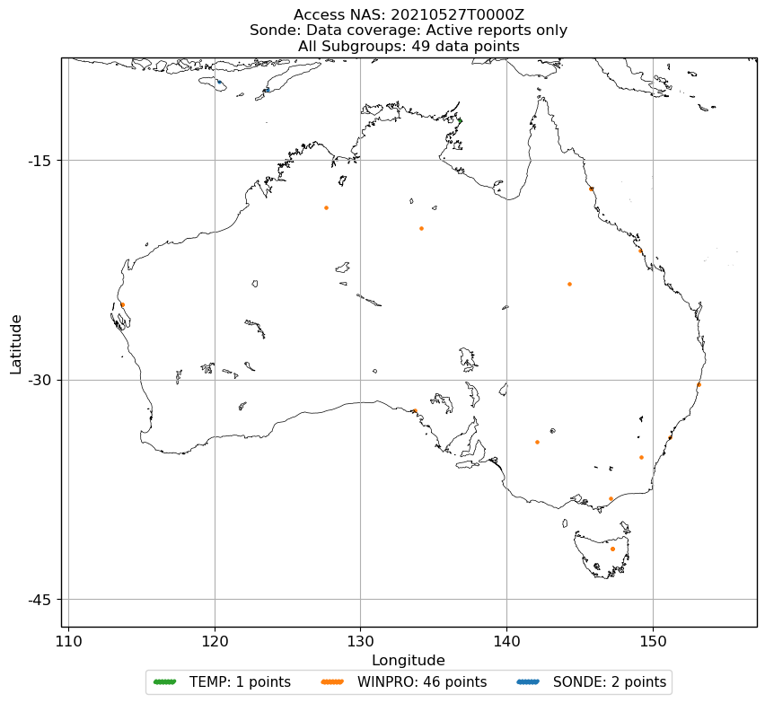
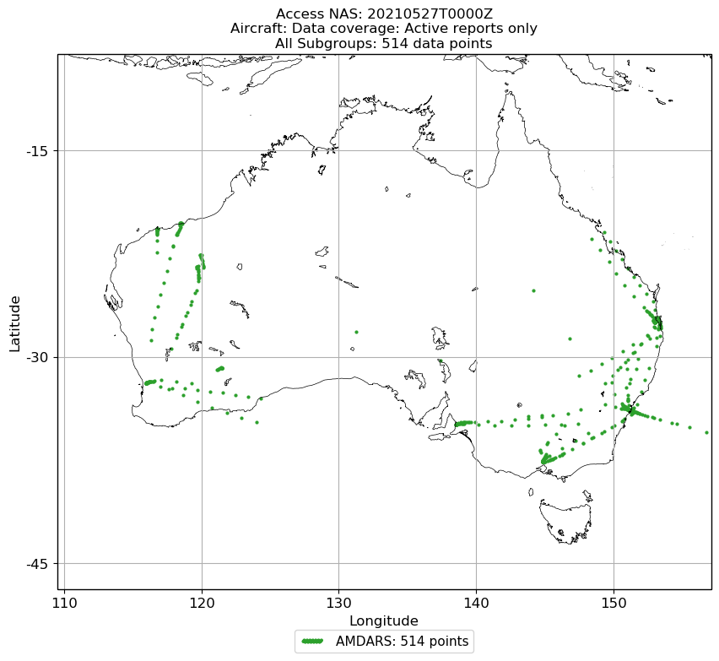
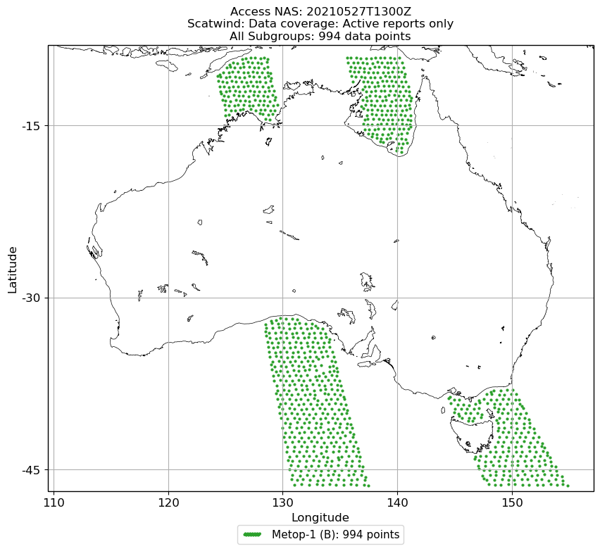
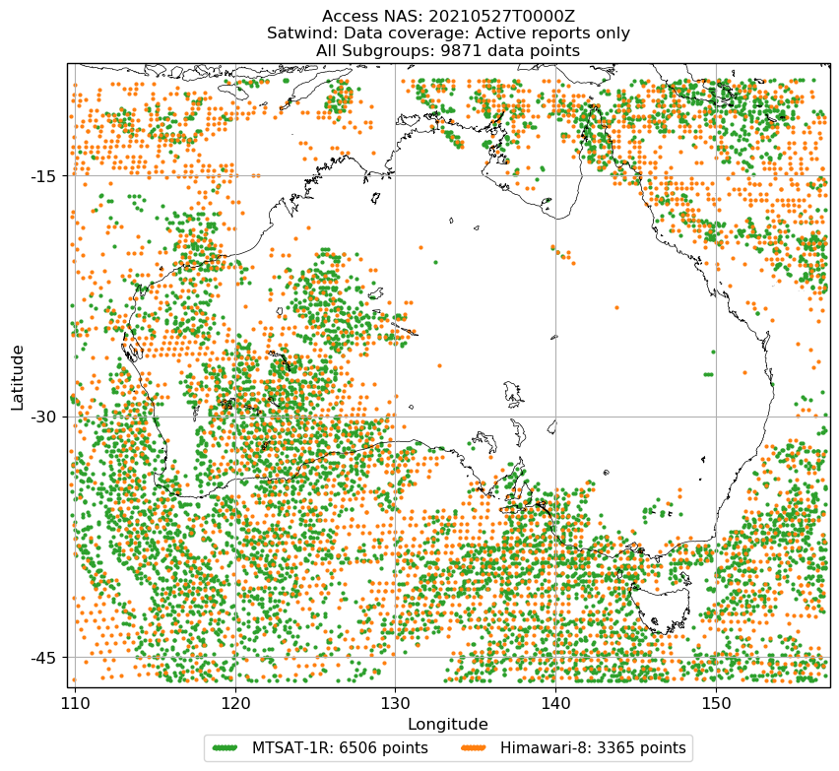
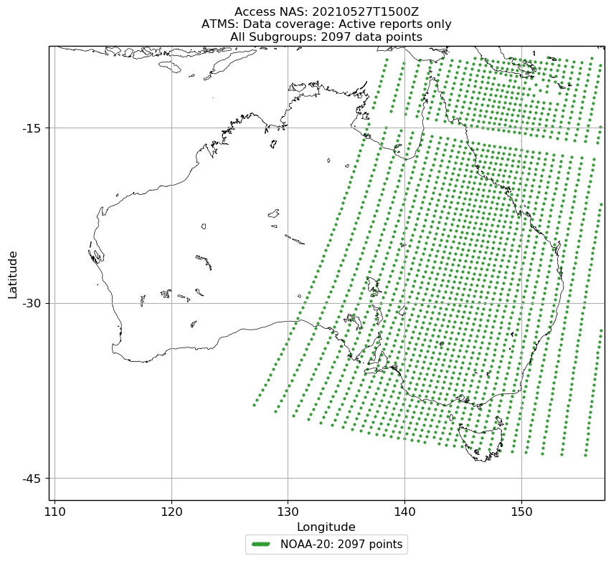
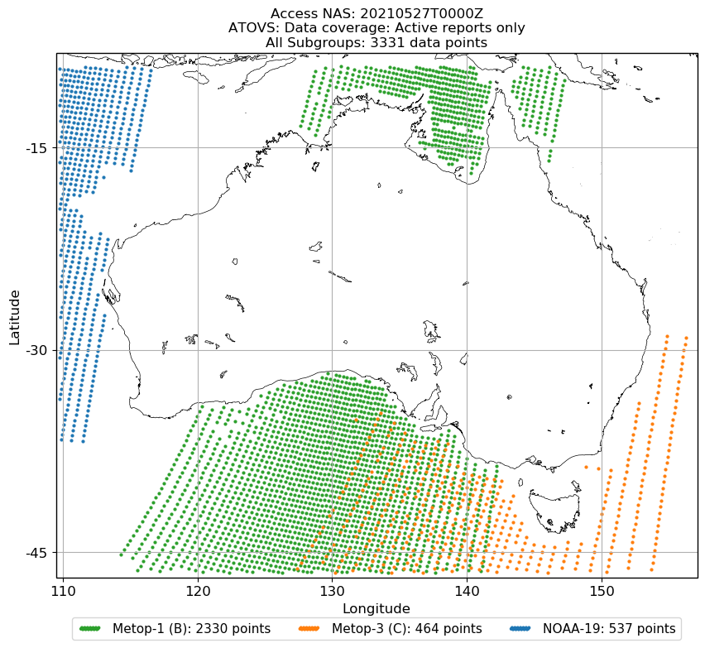
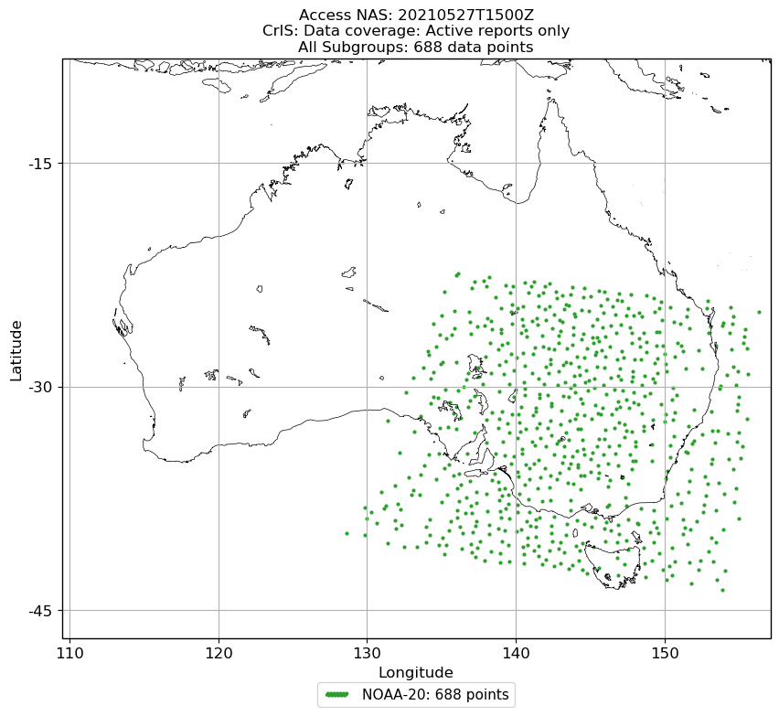
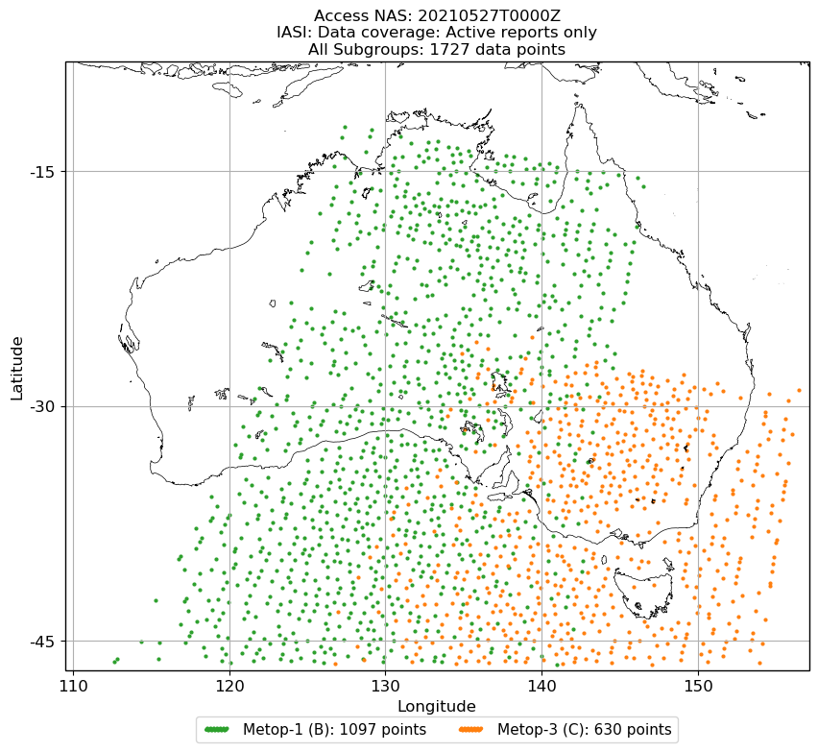
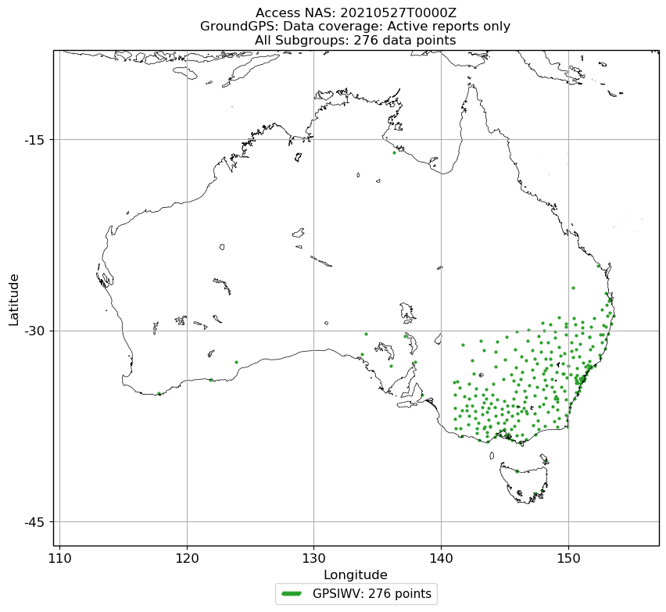
Observation Coverage
Surface
Sonde
Aircraft
ASCAT
AMVs
20210527T1300Z
ATMS
ATOVS
CrIS
IASI
Ground GPS
20210527T1500Z
20210527T1500Z
20210527T0000Z
Plots courtesy of Andy Smith

Slide 7
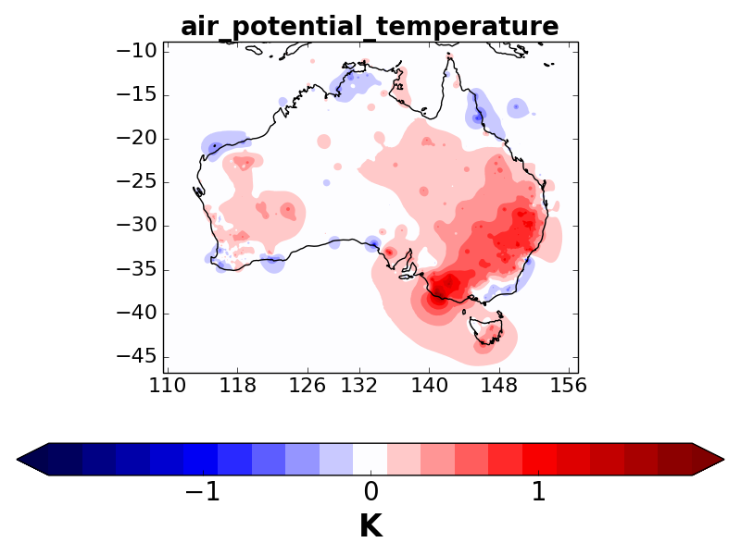
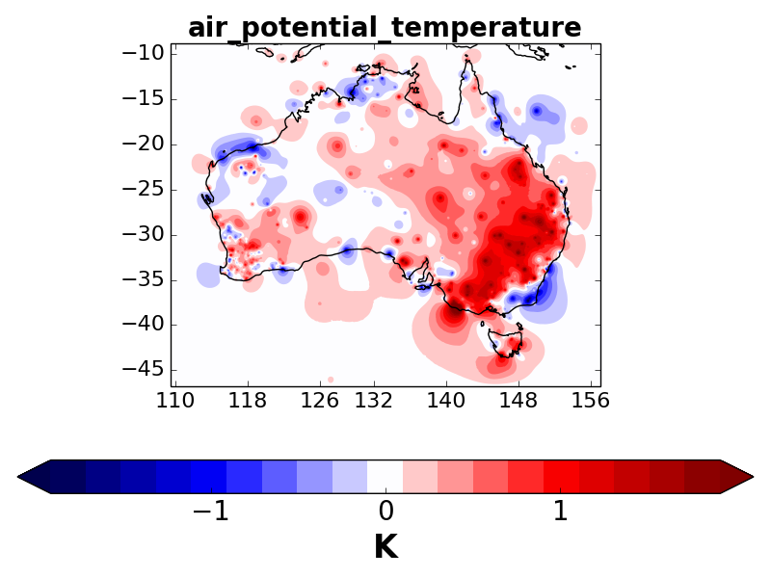
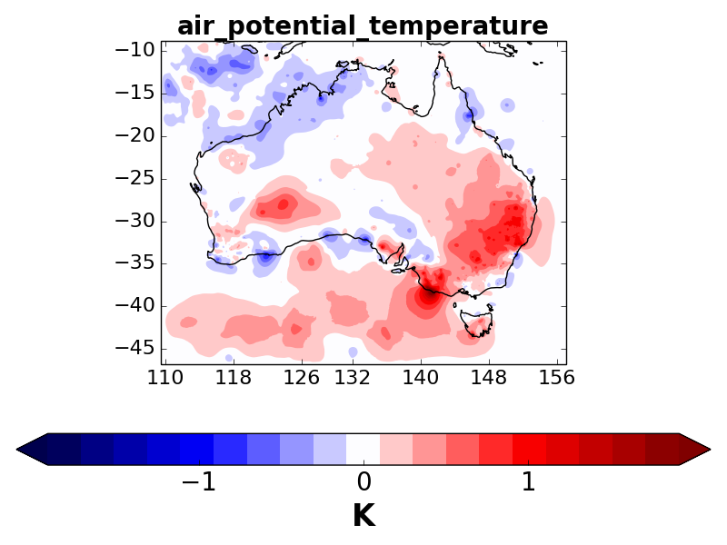
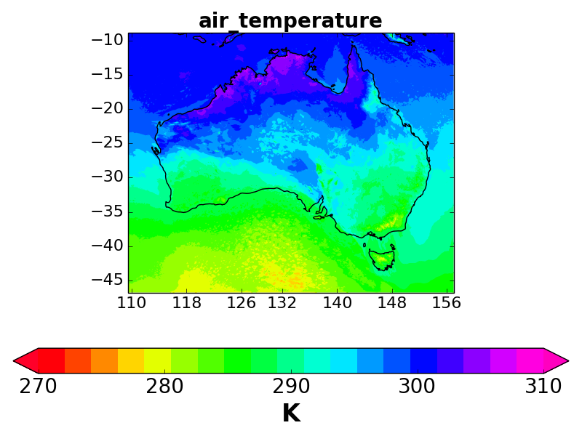


Analyses of Temperature
3D-Var
fit to obs
4D-Var
3D-Var
Analysis
Increments
Analyses
20210607T0600Z

Slide 8
Notable Upcoming Additions
GeoCloud
Assimilation of cloud information from an IR imager (AHI) carried by a geostationary satellite Himawari-8
Implementation and testing in C3 to be extrapolated to NAS
See Jin Lee's presentation
Soil moisture assimilation
Assimilation of soil moisture observations from ASCAT instruments on MetOp in an EKF set up for NAS
Substantial resources required to validate a configuration for Australia
Confidence in the implementation will then be ported to C3
GPSRO
Requires adaptation of a present implementation in a global model to a lower model top and different vertical levels in NAS
Upgrade to 90 vertical levels

Slide 9
Challenges
Significant computational resources and storage space required
Analysis (does not scale well) and forecast (scales reasonably well) to fit within a 1h (20 min) window
Timely acquisition of observations
Observation monitoring necessary
Assimilation of new observation types
Verification of analyses
Cross-validation with ~2.5% surface observation withheld per analysis
Interaction with users and coordination with other projects
Information sharing fortnightly meeting with forecasters

Slide 10
Thank You

