Slide 1
Verification of ACCESS surface winds for wave modelling
Stefan Zieger
11 June 2021

Slide 2
Outline
Observations
Verification
Hindcast
Forecast
Summary

Slide 3
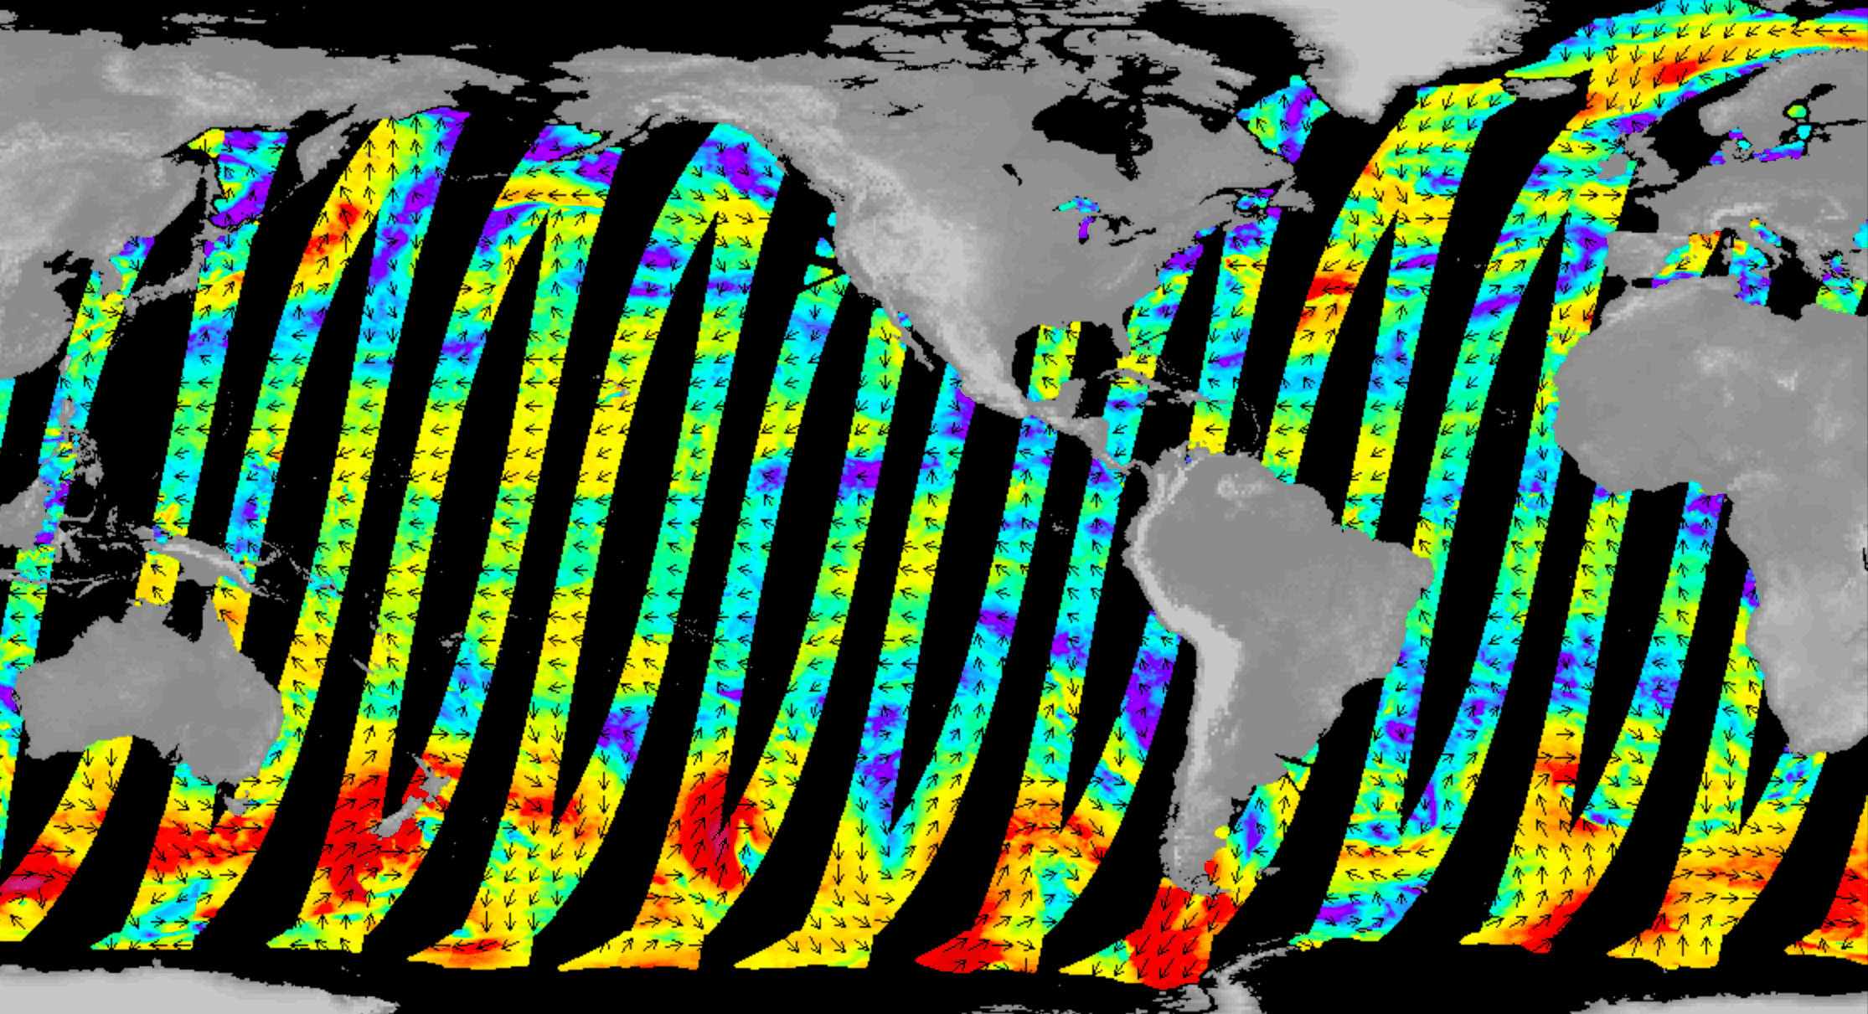
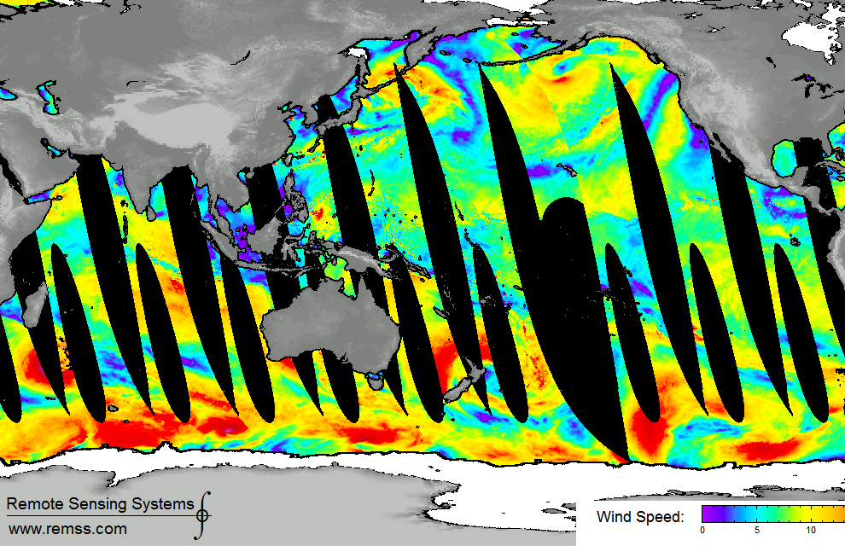
Observations
Daily global coverage
Scatterometer winds (ASCAT)
Active system based on C-band radar
Wind speed range: 0 – 25 m/s
Error: 0.98 m s⁻¹
Radiometer winds (AMSR2)
Passive microwave system based on brightness temperature.
Wind speed range: 0 – 30 m/s
Error: 0.9 m s⁻¹ (no-rain conditions)
Source: Remote Sensing Systems

Slide 4
ACCESS-G3 verification – surface winds
Period: June – October 2020
Recurring ACCESS-G3 surface fields (0-11 hours; hourly)
Resolution: ~12km
Radiometer winds (AMSR2)
Scatterometer winds (ASCAT)
RMSE: 1.21 to 1.26 m s⁻¹
R: 0.946 to 0.950
SI: 0.15 to 0.16
BIAS: -0.23 to -0.11 m s⁻¹

Slide 5
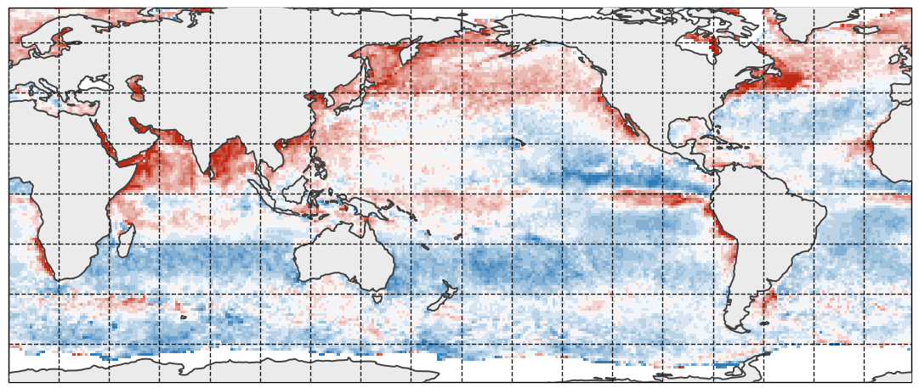
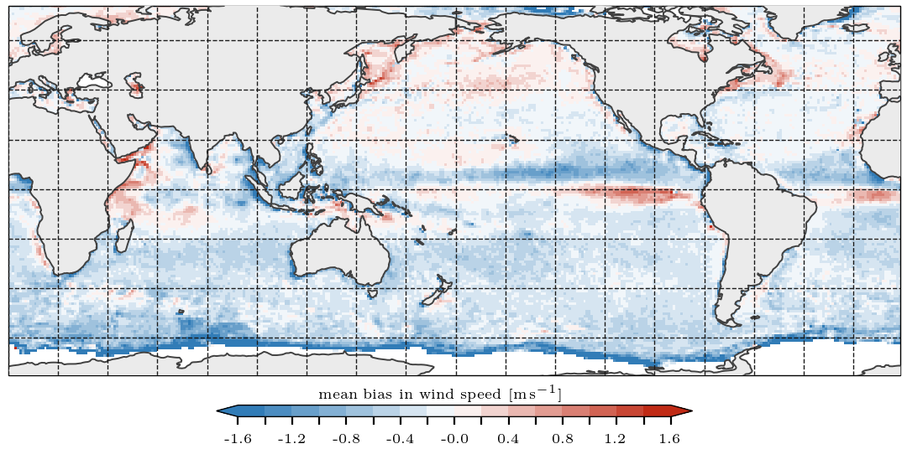
ACCESS-G3 surface wind verification
Period: 01/06/2020 – 01/10/2020
Radiometer wind speed error: 0.9 m s⁻¹ (no-rain conditions)
Scatterometer wind speed error: 0.98 m s⁻¹
Young & Donelan (2018) identified systematic differences in radiometer winds speed that vary in latitude and season.
Radiometers
Scatterometers

Slide 6
Wave model
Cost 1.00 translates to 12 minutes runtime per day simulation (384 CPUs).
 | ST | OM3 | SNL | WINDS | COST | NAMELIST PARAMETERS
OPR | ST4 | No | NL1 | 1.45 | 0.22 | —
S01 | ST6 | No | NL1 | 1.00 | 0.91 | Default LAMBDA=0.250 NLPOP=3.00E7 SINA0=0.09
S02 | ST6 | Yes | NL1 | 1.00 | 1.02 | RWNDC=0.5
S03 | ST6 | Yes | NL3 | 1.00 | 1.60 | NQDEF=5 RWNDC=0.5
S04 | ST6 | No | NL3 | 1.00 | 1.54 | NQDEF=5
S05 | ST6 | No | NL1 | 1.02 | 0.91 | —
S06 | ST6 | Yes | NL1 | 1.02 | 0.93 | RWNDC=0.5
S07 | ST6 | Yes | NL3 | 1.02 | 1.66 | NQDEF=5 RWNDC=0.5
S08 | ST6 | No | NL1 | 1.01 | 1.04 | —
S09 | ST6 | Yes | NL1 | 1.01 | 0.91 | RWNDC=0.5
S10 | ST6 | Yes | NL1 | 1.02 | 1.02 | RWNDC=0.55
S11 | ST6 | Yes | NL1 | 1.05 | 1.07 | LAMBDA=0.237 NLPOP=2.13E7 RWNDC=0.5
S12 | ST6 | Yes | NL1 | 1.05 | 1.07 | LAMBDA=0.233 NLPOP=1.20E7 DIA OPT w/ NLOPT RWNDC=0.5
S13 | ST6 | Yes | NL3 | 1.05 | 1.20 | NQDEF=1 QPARMS = 0.234,0.0,-1.0,2.13E7,2.737E5 RWNDC=0.5
S14 | ST6 | Yes | NL1 | 1.05 | 1.06 | LAMBDA=0.237 NLPOP=2.13E7 RWNDC=0.55
S15 | ST6 | Yes | NL1 | 1.03 | 1.06 | LAMBDA=0.237 NLPOP=2.13E7 SINA0=0.08 RWNDC=0.60
S16 | ST6 | No | NL1 | 1.05 | 0.93 | LAMBDA=0.237 NLPOP=2.13E7 SINA0=0.08
S17 | ST6 | No | NL1 | 1.02 | 0.93 | LAMBDA=0.237 NLPOP=2.13E7 SINA0=0.08
S18 | ST6 | No | NL1 | 1.03 | 0.93 | LAMBDA=0.237 NLPOP=2.13E7 SINA0=0.08
S21 | ST4 | No | NL1 | 1.43 | 1.00 | —
S22 | ST4 | Yes | NL1 | 1.45 | 1.07 | RWNDC=0.5
S23 | ST4 | No | NL1 | 1.45 | 0.98 | —
S24 | ST4 | No | NL1 | 1.40 | 0.95 | —
S25 | ST4 | Yes | NL1 | 1.42 | 1.08 | RWNDC=0.5

Slide 7
Hindcast verification – altimeter
OPR
S15

Slide 8
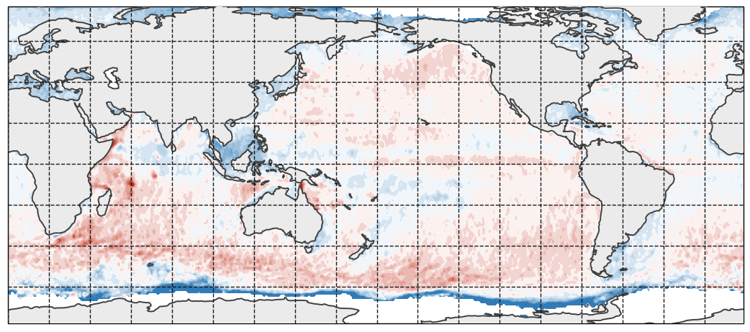
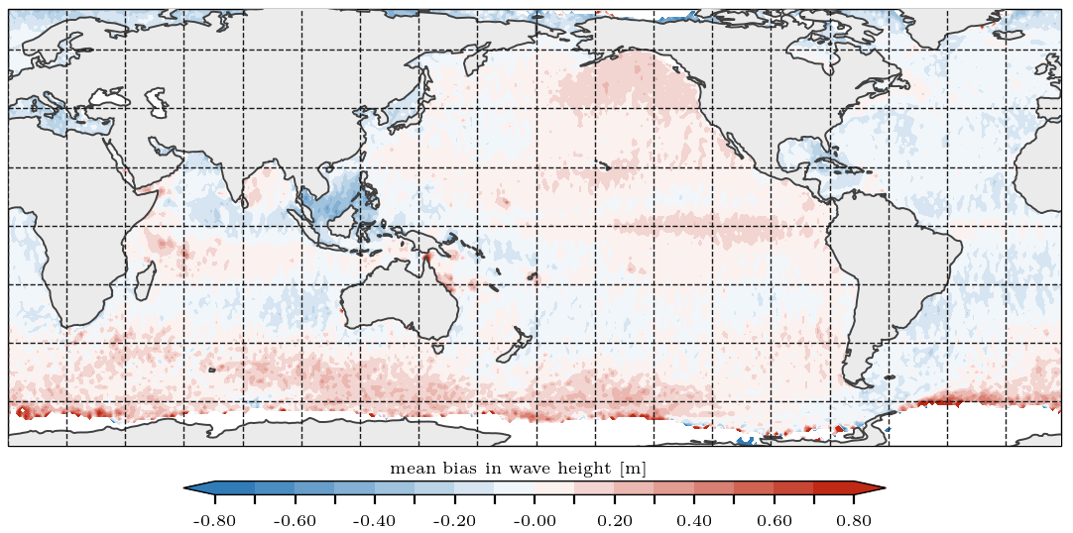
Hindcast verification – altimeter
OPR
S15

Slide 9
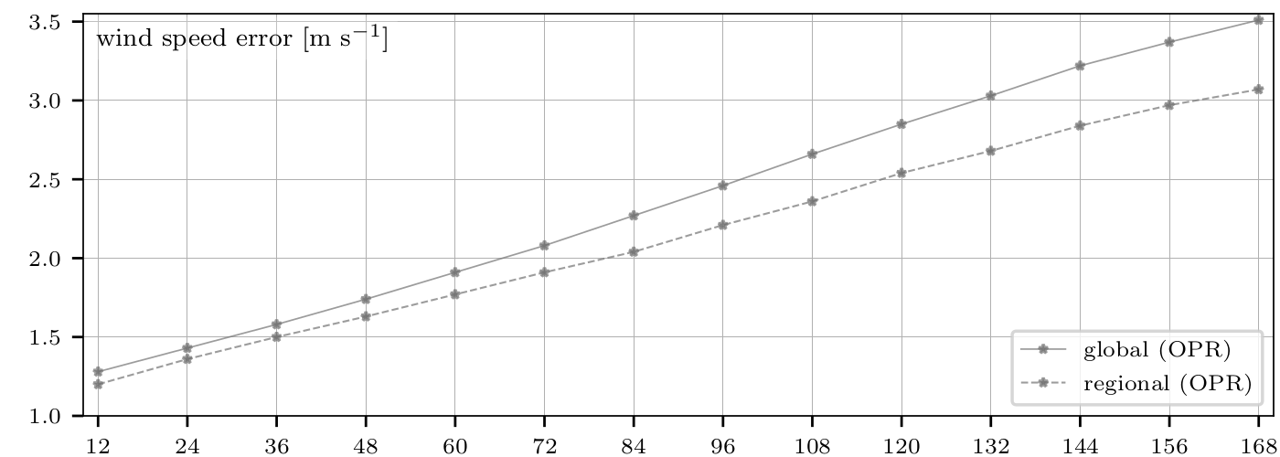
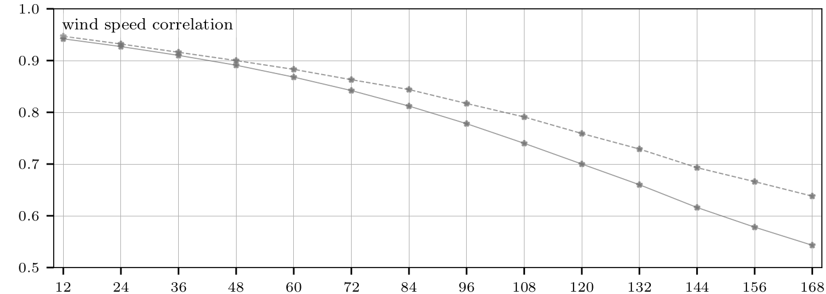
Forecast verification
RMSE in surface wind speed increases linearly with lead time.
Correlation decreases with lead time.
Performance around Australia is generally better than global.

Slide 10
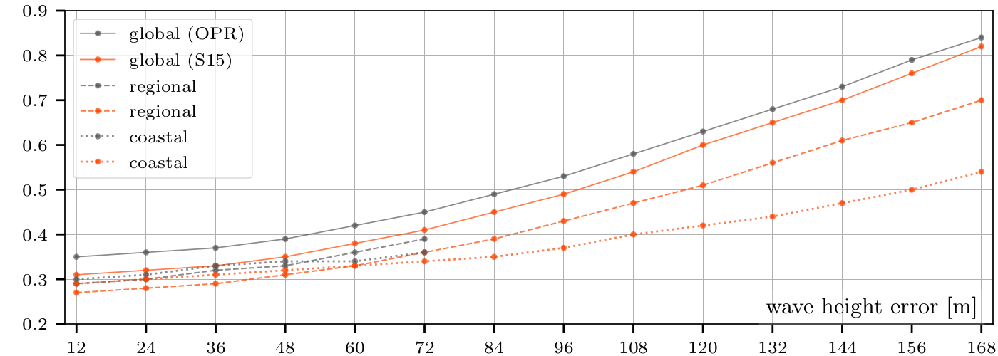
Forecast verification
Wind speed
Wave height

Slide 11
Summary
RMSE, MAE and SI increase with lead time
No change in bias and standard deviation with lead time
No drift in ACCESS-G3 surface winds (persistent boundary conditions)
Error due to phasing ?
REG. | LEAD TIME | E | AE | B | R | I | SI | FIT0 | STD(M) | STD(O)
GLOBAL | +12 | 1.28 | 0.90 | -0.27 | 0.942 | 0.942 | 0.15 | 0.96 | 3.69 | 3.68
 | +24 | 1.43 | 1.02 | -0.25 | 0.927 | 0.943 | 0.17 | 0.96 | 3.69 | —
 | +36 | 1.58 | 1.12 | -0.24 | 0.910 | 0.944 | 0.19 | 0.96 | 3.69 | —
 | +48 | 1.74 | 1.24 | -0.23 | 0.891 | 0.946 | 0.21 | 0.96 | 3.69 | —
 | +60 | 1.91 | 1.35 | -0.23 | 0.868 | 0.946 | 0.23 | 0.96 | 3.69 | —
 | +72 | 2.08 | 1.48 | -0.23 | 0.842 | 0.947 | 0.25 | 0.95 | 3.69 | —
 | +84 | 2.27 | 1.61 | -0.22 | 0.812 | 0.948 | 0.27 | 0.95 | 3.68 | —
 | +96 | 2.46 | 1.75 | -0.21 | 0.778 | 0.950 | 0.30 | 0.94 | 3.68 | —
 | +108 | 2.66 | 1.89 | -0.21 | 0.740 | 0.951 | 0.32 | 0.94 | 3.68 | —
 | +120 | 2.85 | 2.03 | -0.21 | 0.700 | 0.952 | 0.35 | 0.93 | 3.67 | —
 | +132 | 3.03 | 2.17 | -0.24 | 0.660 | 0.951 | 0.37 | 0.92 | 3.67 | —
 | +144 | 3.22 | 2.31 | -0.24 | 0.616 | 0.949 | 0.39 | 0.91 | 3.67 | —
 | +156 | 3.37 | 2.43 | -0.26 | 0.578 | 0.948 | 0.41 | 0.90 | 3.67 | —
 | +168 | 3.51 | 2.54 | -0.27 | 0.543 | 0.946 | 0.43 | 0.90 | 3.68 | —

Slide 12
Questions?
Stefan Zieger
+61 3 9669 4813
stefan.zieger@bom.gov.au

