Slide 1
Using METPlus for Verification of ACCESS-C3 Forecasts
•Nandun Thellamurege
•Software Engineer
•Performance Evaluation and O2R
•Bureau of Meteorology
Notes:
New group (July 2021)
Bought together the verification staff within the Bureau.

Slide 2
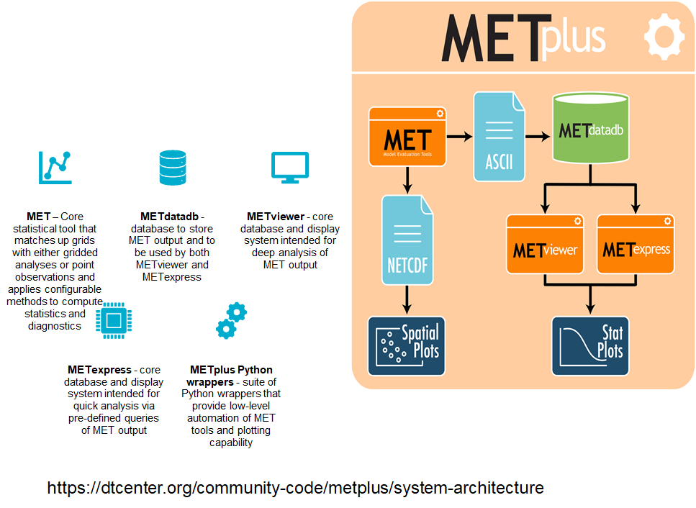

Slide 3
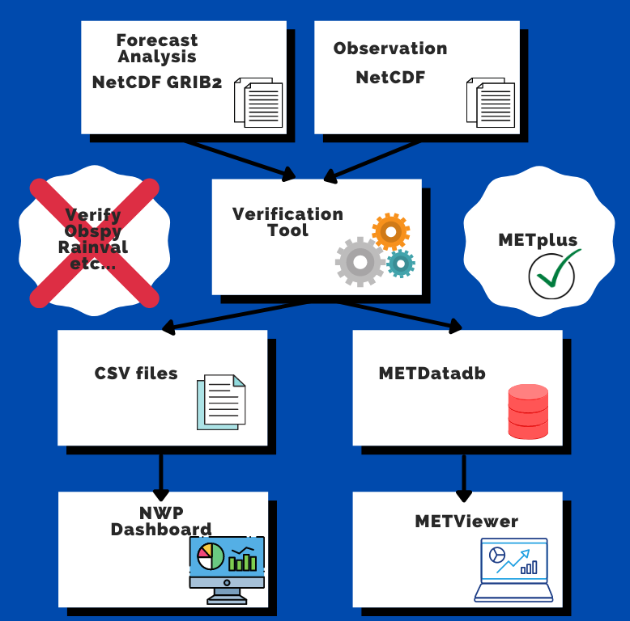
It is the chosen package in the UM Partnership. ​
​
It has been proposed by Forecast Quality Business case to use METPlus as the ongoing gridded verification package for all Australian NWP models. ​
​
In the future, when ready, METPlus will replace the current verification software such as Verify, Obspy , RainVal etc…
​
This will reduce the amount of software used and streamline into one package
Notes:
(graphs or dashboards)
for KPIs and Forecasters

Slide 4
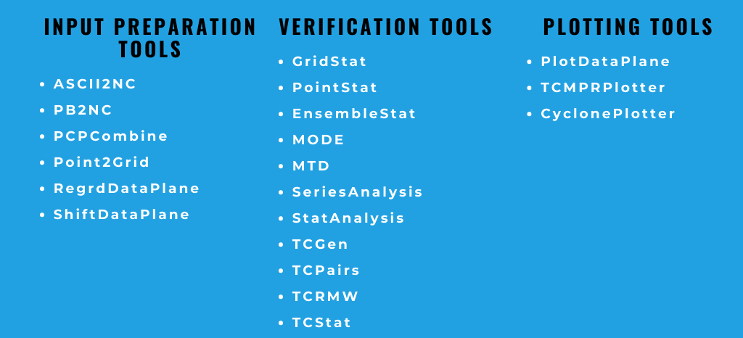

Slide 5
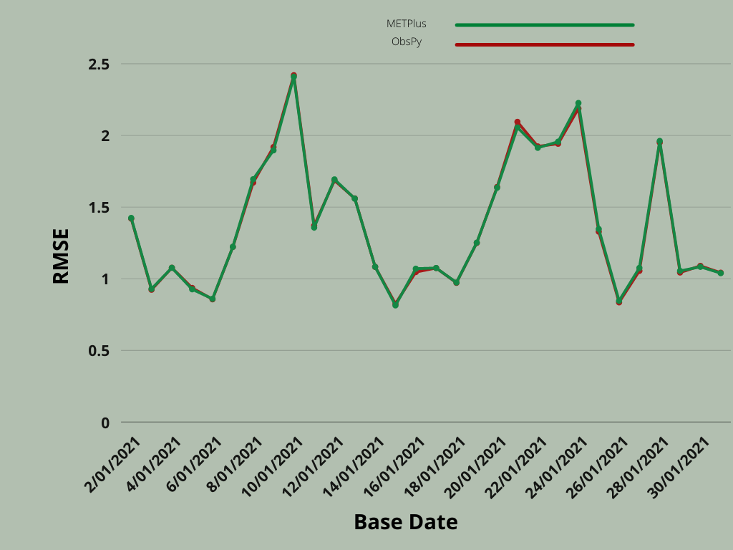
Comparison Between MetPlus and ObsPy
Parameter: Screen Temp
Period: 2021/01
Domain: Ad
Base Time: 0000
Lead Time: 6 Hrs

Slide 6
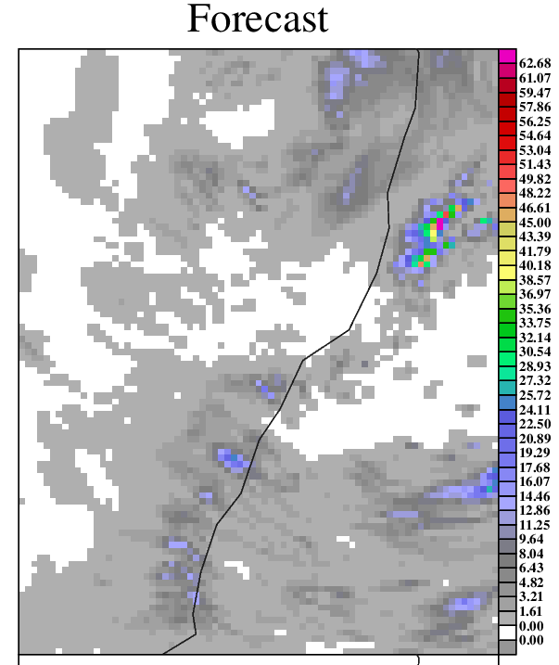
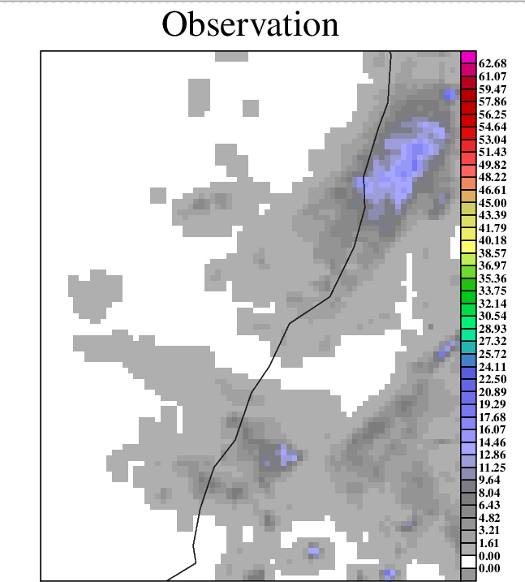
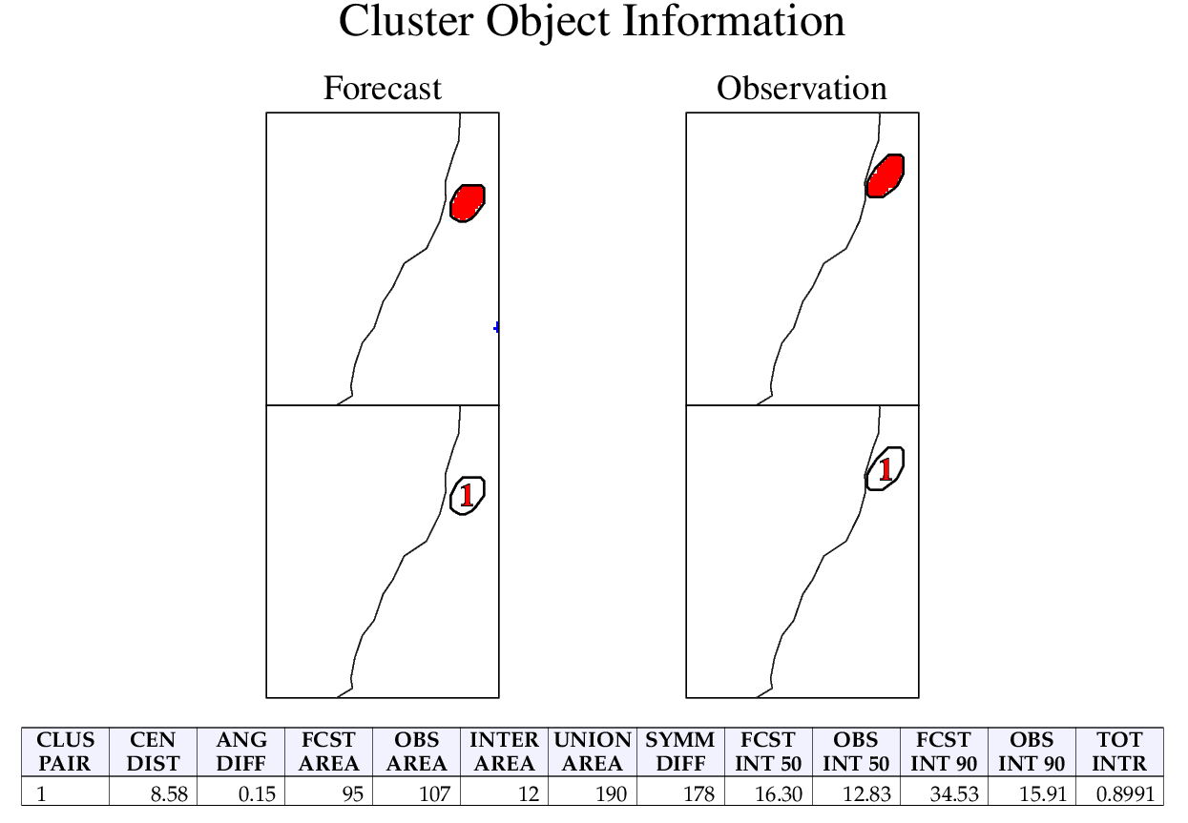
Method for Object-based Diagnostic Evaluation (MODE)
Answers the question : How similar are the forecast objects to the observed objects according to a variety of descriptive criteria?
Precipitation accumulation >= 10 mm
Domain Sy
Date 20210505

Slide 7
Thank you
Any Questions?

