Slide 1
Improved parameterisations of lightning-produced NO_{x} and their impact on tropospheric composition in ACCESS-UKCA
Ashok Luhar¹, Ian Galbally¹, Matt Woodhouse¹, Luke Abraham²
¹Climate Science Centre, CSIRO Oceans and atmosphere Business Unit; ²university of Cambridge
Thanks to Met Office (Fiona O’Connor and Mohit Dalvi) and CSIRO (Martin Dix)

Slide 2
Lightning-produced oxides of nitrogen (LNO_{x})
Lightning-produced NO_{x} (or LNO_{x}) impacts tropospheric composition (e.g. O₃ , OH , CO and CH₄ ) and thus climate and air quality
LNO_{x} is ∼ 10% of the global NO_{x} source, but its O₃ production efficiency per unit NO_{x} is an order of magnitude higher than the surface NO_{x}
Of all NO_{x} sources, LNO_{x} is the biggest contributor to tropospheric ozone in the Southern Hemisphere (Grewe, 2007)
LNO_{x} is a major source of ozone bias in global chemistry models – large uncertainty: 2 – 8 Tg N yr⁻¹ (Schumann and Huntrieser, 2007)
LNO_{x} = Lightning flash rate (F) x NO emitted per flash
Most global chemical transport and chemistry-climate models, including ACCESS-UKCA, use Price and Rind’s (1992, PR92) empirical parameterisations for lightning flash-rate (F) which are functions of convective cloud-top height (H)
Price and Rind (1992)
Oceanic flash rates smaller by 2 orders of magnitude
Notes:
Dissociation of N and O molecules due to high temperature, formation of NO and then NO2

Slide 3
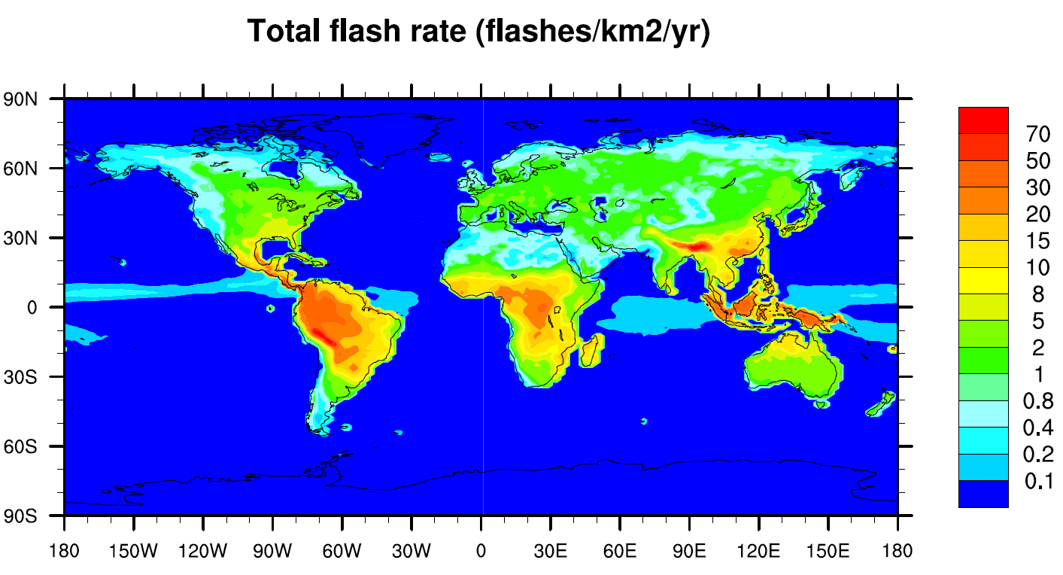
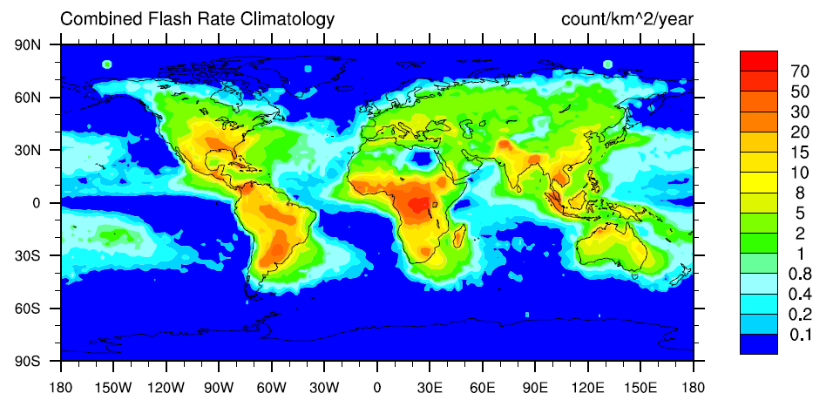
ACCESS-UKCA performance for lightning flash rate (F)
Comparison with the Lightning Imaging Sensor and Optical Transient Detector (LIS/OTD) satellite data (Cecil et al., 2014) - Year 2006
Model
Data
Model
Model
Data
Total observed and modelled lightning flash frequency (count s⁻¹)
 | Global | Land | Ocean | Northern Hemisphere | Southern Hemisphere
Data - climatology | 46.2 | 38.3 | 7.9 | 27.0 | 19.2
ACCESS-UKCA | 32.9 | 32.5 | 0.4 | 16.2 | 16.7
The simple PR92 parameterisations work well over land, but the observed oceanic flash rate is severely underestimated (a known result)

Slide 4
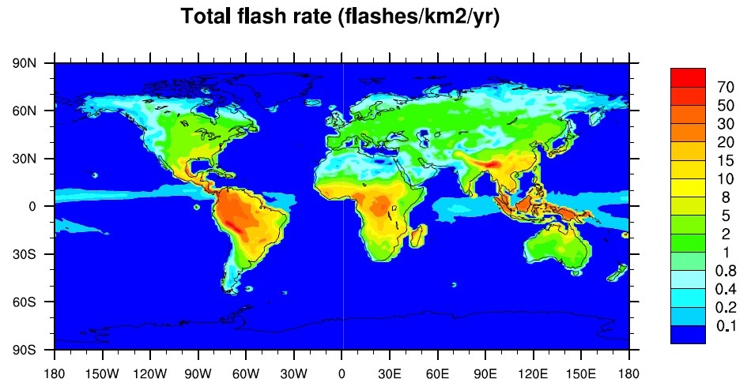
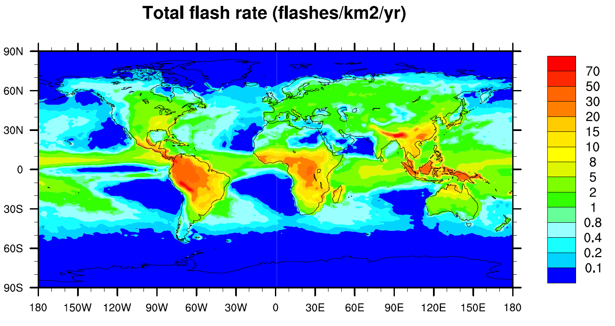
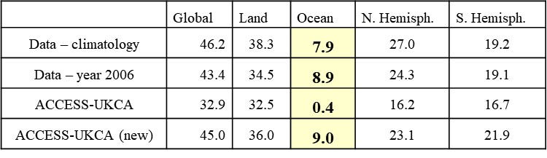


Improving the lightning flash-rate parameterisations
PR92
Boccippio (2002) derived a fundamental scaling relationship between thunderstorm electrical generator power and storm geometry:
Using intermediate steps and available data the coefficients are derived
New relationships:
$$F_{L}=3.44×10^{−5}H^{4.9}$$
$$F_{O}=6.4×10^{−4}H^{1.73}$$
Climatology - Data
ACCESS-UKCA (default)
ACCESS-UKCA with new flash rates
Observed and modelled lightning flash frequency (count s⁻¹)
Although there are some significant spatial differences, the new oceanic flash rate parameterisation in ACCESS-UKCA gives much better results
Notes:
New land parameterisation similar to PR92 Land one.

Slide 5
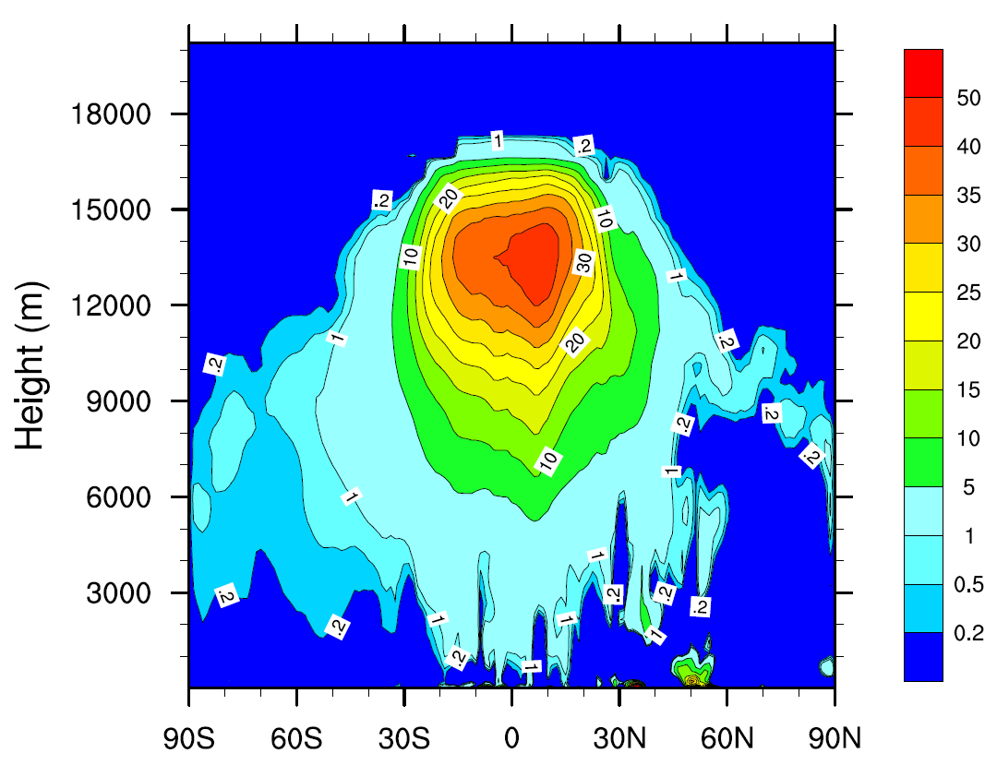
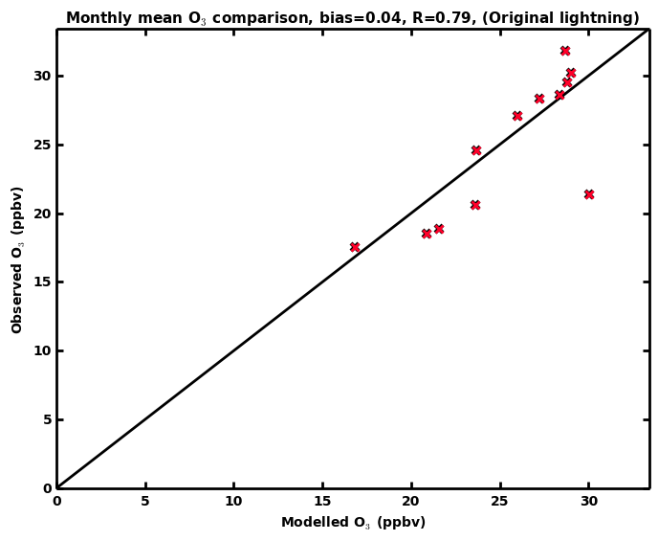
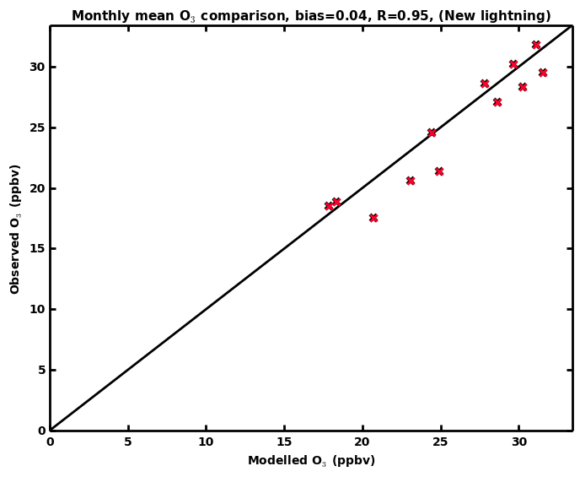
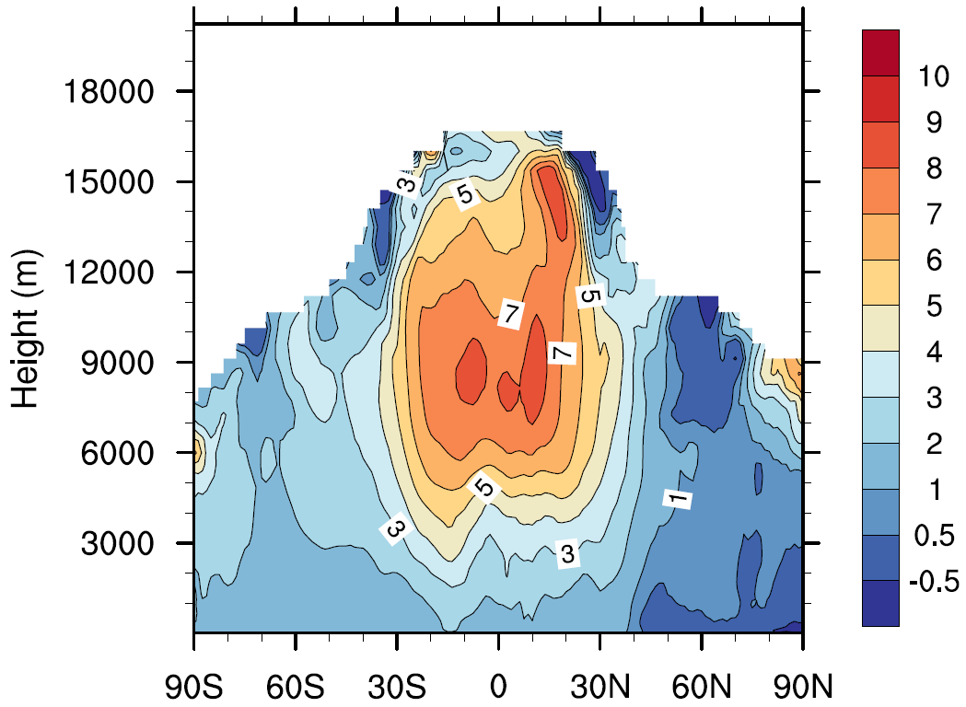
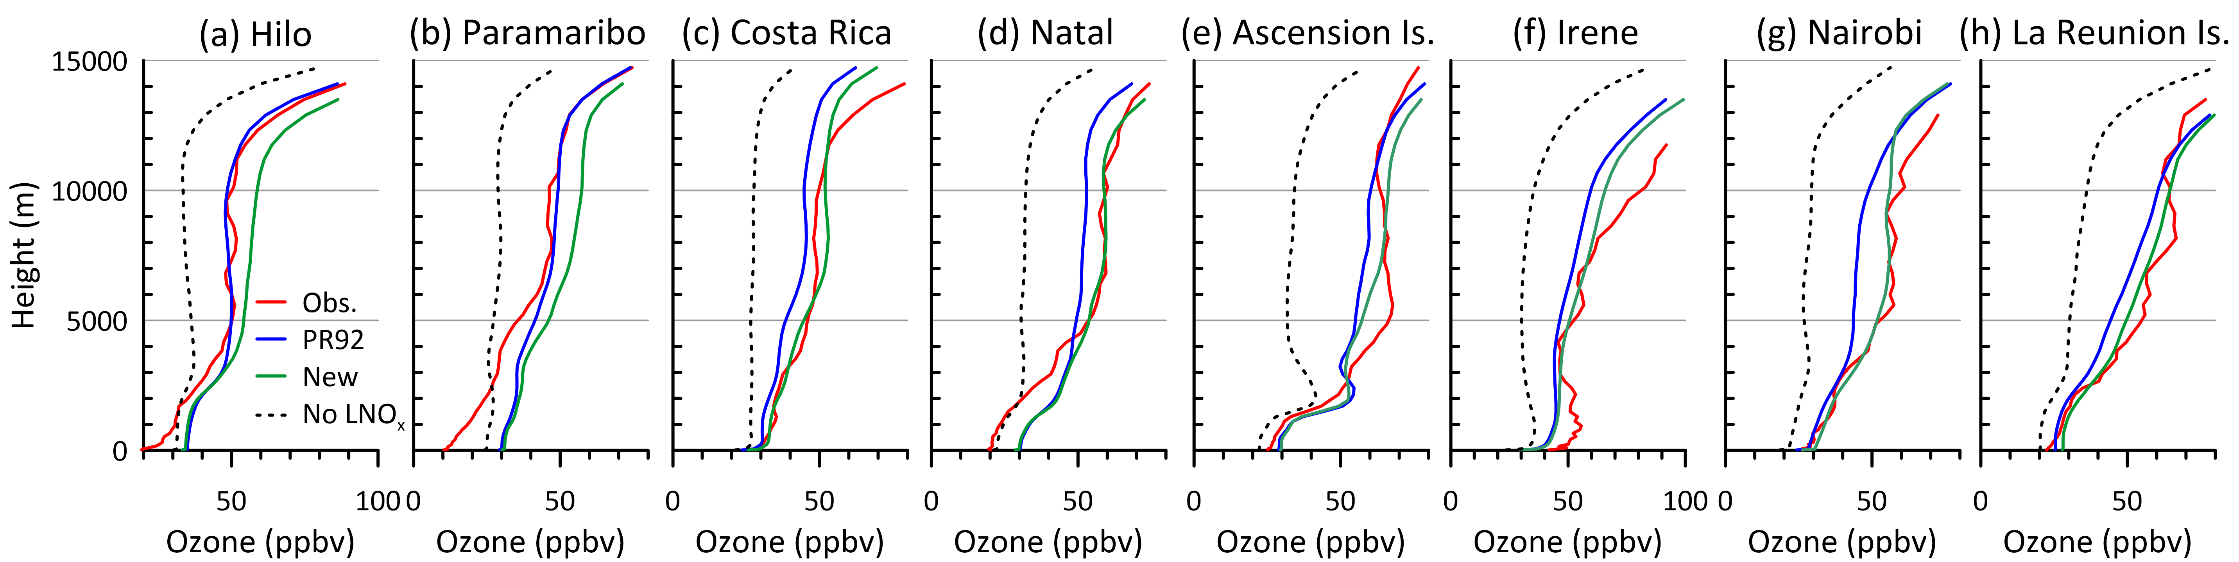
Impact on tropospheric composition
Total LNO_{x}: 38% increase from 4.8 to 6.6 Tg N/yr (cf. 6.3 ± 1.4 Tg N/yr, Miyazaki et al., 2014, based on satellite data assimilation in a global CTM); 330 moles NO per flash used in both (cf. 310 by Miyazaki et al.)
NO_{x} (as NO₂)
Ozone
Zonal NO_{x} difference (new – default), pptv
Model
Global increase by 15.7% (8.7 pptv)
An increase by as much as 40 pptv in the mid to upper troposphere
Cape Grim O₃, 2006, Old
Cape Grim O₃, 2006, New
Zonal O₃ difference (new – default), ppbv
Climatology
A global increase by 4.1 ppbv (8.0%)
Surface O₃ increases by 2 ppbv in the Southern Hemisphere, and 0.5–2 ppbv in the Northern Hemisphere.
Tropospheric O₃ burden increases from 284 to 308 Tg (cf. 337 Tg, IPCC AR5)
Comparison with Southern Hemisphere ADditional OZonesondes (SHADOZ) ozonesonde data
Model with modified marine flash rate

Slide 6
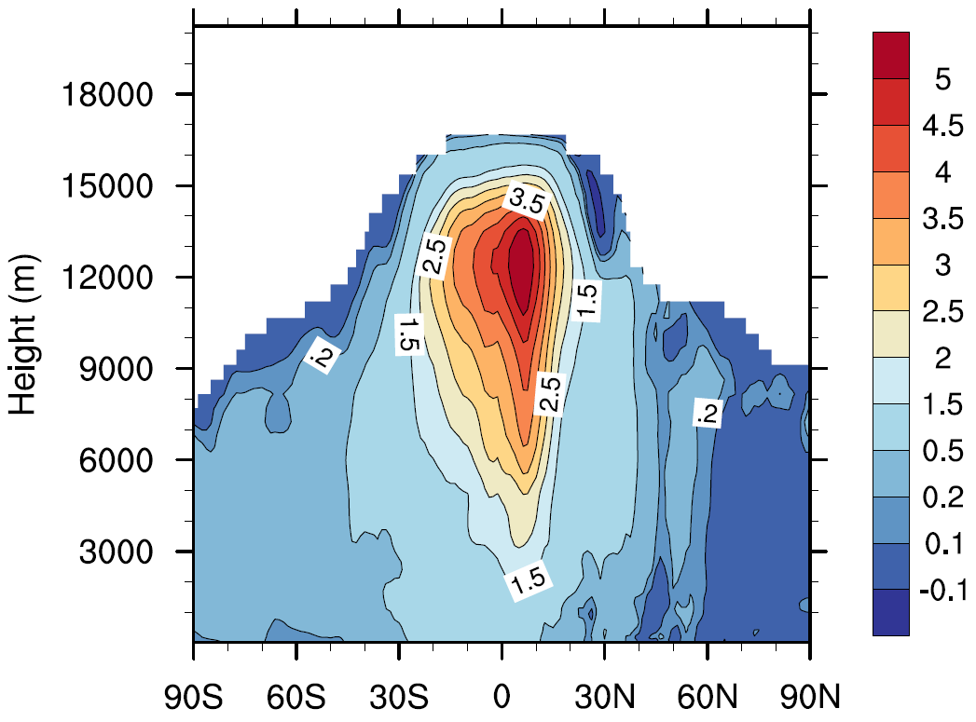
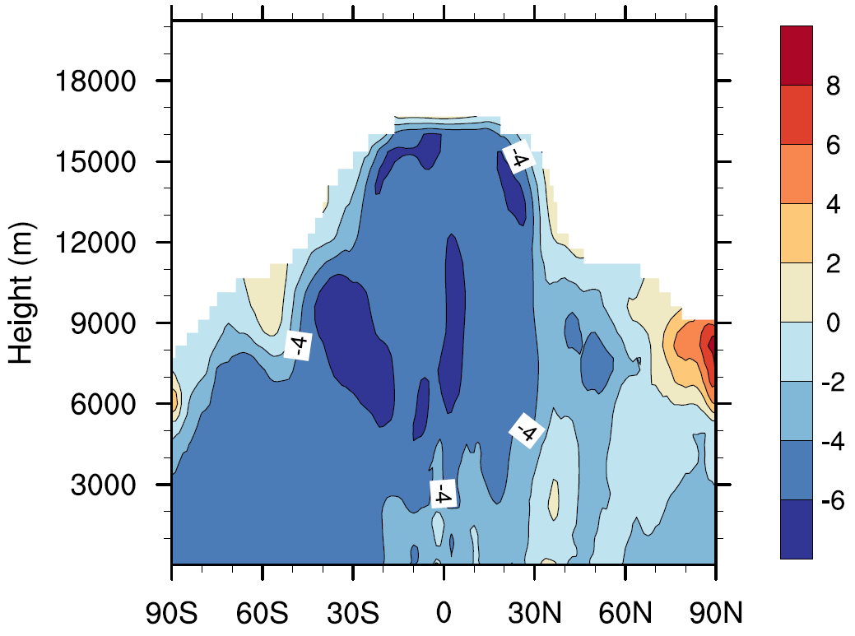
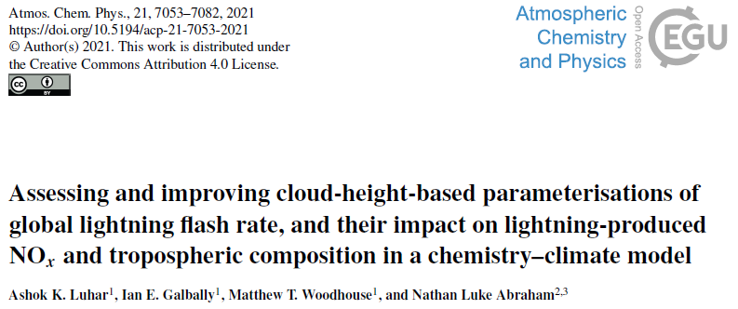
Zonal OH difference (new – default), (× 10⁵ molecules cm⁻³)
Carbon monoxide (CO)
Hydroxyl radical (OH)
Methane lifetime decreases by 6.7%
Larger impact over the southern hemisphere
Implications for radiative forcing and climate change studies
New lightning parameterisations committed into the Unified Model (UM) trunk (@vn11.8)
ACP paper
A 13% increase in the global tropospheric OH
10.6 to 12.0 (× 10⁵ molecules cm⁻³)
16.3% increase over the ocean
7.6% increase over land
An overall reduction by 4.5 ppbv (5.6%)
Over the ocean by 4.7 ppbv (6.2%)
Over land by 4.0 ppbv (4.5%)
Model
Climatology
Zonal CO difference (new – default), ppbv
Model with modified marine flash rate

