Slide 1



BARPA for climate projections in Australia
Harvey Ye, Chun-Hsu Su, Andrew Dowdy, Christian Stassen, Andrew Brown, Peter J. Steinle, Samuel Bell, Chiara Holgate, Bureau of Meteorology, Melbourne Acacia Pepler Bureau of Meteorology, Sydney Simon Tucker Met Office, Exeter, UK

Slide 2
Overall Configuration
BARPA: BOM Atmospheric Regional Projections for Australia
BARPA-R (EA and WA):
UK Met Office Unified Model (UM) version 11.4 for atmosphere
Joint UK Land Environment Simulator (JULES) version 5.4 for land surface
Global Atmosphere/Land GA7.05/GL7 configuration
0.11 x 0.11 deg, 63 levels with 40 km lid, 5-minute time step
Prescribed changes in aerosols optical and cloud properties due to radiative forcing
No nudging
BARPAC (Convective-scale):
Same UM and JULES versions as BARPA-R
RA1-T for tropical domain, RA1-M for mid-latitude domain
0.04 x 0.04 deg (T) or 0.02 x 0.02 deg (M), 70 levels with 40 km lid, 100-sec time step
Nested inside BARPA-EA
No nudging
Notes:
Changes in aerosol optical and cloud properties due to radiative forcing are included by prescribing monthly 3D fields of shortwave and longwave optical properties and cloud droplet number concentration. These fields are generated by combining background aerosol climatology estimated from a pre-industrial forced global atmosphere simulation with a prognostic aerosol scheme at N96 resolution (about 135km in the mid-latitude), with time-varying anthropogenic aerosol changes from the MACv2-SP (Max Planck Institute Aerosol Climatology v2; Stevens et al., 2016) and stratospheric volcanic forcing.
Worth noting based on the UK Climate Projection UKCP18 work.

Slide 3
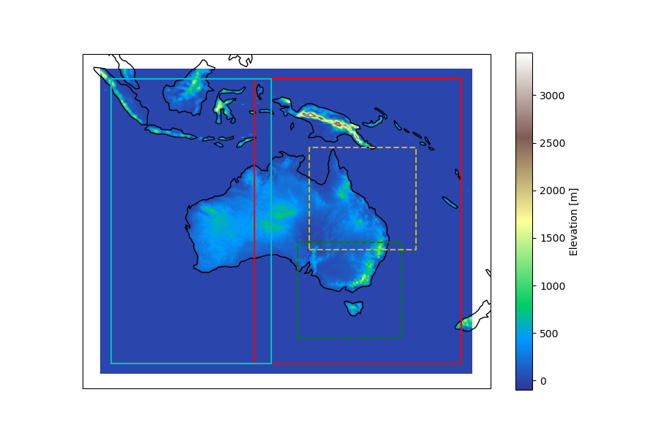
Domains and Status
Domain | GCM | Time period
BARPA-EA, 12km | ACCESS1-0 | 1960-2005 (hist)
 |  | 2006-2099 (rcp 8.5)
 |  | 2030-2059 (rcp 4.5) Other years between 2006-2099
 | ERA-Interim | 1990-2015
BARPA-WA, 12km | ACCESS1-0 | 1980-2005 (hist)
 |  | 2006-2020, 2030-2059 (rcp 8.5) Other years between 2006-2099
 |  | 2030-2059 (rcp 4.5) Other years between 2006-2099
BARPAC-T, 4.4 km | ACCESS1-0 | 1985-2005 (hist) Nov-Apr, 2040-2059 (rcp 8.5) Other months (rcp 8.5)
 | ERA-Interim | Nov-Apr, 1990-2015
BARPAC-M, 2.2 km | ACCESS1-0 | 1985-2005 (hist) Dec-Feb, 2040-2059 (rcp 8.5) Other months (rcp 8.5)
 | ERA-Interim | Dec-Feb, 1990-2015
BARPAC-T
BARPAC-M
BARPA-WA
BARPA-EA
Status: Completed, In progress

Slide 4
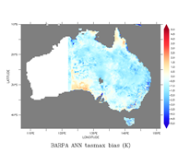
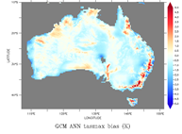
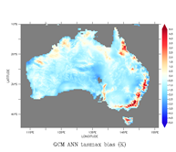
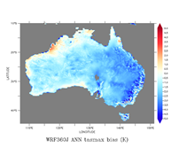
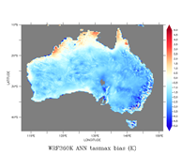
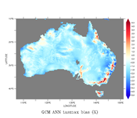
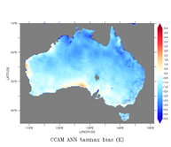
Model Evaluation
(Watterson)
Bias in daily maximum 2m air temperature (1986-2005)
Driving GCM: ACCESS1-0
BARPA
NARCliM v1.5 (Evans et al)
CCAM (Thatcher)

Slide 5
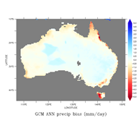
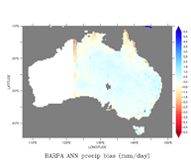
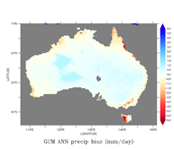
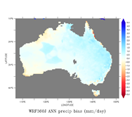
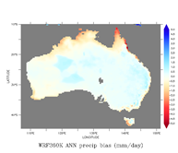
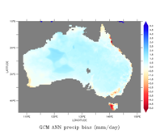
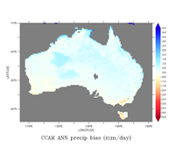
Model Evaluation (cont.)
(Watterson)
Bias in daily precipitation (1986-2005)
Driving GCM: ACCESS1-0
BARPA
NARCliM v1.5 (Evans et al)
CCAM (Thatcher)

Slide 6
Summary and future steps
Many BARPA runs already available with ACCESS1-0 and ERA-Interim forcing at NCI
BARPA is sensible based on inter-model comparisons with CCAM, NARCLIMv1.5.
Paper on assessment of BARPA-R ERA-Interim run under review
Development of BARPA,
Other GCMs and CMIP6 forcing and different scenarios (SSP3-7.0) – ACS
Regional nudging over single Australian domain – Stassen’s talk
Coordinating with other Australian modelling efforts (CCAM, WRF community) and CORDEX
Very fine-resolution nest (sub-km) to study some individual days of extreme event, e.g., a catastrophic fire weather day – NESP2
Assessment and applications – Brown, Bell, Pepler (wind, TC, convective env.), Holgate (surface coupling), etc.

