Slide 1

Land-atmosphere coupling in ACCESS (BARPA)
Chiara Holgate
Andrew Dowdy, Christian Stassen, Chun-Hsu Su, Harvey Ye (Bureau of Meteorology)
Anna Ukkola, Annette Hirsch (UNSW)

Slide 2
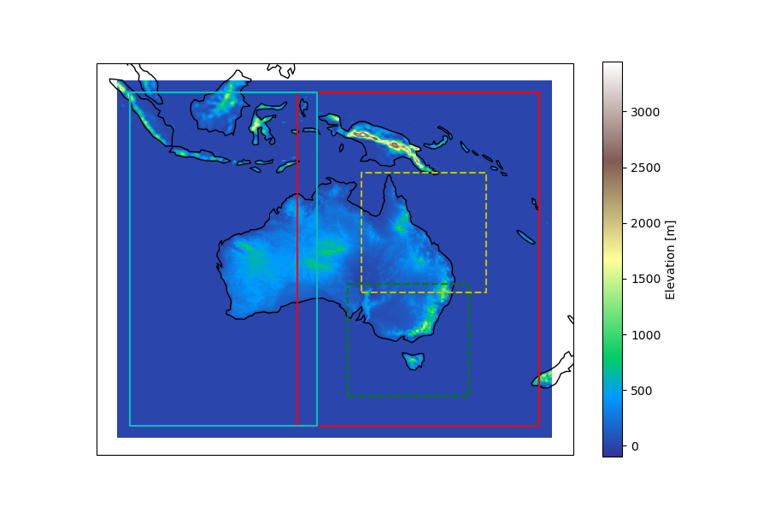
What is BARPA?
Bureau of Meteorology Atmospheric Regional Projections for Australia
UK Met Office Unified Model (UM) version 11.4 for atmosphere
Joint UK Land Environment Simulator (JULES) version 5.4 for land surface
Global Atmosphere/Land GA7.05/GL7 configuration
0.11º, 63 levels with 40 km lid, 5 minute time step
Historical: ERA-Interim 1990-2015
Future: RCP4.5, RCP8.5 to 2099
This talk: BARPA-EA Historical
BARPAC-T
BARPAC-M
BARPA-WA
BARPA-EA

Slide 3
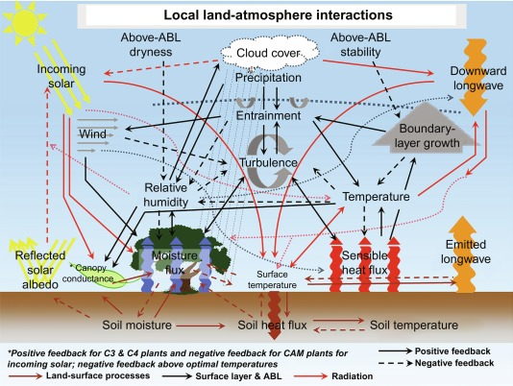
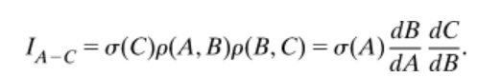
Why care about land-atmosphere coupling?
Accurate prediction of:
Surface climate
Convection
Cloud formation
Drought
Heatwaves
Monsoon variability
Implications for:
Model development
Confidence in projections
Dirmeyer et al (2019)
Two-legged coupling index measures the sensitivity of near-surface air temperature (C) to soil moisture (A) via surface sensible heat flux (B):

Slide 4
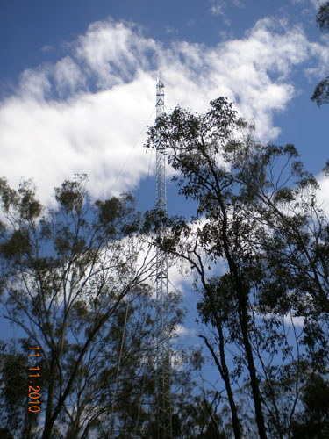
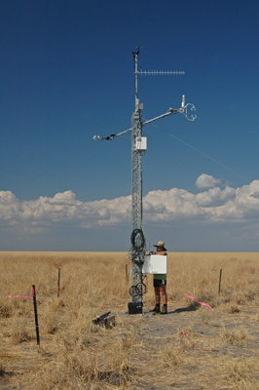
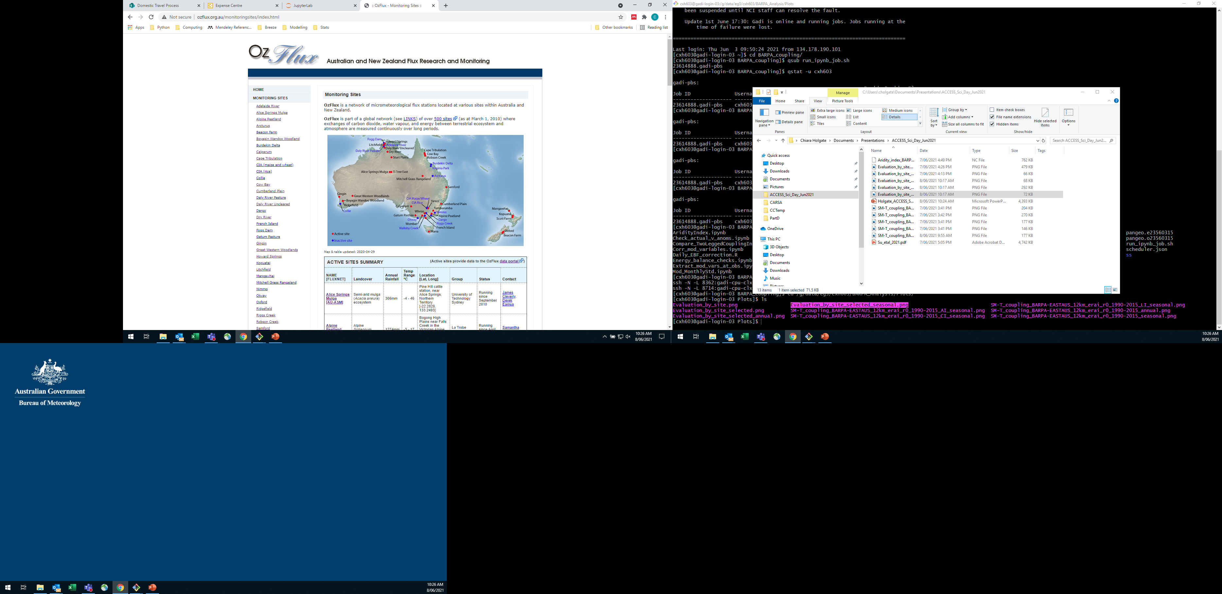
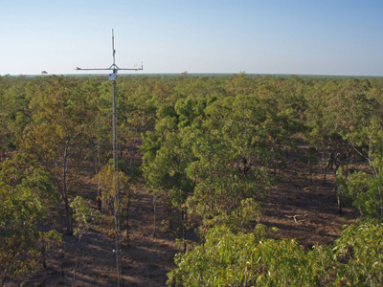
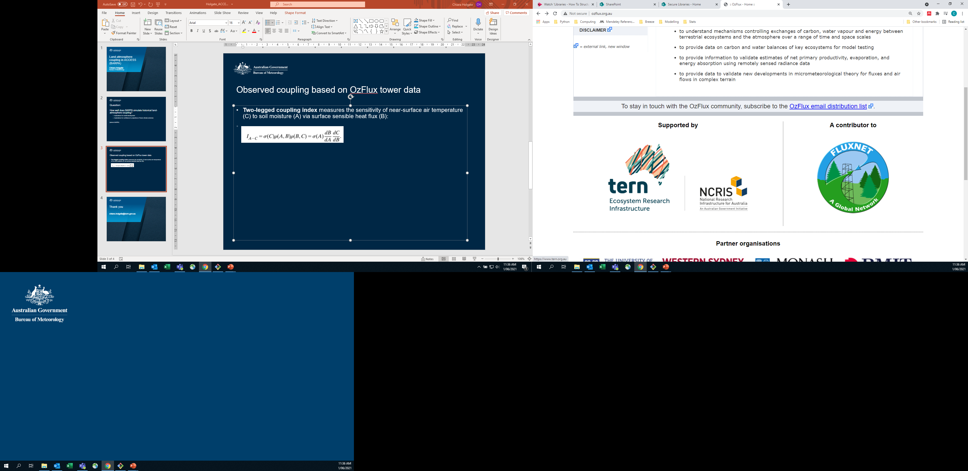
How well does BARPA simulate observed land-atmosphere coupling?
Cumberland Plain, ozflux.org.au
Sturt Plains, ozflux.org.au
Dry River, ozflux.org.au

Slide 5
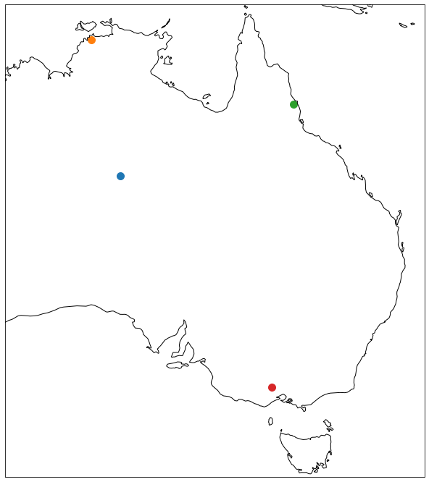
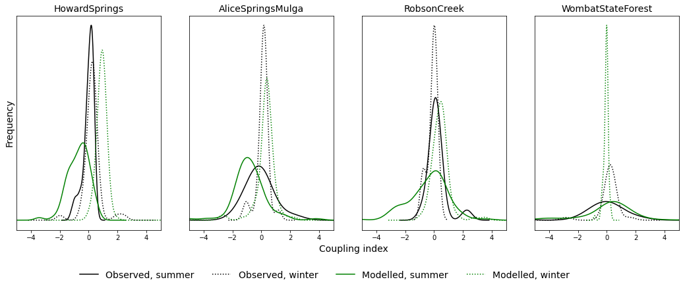
Howard Springs
BARPA temperature too sensitive to surface wetness
Robson Creek
Alice Springs Mulga
Wombat State Forest

Slide 6
Next steps
Evaluate model sensitivity by aridity and vegetation classes
Understand implications of coupling bias to simulated extreme temperatures
chiara.holgate@bom.gov.au

