Slide 1
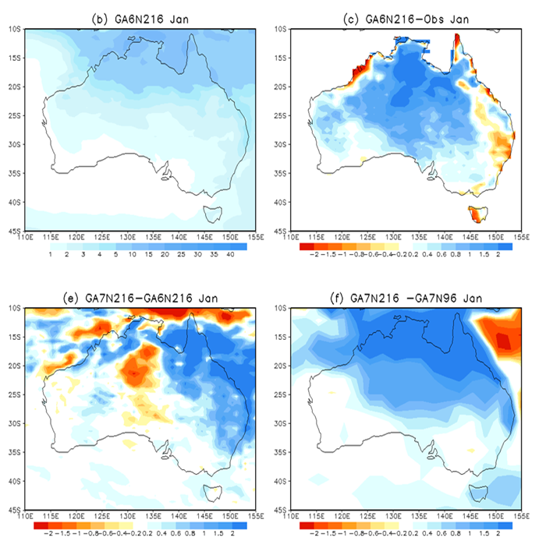
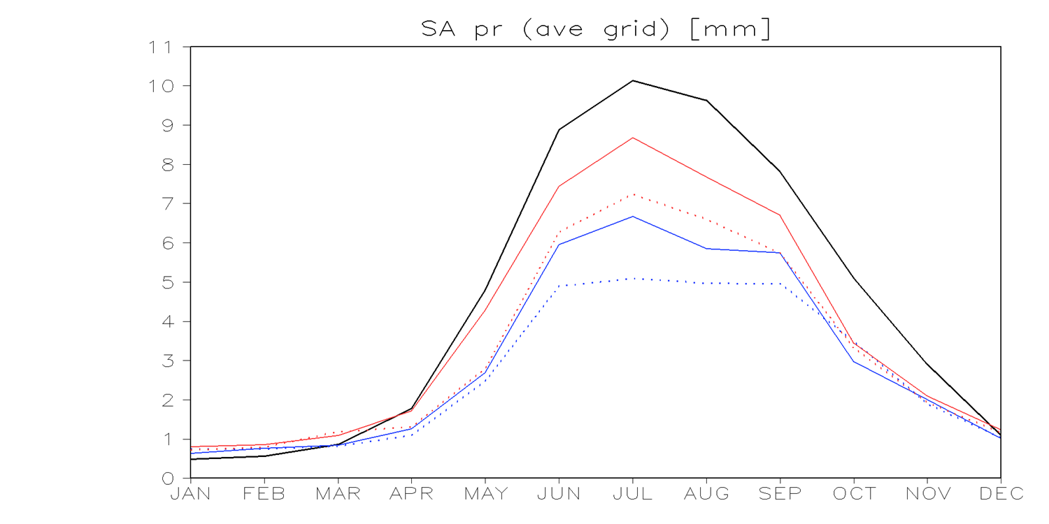
Averaged Indian rainfall:5-25N,65-90E
Black = GPCP
Red = GA7
Blue = GA6
Solid line =N216
Dashed line =N96
Fact: Monsoon rainfall is improved in GA7 (UM10.3)
Question: what is the implication for tropical-extratropical interactions in UM/ACCESS?
Who: BoM: Huqiang Zhang, Aurel Moise
CMA/China: Lili Jin (three-month visit)
MO: Gill Martin, Sean Milton, Jose Rodriguez

Slide 2
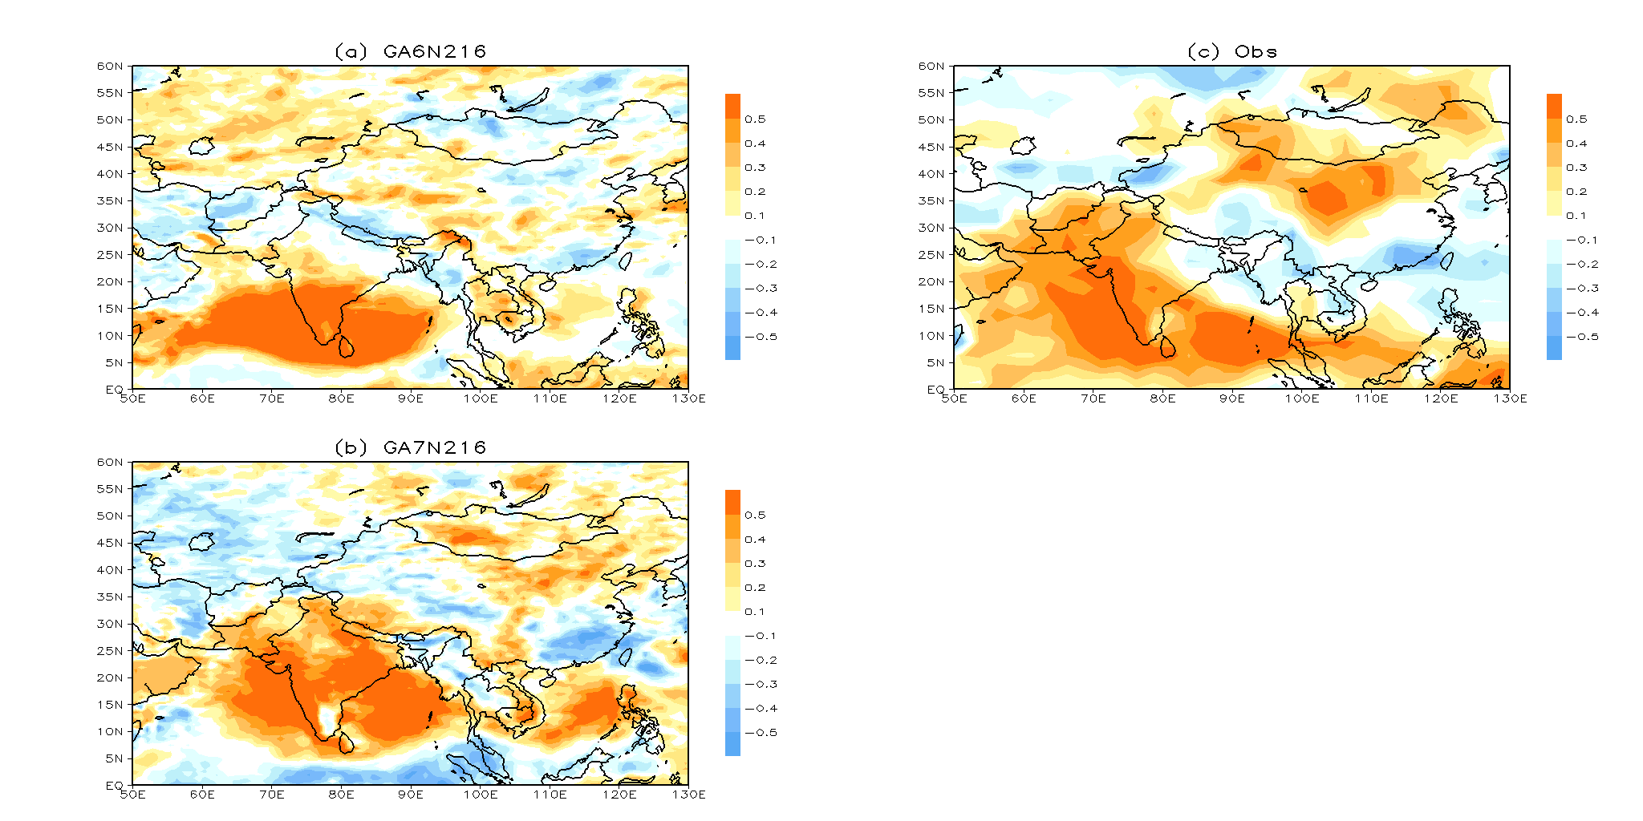
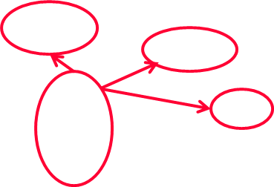
Correlation of Indian monsoon rainfall with the rest
Question: WHY???
teleconnection; tropical-extratropical interactions

Slide 3
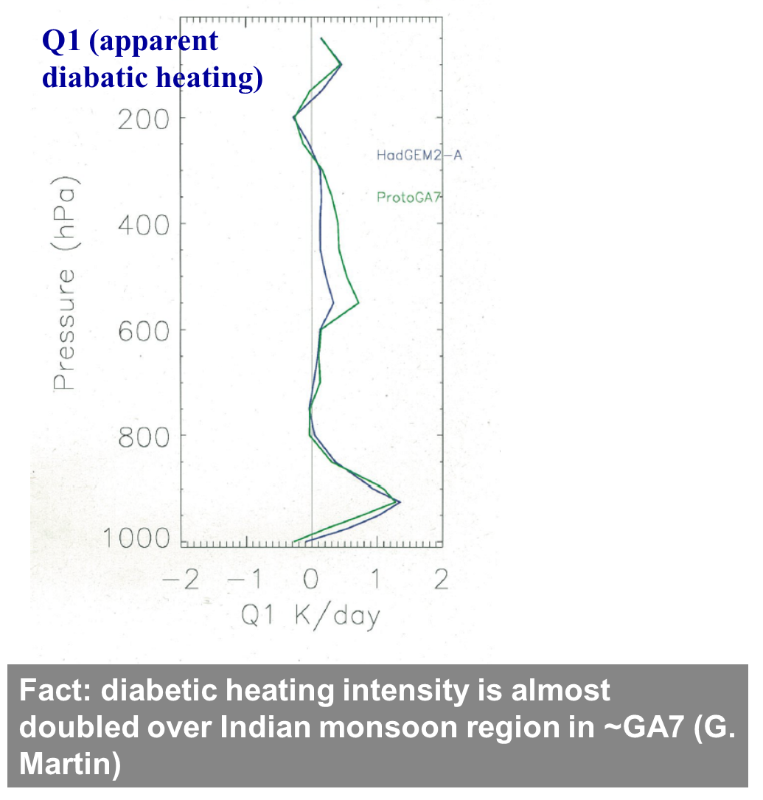
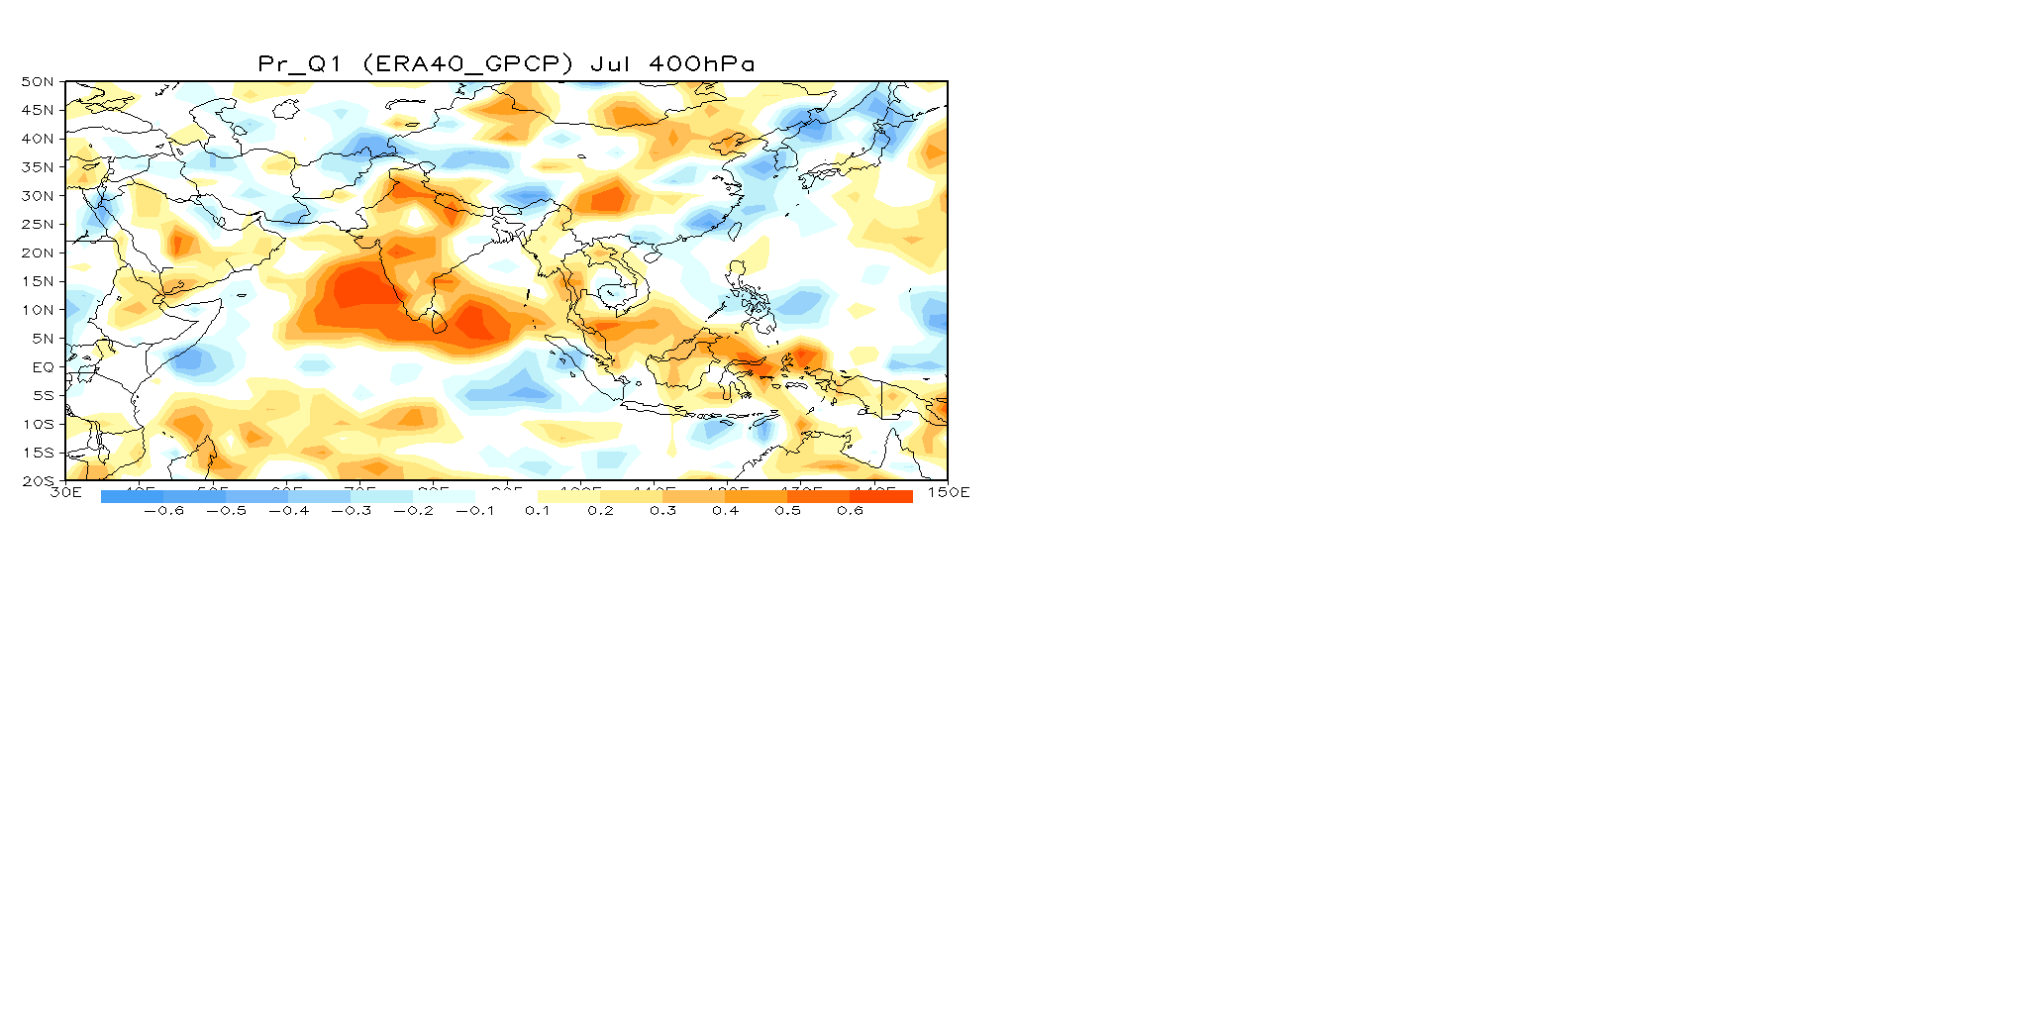
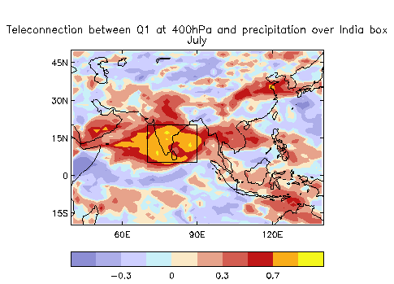
Correlation between Indian monsoon rainfall and diabatic heating at upper troposphere ( 400hPa)
ProtoGA7

Slide 4
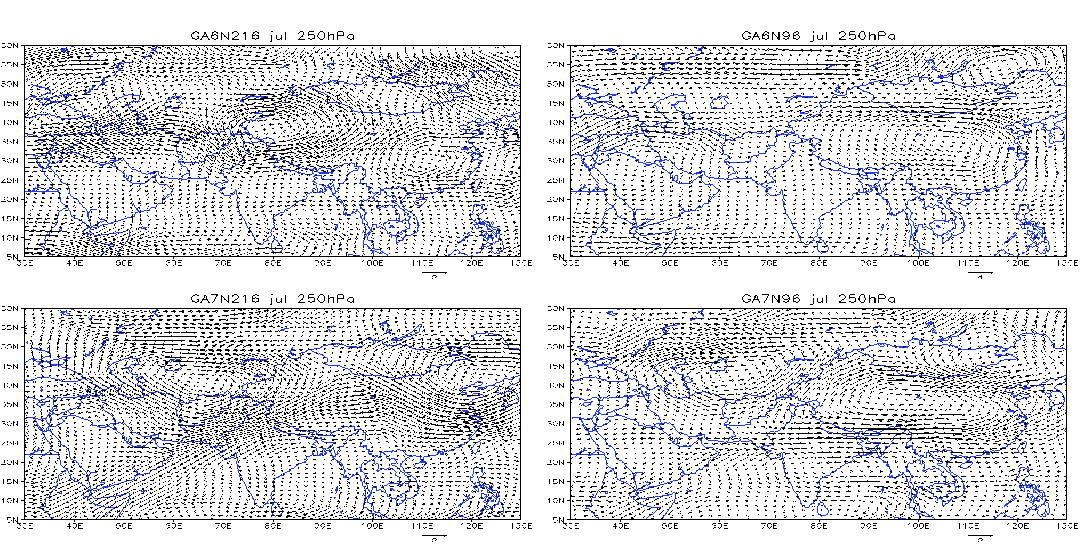
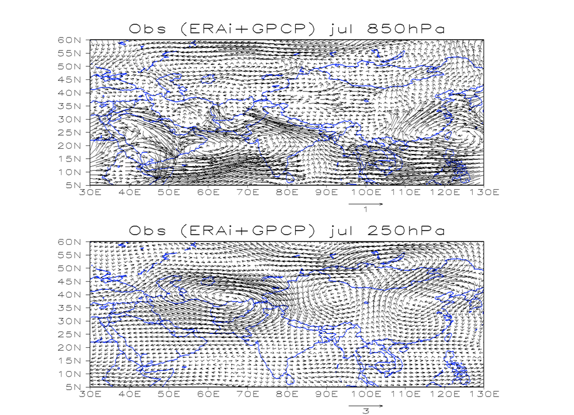

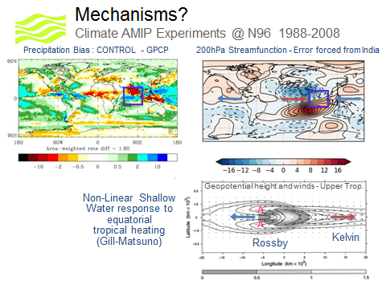
Indian monsoon rainfall correlation with 250hPa wind
Questions:
More realistic monsoon-desert teleconnections?
More realistic monsoon interactions with South Asian High (SAH)?
More realistic hemispheric A-A monsoon interactions?
Supported by nudging results

Slide 5
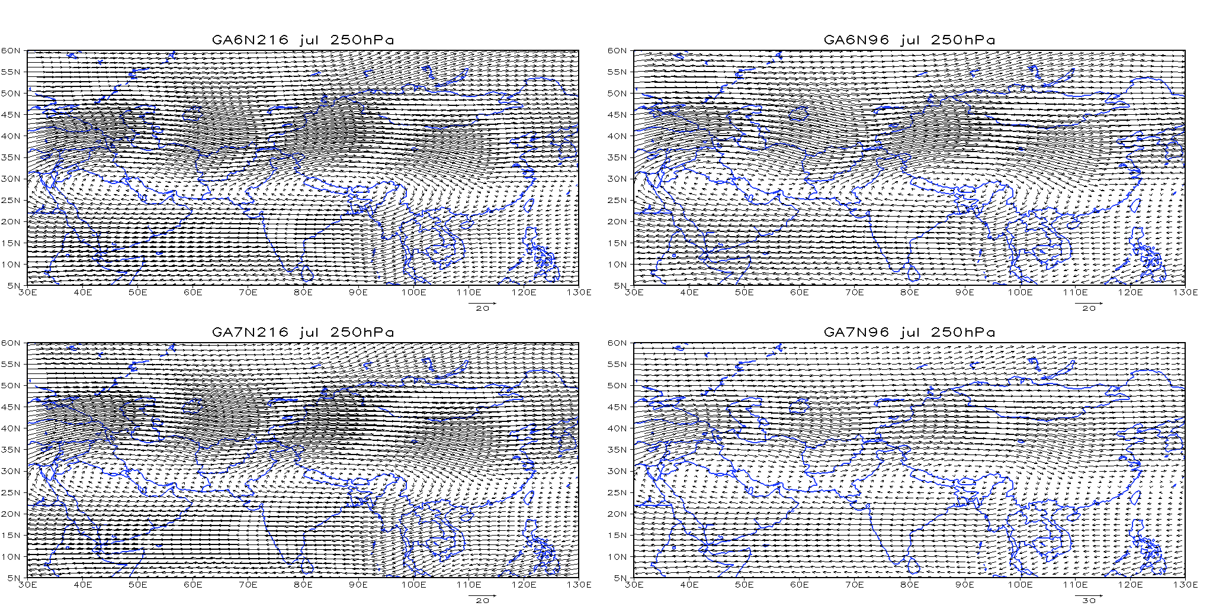
Silk Road Mode or Circumglobal Teleconnection(GCT)
South Asian High

Slide 6
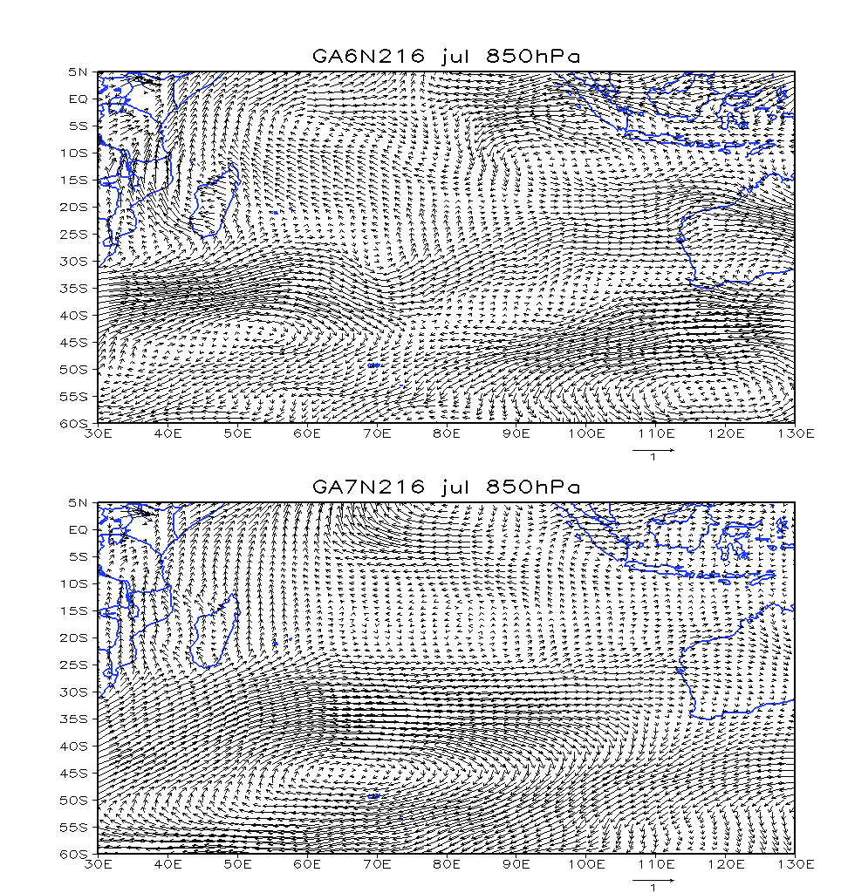
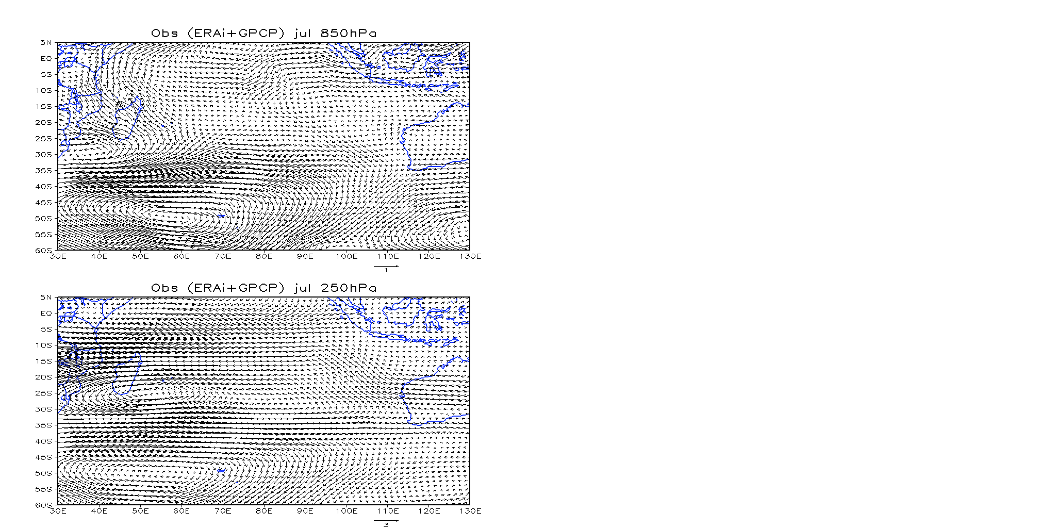
Summary
Improved Indian monsoon in GA7 improves the tropic-extratropical interactions;
Possible mechanism including the diabatic heating triggered Gill-type responses and modulation of South Asian High;
Will explore more details, including comparison with ACCESS-CM.
Impacts on hemispheric interactions: correlation of Indian monsoon rainfall with circulation in SH

