Slide 1
Improved estimates of dry deposition of ozone using ozone reanalysis and ACCESS
Ashok Luhar, Matthew Woodhouse, Ian Galbally
5 September 2017
Climate Science Centre, Oceans and atmosphere

Slide 2
Ozone (O₃)
Ozone is a greenhouse gas, and impacts human health and plant productivity
Increase in tropospheric ozone burden by ~ 40% since preindustrial times
Current tropospheric ozone budget (IPCC AR5)
Chemical production (P): 4877 ± 853 Tg yr⁻¹
Stratosphere to the troposphere (P): 477 ± 96 Tg yr⁻¹
Chemical loss (L): 4260 ± 645 Tg yr⁻¹
Dry deposition loss (L): 1094 ± 264 Tg yr⁻¹
Atmospheric burden: 337 ± 23 Tg
Dry deposition to the Earth’s surface is an important sink of ozone
About 300-350 Tg yr⁻¹ (30%) is to the ocean (largest uncertainty)
ACCESS-UKCA, at UMv8.4, CheST, N96L85, atmosphere only, nudged
Process of transfer from the atmosphere onto surfaces

Slide 3
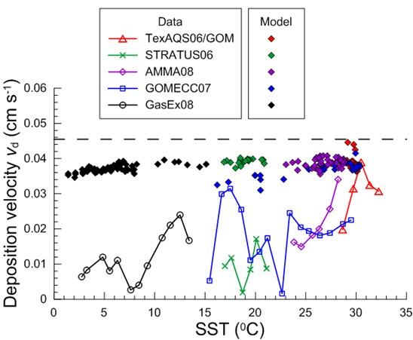
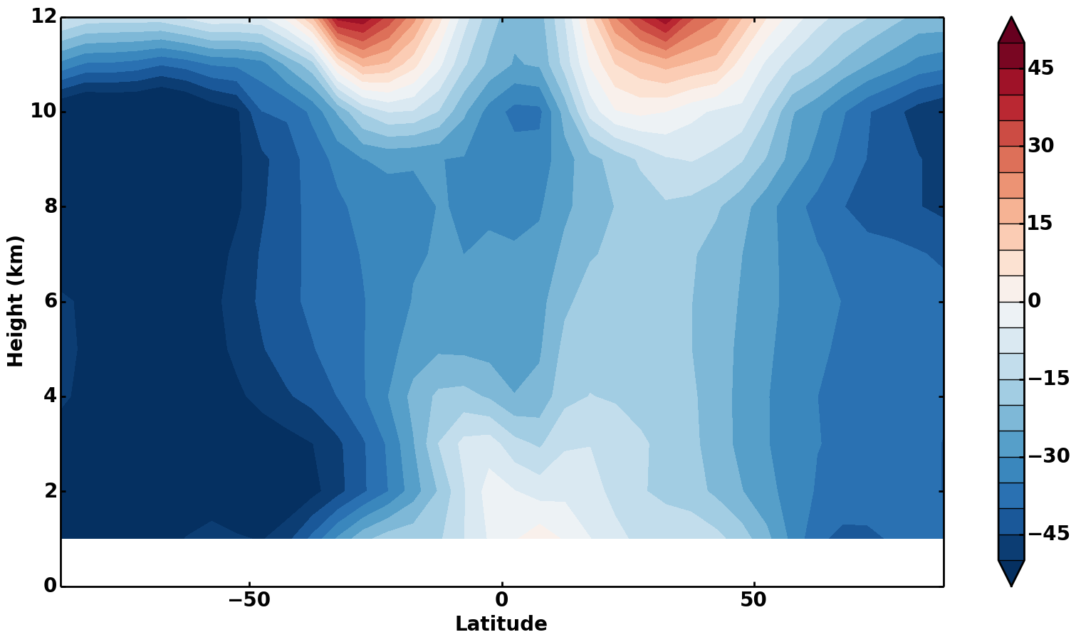
Ozone dry deposition modelling issues
Ozone deposition flux (F) = - Deposition velocity (v_{d}) × Concentration (C)
Two issues with ozone dry deposition flux modelling
General issue: Most global models (e.g. ACCESS-UKCA) assume surface resistance r_{c} ~ 2000 s/m for water – not supported by measurements
ACCESS-UKCA specific issue: Model underestimates global troposheric ozone
Zonal (M-O)/O% using ozonesonde data
Helmig et al. (2012) data

Slide 4
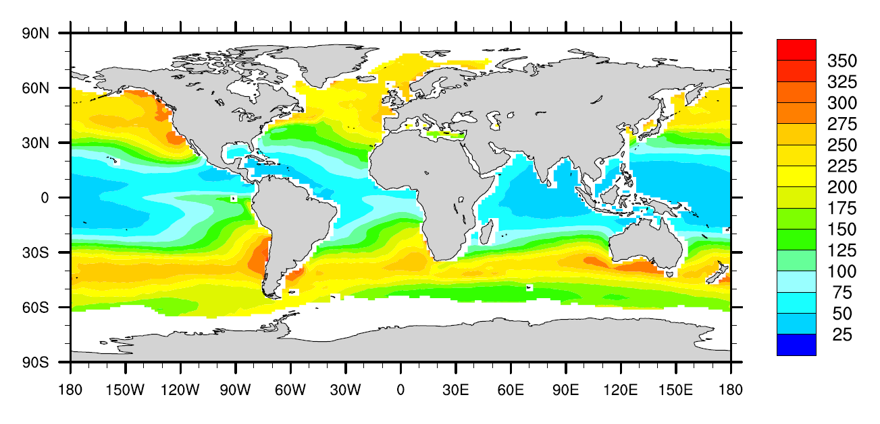
Improving O₃ dry deposition
Resolving the first issue: A new scheme for r_{c} for the ocean; includes waterside processes: ozone solubility, its reaction with dissolved iodide, molecular diffusion & turbulent mixing
% Overestimation of v_{d} by the original scheme
K₀, K₁ modified Bessel functions
Original
ACCESS-UKCA,
r_{c} = 2200 s/m
New scheme for r_{c} in ACCESS-UKCA

Slide 5
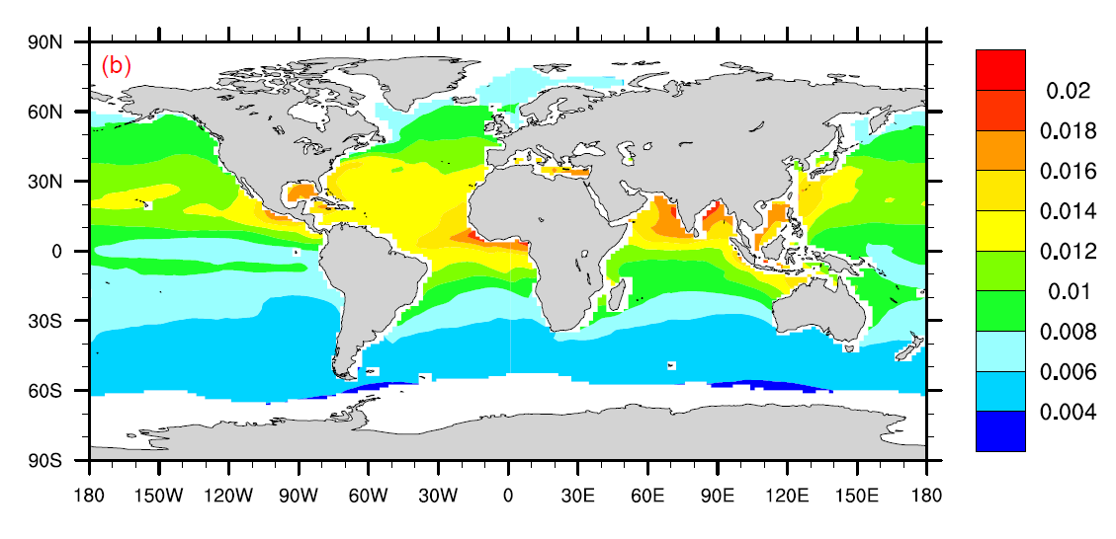
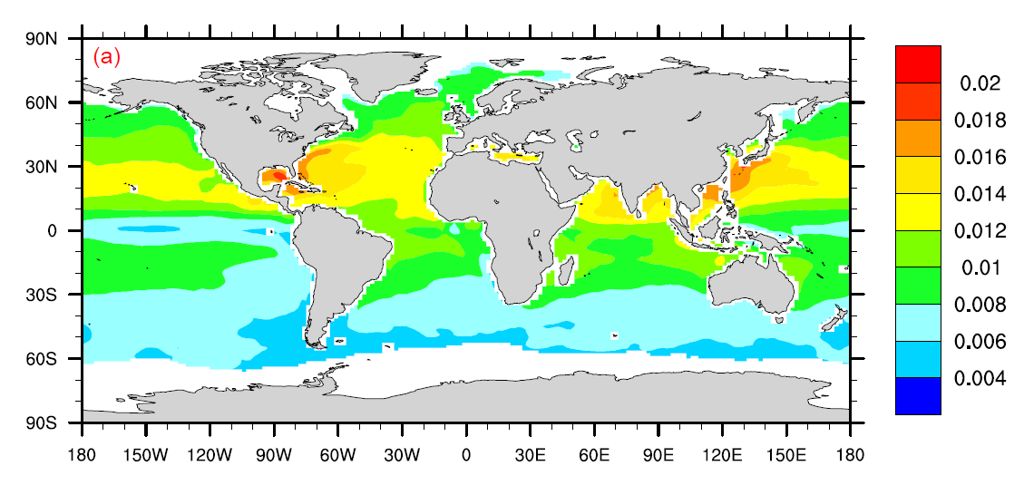
Addressing the second issue:
Ozone deposition flux (F) = - New ACCESS-UKCA v_{d} × ACCESS-UKCA O₃
The new r_{c} in ACCESS-UKCA improves O₃ but the modelled global O₃ still low compared to measurements
To better estimate global deposition, ECMWF MACC (Monitoring Atmospheric Composition and Climate) reanalysis ozone for years 2003–2012 is used (3 hourly global fields)
Ozone deposition flux (F) = - New ACCESS-UKCA v_{d} × MACC O₃
Flux (μg m⁻² s⁻¹), ACCESS-UKCA O₃ (2005)
Flux (μg m⁻² s⁻¹), MACC O₃ (2005)

Slide 6
Global annual ozone dry deposition (Tg yr⁻¹) after addressing the two issues
Method | Ocean | Land | Global total
Galbally and Roy (1980) | 491 | 600 | 1091
Stevenson et al. (2006) | - | - | 1003 ± 200
Wild (2007) | - | - | 949 ± 222
Ganzeveld et al. (2009) | 291.5 | 543.5 | 835
Hardacre et al. (2015) | 340 | 638 | 978 ± 127
IPCC AR5 | - | - | 1094 ± 264
ACCESS-UKCA (MACC) | 98.4 ± 4.5 | 624.4 ± 17.4 | 722.8 ± 20.9
The land based deposition is similar in all studies
With the new for ozone deposition to the ocean, the ozone loss is reduced by ~200 Tg yr⁻¹ (by ~65% over the current estimates)
The oceanic reduction leads to a 20% decrease in the modelled total global dry deposition
An increase of ~ 5% in the modelled tropospheric ozone burden
Will impact tropospheric O₃ radiative forcing and increase near-surface O₃

