Slide 1
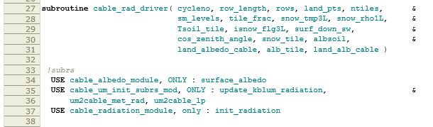
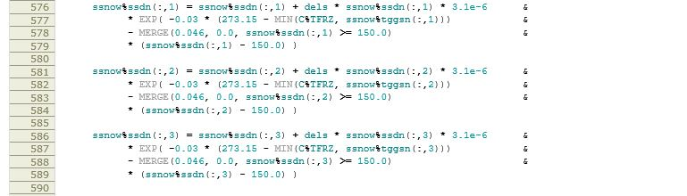
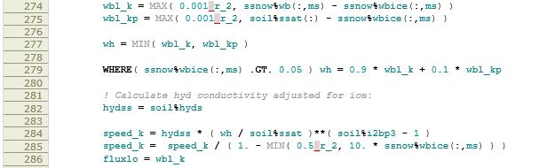
CABLE in ACCESS: Status and plans for JaC
Ian Harman¹, Jhan Srbinovsky¹, Martin Dix¹, Rachel Law¹, Daniel Eisenberg²
24 May 2019
¹CSIRO Climate Science Centre, CSIRO Oceans and atmosphere
²ARC Centre of excellence in climate extremes, UNSW

Slide 2
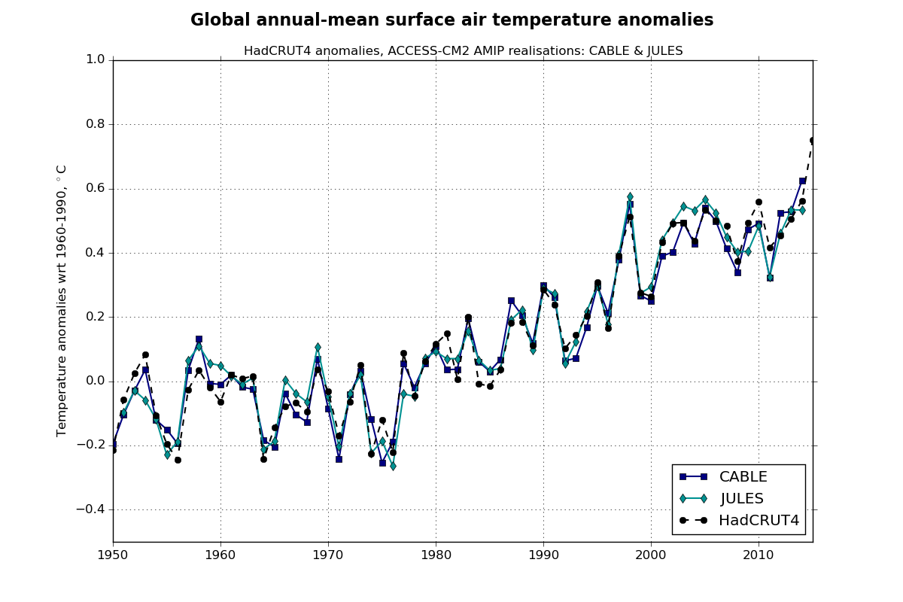
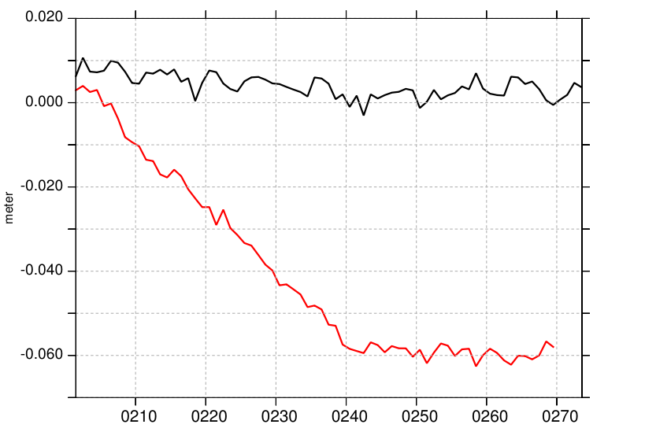
CABLE in ACCESS-CM2: Status
historical global T (AMIP)
Updates from ACCESS1.3/ACCESS-ESM1.5
ENDGAME dynamics
MOSES → JULES
rivers and inland water bodies
consistency with iceberg scheme
UKCA interface
Medlyn stomatal function
leaf area and root distribution
soil thermal properties
general code improvements
courtesy R. Bodman
pre-industrial change in sea level
ACCESS-CM2 is physics model only:
CASA carbon cycle model functions but not tested
JULES
recalibrated iceberg flux
Several CABLE science updates available/in train but not utilised
CABLE

Slide 3
JaC: What and Why?
CABLE-CASA-CNP
UM
CABLE-JULES-UM albedos
UM
UM AP1
OASIS
CABLE-JULES-UM explicit
CABLE core
UM AP2
CABLE-JULES-UM implicit (x2)
MOM
CICE
UM output
CABLE-JULES-UM extra
WOMBAT
ACCESS uses JULES’ sea, sea-ice, aerosols, river, … – science and technical reasons
Technical coupling: ACCESS 1.3, ACCESS-ESM1.5, ACCESS(UMv8.6), ACCESS-CM2 to date
LFRic will also require coupling changes

Slide 4
JaC: What and Why?
JaC: JULES and CABLE – the technical implementation of CABLE within the JULES structure
including common input and output
Partnership between UKMO, CSIRO-CSC and ARC-ClEx (UNSW)
Pros
future proofing ACCESS
independent review of the coupling to date
facilitate use of CABLE in ACCESS-NWP
simulation repeatability via rose
automated testing and benchmarking
expose CABLE to wider audience
facilitate JULES/CABLE comparisons
Cons
even more technical work
risk splitting the CABLE community
duplicate existing capability
potential block to new CABLE science
impose operational model code development practices onto CABLE
impose changes in CABLE core code
require documentation practices

Slide 5
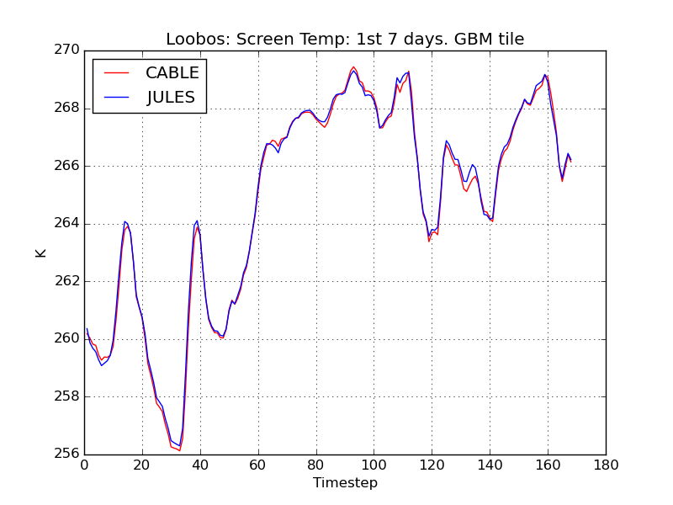
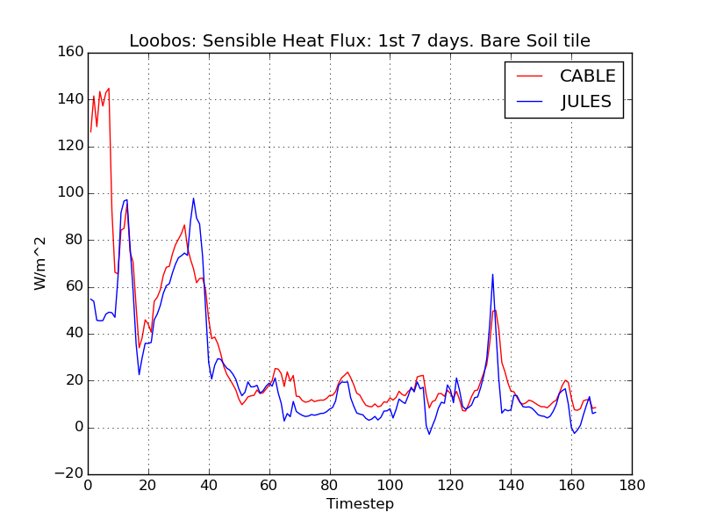
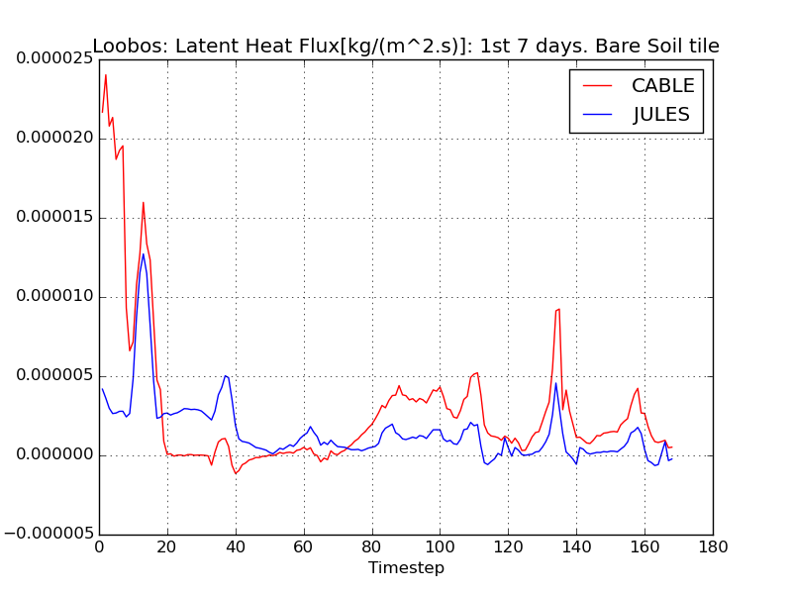
JaC: Progress to date
ACCESS-CM2 CABLE physics code resides in JULES v5.4 and runs single site
1/3 of input requirements via JULES structures and accepted onto JULES trunk
aiming for most CABLE biophysics code into JULES v5.6
Significant testing and development will be required
single site surface-only: JaC(JULES) ≡ JULES, JaC(CABLE) ≅ CABLE
global surface-only
ACCESS-AMIP style simulations (checking requirements for NWP can commence here)
ACCESS-CM simulations
Repeat the above for Earth system and carbon cycle components

