Slide 1
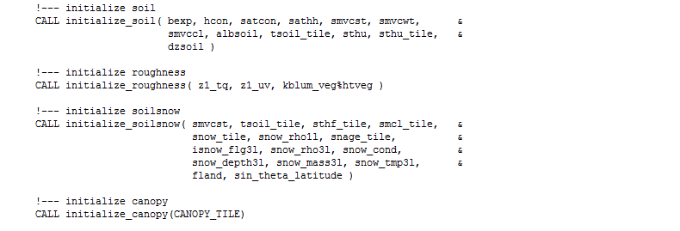
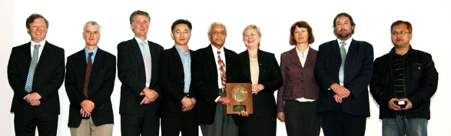
ACCESS community: collaboration and governance
CSIRO Climate Science Centre
Rachel Law| ACCESS group leader

Slide 2
How do we want to operate as a community?
Governance
ACCESS Advisory Group (AAG)
ACCESS Research Leaders Group (RLG)
Dependence on outcome of NCRIS scoping study
Meetings
COSIMA
CABLE / COE Land group
UM partnership sponsored meetings
ACCESS science day (frequency and style?)
www.csiro.au/state-of-the-climate

Slide 3
Communication
Email lists
access_users@lists.hpsc.csiro.au
access-cmip6@lists.csiro.au
Cable-users@lists.csiro.au
cosima-announce@mailman.anu.edu.au email list
Wiki / Trac / Github
ACCESS Wiki - https://accessdev.nci.org.au/trac/wiki – who maintains?
CABLE wiki - https://trac.nci.org.au/trac/cable/wiki - CABLE committee
ACCESS-OM2 - https://github.com/OceansAus/access-om2 (also MOM5)
MOSRS – also UM partners communication group
Websites
research.csiro.au/access – almost live, climate/carbon/chemistry focus including CMIP6
http://cosima.org.au/
Various individual pages on BoM/CAWCR/CSIRO/NESP
SLACK
https://arccss.slack.com/messages/C6PP0GU9Y/details/ (COSIMA)
www.csiro.au/state-of-the-climate

Slide 4
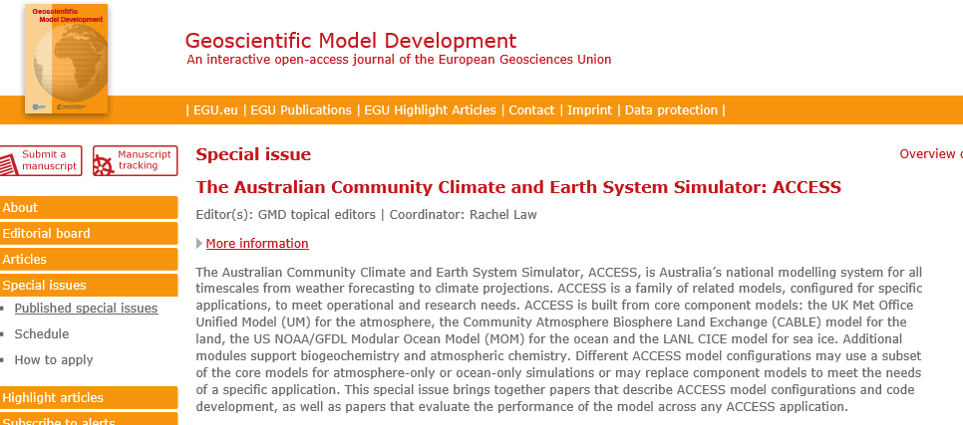
Announcement – GMD special issue
https://www.geosci-model-dev.net/special_issue1027.html
6 published papers (Lorenz14, Uhe 15, Kala15, Ackerley16, Kowalczyk16, Ziehn17, Law17)
1 paper in discussion (Kiss19)
Indefinite, standard review process, select special issue when registering manuscript

Slide 5
Feedback / Discussion
Is our communication effective?
Do we do enough collaborative project work?
What governance do we need?
How do we resource community activities?
Do we need an ACCESS strategy or roadmap or similar?
Provide comments to
Helen Cleugh, Rachel Law (CSIRO)
Peter May, Tony Hirst (BoM)
Andy Pitman, Christian Jakob (Universities)

