Slide 1

An upgraded seasonal prediction system: ACCESS-S2
Debbie Hudson
Research Program

Slide 2
ACCESS-S1
UKMO GC2 (Global Coupled model version 2)
Using UKMO ocean initial conditions + BoM ensemble generation
Hindcast:
23 years (1990-2012)
11 ensemble members
4-starts per month
Real time: 99 members (uses burst and lagged)
Sub-seasonal: 6-weeks
Seasonal: 6 months
Calibrate to 5km for key variables over Australia

Slide 3
ACCESS-S2 summary
Break dependency on UKMO Initial conditions
Same GC2 model but tweaks/corrections for known issues
BoM weakly-coupled assimilation (affects ocean and land initialisation)
More hindcasts: 38 year (1981-2018), 27 member ensemble hindcasts to support applications
More timely forecasts in real-time (less of a delay) – especially for multi-week
Run out to longer leads (7 months)
Same number of real-time forecasts as S1 (i.e., products based on 99-member time lagged ensemble)
Currently transitioning to operations

Slide 4
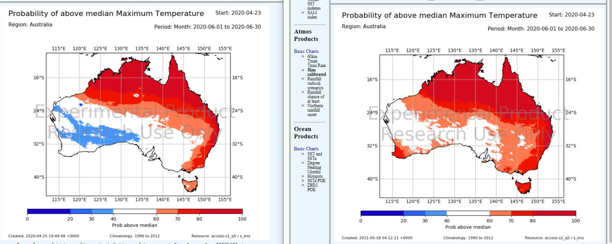
Do ACCESS-S1 and S2 use the same model?
Mostly, yes. GC2. However, minor changes were made to address known issues:
Coupling frequency between the ocean-atmosphere was increased to 1-hour (improves ocean shallow layers in the Pacific)
Representation of drainage of rivers into inland lakes was changed as the S1 (led to "bullseyes" in the outlooks).
The updating of ozone was changed following bug found in the GC2 core code
S1
S2

Slide 5
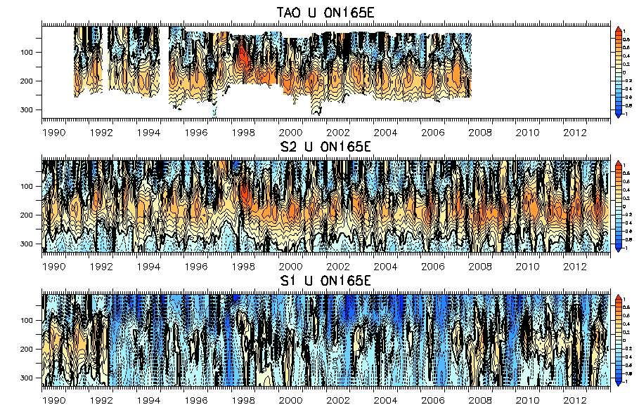
Data assimilation Example: ocean currents better in S2
Monthly mean U from ADCP TAO/TRITON, ACCESS-S2, S1(1990-2013)
U (0N,165E)
OBSERVED
S2
S1

Slide 6
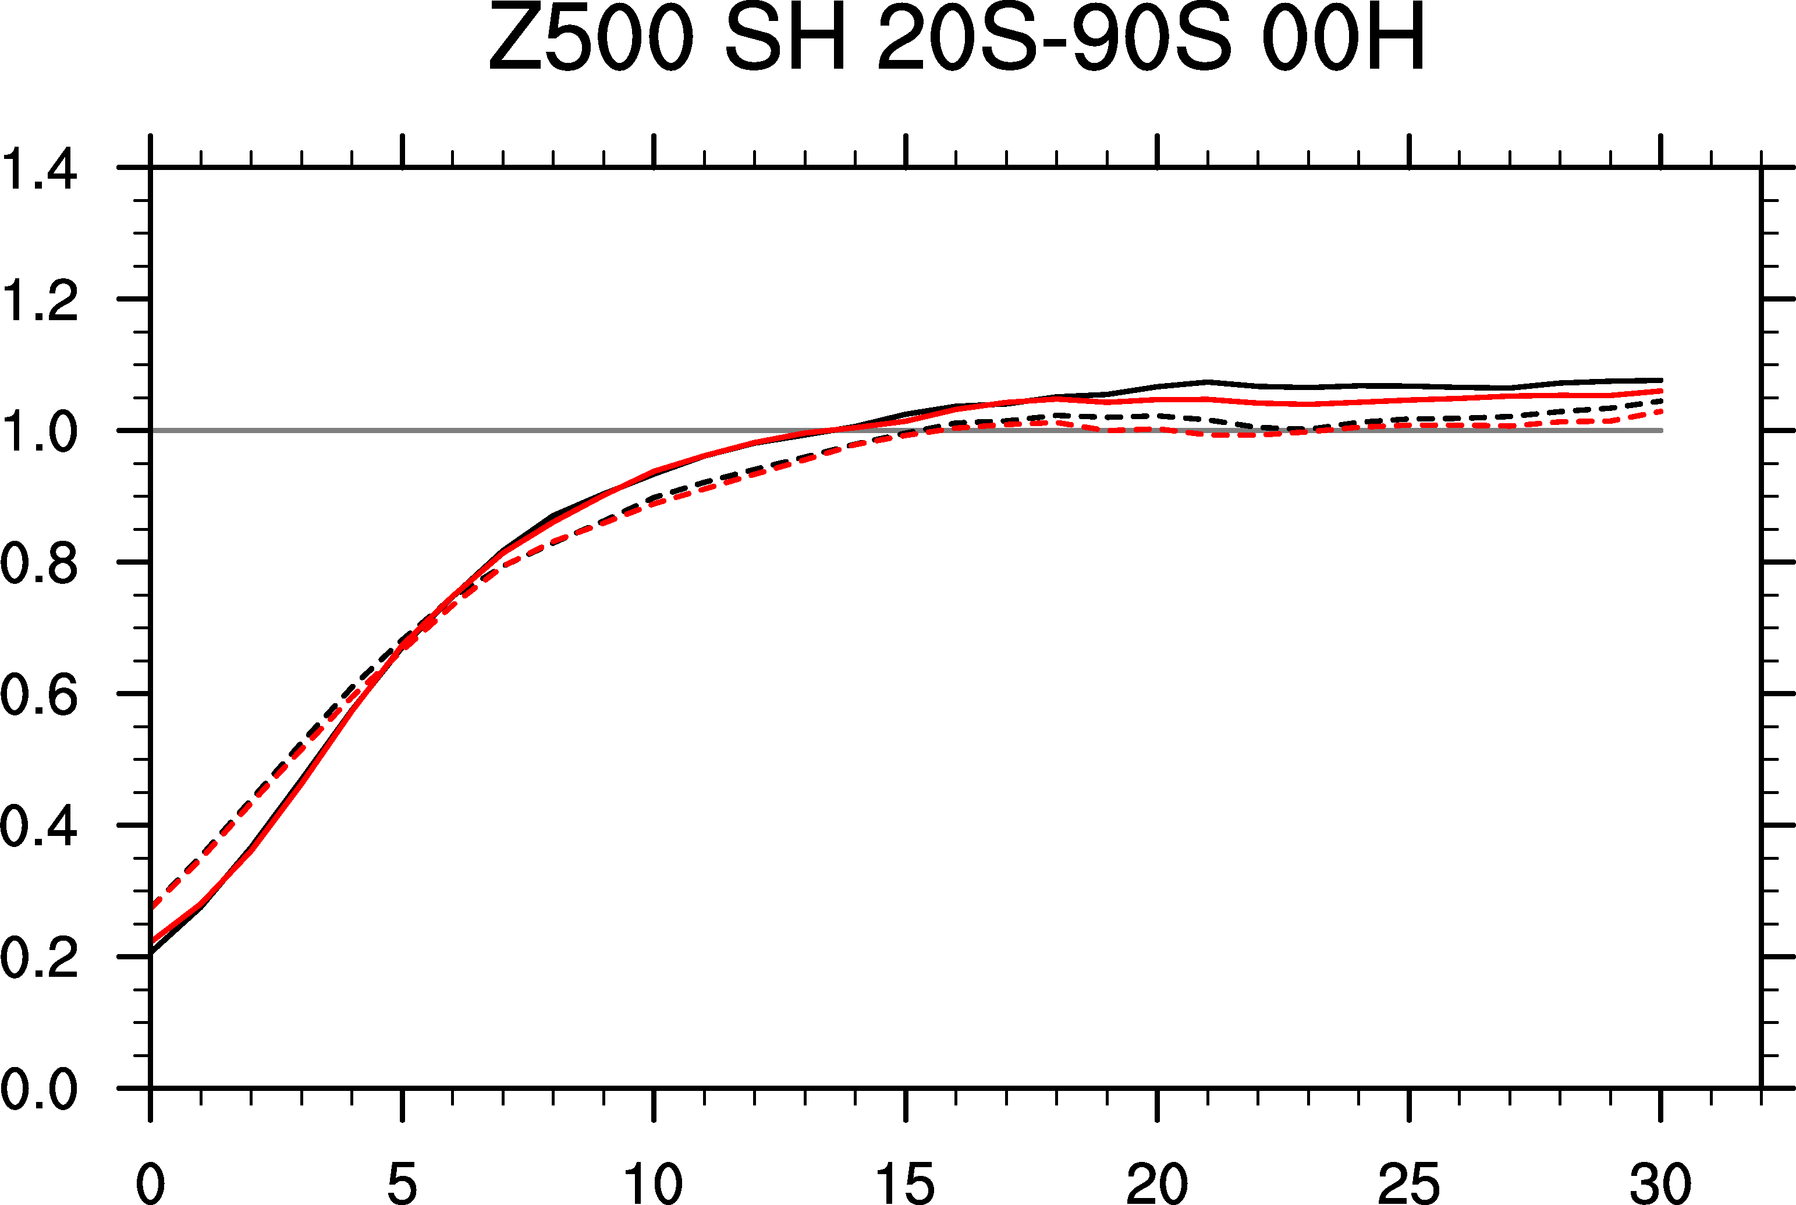
Forecasts RMSE and spread
RMSE SPREAD
S1 S2
Starts: 0501; 0417
From: Guomin Wang

Slide 7
Improving initialisation of soil moisture in ACCESS-S2
Tests showed that we could improve the forecast performance (especially Tmax and in winter half of the year) in the next version of ACCESS-S (vn 2)
Realistic soil moisture initialisation
Climatological soil moisture initialisation
Realistic soil moisture initialisation
Correlation
Forecasts initialised on 1st May for month May (1990-2012)
From: Maggie Zhao

Slide 8
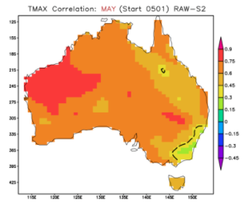
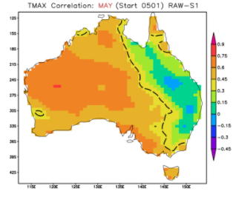
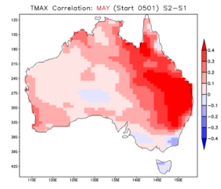
Caution: Only 23 years in the comparison
Forecasts Example: Tmax
Tmax: Skill for May (from 1st May Starts)
ACCESS-S2
ACCESS-S1
Difference (S2-S1)
Realistic soil moisture initialisation tests
Climatological soil moisture initialisation
From: Li Shi
Correlation

Slide 9
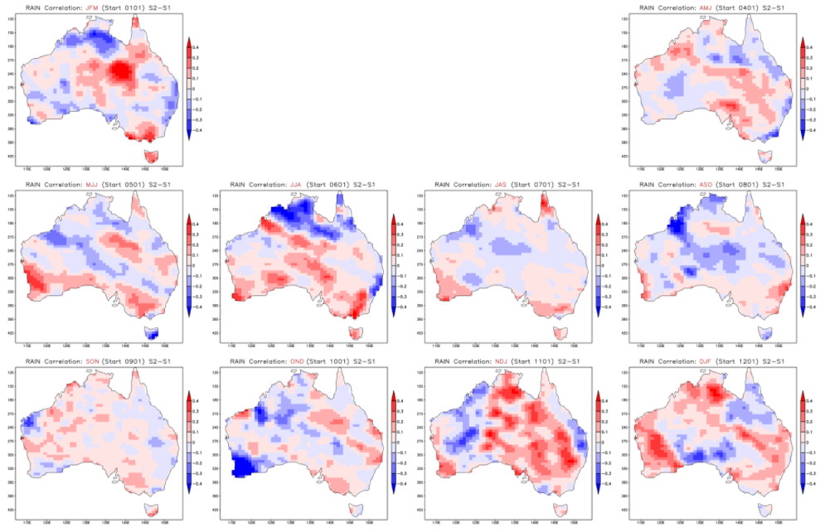
Caution: Only 23 years in the comparison
Forecasts Example: Rainfall
Difference in skill for seasonal rainfall (S2-S1)
Low rainfall region
JFM
AMJ
MJJ
JJA
JAS
ASO
SON
OND
NDJ
DJF
From: Li Shi

Slide 10
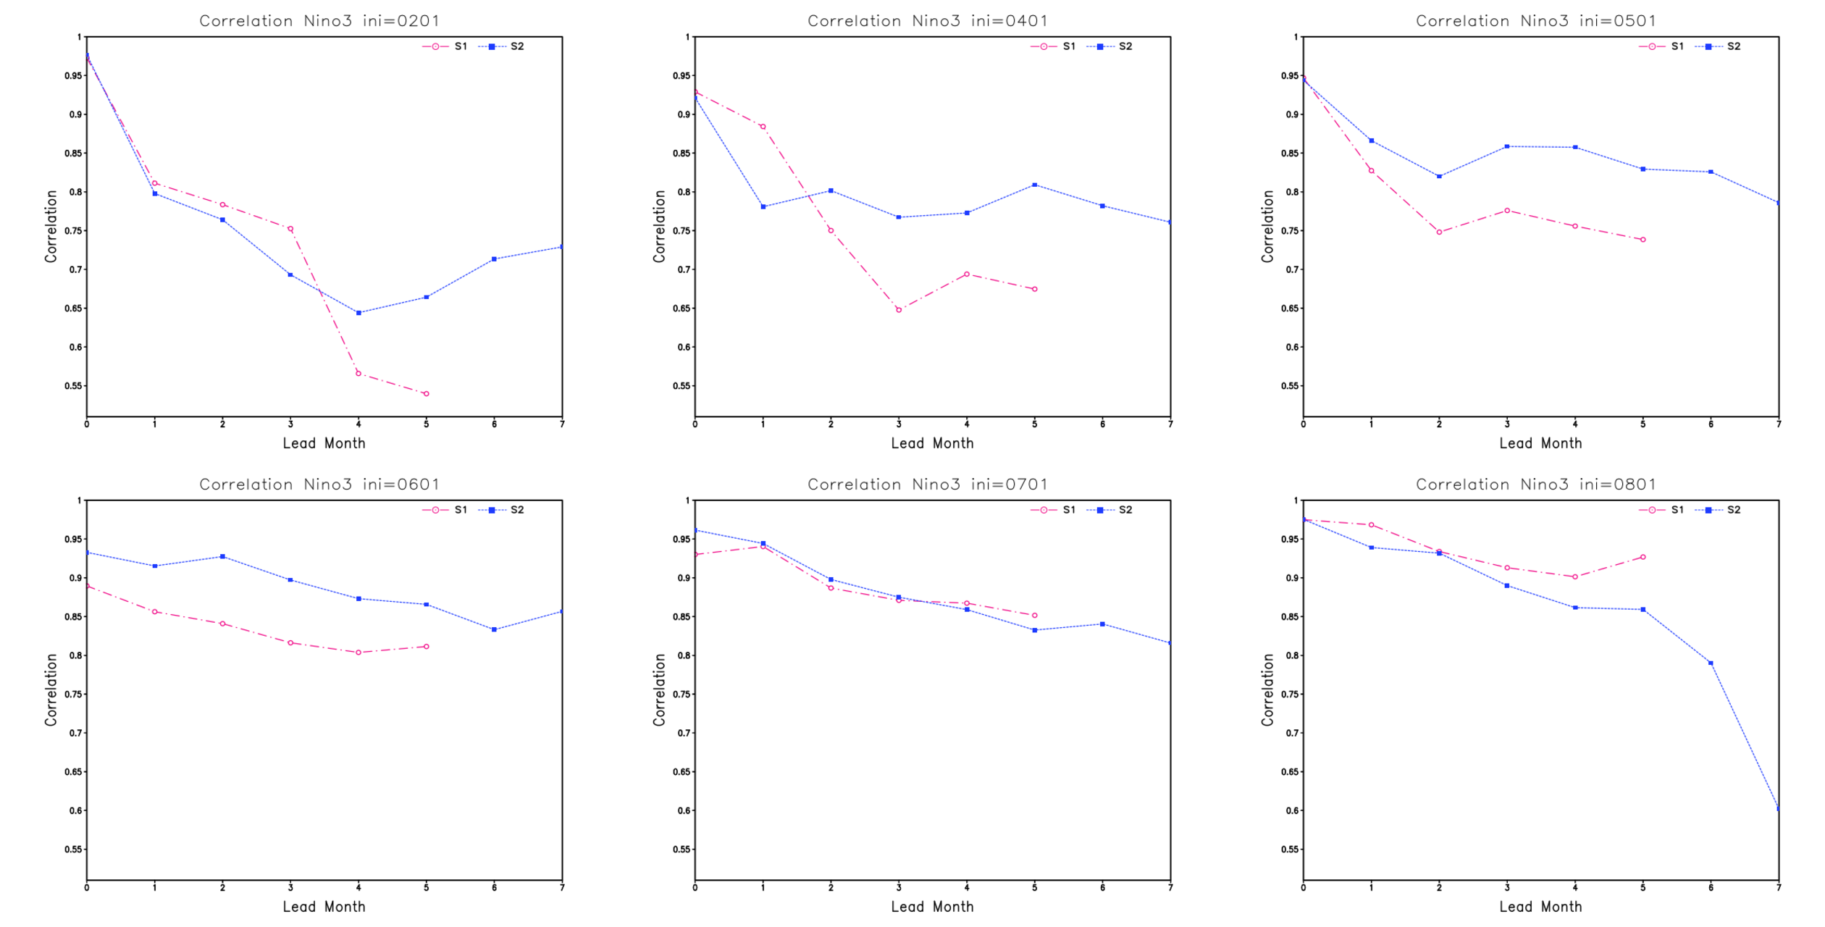
Caution: Only 23 years in the comparison
Forecasts Nino3
ACCESS-S2
ACCESS-S1
Forecast start: FEB
Forecast start: APR
Forecast start: MAY
Forecast start: JUN
Forecast start: JUL
Forecast start: AUG
From: Li Shi
Notes:
Note: Probably still a lot of noise – small ensemble (~11) and only 23 years

Slide 11
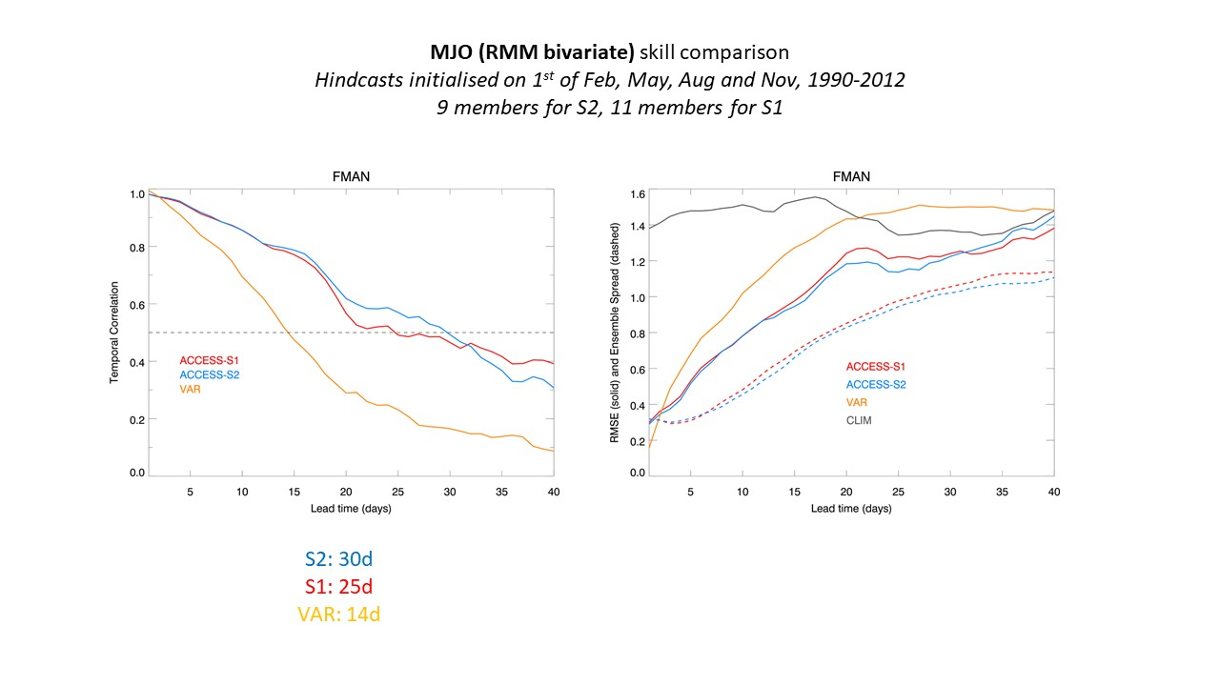
Forecasts MJO
ACCESS-S2
ACCESS-S1
From: Andrew Marshall

Slide 12
ACCESS-S2 current status
Hindcasts are complete and available on the NCI OpenDap and to NCI users for research purposes:
On NCI: /g/data/ux62/access-s2/hc
On OpenDap: https://geonetwork.nci.org.au/geonetwork/srv/eng/catalog.search#/metadata/f3311_4920_0252_8073
https://dapds00.nci.org.au/thredds/catalogs/ux62/access-s2/access-s2.html
ACCESS-S2 real-time system is running in trial mode

Slide 13
Thank you
Debbie.Hudson@bom.gov.au

