Slide 1
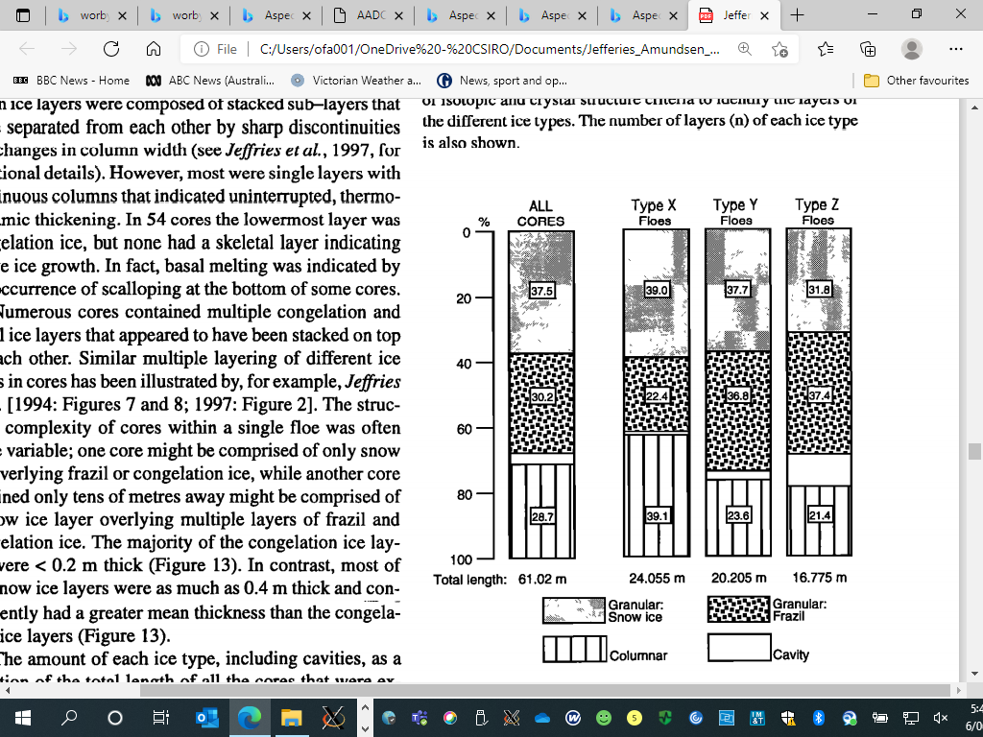
Antarctic Sea ice in CMIP6
Ice Model Diversity in CMIP6 : Now and in the Future*
Siobhan O’Farrell CSIRO Oceans and Atmosphere
*CICE6 v SI³ (Sea Ice modelling Integrated Initiative)
Email: siobhan.ofarrell@csiro.au
Jefferies, 1998, Amundsen, Eastern Ross Seas

Slide 2
CMIP6 models: 16 available on NCI with additional ice budget data (10 variables in all)
Selected models that had realistic ice seasonal cycle (based on Roach et al, 2020) and what was available at ESGF. SIMIP model variables were not standard model output.
Paper by Li et al, 2021 just published overview of these results for Antarctic Keen et al 2021 did a more detailed study for the Arctic.
Concentrating here on CICE models v European model.
CICE5(.1.2): multi-layer thermodynamics –ACCESS CM2, HadGEM3-GC3.1-LL, UKESM1-LL
CICE5(.1.2) ‘mushy layer’ thermodynamics- CESM2, CESM2-WACCM, NorESM2-LM
LIM3.6: IPSL-CM6A-LR, EC-Earth3
Gelato (v6): CNRM-CM6-1, CNRM-CM6-1-HR

Slide 3
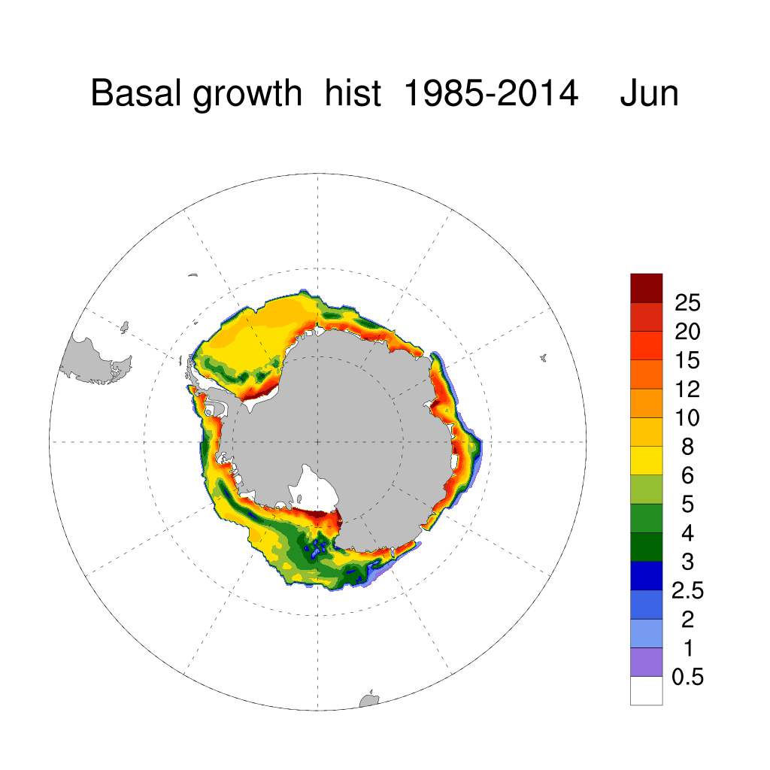
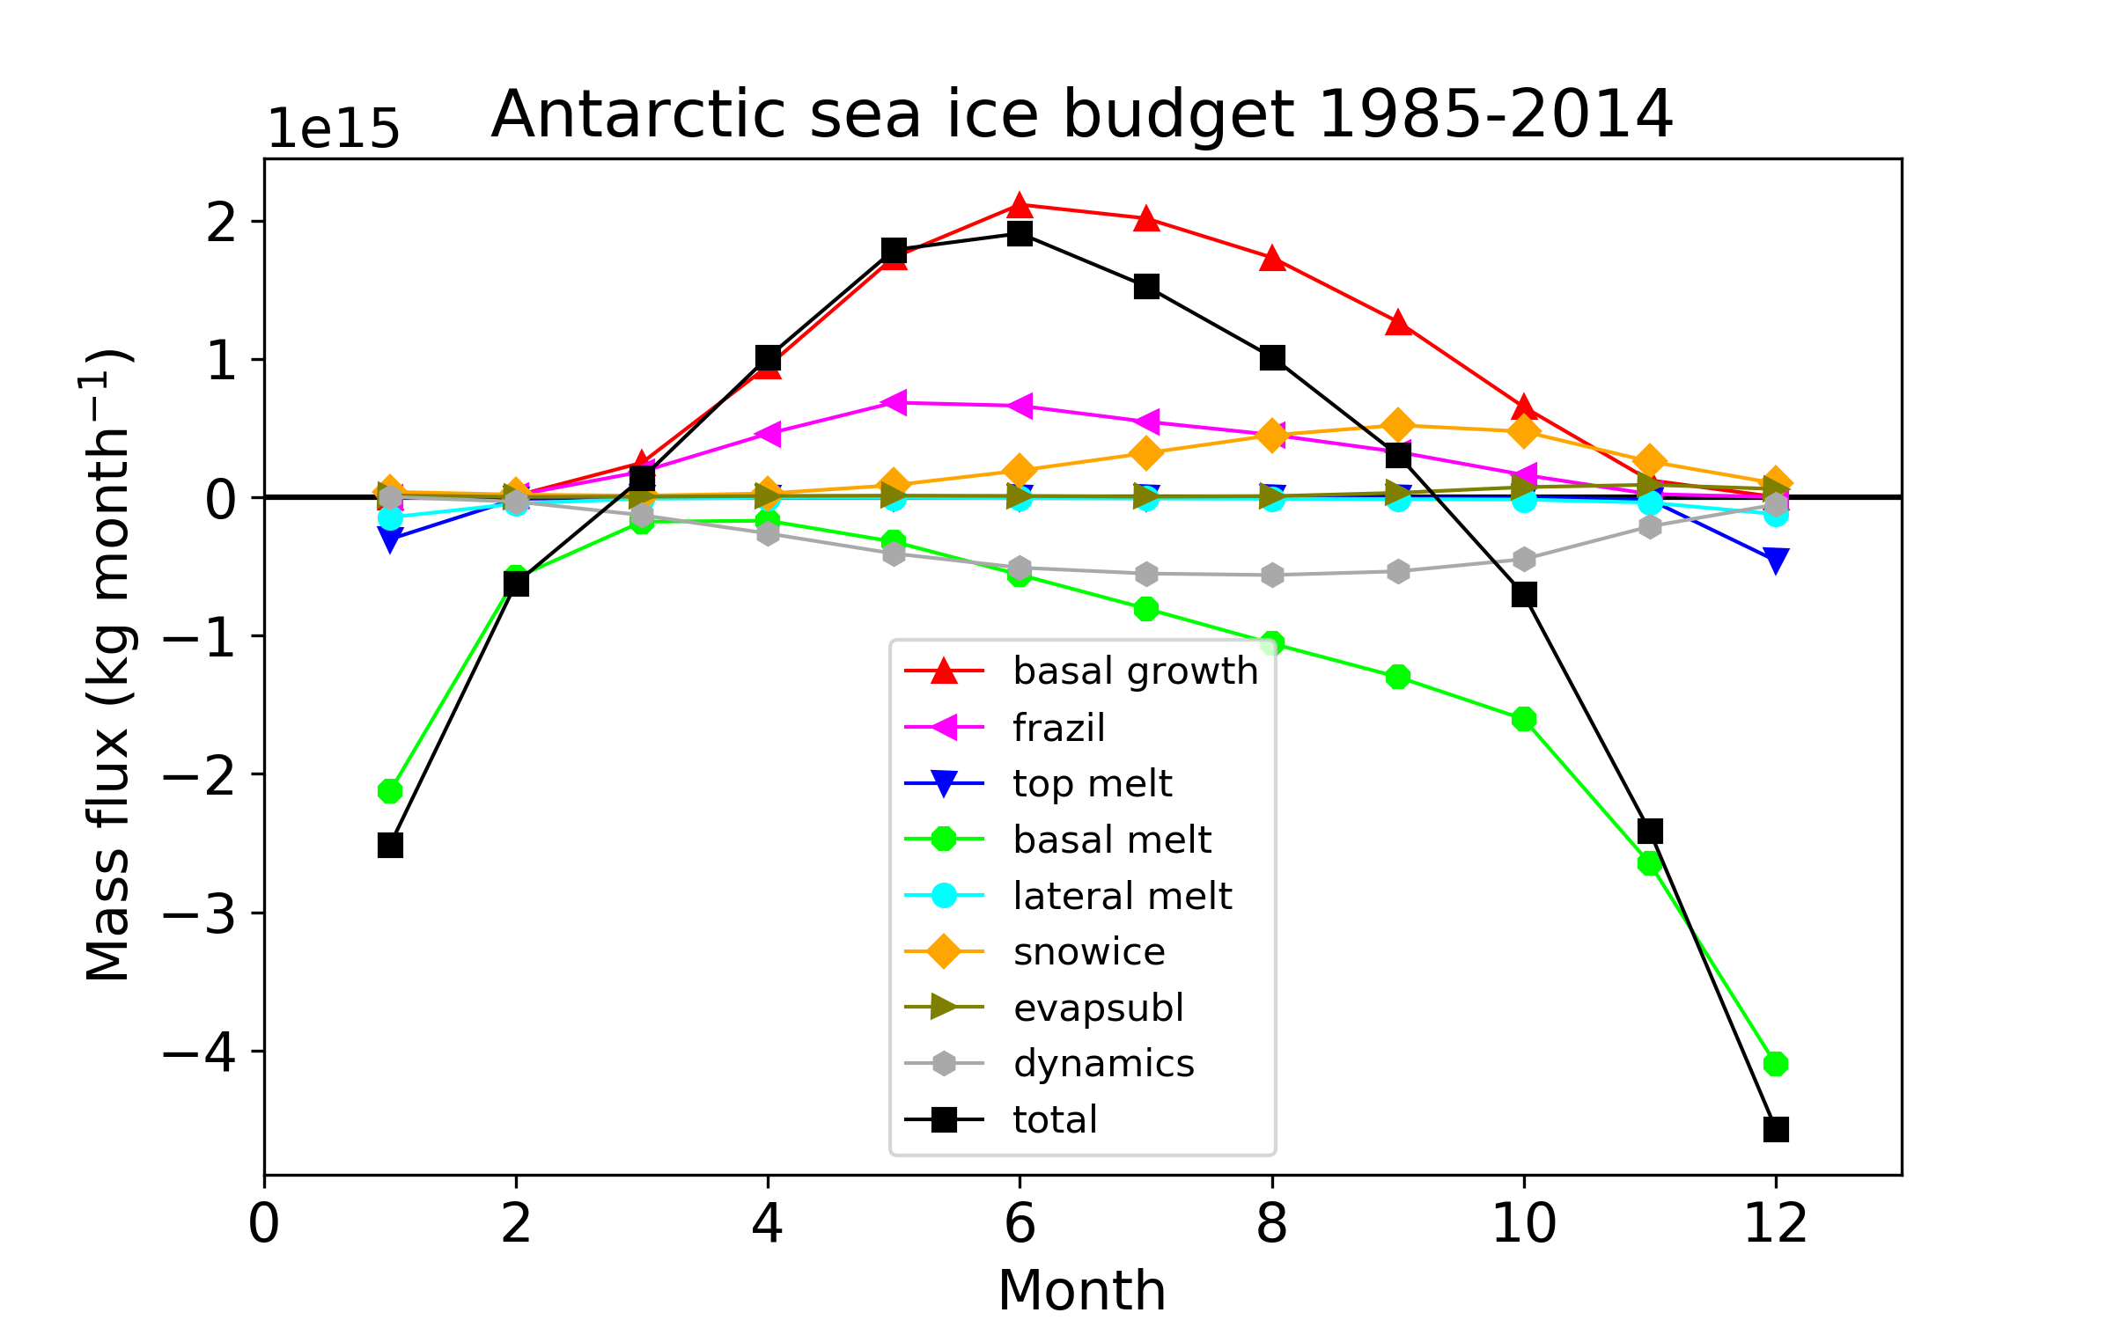
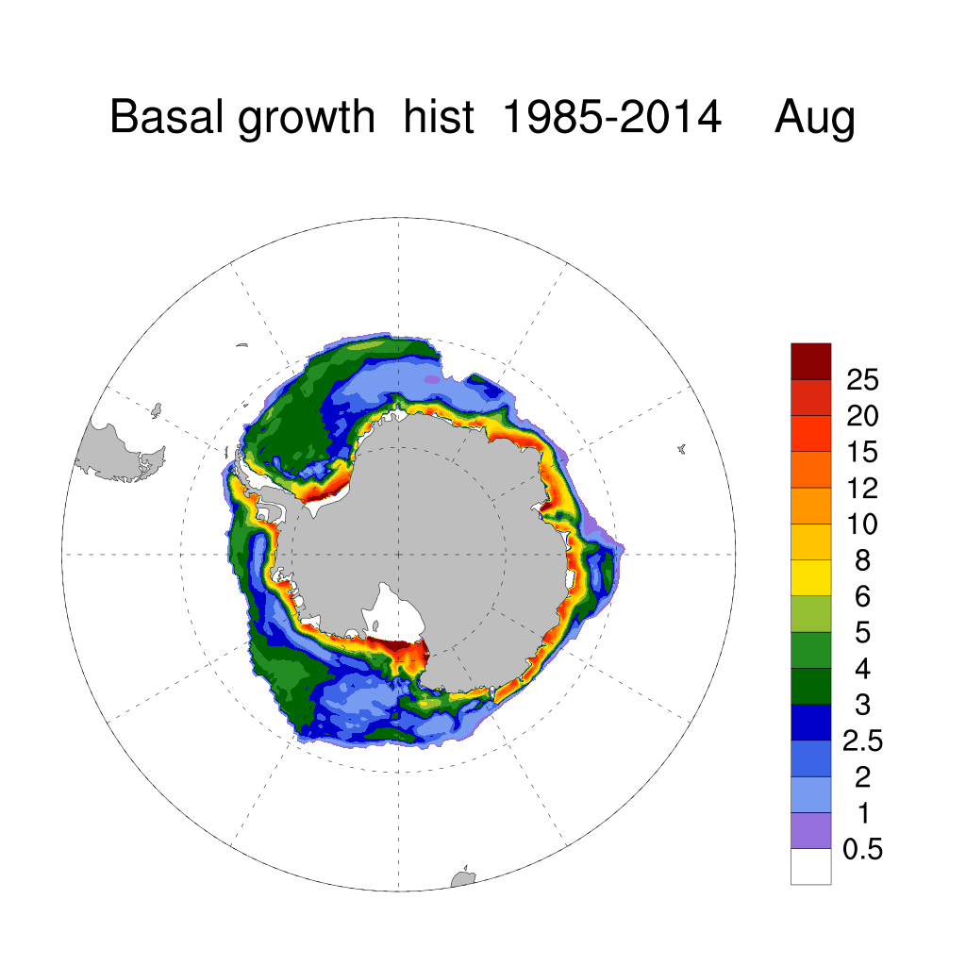
Individual terms in Antarctic budget for ensemble average of ACCESS-CM2 historical runs 1985-2014
ACCESS-CM2 basal (columnar) ice growth in historical simulation 1985-2014 average.
For similar curves for other CMIP6 models see Li et al 2021.
Units: 1e5 kg m ⁻² s ⁻¹

Slide 4
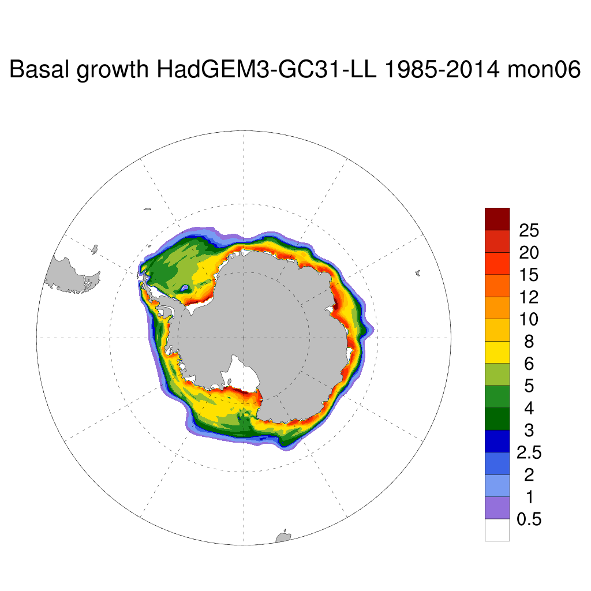
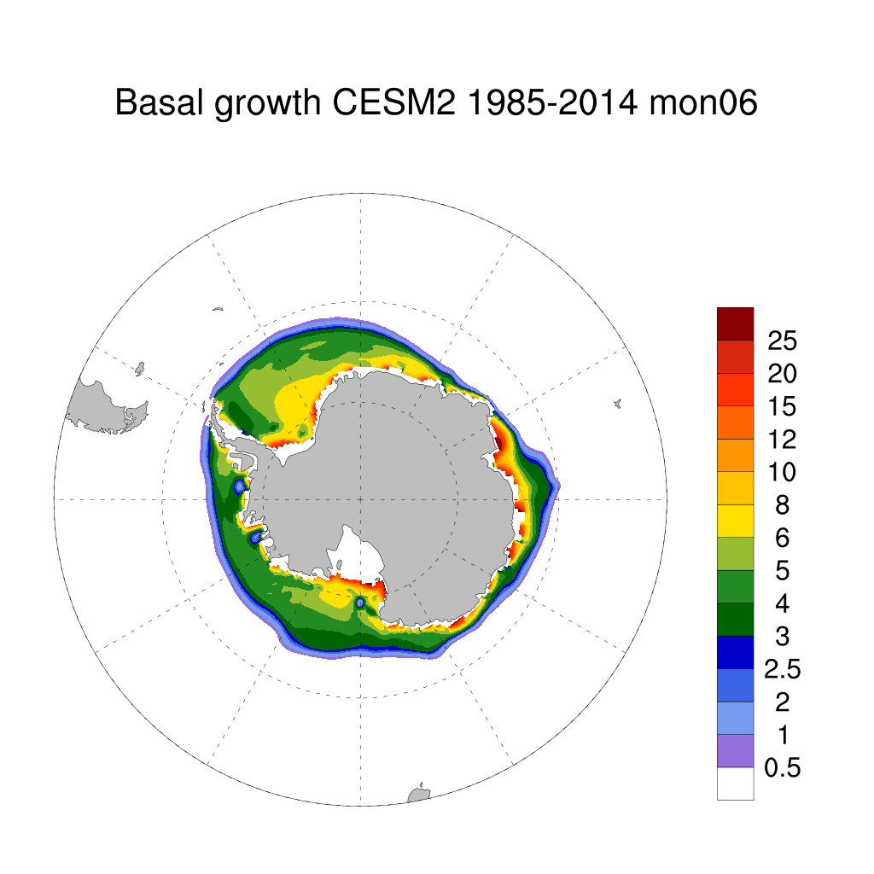
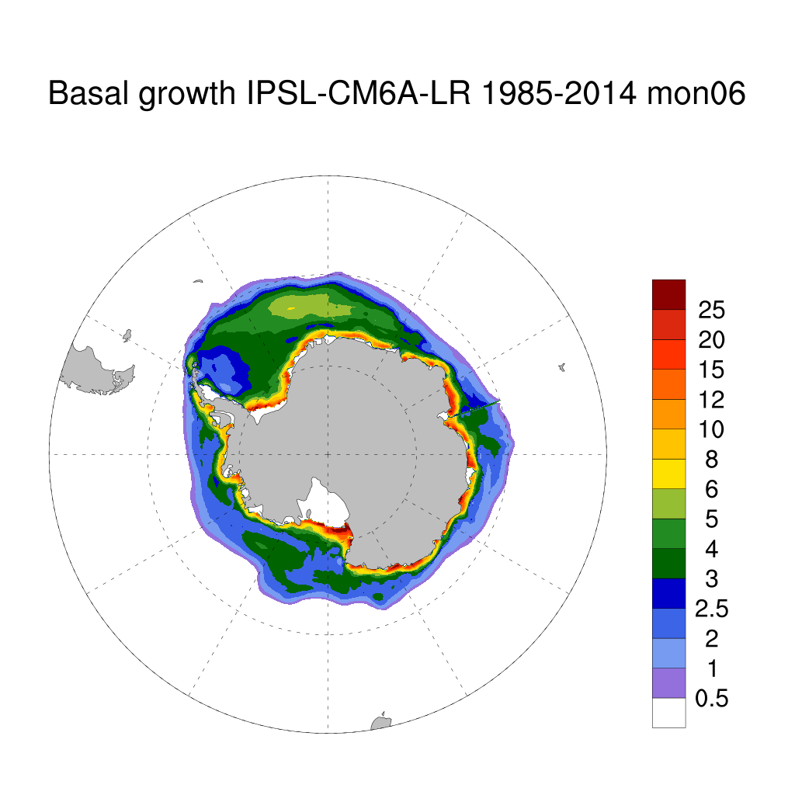
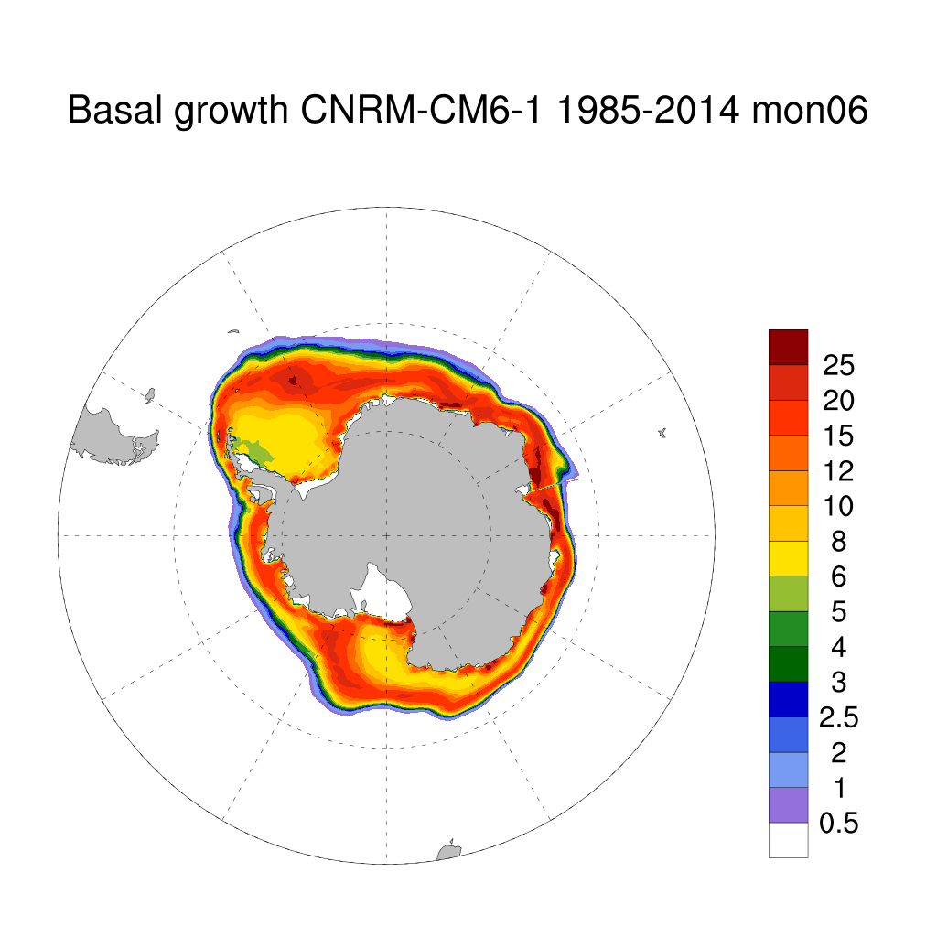
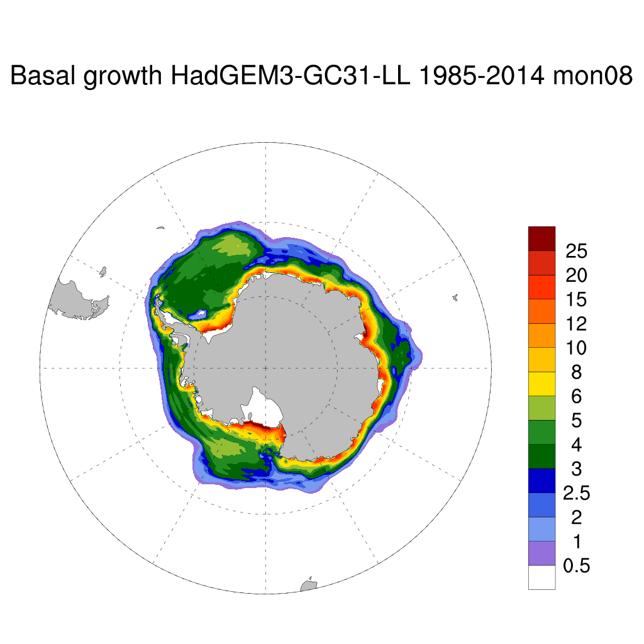
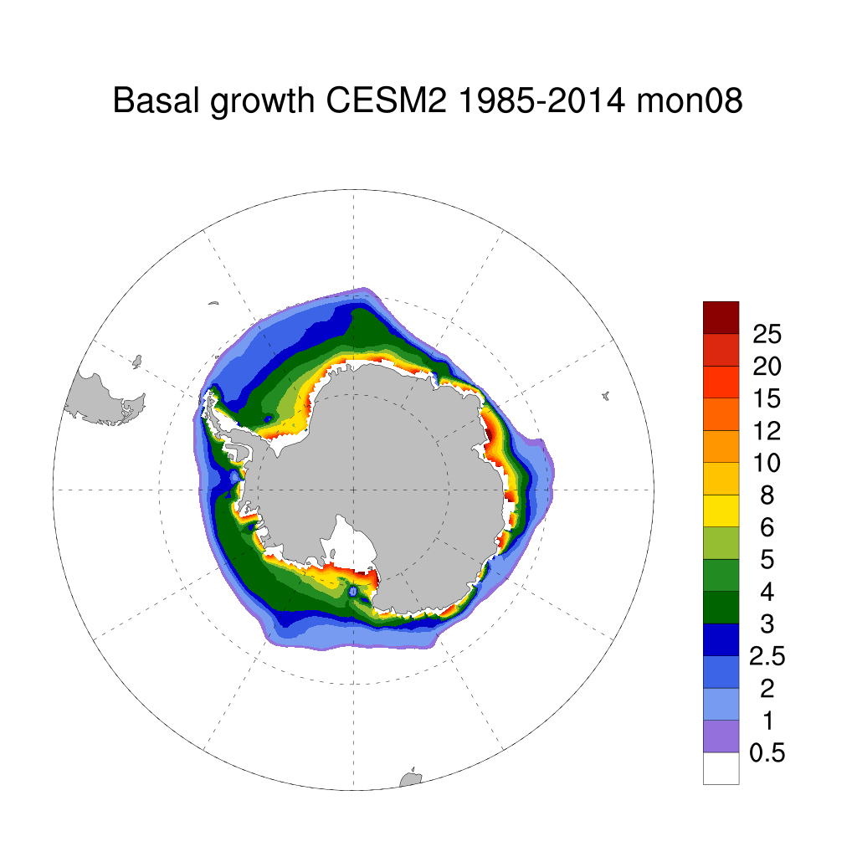
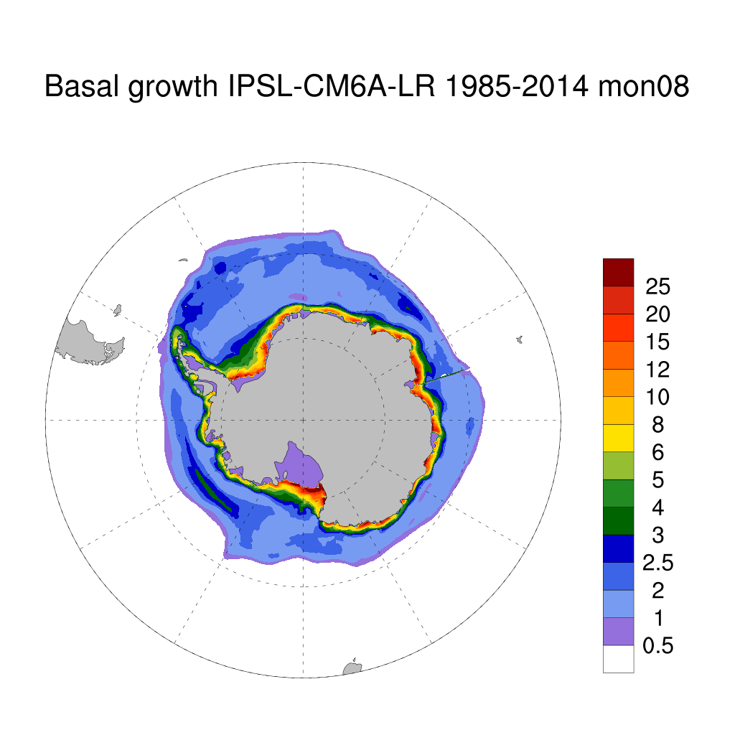
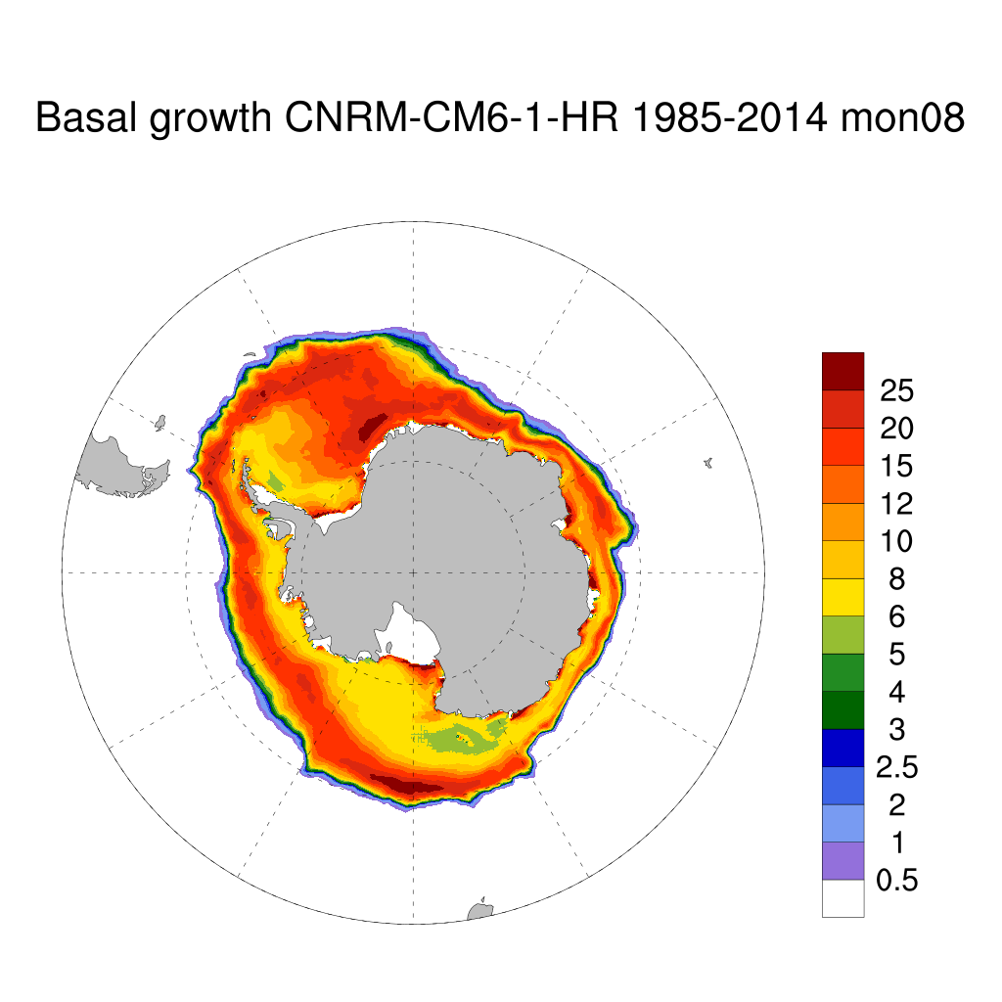
Basal ice growth in CMIP6 models representative of 4 of the ice model codes.
Units: 1e5 kg m ⁻² s ⁻¹

Slide 5
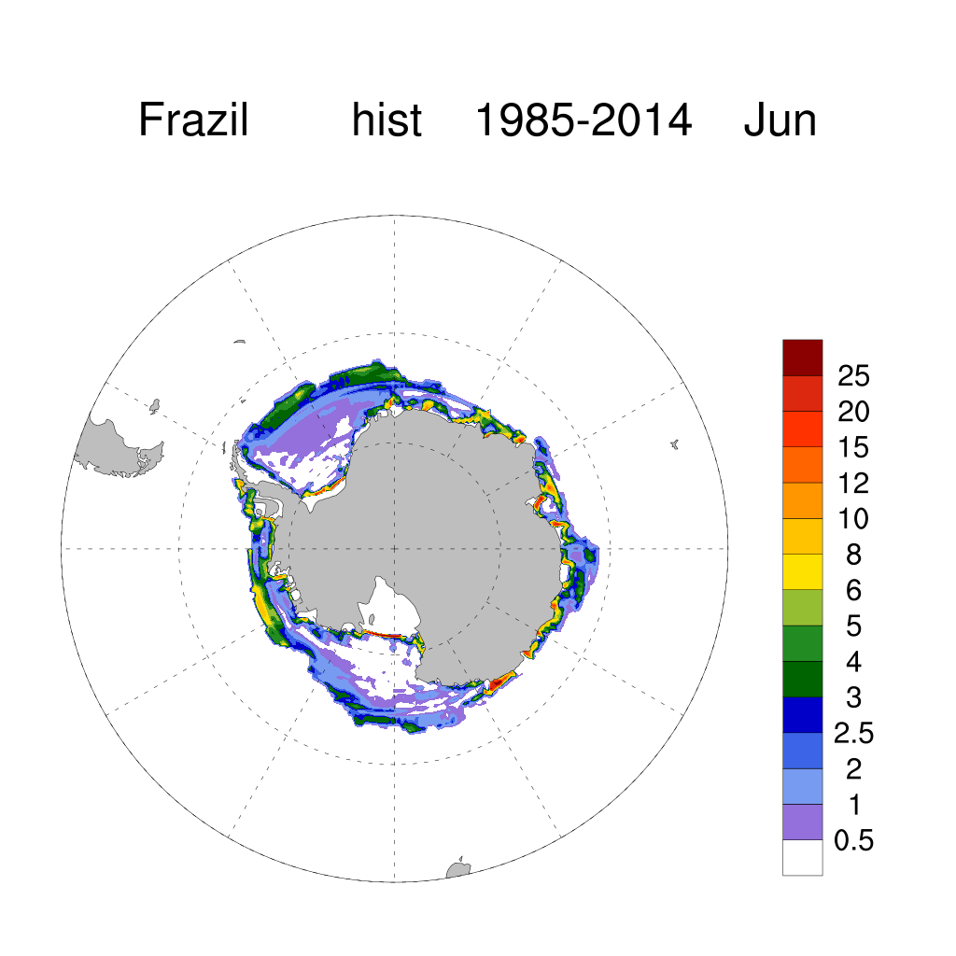
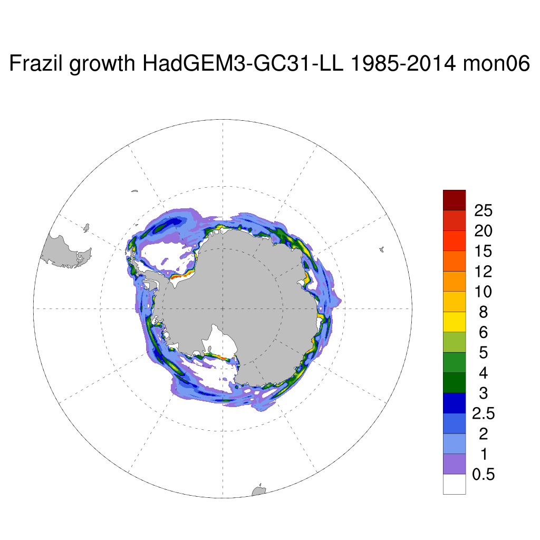
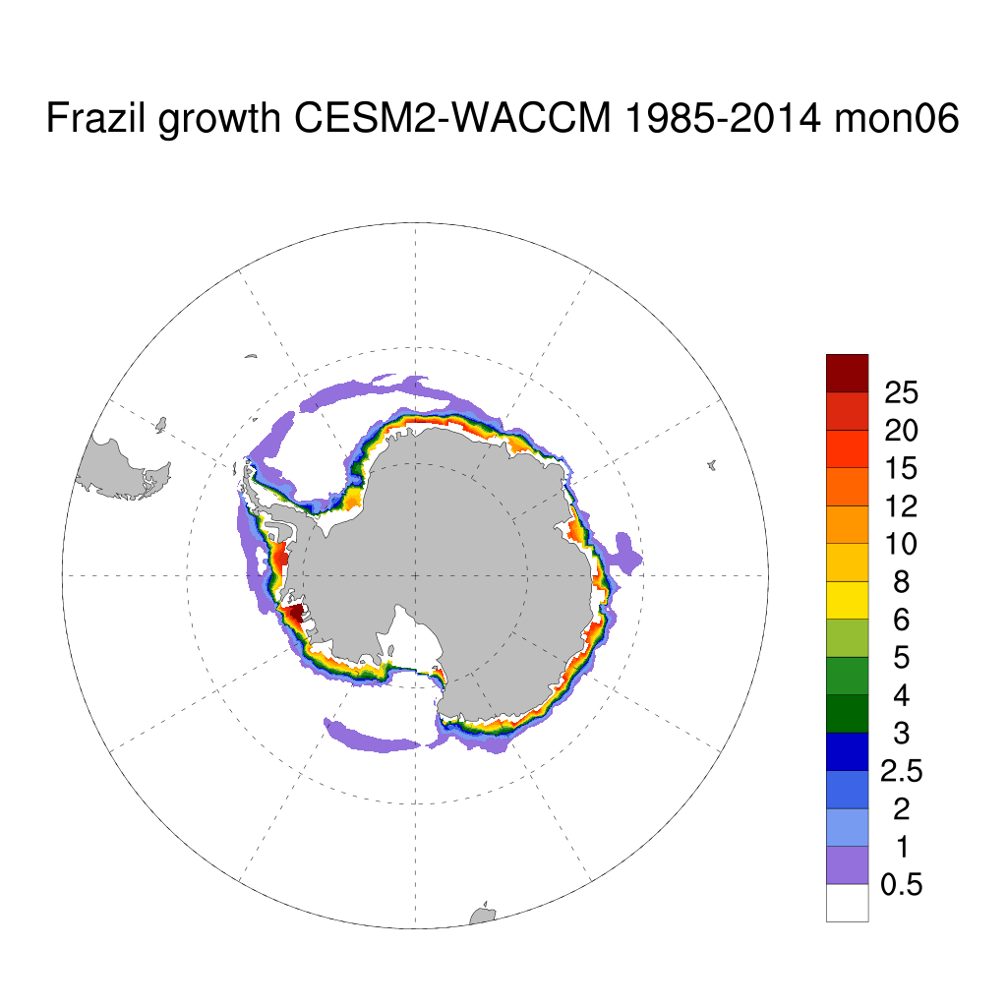
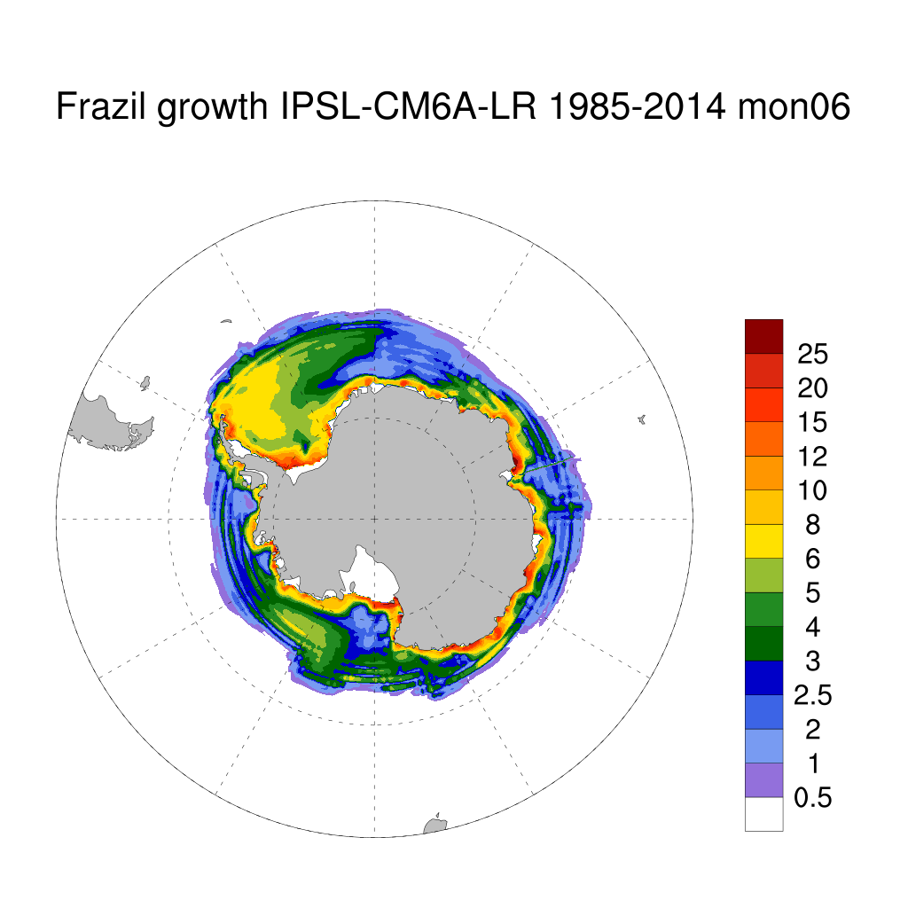
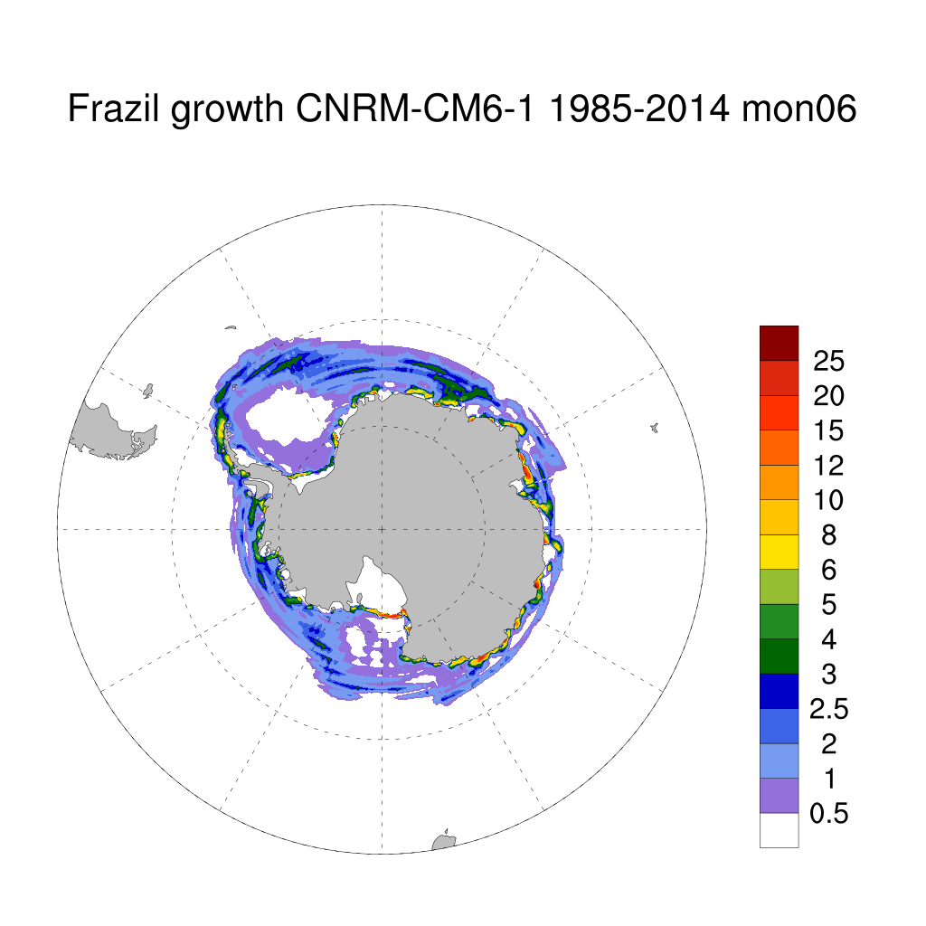
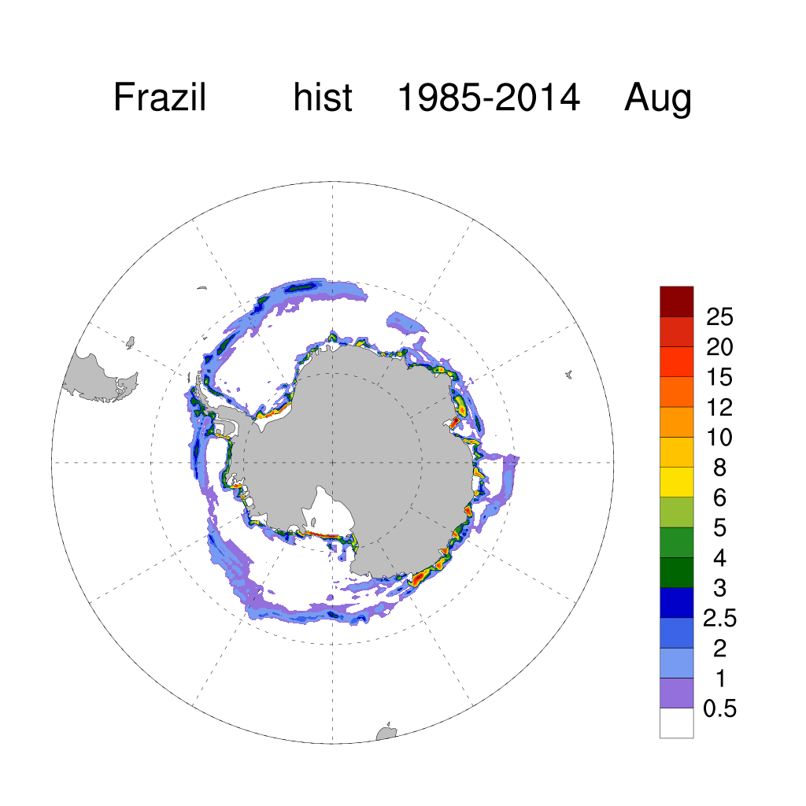
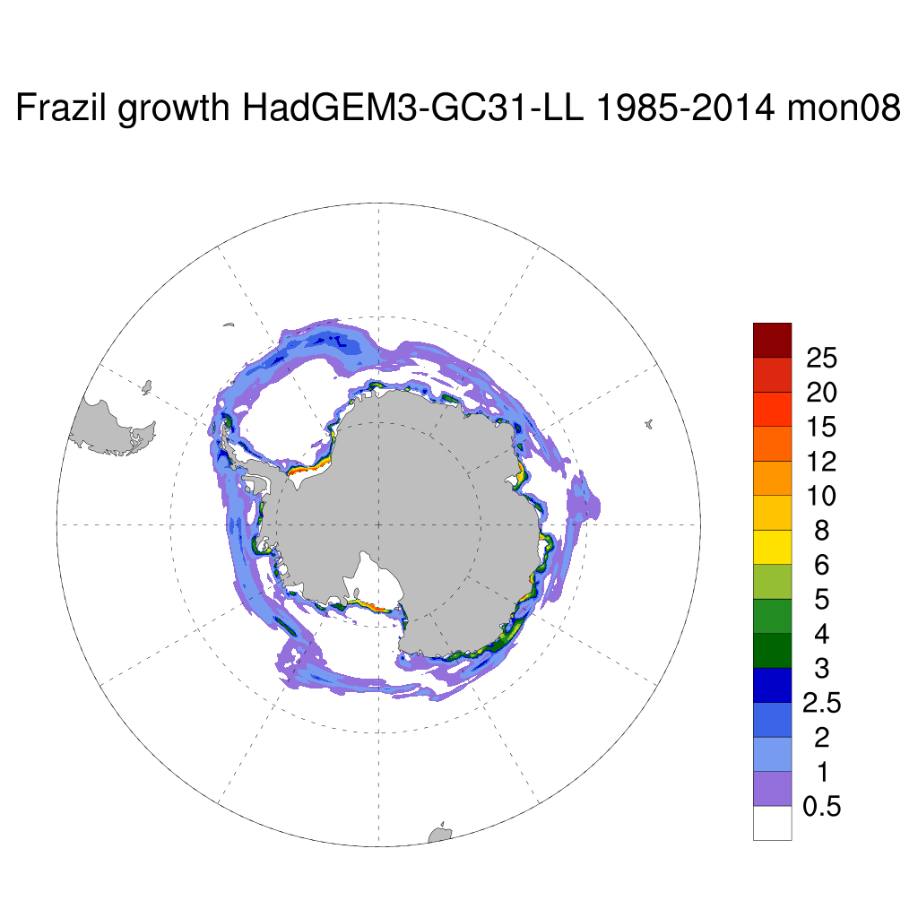
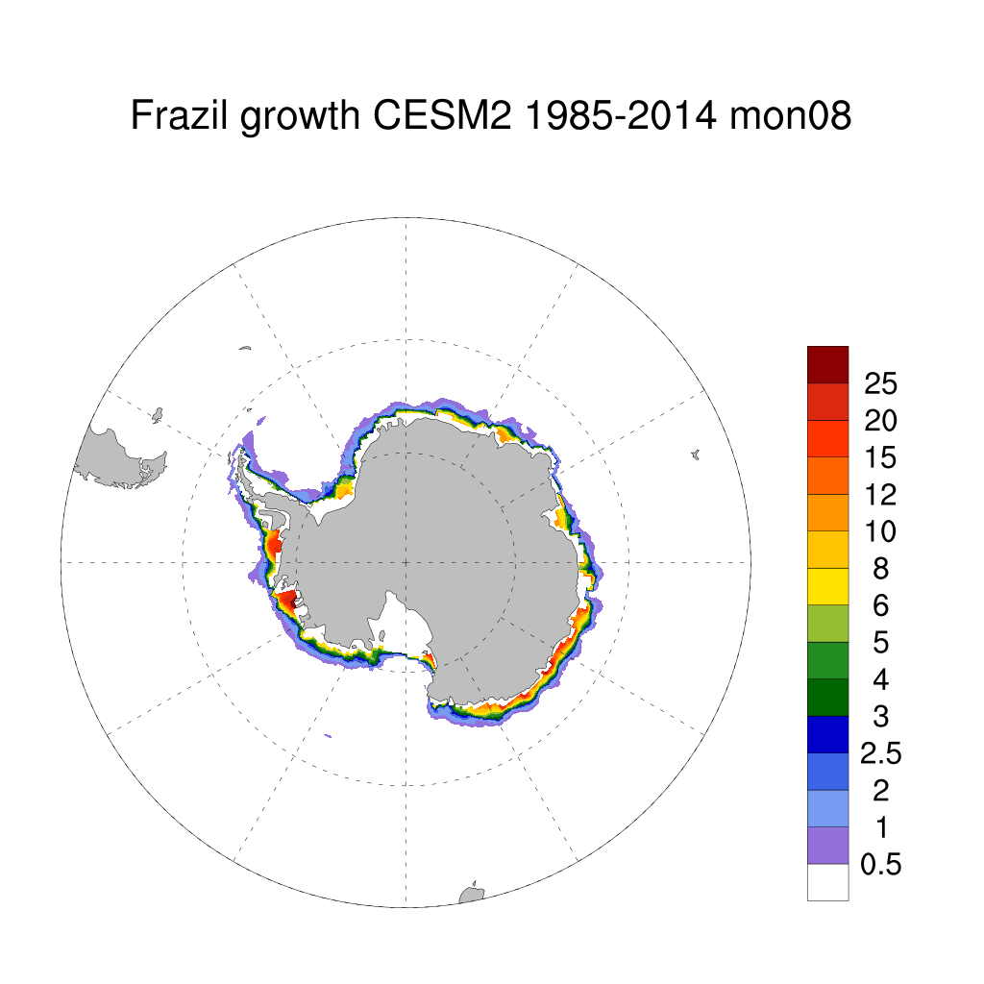
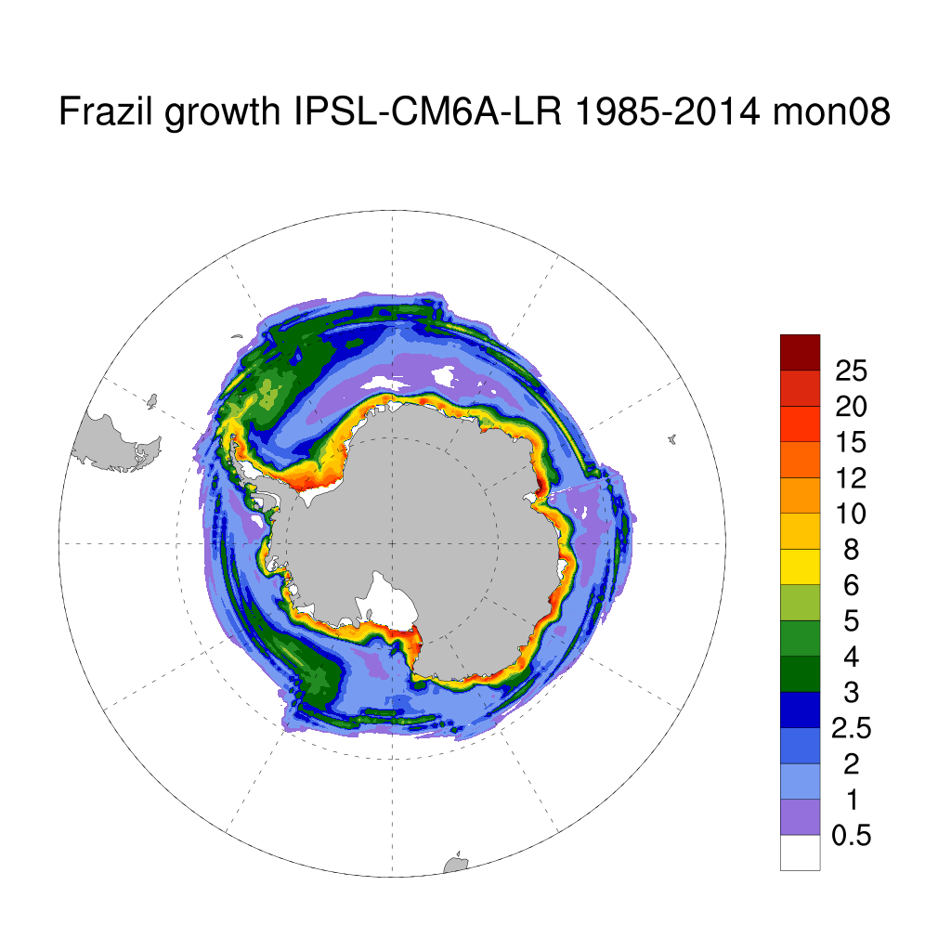
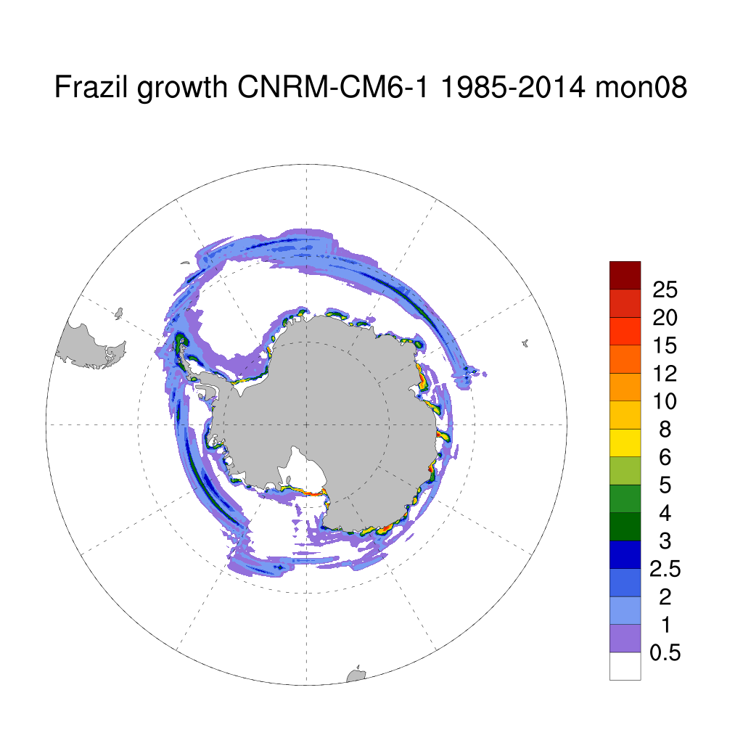
ACCESS-CM2
ACCESS-CM2
Frazil ice growth in the same 4 CMIP models: Note CESM colleagues, Bailey et al (2020) published runs showing differences between ‘mushy’ and the multi-level scheme in frazil and snow ice.
Units: 1e5 kg m ⁻² s ⁻¹

Slide 6
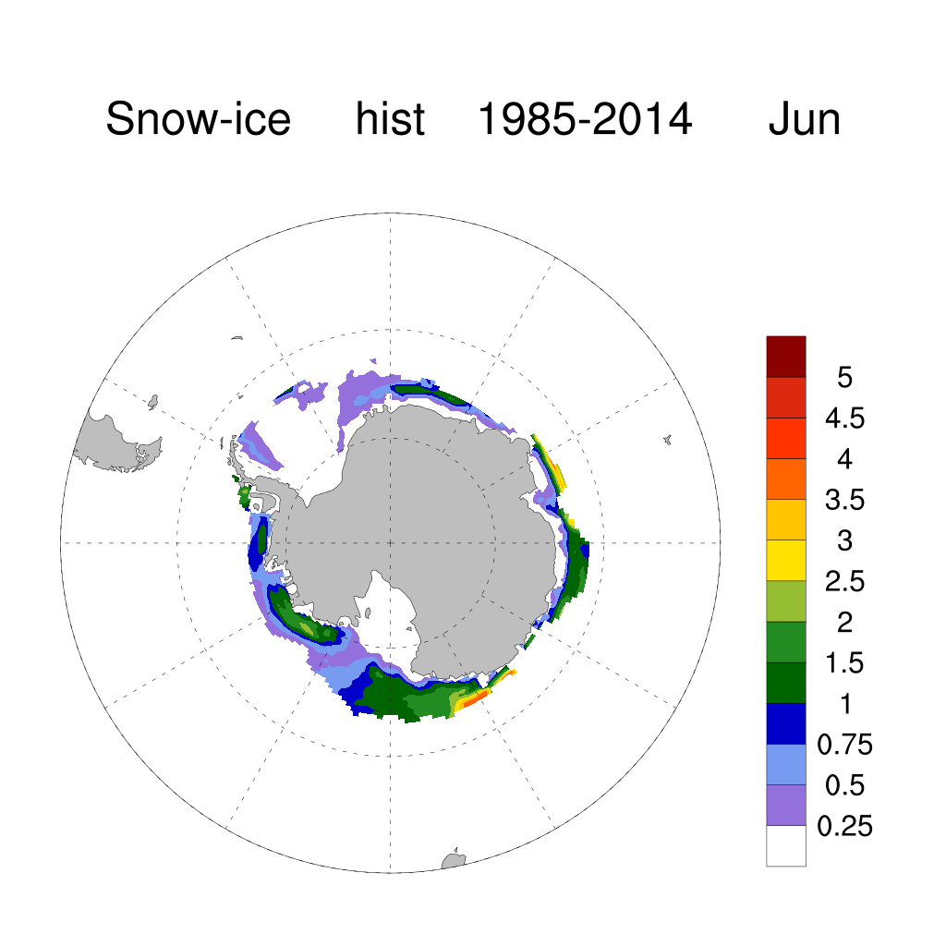
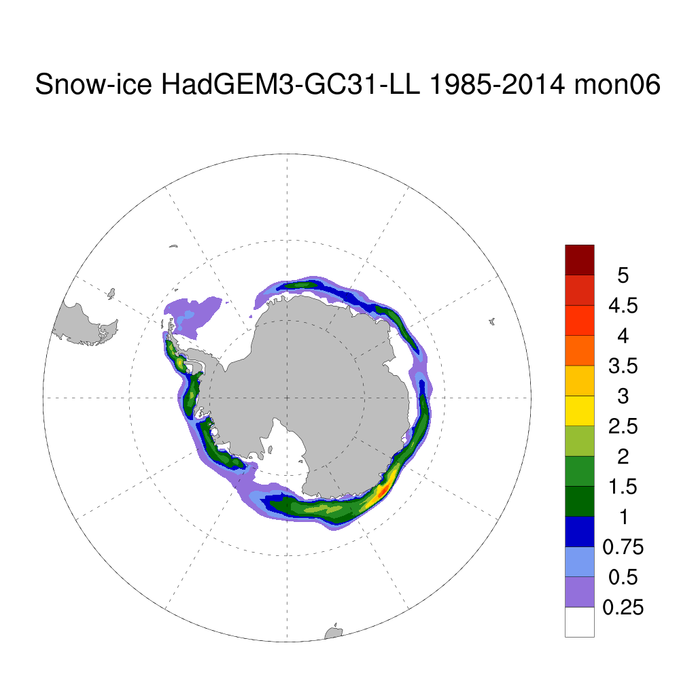
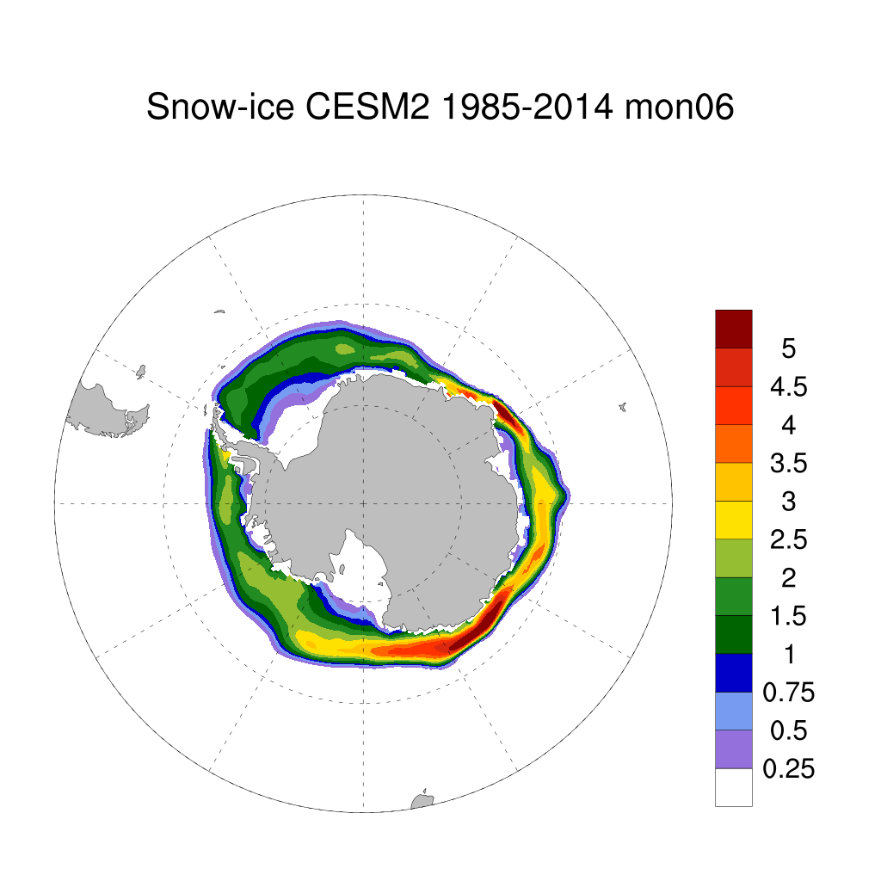
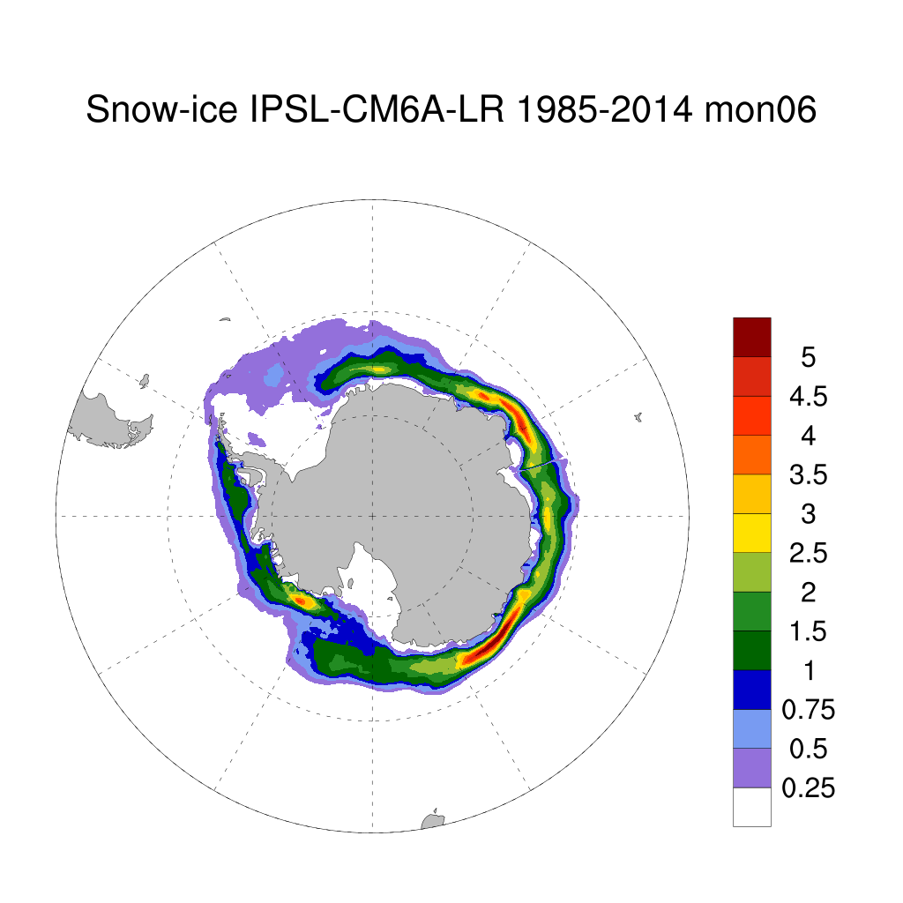
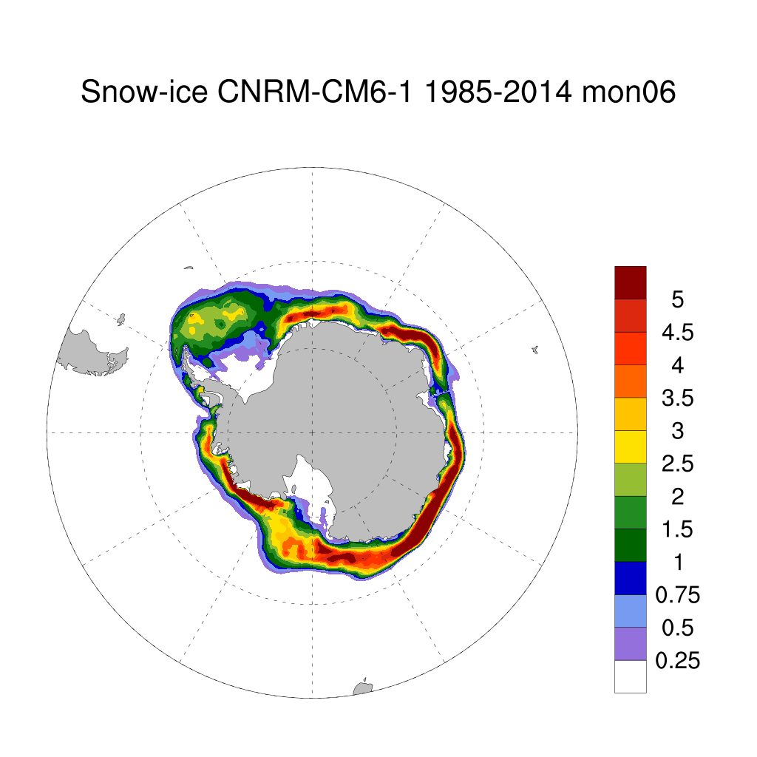
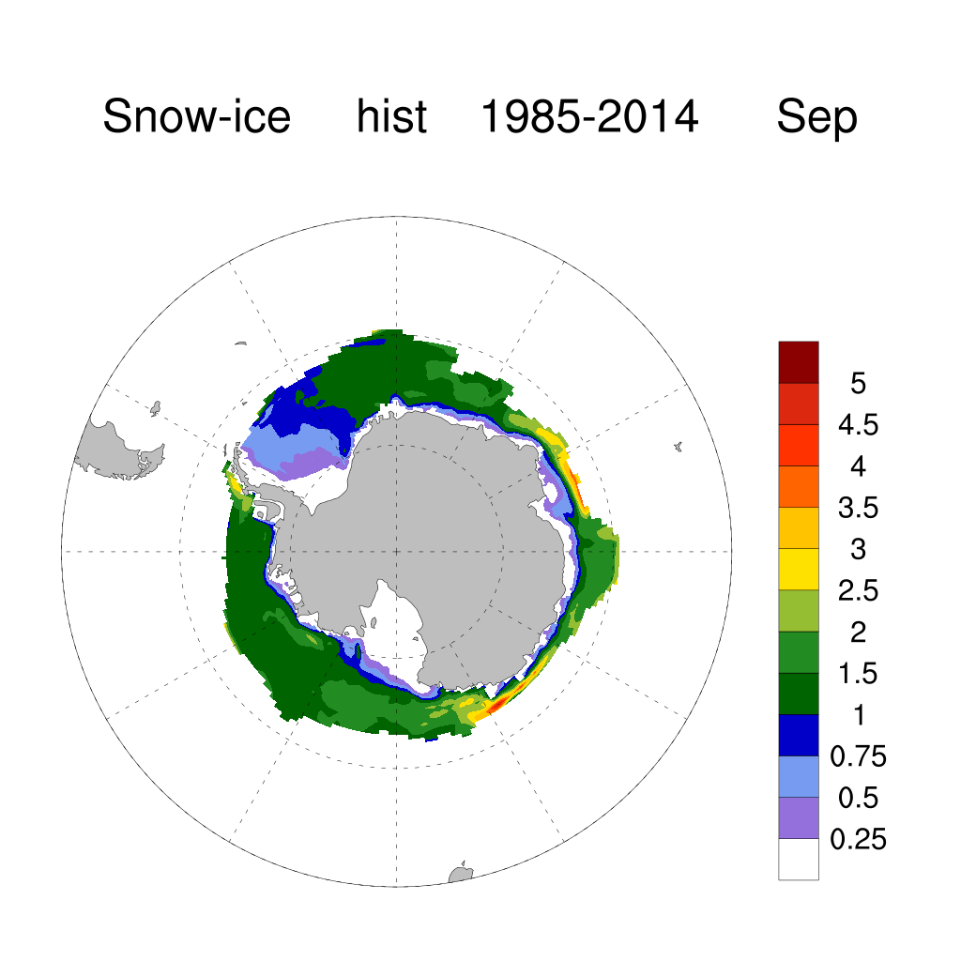
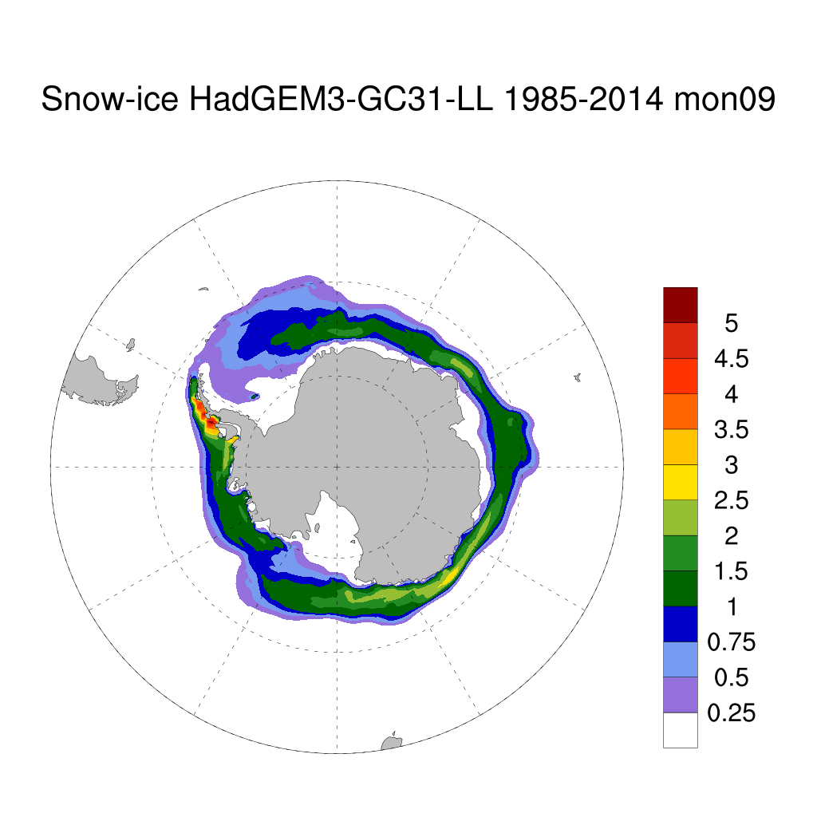
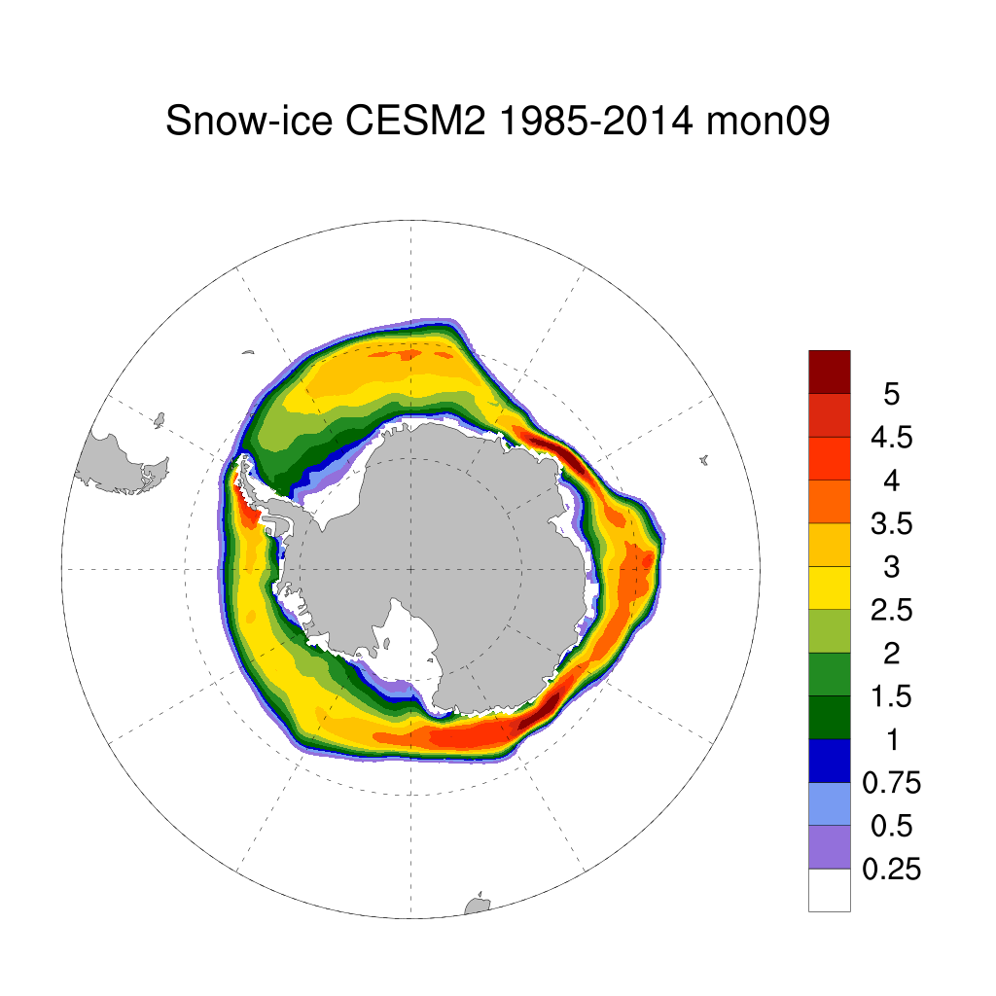
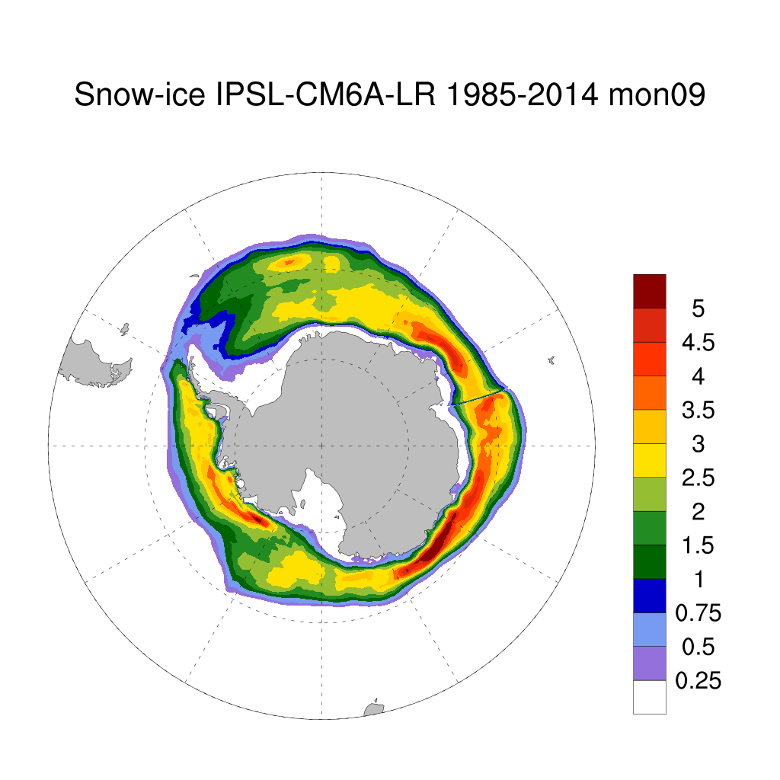
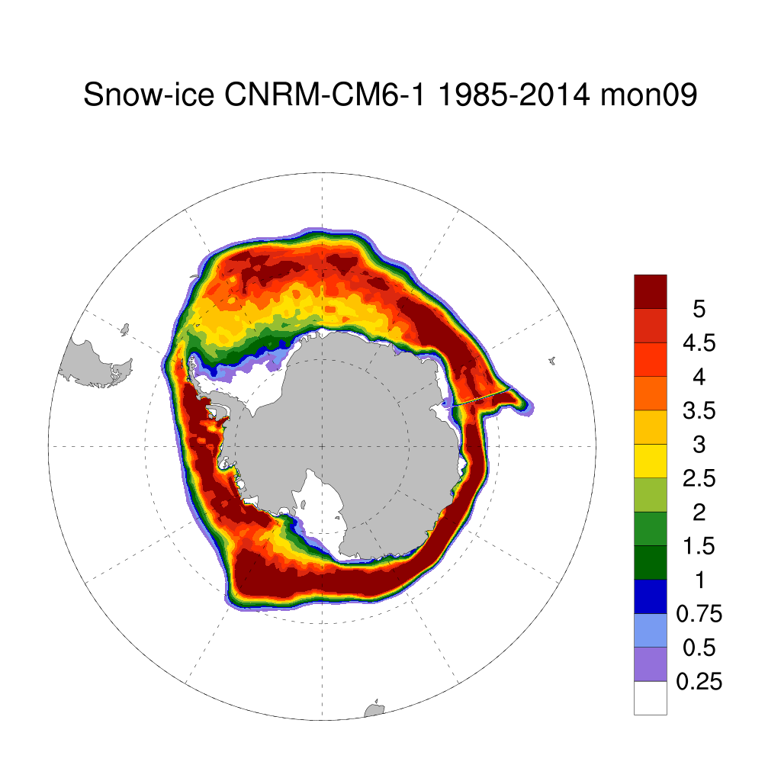
ACCESS-CM2
ACCESS-CM2
Snow ice in the 4 models compared to ACCESS-CM2, which is similar to HadGEM3-GC3.1 and much less than the other models which are thought to be more realistic. Need to do comparison for all 3 of these variables with available observational data.
Vertical scale enhanced
Units: 1e5 kg m ⁻² s ⁻¹

Slide 7
Summary
Large scale sea ice response in CMIP6 controlled by Atmosphere ocean-model climatology and biases.
Individual ice models however do have clear differences in the regions of production of basal ice, frazil and snow ice.
Need to do more comparisons with observations, data from floes heterogeneous and highly variable, cruise reports.
Discussions with colleagues, in other (ice) modelling groups.

