Slide 1
Sensitivities of ACCESS climate model to surface temperature
---implication of convection scheme
Hongyan Zhu
Research, BOM
Science Day workshop

Slide 2
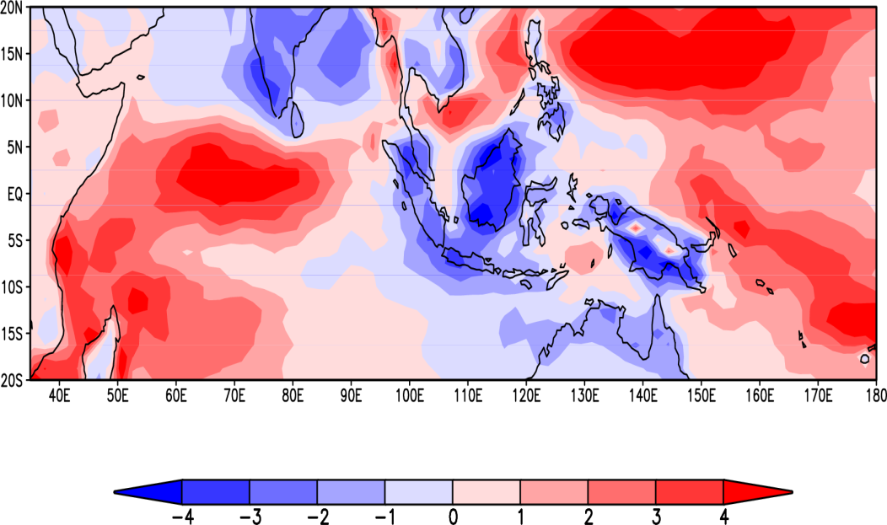
Rainfall bias (mm/day) in the control experiment versus GPCP

Slide 3
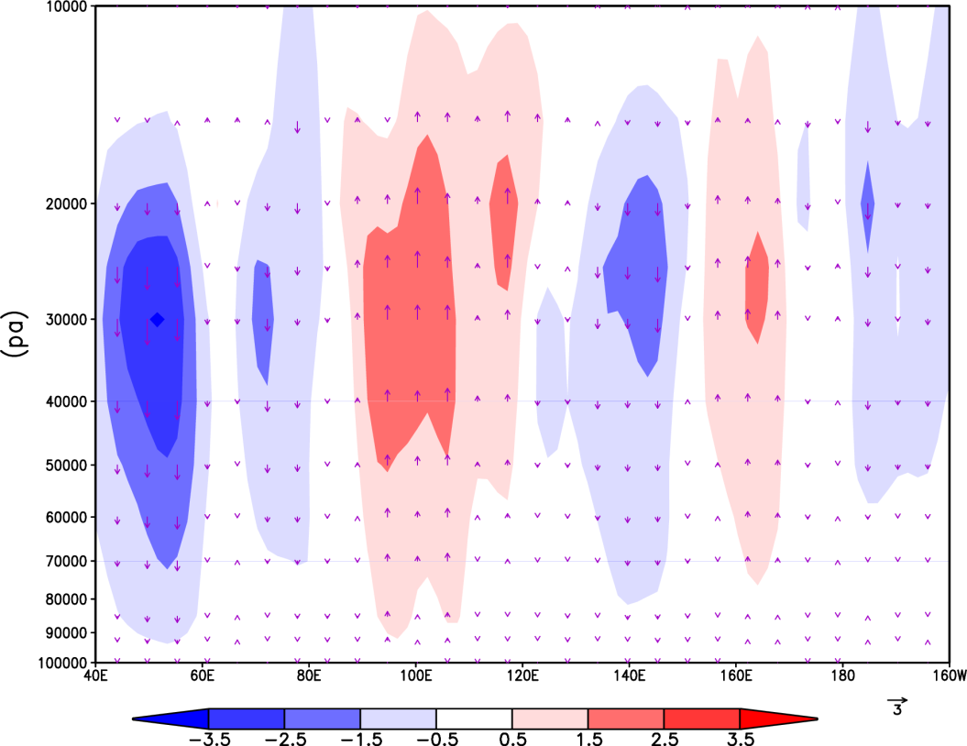

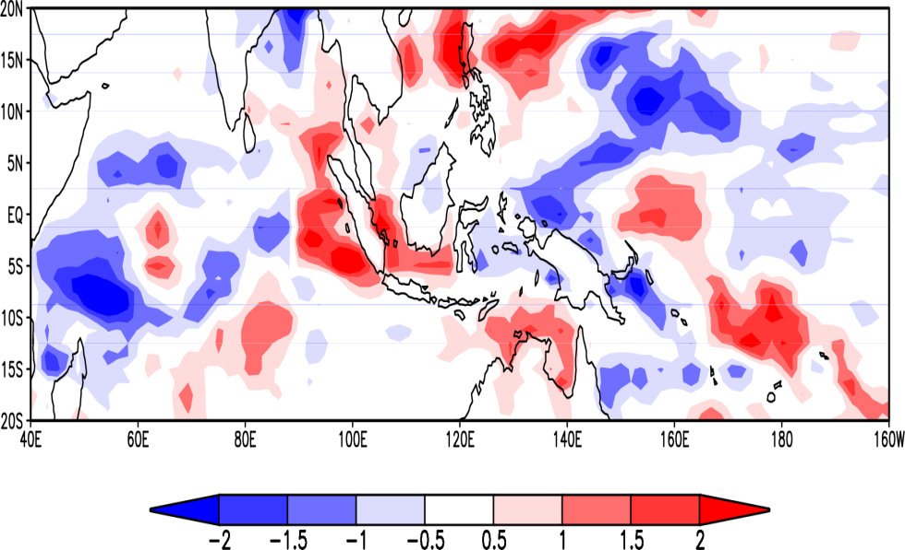
The difference of the precipitation rate and vertical velocity between the experiments with a local SST increase over MC and the control experiment.

Slide 4
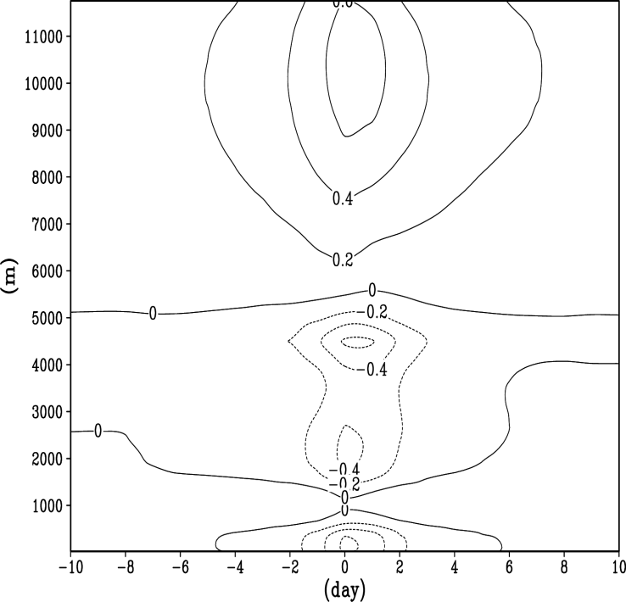
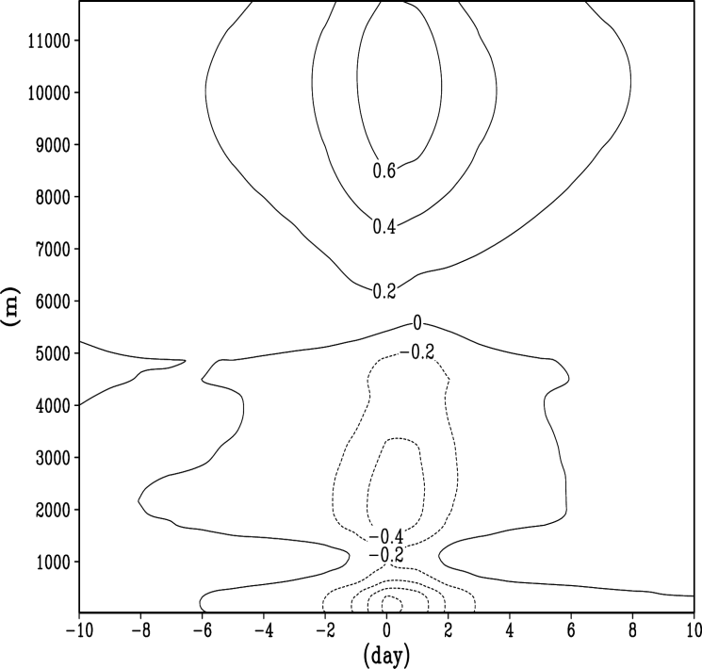
Convection changes with improved heating profile
1. Improved Melting layer physics
Temperature anomaly relative to the heavy rainfall events (60E-180E, 20S-20N)
Spreading the melting of snow between temperatures from the freezing level to 3K above the freezing level. This change allows a mix of snow and rain between the freezing level and 3K above this with the proportion of rain increasing linearly from zero at the freezing level to one at the freezing level plus 3K.
(a) Control experiment
(b) Expt. 1
Zhu, H., E. Maloney, H. Hendon and R. Stratton, 2017: Effects of the changing heating
profile associated with melting layers in a climate model. Quart. J. Roy Met. Soc.
143: 3110–3121

Slide 5
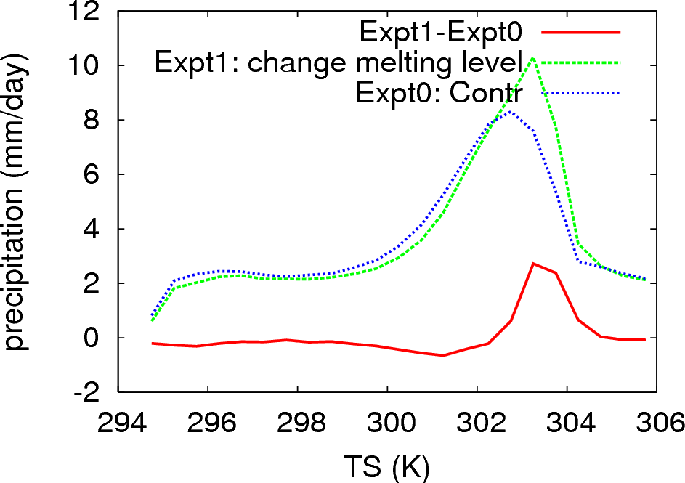
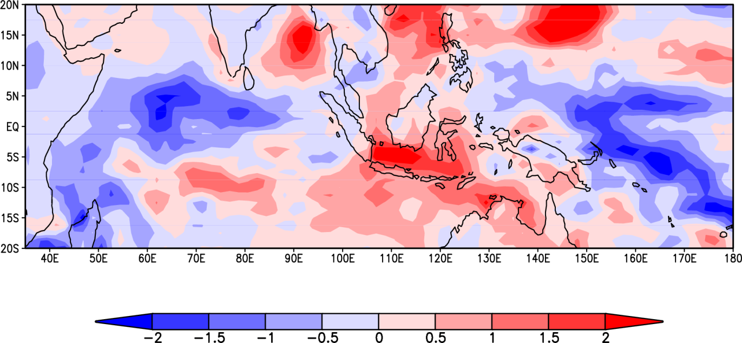
Rainfall difference
Precipitation (mmd⁻¹) as a function of surface temperature (60E-180E, 20S-20N)

Slide 6
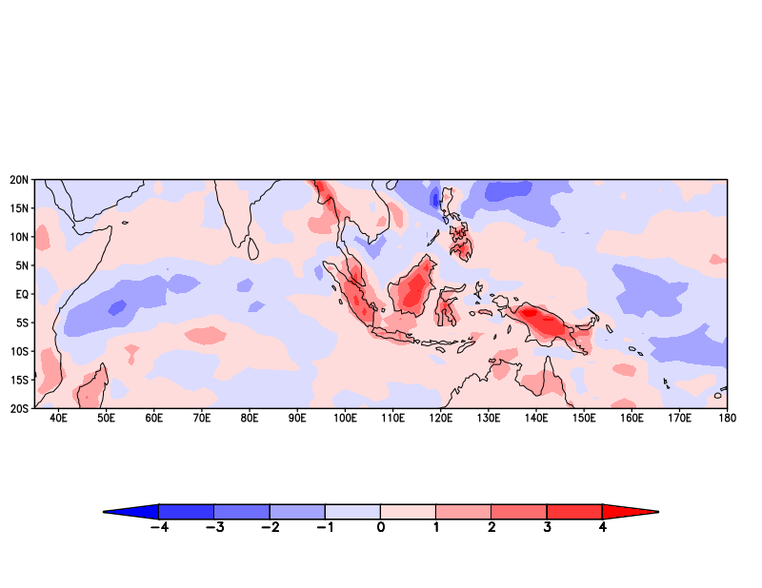
Convection changes with convective memory
2. Improved Convective Memory (EntProg scheme)
Linking the deep convective entrainment rate to the amount of convective activity within the last several hours.
Locations that have experienced high levels of recent convective activity will be populated with relatively large convective clouds that have low entrainment rates.
Conversely, locations that have experienced low levels of recent activity will be populated with relatively small convective clouds (if any) that will have high entrainment rates.
Willett M. R. and M. A. Whitall, 2017: A simple prognostic based convective entrainment rate for the
unified model: description and tests, Forecasting Research Technical report No: 617, UK Met
Office.
Rainfall difference

Slide 7
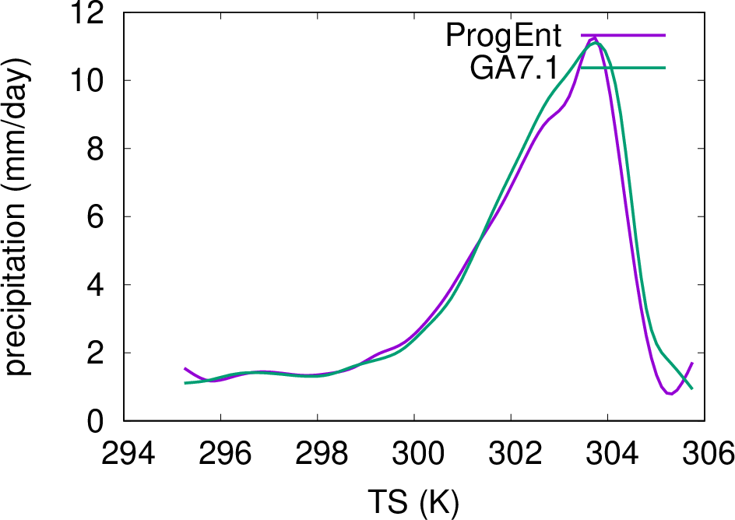
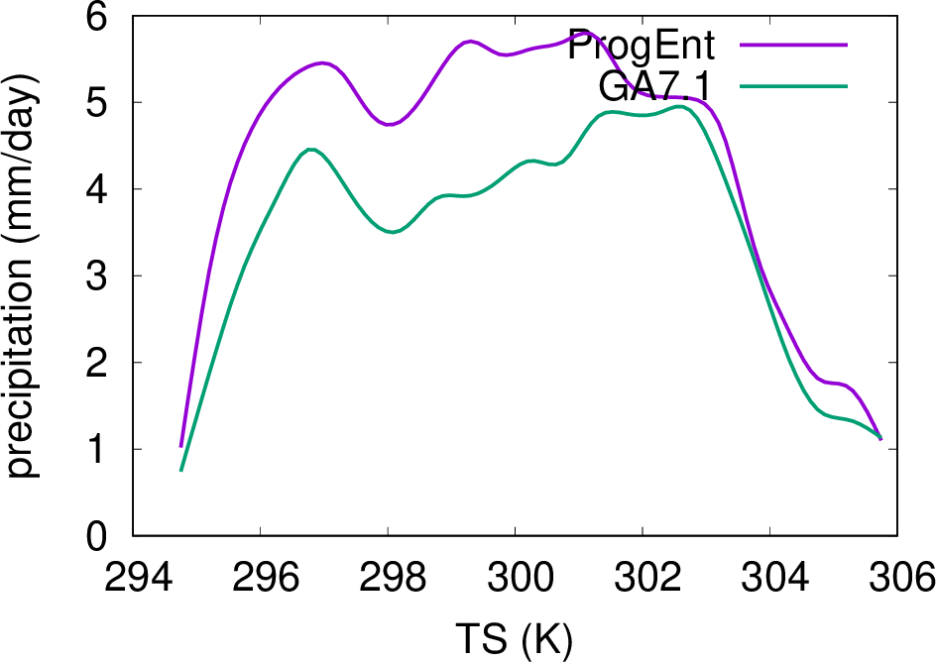
Precipitation (mmd⁻¹) as a function of surface temperature (60E-180E, 20S-20N) for the experiment with the convective memory.
Ocean
Land

Slide 8

A New Generalised Mass-flux Convection Scheme for the Met Office Unified Model
Mike Whitall
Summary
A new mass-flux convection scheme, called CoMorph, is being development as part of the NERC / Met Office ParaCon project. CoMorph is written in a generic and flexible way, to:
a) Avoid ad-hoc structural assumptions which have hampered progress in the past:
b) Enable representation of many additional physical processes, such as:
- Mixed-phase, non-equilibrium cloud and precipitation processes within the updraft / downdraft parcel, which significantly affect the parcel buoyancy and hence the convective transport.
- Vertical momentum of convective thermals represented, to simulate both overshoots and their subsequent fall-back to neutral buoyancy level.
- Forced uplift by convective cold-pools.
- Entrainment and detrainment based on parcel vertical velocity minus resolved vertical velocity, for coupling to resolved convection in the grey-zone.
- Parcel initial perturbations based on stochastic, scale-aware sub-grid turbulence PDF model.
Old scheme:
Shallow / deep convection prescribed to start from a predefined “magic” level (surface or surface-based LCL); separate mid-level scheme may only activate above BL-top or shallow / deep Cu top.
Cumulus pre-diagnosed based on height reached by a separate undilute test ascent, with many ad-hoc assumptions and switches.
Post-hoc CAPE closure rescaling ignores triggering condition, causing intermittency.
CoMorph:
Unified approach with interactively varying cloud-size; convection can initiate independently from any level where there is moist instability.
Cumulus naturally emerges when the main convective parcel ascent happens to reach saturation.
Intermittency avoided by using implicit-
in-time discretisation for detrainment at each level; no rescaling needed.

Slide 9
Discussion
Convective parametrized convection scheme in the climate models is one key factor contributing to the biases over Tropical Indo-Pacific and north Australia.
With improved convection scheme, the model biases over the Indo-Pacific regions are partly reduced.
The newly developed Cormorph convection will be investigated at ACCESS climate models.

Slide 10
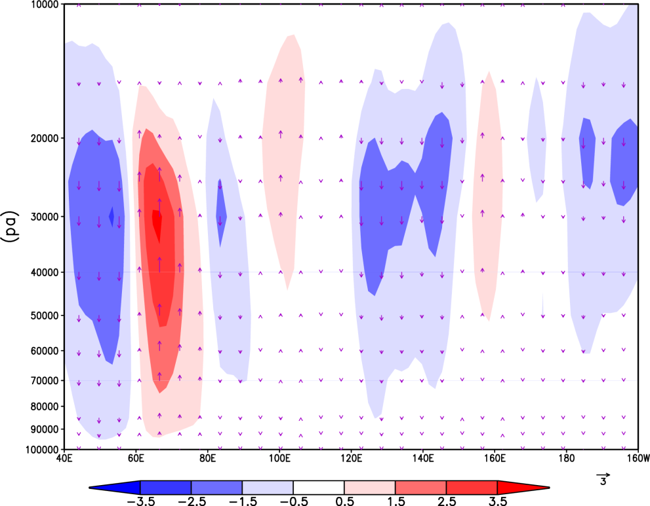
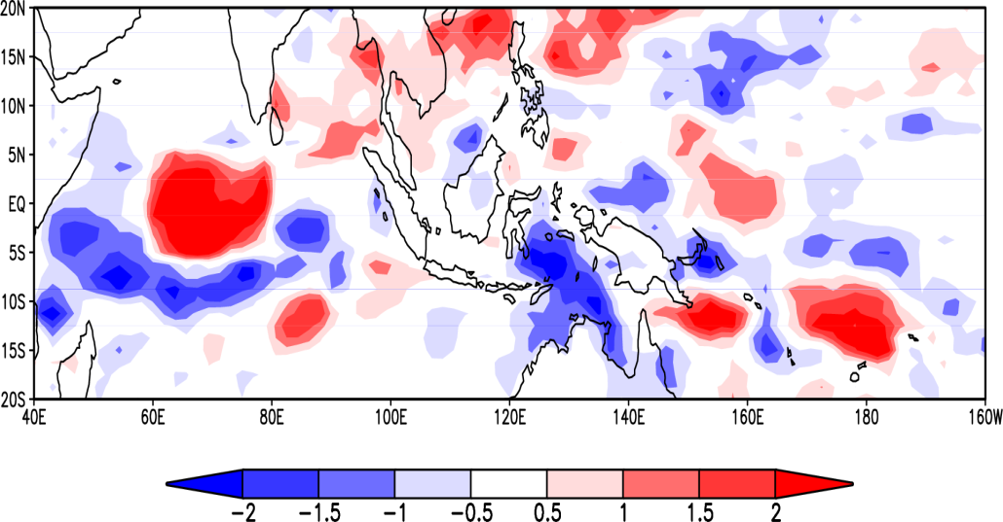
The difference of the precipitation rate and vertical velocity between the experiments with a local SST increase over IO and the control experiment.

