Slide 1
ACCESS NWP Suite Design
Yi Xiao and Michael Naughton
CAWCR-BoM Earth System Modelling Program
Acknowledgement: ESM and BNOC colleagues, Hilary Oliver, NIWA

Slide 2
What do we mean by NWP suite design?
The software environment for specifying, running and maintaining ACCESS NWP suites
The ideas that have gone into the way the NWP suites are written
In this talk the focus will mainly be on the schedulers used in Bureau NWP suites in research and in operations

Slide 3
History of ACCESS NWP Schedulers (1)
ACCESS NWP suites were first developed from 2007 onwards using the UM NWP software environment:
UM & UMUI for the model
VAR & VARUI for the 4D-Var minimisation
OPS & OPSUI for observations processing
SCS & SCSUI, suite control system, for combining OPS/VAR/UM/SURF components together into a NWP suite.
Hilary Oliver provided assistance with our initial implementation.
SCS component is different from the UI's, it has the functions of a job scheduler like Cylc & SMS to manage component tasks.

Slide 4
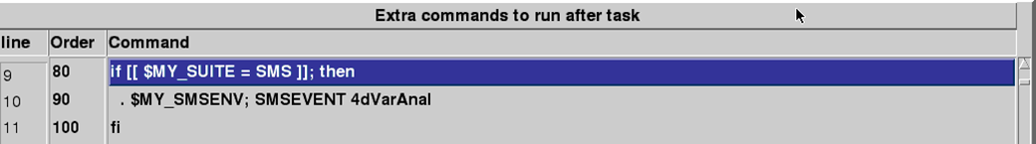
History of ACCESS NWP Schedulers (2)
ACCESS NWP research suites for APS0 were based on a combination of SCS "core" and additional "launch scripts".
(Although submit within SCSUI is possible)
Bureau Operations have used ECMWF SMS as their operational job scheduling environment since the 1990's.
ACCESS NWP operational suites were developed from 2008 onwards with a hybrid SMS-SCS approach:
SMS as the scheduler controlling the suite initiation
SCS controlling the core NWP suite, communicating back to SMS
ACCESS NWP with this design has been operational since September 2009
APS0: 2009-2011, APS1: 2011-present, APS2: coming soon
With this approach, research and operations share identical SCS components, with similar but different controlling frameworks
In research, suites are monitored via the SCS html browser.
In operations, suites are mainly monitored through Xcdp, the SMS GUI.

Slide 5
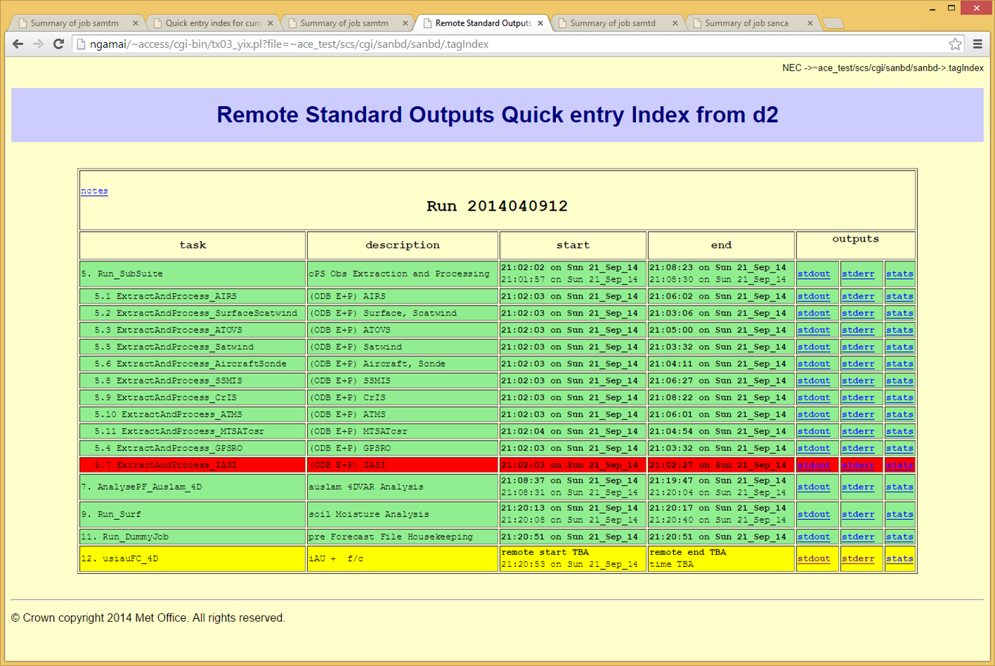

Slide 6
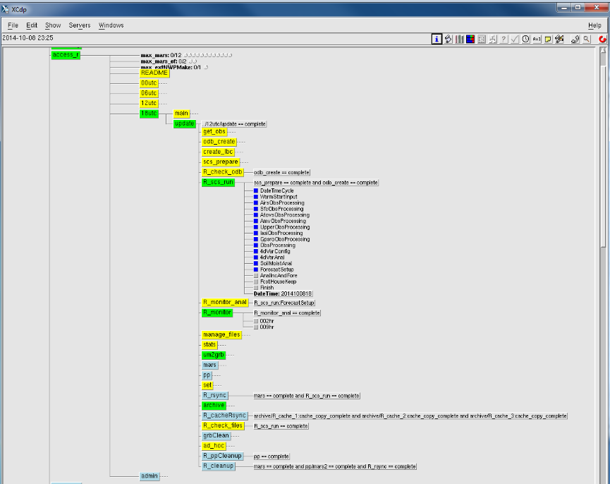
Operational ACCESS-R Under SMS-SCS
Xcdp screen dump
Core NWP part
Xcdp screen dump (Joan Fernon)

Slide 7
History of ACCESS NWP Schedulers (3)
While SMS has remained at the core of Bureau operational job scheduling, SCS, SCSUI and UMUI turned out to be far more difficult to use and less suitable.
SCS can not easily control running of individual tasks within the suite (as SMS can do).
SCS is a difficult system for both development and debugging.
Many tasks are written to stay outside of the SCS suite itself.
Trigger conditions are difficult to set, especially for complex suites.

Slide 8
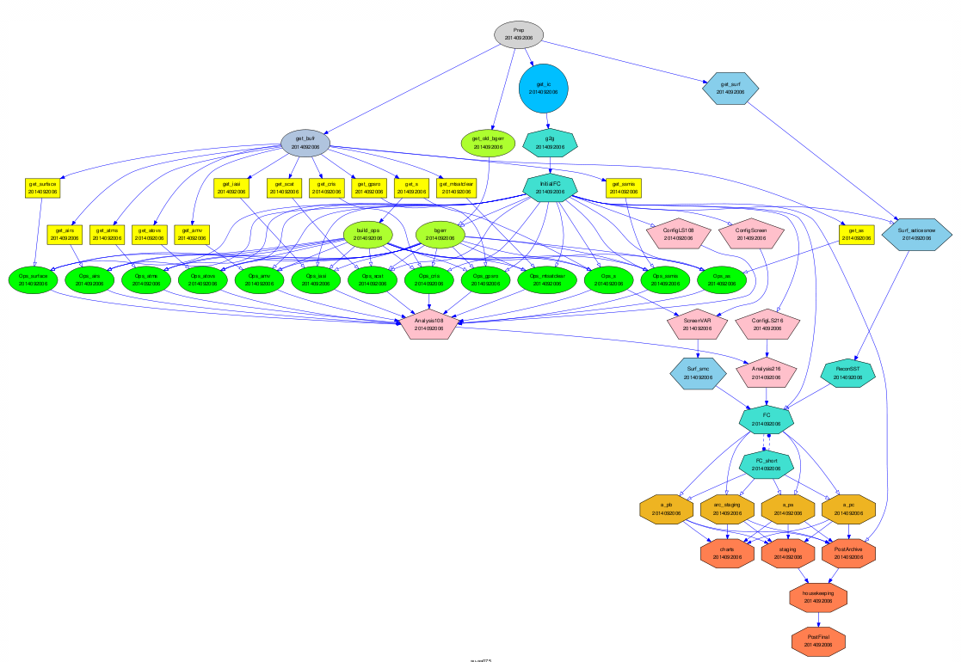
Example: A complex NWP suite ACCESS-G
Suite Tasks and Data Flow
ODB family (in yellow)
OPS family (in green)
Each node represents a task. Colour coded by family
Arrows describe relations among tasks.

Slide 9
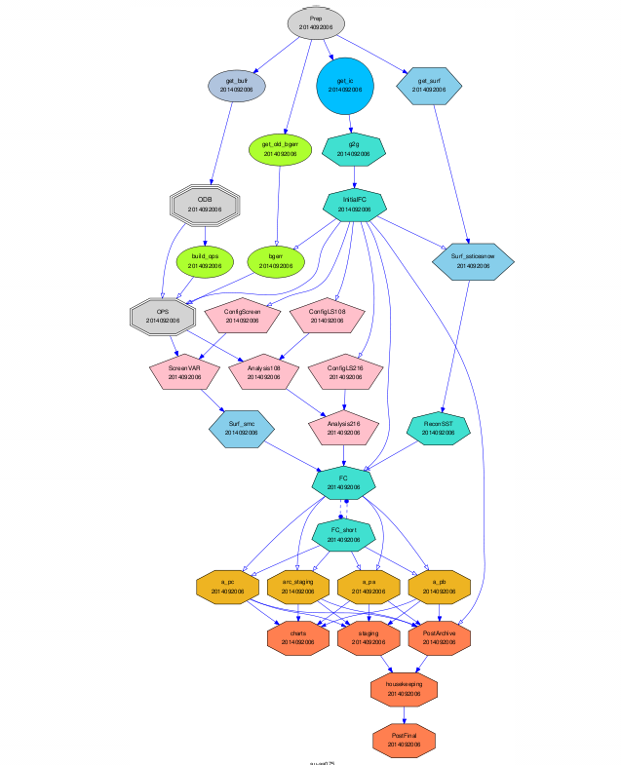
ACCESS-G Suite Tasks with Grouped Families (ODB and OPS)
ODB
OPS

Slide 10
Setting Task Triggers (Examples)
Family Trigger (if family OPS finished and any its member succeeded, start task Analysis108)
Impossible to set complex family triggers in SCS
Possible, but not easy or less elegant, to set such a family trigger in SMS.
It is very easy in Cyle. For example
OPS:succeed-any => Analysis108
Inter-cycle trigger (start PostArchive once task FC succeeded at previous cycle (T-6))
Impossible to set in SCS
Also not possible in SMS suite definition.
Very easy to set in Cylc. For example
FC[-PT6H] => PostArchive

Slide 11
History of ACCESS NWP Schedulers (4)
From around 2009 onwards, the UM technical infrastructure was re-developed from scratch at NIWA and the Met Office.
Cylc was developed by Hilary Oliver as a general purpose job scheduler.
Rose was developed by the Met Office UM TI team as a general purpose system for task specification and experiment configuration management.
Cylc and Rose are both Open Source projects, managed under GIT.

Slide 12
History of ACCESS NWP Schedulers (5)
From 2011 onwards, ACCESS NWP research suites have been converted away from SCS, first to use Cylc for the scheduling part, and then to also use Rose for the task specification part.
All ACCESS NWP research suites are now using Rose-Cylc environment.
This conversion has been done, while still retaining backward compatibility with the SMS+SCS ACCESS NWP operational environment.
The design allows existing scripts to be used in Rose-Cylc suite with little modification.
Tasks from Rose-Cylc suites can be packaged into SMS (and SCS) suites with little modification.

Slide 13
Schedulers used in ACCESS-G and other NWP Systems
 | Systems | Research | CAWCR-Dev | Operations
2010 (2007-2013) | APS0 G(80km) R,TX(40km) A,TC(12km) | SCS | SCS | SMS+ SCS
2012 (2009-2015) | APS1 G(40km) R,TC(12km) | SCS / Cylc | SCS | SMS+ SCS
2015 (2012-) | APS2 AGREPS | Rose-Cylc(?) | SMS | SMS
2014 (2011-) | FDP RUC(1.5km) | Rose-Cylc | N/A | N/A
2015 (2012-) | APS2 G(25km) R,TC(12km) | Rose-Cylc | SCS | SMS+ SCS
2016-17 (2015-) | APS3 G(17km) R,TC(?km) | Rose-Cylc | Rose-Cylc | Rose-TBD
2018 (2017-) | APS4 G(12km) | Rose-Cylc | Rose-Cylc | Rose-TBD
2019-20 (2018-) | APS5 G(12km) | Rose-Cylc | Rose-Cylc | Rose-TBD

Slide 14
Schedulers used in ACCESS-C Forecast-only Systems
 | Systems | Research | CAWCR-Dev | Operations
2010 (2007-2013) | APS0 C(5km) | SMS | SMS | SMS
2012- | Fcst Only (domain, res. Independent) | Rose-Cylc | N/A | N/A
2013 (2009-2015) | APS1 C(4km) | SMS / Rose-Cylc | SMS | SMS
2015 (2014-) | APS2 C(1.5km) | Rose-Cylc | SMS | SMS
2016-17 (2015-) | APS3 C(1.5km_NWP) | Rose-Cylc | Rose-Cylc | Rose-TBD
2018 (2017-) | APS4 G(N1024) | Rose-Cylc | Rose-Cylc | Rose-TBD
2019-20 (2018-) | APS5 G(N1024) | Rose-Cylc | Rose-Cylc | Rose-TBD
Transition to APS2 operations should take place from late-2014 to early-2015
No planned scheduler change for operations in APS2
SCS will be retired after APS2
All ACCESS NWP systems in research are already using Rose-Cylc

Slide 15
Design Principles(1)
Suite should be be easy to understand, to (re)run, to debug and to further develop
Suite definition file contains only information about what tasks are in the suite, when and how to run them (easy to understand, easy to switch to a different scheduler).
Suite envfile: Additional information, such as data flow within the suite, location of control data etc., can be kept in a suite specific configuration file, for example, envfile.
Self-contained: Suite should be as self-contained as possible. This is difficult to do under SCS, but it is much easier under Rose-Cylc.
Task rerunable: It should be possible to run or rerun tasks or a family of tasks easily without interfering with the running suite
Particular important when debugging and developing a suite.

Slide 16
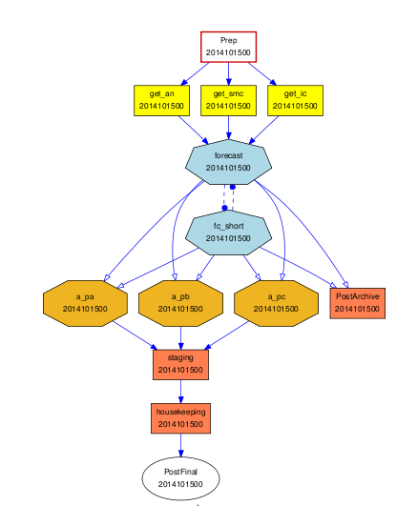
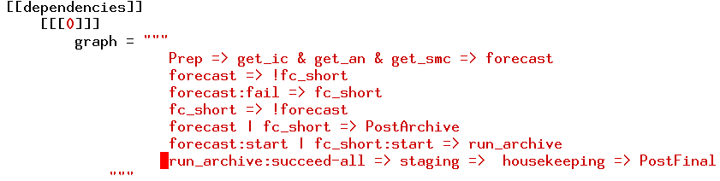
Suite Definition File under Cylc
A Simple Forecast Only Suite
suite.rc: Tasks in the suite, when to run them
[runtime]
[[root]]
command scripting = rose task-run –verbose
[[[environment]]]
RENVFILE = $CYLC_SUITE_DEF_PATH/bin/envfile
…
[[ get_ic, get_an, get_smc ]]
inherit = remote_cycling
description = "get start dump / an / smc file"
retry delays = 1,2
command scripting = ${CYLC_TASK_NAME}.ksh ${RENVFILE}
How to run tasks
Note: Existing scripts (such as get_an.ksh) can be used without
modification.

Slide 17
Suite Specific envfile
#---------------------------------------------
# control files: 1. UM
#---------------------------------------------
export UMDIR=~access/umdir
export UM_VERSION=8.2
export UM_BIN=/short/dp9/ycx548/data/um/bin/n512
export UM_EXE=$UM_BIN/umefa.exe
export SWSPECTD=$UMDIR/vn$UM_VERSION/ctldata/spectral/ga3_1/spec_sw_ga3_0
export LWSPECTD=$UMDIR/vn$UM_VERSION/ctldata/spectral/ga3_1/spec_lw_ga3_1
export MY_VERT_LEV=~access/umdir/vn$UM_VERSION/ctldata/vert/vertlevs_L70_80km
[[UM]]
inherit = remote_cycling
pre-command scripting = """ . $CYLC_SUITE_DEF_PATH/bin/envfile; \
export PATH=$UM_BIN:$PATH
"""
[[ forecast, fc_short ]]
inherit = UM
description = "forecast only"
retry delays = 1,5
post-command scripting = um-staging.ksh ${CYLC_TASK_NAME} ${RENVFILE}
[[[job submission]]]
method = pbs
[[[directives]]]
-q = normal
-l = 'ncpus=1040,mem=1500G,walltime=02:50:00'
-P = {{ my_project }}
Use envfile to define $UM_BIN
How to run Um forecast tasks?
qsub via PBS

Slide 18
Self-Contained Suite
cylc suites can be managed with svn through rosie
(copy someone else’s suite is easy, e.g. use “rosie go”)
A cylc suite usually contains the following (opt. to have more directories) :
Example: A simple Forecast only suite : aa-au083
svn ls svn+ssh://accessdev.nci.org.au/home/access-svn/roses_au_svn/a/a/0/8/3/trunk
app/ bin/
rose-suite.conf rose-suite.info suite.rc
suite.rc -- suite definition file.
app: (Directory contains task configuration directories for rose to use
via command ”rose task-run “)
fc_short (Directory for task fc_short: UM task)
rose-app.conf (may contain additional sub-directories, such as file,fcm_make,meta)
forecast (Directory for task forecast)
rose-app.conf
bin: (Directory bin contains scripts that cylc uses to run tasks within the suite)
Prep.ksh arc2mars.ksh envfile get_an.ksh get_smc.ksh tidy.ksh
UMScr_RunUM8.2 arc2sam.ksh event-hook.sh get_ic.ksh staging.ksh um-staging.ksh
1. scripts in bin directory can be wrapped. Real scripts can stay somewhere else.
2. The location of real scripts can be defined in envfile, to accommodate different needs.
3. Existing scripts (such as those for SMS and SCS) can be used with little or no change.
4. Binaries are not under bin directory. Their locations are defined in envfile.

Slide 19
Design Principles (2)
2. Suite should have good portability
Among different users
Suite is responsible for its own environment.
Suite should NOT dependent on any individual’s login environment.
Between Research and Operations
Except for differences in upstream and downstream applications, we aim to have the same core part of ACCESS NWP systems in research and operations.
Under SCS, this is done within SCSUI.
Under cylc+rose, this can be done with rosie database.
Research and Operations have the same envfile, except for minimum (a few) number of variables, such as locations of files.
Research and Operations share the same directory structure for NWP related files.
Between different platforms
Consider how to organize platform specific information.
Platform specifics can not be fully avoided (such as PBS and SGE)

Slide 20
Design Principles (3)
3. Suite should be efficient
Under Cylc, each task has its own cycle time ( or cycle point in Cylc-6).
A separate working directory is used for each cycle point. E.g.
WORKSPACE = $WORKDIR/$CYLC_SUITE_REG_NAME/$CYLC_TASK_CYCLE_POINT
Tasks with different cycle points can run at the same time without interfering with each other . This allows for maximum efficiency, especially when falling behind.
Efficient means tasks can run when inputs and resources are available.

Slide 21
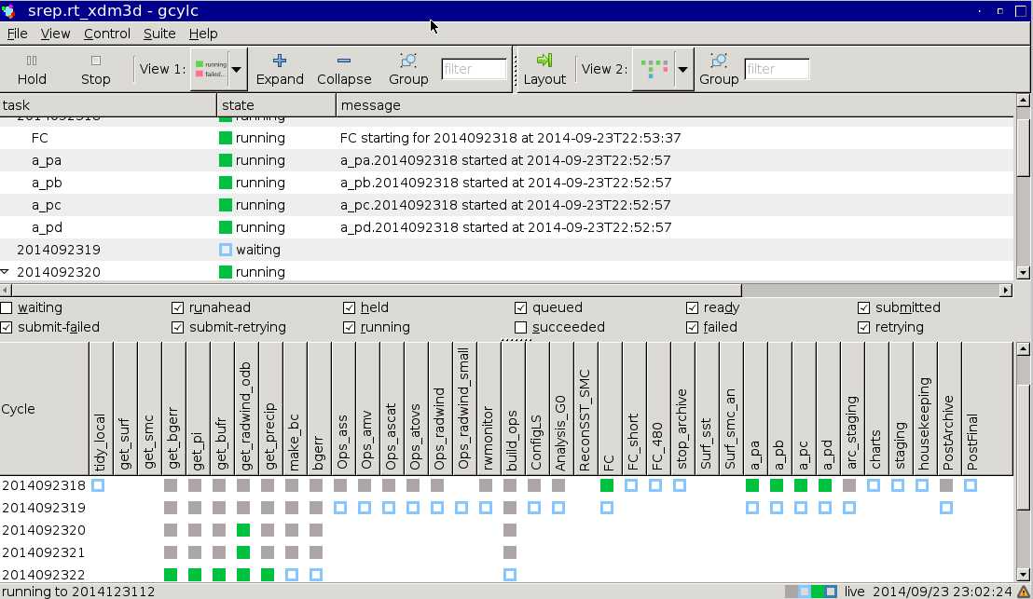
Efficiency Illustration
Real Time Forecast Demonstration Project: RUC Suite
18Z was delayed due to late arrival of obs.
Ready to run tasks in later cycles (19Z,20Z,21Z,22Z)
already finished or are running.

Slide 22
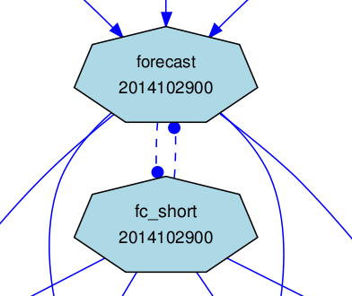
Design Principles (4)
4. Suite should be robust
Configure “auto retry “ for all tasks, for both execution and submission failure.
[[root]]
retry delays = PT1M,PT3M (means retry 1 min. and 3 min. after each execution failure)
[[[job submission]]]
retry delays = PT3M,PT5M (means retry 3 min. and 5 min. after each submission failure)
Add useful “redundant” tasks
For example: 2 UM forecast tasks in the suite: forecast and fc_short ,
UM forecast succeeds with only one of them. The UM forecast only fails if both forecast tasks fail.

Slide 23
Summary (1): Conversion from SCS to Rose-Cylc
CAWCR plans to support SMS+SCS for ACCESS NWP Operations for the next upgrade to APS2 (2014-2015).
SCS is no longer used or supported by the Met Office.
From APS3, we will retire SCS.
For APS3 and beyond (2016 onwards), ACCESS NWP suites will be supplied based on Rose-Cylc components, tailored as needed for operational requirements.
Switching from SCS to Rose-Cylc has happened in research (since 2011).
The Met Office converted all their operational suites from SCS to Rose-Cylc in Feb 2014 (PS33).
All UM Partners are in the process of migration to Rose-Cylc for all research and operational UM systems.
Rose-Cylc development and conversion is a major work package in the UM Partners Technical Infrastructure Collaboration.
Partners and Associates are UK (Met Office, Universities), Australia (BoM, CSIRO, Universities), Korea (KMA), India (NCMRWF), New Zealand (NIWA), Singapore (SMS)

Slide 24
Summary(2): Features of Rose-Cylc suites
ACCESS NWP Rose-Cylc suites contain full functionality for step-by-step control of suites.
Cylc has all the key features required for both operational and research job scheduling.
E.g. run, rerun, kill, poll, hold individual task or a family of tasks at any cycle time.
Insert tasks to a running suite.
Modify a running suite or task configurations without stopping
Rose-Cylc has all features required for suite development.
E.g. rose config editor to configure NWP components; Rosebud to convert UMUI jobs (8.4 or above) to rose app configuration files.
Cylc utilities for validate suite definition file; Running a suite in simulation or dummy mode for further checking dependencies, submission and communication with remote hosts, run scripts etc.
Rose contains all the features required for configuration management of suites and their components.
E.g. rosie database for suite management (svn)
Rose-bush for managing suite outputs.

Slide 25
Summary(3) Evaluation Cylc as an operational scheduler
BNOC are currently evaluating the suitability of Cylc as the job scheduler for operational ACCESS NWP systems.
This would extend also to ACCESS Seasonal Forecast and potentially to other core BNOC operational applications.
Like SMS, SVN, GIT and FCM, neither Rose nor Cylc are tied in any way to the UM; they are designed to be used for any applications.

Slide 26
Summary(4): Design Principles
Design principles have been implemented in our Rose-Cylc suite development. Further refinement is in progress.
Collaboration on NWP suite design across the UM Partnership is also being considered as part of the Technical Infrastructure Collaboration Project.
Current Met Office suites have been shared with all the UM Partners for this purpose.
A shared repository for Rose experiments will be available across the UM Partnership.
Further design discussions are scheduled during Hilary's visit this week.

